Slide 1

Energy Assistance Program
FFY26 Annual Training
Office of the Attorney General

Slide 2
Office of the Attorney General
Becky Huting
Assistant Attorney General

Slide 3
Office Overview
RESOURCES
LAW HIGHLIGHTS
Assistant Attorney General Becky Huting

Slide 4
What does the AG do?
The Attorney General is the chief law enforcement officer for Minnesota
Minnesota Statute section 8.31 gives the attorney general the power to investigate and prosecute violations of laws related to unfair, discriminatory, or other unlawful practices in business, commerce, or trade

Slide 5
What does the AG do?
Responsible for protecting consumer rights. A few of the Office’s work:
  Comcast
    Obtained refunds for 15,600 Minnesotans following undisclosed fees and secured changes to advertising practices
  JUUL
    Secured $60.5 million for targeting youth in vape marketing
  Glock
    Lawsuit against gun manufacturer for manufacturing, marketing, and selling semi-automatic handguns, it knowingly knew could be converted into illegal machine guns.

Slide 6
What does the AGO do?
  Landlords – case examples
    HavenBrook Homes - Obtained over $4M in relief for tenants harmed by under-maintained single-family rental homes with lead paint issues
    IPG lawsuit – Just last week obtained over $5 million in relief from a landlord that imposed illegal utility billing upon 4,000 tenants
  Legislative work
    Collaborated on recent passage of Debt Fairness Act, establishing income-based wage garnishment levels among other consumer protections
Investigate and sue for violations of civil laws.
Can appear in criminal cases upon request of the county attorney or governor

Slide 7
AGO publications
Landlords and Tenants: Rights and Responsibilities, which includes guidance for many common issues that tenants may experience. The publication is also available online at the Office’s website: www.ag.state.mn.us/Office/Publications.asp.
The website also has many other publications on topics like a car buyer’s rights, home buyer’s rights, credit report rights, and how to prevent scams.

Slide 8
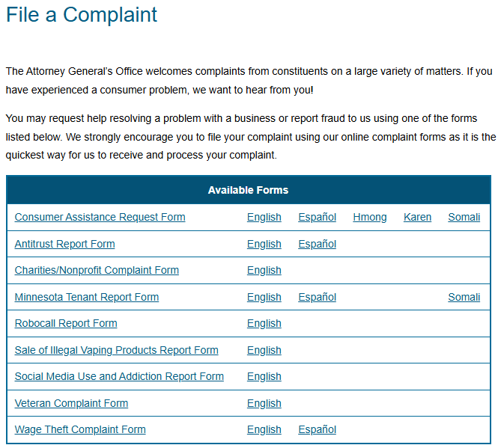
Reports to our Office
AGO Consumer Reports: https://www.ag.state.mn.us/Office/Complaint.asp

Slide 9
AGO homeowner publications
Home building and remodeling
  Brochure on helping homeowners navigate the process, including:
    Selecting a contractor
    Writing a home improvement contract
    Minnesota mechanic’s lien law
Home improvement scams
  Don’t fall for pressure tactics
  Ask for identification and research the business
  Contact the Department of Labor and Industry to check on permit or license

Slide 10
Verifying a contractor license or permit
Minnesota Department of Labor and Industry
443 Lafayette Road North
St. Paul, MN 55155
(651) 284-5069 or (800) 342-5354
www.dli.mn.govexternal link icon
DLI.contractor@state.mn.us

Slide 11
AGO homeowner publications
Mortgage assistance scams
  Homeowners facing financial trouble that may jeopardize mortgage payments should be wary of mortgage assistance scams. There are several types:
    Foreclosure consultant scams
    Mortgage modification scams
    Forensic loan audit scams
    Refinance scams

Slide 12
Agency contacts
The following agencies may be available to provide information and assistance regarding foreclosure issues:
United States Department of
Housing and Urban Development (HUD)
Minneapolis Field Office
212 Third Avenue South, Suite 150
Minneapolis, MN 55401
(612) 370-3000
hudgov-answers.force.com/housingcounseling/
Minnesota Housing
400 Wabasha Street, Suite 400
St. Paul, MN 55102
(651) 296-7608 or (800) 657-3769
www.mnhousing.gov

Slide 13
Agency contacts continued
Minnesota Homeownership Center
1000 Payne Avenue, Suite 200
St. Paul, MN 55130
(651) 659-9336 or (866) 462-6466
www.hocmn.org
Lutheran Social Services Financial Counseling
424 West Superior Street, Suite 600
Duluth, MN 55802
(218) 529-2227 or (888) 577-2227
www.lssmn.org/Housing-Counseling

Slide 14
AGO homeowner publications
Home buyer’s handbook
  Considerations in buying a home
  Needs and wants checklist
  Discrimination and fair lending
  Methods of finding a home
  Home inspections
  Understanding the purchasing agreement
  Financing the home

Slide 15
Utility billing by landlords
Recent changes this year to Chapter 216B (Public Utilities) and Chapter 504B (Landlord and Tenant)
  Aimed to protect tenants in shared-metered residential buildings, and address concerns about deceptive billing practices and inadequate recourse for disputes
  Helps provide renters who pay their landlord or a third-party biller similar protections to renters who pay utility providers directly

Slide 16
Residential utility law basics
Methods of tenant utility billing
  Landlord pays utilities for the building and apportions (divides) utility bills among tenants
  Tenant pays utilities directly for their unit
  Landlord or a third-party billing agent installs submeters to measure utility usage and bills tenants for usage in their unit

Slide 17
Landlord/tenant utility law changes
Most changes effective January 1, 2025, and for leases entered into on or after that date
New Minnesota Statute § 504B.216 (effective January 1, 2025), repeals Minnesota Statute § 504B.215
  Carries forward and supplements the shared meter consumer protections
  Adds rules around submetering, apportionment billing, and service protection detail

Slide 18
Minn. Stat. § 504B.216
Landlords in shared-meter buildings must contract directly with the utility provider. They may not require tenants to do so.
Prevents landlords from requesting the removal of a directly-metered tenant’s name from an account.
If a landlord submeters utilities like gas, electricity, water, or sewage, tenant gets same protections as directly-metered tenants.

Slide 19
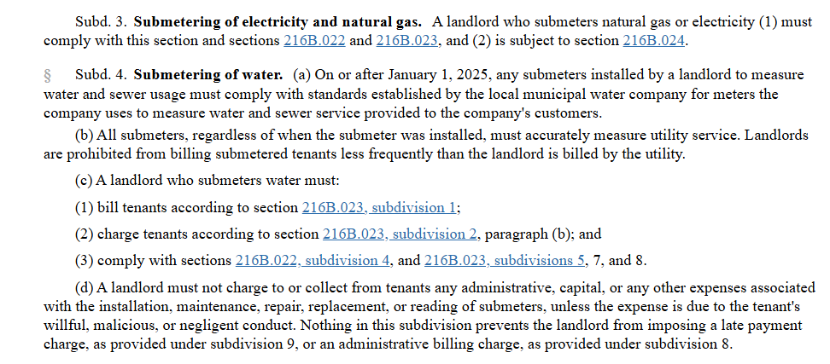
Minn. Stat. § 504B.216 submetering rules

Slide 20
Minn. Stat. § 504B.216
Prohibits apportionment of electricity (effective for all leases entered into on or after January 1, 2025)
Billing frequency must match the frequency the landlord is billed by the utility provider.
If tenant requests it, landlord must provide actual and past utility bills
  For the preceding two years or the time the landlord acquired the building, whichever is more recent

Slide 21
Minn. Stat. § 504B.216
Mandates one method of apportionment for gas
Sq. ft. of tenant’s unit / sq. ft. of all units
Total square footage must deduct common areas, areas used by the landlord, or vacant units
Must also deduct any credits landlord receives from the utility proportionally

Slide 22
Minn. Stat. § 504B.216
Mandates one method of apportionment for water
# of tenants on the lease/total building occupancy
Landlords must deduct common areas, areas used by the landlord, vacant units, water used for maintenance, and shared amenities (laundry, pools, etc.)
Must also deduct any credits landlord receives from the utility proportionally

Slide 23
Minn. Stat. § 504B.216
Landlord may not charge more than $8.00 administrative charge per billing period
Caps late charges at $5.00 per month (combined for all utilities billed)
Landlords must disclose apportioned billing formulas to tenants, along with tenant rights and protections

Slide 24
Minn. Stat. § 504B.216
Prohibits landlords from shutting off a tenant’s utilities due to nonpayment of utility charges
  Cold Weather Rule (Minn. Stat. § 216B.096) still applies to utilities:
    Protects low-income residential utility customers from having their heating service disconnected from October 1 through April 30 of the following year.
Requires landlords to apply amounts paid first to rent and then to any unpaid utility charges
Limits the circumstances under which a failure to pay utilities can amount to a breach of lease to seek eviction

Slide 25
Minn. Stat. § 216B.022: Submetering
Landlords who install submeters to measure a utility service directly in a tenant’s unit are subject to the PUC’s authority
Requires that all submeters installed after January 1, 2025 meet national standards for accuracy
Mandates that all submeters, even those installed before January 1, 2025, accurately measure a tenant’s utility service

Slide 26
Tenant utilities dispute resolution
  A tenant attempting to resolve a billing dispute must first attempt to resolve it with the landlord. Minn. Stat. § 216B.024
  If landlord and tenant can’t agree on a payment plan, landlord must provide the tenant with contact information for the PUC’s Consumer Affairs Office. Minn. Stat. § 216B.024
  Minn. Stat. § 216B.172: consumer disputes and judicial review
    Tenants must first seek resolution with the landlord and then file a complaint with the PUC’s Consumer Affairs Office.
    If not satisfied, a tenant may file an appeal with the Public Utilities Commission.

Slide 27
Tenant utilities dispute resolution
  Minn. Stat. § 216B.172: consumer disputes and judicial review
    Tenants must first seek resolution with the landlord and then file a complaint with the PUC’s Consumer Affairs Office.
    If not satisfied, a tenant may file an appeal with the Public Utilities Commission.
    A tenant can seek review in court of an adverse PUC decision
    The utility must continue or restore service to a tenant during dispute resolution process, provided they meet requirements set forth under the law
  A court must stay (hold off) eviction of a tenant for breach of lease if there is pending PUC complaint or appeal regarding utilities due.
  Minn. Stat. § 504B.285

Slide 28
Highlights of new landlord/tenant laws
Pre-eviction protection (Minn. Stat. § 504B.321):
  Landlords must give their tenants 14 days’ written notice before filing an eviction action for nonpayment against them in court. Before, there was no pre-eviction notice requirement
  Cities are allowed to enact and enforce their own stronger pre-filing notice requirements
  Effective January 1, 2024

Slide 29
Highlights of new landlord/tenant laws
Housing eviction expungement reforms (Minn. Stat. § 484.013, subd. 3)
An eviction expungement is when an eviction is removed from the public court record
  Before January 1, 2024:
    Cases could be expunged when landlord/tenant agreed to expungement
    If the tenant was successful in a Motion to Expunge

Slide 30
Highlights of new landlord/tenant laws
  As of January 1, 2024, eviction expungements are now mandatory when:
    The tenant prevails in the case
    The case against the tenant is dismissed
    The eviction was ordered 3 years ago

Slide 31
Highlights of new landlord/tenant laws
Now more transparency in cost of housing (Minn. Stat § 504B.120)
  Landlord must disclose non-optional fees (along with the rent) on the first page of the lease and in any advertising or posting
  Landlord must describe the total of rent and all non-optional fees as the “Total Monthly Payment”
  Effective January 1, 2024 and applies to leases signed on or after this date

Slide 32
Fee Examples
Examples of common mandatory fees
Portal fee
Administrative fee (usually annual so divide by # of months)
Amenity fees
Utilities fees, if charged by landlord
Internet/Cable
Lease Processing fee
Utilities—specifically mentioned in law--“the landlord must disclose whether utilities are included or not included in the rent.”
Examples of common optional fees
Garage spot/parking fee
Pet fee

Slide 33
Highlights of new landlord/tenant laws
Service Support Animal Fee Prohibition Disclosure (Minn. Stat. § 504B.113)
  Landlords must disclose in the lease that fees, charges and deposits relating to service and support animals are prohibited if there is normally a pet fee for non-service and support animals.
  Problem addressed: tenants did not know that landlords could not charge fees related to Service and Support Animals.
  Effective January 1, 2025

Slide 34
Highlights of new landlord/tenant laws
Stronger Privacy Rules (Minn. Stat. § 504B.211)
  Requires 24-hour notice from landlords before entering a tenant’s apartment unless the tenant & landlord agree otherwise. Before this law, it was only “reasonable notice”
  The landlord must specify an anticipated window of time of entry and may only enter between 8 AM and 8 PM unless the landlord and the tenant agree to an earlier or later time
  Effective January 1, 2024

Slide 35
Highlights of new landlord/tenant laws
Tenants can now break lease due to medical necessity (Minn. Stat. § 504B.266)
  Allows tenants to break their lease with a 2-month notice if certain medical conditions—determined by a medical professional—require them to move to a medical facility
  Effective January 1, 2024 and applies to leases signed on or after this date
Public housing tenants now have the right to counsel in breach of lease cases (Minn. Stat. § 504B.268)
  Does not impact most tenants
  Effective August 1, 2023

Slide 36
Highlights of new landlord/tenant laws
Limitations on Crime-free Lease Provisions (Minn. Stat. § 504B.171)
  Landlords can’t evict a tenant for committing a nonviolent crime that happens somewhere other than on the rental property
  Can still evict if a crime of violence happens off-site if it is against landlord, employee, another tenant, or tenant’s guest
  Effective June 1, 2024

Slide 37
Highlights of new landlord/tenant laws
Landlords must now offer move-in/move-out inspections (Minn. Stat. § 504B.182)
  The tenant unilaterally decides if they want to do these inspections
  Should help minimize security deposit disputes
  Applies to leases signed or renewed after January 1, 2024

Slide 38
Highlights of new landlord/tenant laws
Tenant moves during lease (Minn. Stat. § 504B.154)
  If a tenant abandons the dwelling mid-lease the landlord must make reasonable efforts to re-rent to mitigate, or reduce, damage to the tenant. Before, landlord arguably did not need to mitigate damages.
  Effective January 1, 2025

Slide 39
Highlights of new landlord/tenant laws
Cannabis (Minn. Stat. § 504B.171)
  Landlords cannot stop a tenant from possessing cannabis in their rental unit – previously they could
  A landlord can still prohibit smoking/vaping, whether it’s cannabis, tobacco, etc.
  This change effective August 1, 2023

Slide 40
Highlights of new landlord/tenant laws
Limits on late fee in government subsidized housing
(Minn. Stat. § 504B.177)
  Law makes clear that late fees can only be assessed on the tenant’s portion of rent in government housing subsidy programs
    Law addressed problem of landlords charging late fees based on the entire rent amount, not just the tenant’s portion
  This change effective January 1, 2025

Slide 41
Highlights of new landlord/tenant laws
No rent payments for condemned property (Minn. Stat. § 504B.204)
  Problem: Landlords were able to continue to collect rent on condemned properties if the property was condemned after the tenancy began
  A landlord may not accept rent if the tenant has been ordered to vacate by a government entity (such as a city tasked with enforcing local health/safety/rental codes). Tenants can use Rent Escrow actions as an enforcement mechanisms
  Effective January 1, 2025

Slide 42
Highlights of new landlord/tenant laws
Tenant right to seek police and emergency assistance for mental health issues (Minn. Stat. § 504B.205).
  Problem: A tenant’s right to be protected from certain impacts of local crime-free housing ordinances while seeking emergency assistance did not specifically include instances involving mental health issues.
  Emergency calls for mental health issues are specifically protected.
  Effective January 1, 2025

Slide 43
Emergency Tenant Remedies Action
An expedited repair action brought by tenant against their landlord
Minnesota law requires that landlords provide habitable homes and make repairs, unless the repair is needed due to the tenants’ willful or irresponsible conduct. (Minn. Stat. § 504B.161)

Slide 44
Emergency Tenant Remedies Action
List of Emergency Repairs
  The loss of running water, hot water, heat, electricity, sanitary facilities
  Non-Working Refrigerator
  Air Conditioning (When the landlord is responsible for providing)
  Non-Working Elevator (When the landlord is responsible for providing)
  Serious Infestation
  Notice of Intent to Condemn, Revoked Rental License
  Loss of any conditions, services or facilities that pose a serious and negative impact to health and safety

Slide 45
Tenant remedies actions for repairs
All tenant remedies actions require the tenant to:
  Request the landlord to make repair
  File a petition
    Emergency petition procedure under Minn. Stat. § 504B.381
    Regular repair action procedure under Minn. Stat. § 504B.385
  Have a hearing with housing referee

Slide 46
Other resources
HOME Line is a statewide nonprofit organization providing free legal, educational, and advocacy services to Minnesota renters.
  HOME Line Tenant Hotline: 612-728-5767 Toll-free: 866-866-3546 ● Para Español, llame al 612-255-8870 ● Af- Soomaali wac 612-255-8860 ● Hais lus Hmoob, Hu 612-255-710
  Great resources, including summary of new landlord/tenant laws
Community housing inspectors; local Legal Aid office; Volunteer Lawyers Network Phone: (612) 752-6677 www.vlnmn.org/help

Slide 47
Other resources
Legal Aid
  Find fact sheets at lawhelpmn.org
  Visit mylegalaid.org
  Legal Aid Intake: 1-877-696-6529
  Minnesota Disability Law Center: 1-800-292-4150

Slide 48
Q&A

