Slide 1

Energy Assistance Program
FFY26 Annual Training
Data Practices

Slide 2
Data Practices
Tracy Smetana
Energy Affordability Office Director

Slide 3

Thank you!
Image Credit: pixabay.com

Slide 4
Data Practices
Topics
Minnesota Government Data Practices Act (MGDPA)
Data classifications
SP Responsibilities
Access to data
Data breach
eHEAT

Slide 5
MGDPA

Slide 6
Scope
Scope
SPs under contract with Commerce create, collect, receive, store, use, maintain, disseminate government data
Minnesota Government Data Practices Act (MGDPA) applies
Commerce cannot provide legal advice to SPs
This training provides information on MGDPA - not legal advice
Notes:
SPs rely on their own legal counsel for legal advice
Case-specific scenarios are legal advice. How we handle things at Commerce is legal advice.
Understand this distinction is sometimes fuzzy – when situations arise, we navigate together.

Slide 7
MGDPA
Minnesota Government Data Practices Act (MGDPA)
Minnesota Statutes, Chapter 13
  Defines government data
  Presumes government data are public
  Classifies not public data
  Requires data on individuals are accurate, complete, current, secure
Minnesota Rules, Chapter 1205
Notes:
Seems like a heavy topic, lots of legalese, etc.
Take comfort knowing State of MN takes protecting private data seriously
Think about how you would want an agency or organization to treat your private data

Slide 8

What Are Government Data?
What are government data?
Information collected, created, stored, maintained, or disseminated
All the work SPs do per contract with Commerce
Examples
  EAP applications & documentation
  Emails & other correspondence
  Notes
  Statistics
Image Credit: pixabay.com

Slide 9
EAP Household Data
EAP HH Data
Collected, maintained, or created because an individual applies for EAP
Private data on individuals
Must not be disseminated except pursuant to section 13.05, subdivisions 3 and 4
Minnesota Statutes § 216C.266, subd. 1
Notes:
Subd 3 and 4
Need to access for your job
Access permitted by law or authorized by the individual

Slide 10

Record Retention
Record Retention
Maintain EAP records for at least 6 years after the program year ends
Best practice: do not keep records beyond their retention dates
Minnesota Statutes § 16C.05, subd. 5
Image Credit: pixabay.com
Notes:
For example – if a household requested all application information – need to provide everything you have. Riskier for private data.

Slide 11
Data Classifications

Slide 12

Data Classifications
Classifications
Who can access the data?
Those in entity whose work requires access
Entities authorized by law
Not available to data subject
Confidential
Data subject
Those in entity whose work requires access
Entities authorized by law
Those authorized by the data subject
Private
Public
Available to anyone for any reason
Notes:
This slide describes the different types of data on individuals – the next slide provides examples.
The data practices act includes classifications for data not on individuals – since our focus is data on individuals, I’m leaving that out.

Slide 13
Examples
Classifications
Examples
Confidential
Verification details from SSA
All EAP records about an individual or HH
Hard and electronic copies of the application
Application summary in eHEAT
Private
Aggregate data with no way to identify individuals
Number of HHs served
Number of HHs with wages
Public
Notes:
Note – SPs will not have access to SSA details – will just know if info verified or not verified
Aggregate data – like the EAP dashboard,

Slide 14
SP Responsibilities
Notes:
Local Plan requirements
SMe will dig into eHEAT access requirements
Pixabay.com

Slide 15

Keep Records Secure
Keep Records Secure
Limit access to private data to those authorized by law or by applicant’s written permission
Establish requirements for transporting and storing private data
Ensure eHEAT roles & transitions are handled in a timely manner
Image Credit: pixabay.com
Notes:
Local Plan requirements – not an exhaustive list
Transportation & storage – business need and security needs. Think about staff working remotely – at home, at a conference, etc.
SMe will dig into eHEAT access requirements
Pixabay.com

Slide 16

Keep Records Secure
Keep Records Secure
Use strong passwords to access electronic documents & systems containing private data
Require encryption of electronic data on laptops, mobile devices, and flash drives
Store private data in locked cabinet
Image Credit: pixabay.com
Notes:
Local Plan requirements
Note: Household numbers are not private information. Names and addresses and other identifying information are private

Slide 17

Keep Records Secure
Keep Records Secure
Require strong passwords on all devices
Lock computer when stepping away
Wireless networks must be secure and require strong passwords
Do not use public Wi-Fi to access private data
Use a VPN
Image Credit: pixabay.com
Notes:
Local Plan requirements

Slide 18

Keep Records Secure
Keep Records Secure
Ensure duplicate, secure records back up for SP financial data & electronic records
Ensure reports or other data compiled, produced, or published do not reveal or connect any applicant's private data to any public information
Notes:
Local Plan requirements
Commerce maintains backup for eHEAT
For example – annual reports
Stock Image

Slide 19

Email
Email Data Privacy
Use only HH number for identification when possible, including the subject line & attachments
Use secure email when private HH data are included
Remind energy vendors and others to use HH number when communicating via email about an EAP HH
Image Credit: pixabay.com
Notes:
Do not access emails with private data on public wifi, phone, etc. unless using VPN or other secure method

Slide 20

Social Security Numbers
Social Security Numbers
SSNs are private data
Must not be disclosed to anyone other than the person to whom the SSN applies, unless they consent to its release
Cannot mail or deliver an item with SSN on the outside of the item or where SSN is visible without opening the item
Notes:
Image Credit – public domain

Slide 21
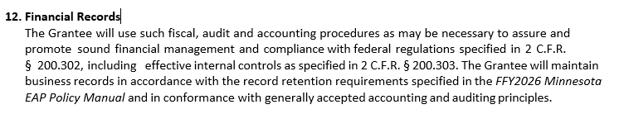
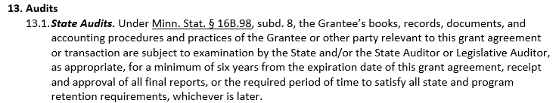
EAP Contract
Record retention
Notes:
The SP contract with Commerce references record retention in 2 places.

Slide 22
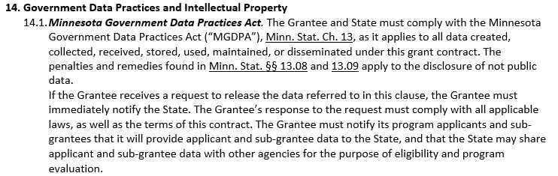
EAP Contract
MGDPA
Notes:
A section on the data practices act

Slide 23
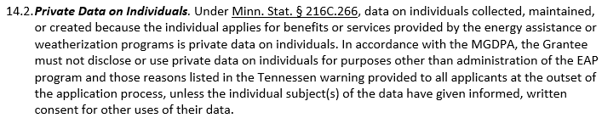
EAP Contract
Private Data on Individuals

Slide 24
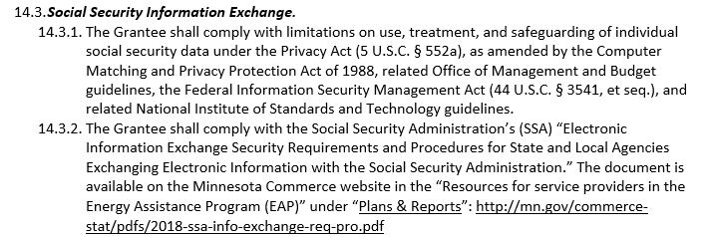
EAP Contract
Social Security Information Exchange
Notes:
Excerpt from the SS info section – again, SPs will not have access to the SSA verification details

Slide 25
Access to Data

Slide 26
HH Access to Data
HH may request to see private data about themselves
Be mindful about HH file documentation – just the facts!
SPs must take great care to ensure data is released only to the data subject by
  Confirming the data requestor’s identity
  Mailing copies of data by certified and restricted delivery mail to the data subject at their address
A copy of the data must be provided within 10 business days of the request

Slide 27
HH Access to Data
HH may request to see private data about themselves
SPs must maintain documentation of all private data releases
  For phone requests, maintain a log or put a note in the file
  Get the requestor’s signature on a list of data viewed or picked up
  Maintain a list of data mailed and copies of the certified mail receipt, record of delivery, and signature confirmation
See Handling Data Requests for specific, step-by-step procedures for releasing data to the data subject
Notes:
Chapter 11, Handling Data Requests

Slide 28

Others’ Access to Data
HH may authorize others to access their private data
Application
Informed Consent

Slide 29
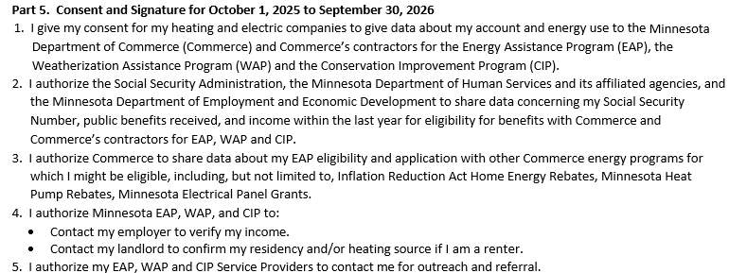
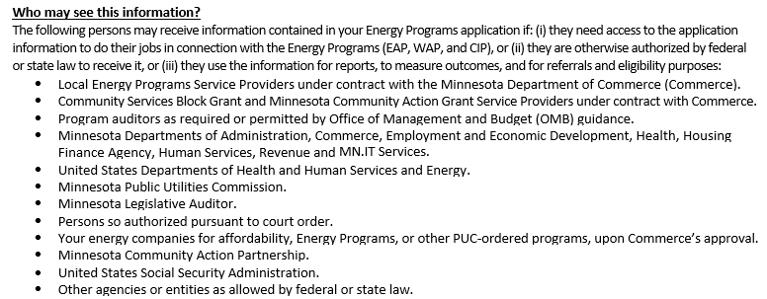
Application
Notes:
Signature page – HH authorizes other orgs to share info with EAP – authorizes EAP to share info with other orgs for specific purposes
Privacy notice includes list of authorized parties

Slide 30

Informed Consent
HH identifies which data to share and with whom
Examples: social worker, family member, other programs
Primary applicant can authorize for self, minor children, HH
Each adult must authorize for their private data
Valid for the program year
Notes:
Household may authorize additional parties to access their application info with informed consent
Examples: social worker, family member, other programs
For example – primary applicant may authorize for application date, eligibility status, housing type, etc.
Each adult must sign for their own data – for example – name, income details, date of birth, etc. Noted on the informed consent form

Slide 31

External Requests
What about external requests?
Examples: elected officials, advocates, family members, neighbors, media, law enforcement
Public data – OK to release
Private HH data – cannot release without HH consent
  Subpoena, court order - notify Commerce
Notes:
Public data – available to anyone for any reason.
Stock image

Slide 32
Data Breach
Notes:
Can be intentional or unintentional
Can be verbal – conversation with or near unauthorized party
Pixabay.com

Slide 33


Data Breach
What is a data breach or data incident?
An unauthorized person obtained access or acquisition of not public data
Examples
  Email to the wrong address
  Lost HH files
  Mismatched mail merge
  Unauthorized access to HH files
Image Credit: pixabay.com
Notes:
Can be verbal – conversation with or near unauthorized party
Can be intentional or unintentional
Pixabay.com

Slide 34

Data Breach
Submit incident report – EAP policy
Follow your agency policy
Fixes are easier if we can act quickly
We can evaluate the situation and identify next steps
When in doubt, check it out
What if I am involved in or witness a data breach?
Notes:
In some cases, Commerce required to submit reports to Commerce Legal, Office of the Legislative Auditor, etc.
If you’re not sure if the situation is a data breach or incident – better to check it out! “See something – say something”
Stock image

Slide 35

Penalty
Government entities & contractors may face penalties for MGDPA violations
Person may bring action to cover damages, costs, reasonable attorney fees
For willful violation, additional damages $1000 - $15,000 for each violation
Minnesota Statutes § 13.08
Notes:
See EAP Policy Manual, Ch 11 or the Minn Stat section for the full text
Again, State of MN takes data practices seriously!
Stock Image

Slide 36

Key Message!
How does the MGDPA affect my job?
Be a good steward of the information you access for your job
  You are responsible for the data you access
  You are responsible for the data you share with others – internally and externally
Notes:
Stock Image

Slide 37

Recap – Your Responsibilities
Become familiar with data retention and data practices policies
Ensure the data you access is for business purposes only
Understand data classifications
Ensure the data you use is maintained in an easily accessible manner
If you are a party to or witness a data breach, notify Commerce
Notes:
Stock Image

Slide 38
Resources
Minnesota Statutes, Chapter 13
Minnesota Statutes § 16C.05, subd. 5
Minnesota Statutes § 216C.266, subd. 1
Minnesota Rules, Chapter 1205
Department of Administration Data Practices Office
EAP Policy Manual, Chapter 11
SP – Commerce Contract

Slide 39
eHEAT User Review
S.Melaine Schwahn-Doyle

Slide 40
eHEAT User Review
S. Melaine Schwahn-Doyle

Slide 41
eHEAT User Review
Commerce Active eHEAT user review
Implemented January 2024
Strengthens Commerce controls around protecting EAP data
  Mitigates the risks of SP control failure
  Incorporates state-level eHEAT user access review (e.g., WAP, PUC, etc.)
  Assures all active eHEAT users are appropriate
Quarterly frequency

Slide 42

eHEAT User Review
SPs must have processes or procedures to:
Manage eHEAT access to ensure only current, authorized users have eHEAT access
  Access limited to current, authorized users
  Roles or features should be necessary for their work
  See Roles and Responsibilities section Ch 11 p 9 for more detail

Slide 43

eHEAT User Review
On and off-boarding staff
  SPs must immediately deactivate eHEAT admins and users when needed
  Off-boarding procedures must include deactivating access to eHEAT and other systems containing EAP private data

Slide 44

eHEAT User Review
eHEAT access checks by eHEAT Admin
  Conduct routine eHEAT user access checks
  Immediately deactivate eHEAT admins & users when needed
    Separation from SP or leaves EAP org
    Administrative leaves or suspension, other leaves over 30 days: laid off or furloughed, extended vacations, or reassignments
  Edit the user’s features or access when staff work duties change
  Off-boarding procedures must include deactivating access to eHEAT and other systems containing EAP private data

Slide 45

eHEAT User Review
User Review Steps
Commerce announces user review & due date in EZ
Use the ‘Active User Report’ in eHEAT to obtain a list of active users
Review all active users
  Confirm the user is an active staff person who requires access for their current role
  Edit or deactivate any users not meeting the criteria to maintain access & record the circumstances for each
Submit attestation email to eap.mail

Slide 46

eHEAT User Review
Attestation email requirements
Statement confirming the SP completed the user review
Date the review activity was conducted
Statement confirming all users have only the necessary eHEAT access for their current roles
List all access changes resulting from this review, including the user and circumstances
If there are no changes, clearly state no changes required

Slide 47
eHEAT User Review
Let’s review email requirements
Statement confirming the SP completed the user review
Date the review activity was conducted
Statement confirming all users only have necessary eHEAT access for current roles
“This email confirms the eHEAT active user certification for <SP Agency> was completed on <Date>. All users have eHEAT access necessary for their current roles.”

Slide 48
eHEAT User Review
“This email confirms the eHEAT active user certification for <SP Agency> was completed on <Date>. All users have eHEAT access necessary for their current roles.
Removed access from Wiley Coyote due to a job change to Head Start on 8/4/25.
There were no changes.”
List all access changes resulting from this review, including the user & circumstances
  If there are no changes, clearly state no changes required
  Reminder
  Ensure all requirements are met
  Send to eap.mail by due date
  Late reports are recorded
`
`

Slide 49
Q&A

