Slide 1

Energy Assistance Program
FFY26 Annual Training
Utility Customer Protections

Slide 2
Utility Customer Protections
Jon Brown

Slide 3
Utility Customer Protections
Topics
Cold Weather Rule (CWR)
Hot Weather Rule
Medically necessary equipment

Slide 4

Utility Customer Protections
Cold Weather Rule
What is CWR?
Utility shut off protection between October 1 and April 30
Heat-affected, electric and natural gas residential accounts
Covers renters if utility account in HH name and primary heat source
Prevents disconnection
If disconnected – service reconnected within 24 hours if possible
Service limiters are considered a disconnect under CWR

Slide 5
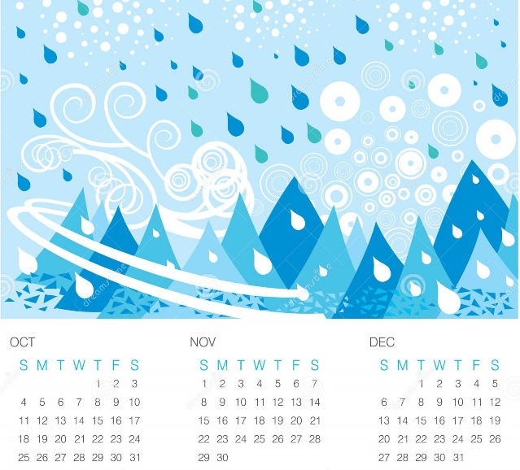
Utility Customer Protections
Cold Weather Rule
What is CWR?
Not automatic – HH must contact their utility company
Do not have to be current to set up arrangement
HH can set up plan anytime during CWR period

Slide 6

Utility Customer Protections
Cold Weather Rule
What is CWR?
Agree to a payment plan based on HH financial situation
Intention is keeping service on, not pay back arrears
Must keep payment plan or lose protection
Timely payment is within 5 days of the agreed-upon due date
MN Statutes 216B.096 and 216B.097

Slide 7
Utility Customer Protections
Cold Weather Rule
Regulated vs unregulated
CWR applies to all electric and natural gas utilities, but rules differ
Regulated (Xcel, CenterPoint, MERC, MN Power, etc.) | Unregulated (Coops and municipals)
Protections for HHs above and below 50% SMI | Only available to HHs at or below 50% SMI
10% of income payment plan cap for 50% or less SMI HHs | No payment plan cap – amount set by utility
Can’t disconnect within 10 working days of mailing notice or 7 working days of in-person delivery of notice | Can’t disconnect within 30 days of mailing notice or 15 days of in-person delivery of notice
PUC decides appeals | Utility decides appeals

Slide 8

Utility Customer Protections
Cold Weather Rule
Not regulated
Business and commercial service
Delivered fuels – oil, propane, wood/biofuel
If electric runs furnace for these heating types, electric is eligible
Non-heat electric
Electric not protected if dwelling has heat when service is disconnected

Slide 9

Utility Customer Protections
Hot Weather Rule
No disconnection of residential service during extreme heat
Does NOT require service restored if already disconnected
Applies to all electric utilities – regulated, coop, and municipal
Covers counties where National Weather Service issues:
Excessive heat watch
Heat advisory
Excessive heat warning
MN Statute 216B.0975

Slide 10

Utility Customer Protections
Medically necessary equipment
Utility must maintain or reconnect service to HHs where:
Medical emergency exists
Life sustaining medical equipment requiring electricity is in use
Requires written certification that loss of service will impair or threaten health or safety of resident in the HH
Initial certification by telephone allowed if written
certification provided within five business days

Slide 11

Utility Customer Protections
Medically necessary equipment
Certification must be by doctor, physician assistant, or nurse
Certification is valid for 6 months and may be renewed
Utility may extend to 12 months depending on HH circumstance
HHs in arrears must agree to payment plan
Plan must consider financial circumstances of the HH
Agreement may include arrears forgiveness
MN Statute 216B.098 Subd 5

Slide 12
Q&A

