Slide 1

Energy Assistance Program
FFY26 Annual Training
Online App Enhancements & Refresher

Slide 2
Online App Enhancements & Refresher
Ian Villa-Watt

Slide 3
Online App Enhancements & Refresher
Topics
New Enhancements for FFY26
Refresher on Online App Processing

Slide 4
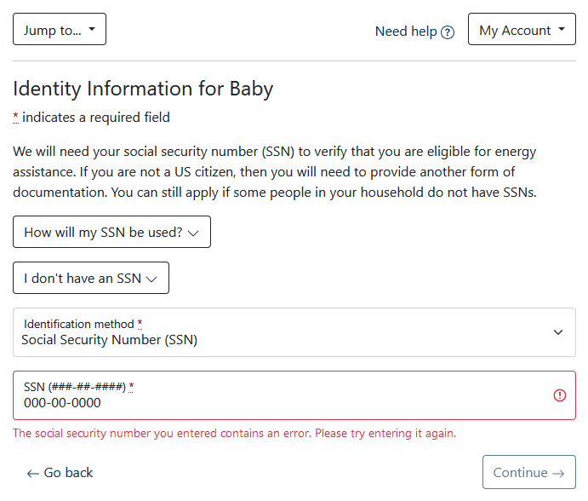
Online App Enhancements & Refresher
SSN Validation
000 - ## - ####
### - 00 - ####
### - ## - 0000
666 - ## - ####
9## - ## - ####

Slide 5
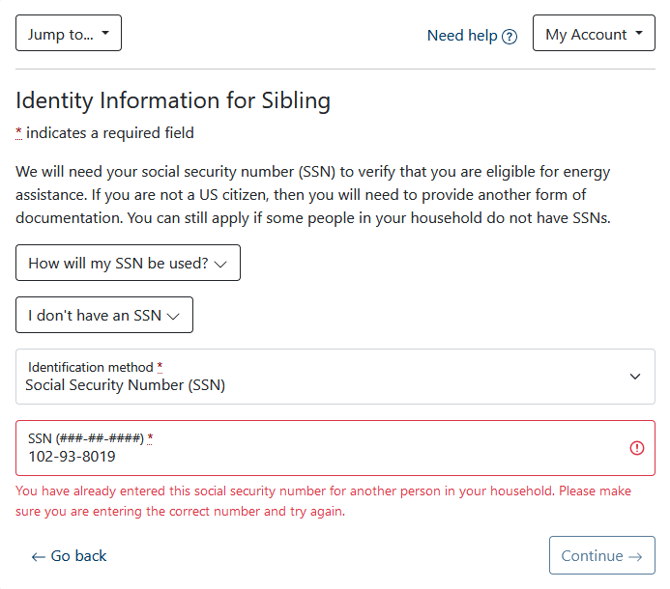
Online App Enhancements & Refresher
SSN Conflicts
What if HH enters an SSN that has already been entered on the same app?

Slide 6
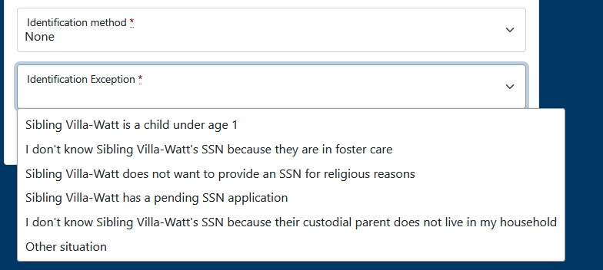
Online App Enhancements & Refresher
* requires documentation

Slide 7
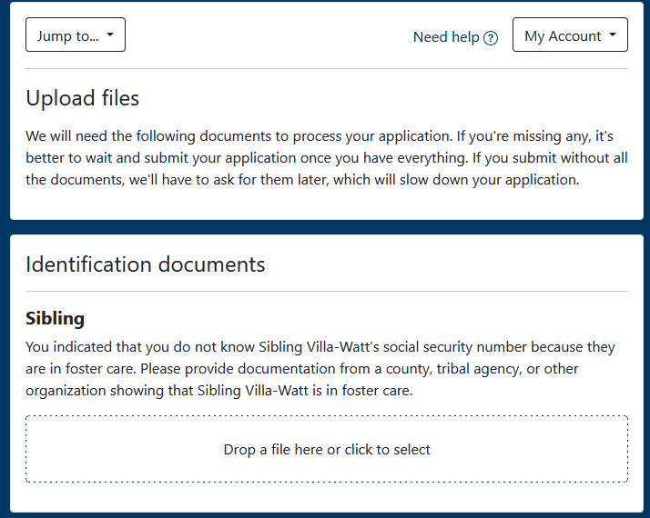
Online App Enhancements & Refresher
SSN Exception File Uploads
Exception | Documentation
Pending SSN | You indicated that [person] does not have a social security number yet. Please provide a copy of their pending SSN application.
Foster Care | You indicated that you do not know [person]’s social security number because they are in foster care. Please provide documentation from a county, tribal agency, or other organization showing that [person] is in foster care.
Religious Objector | You indicated that [person] has chosen not to provide a social security number for religious reasons. Please provide a copy of [person]’s approved IRS Form 4029.

Slide 8
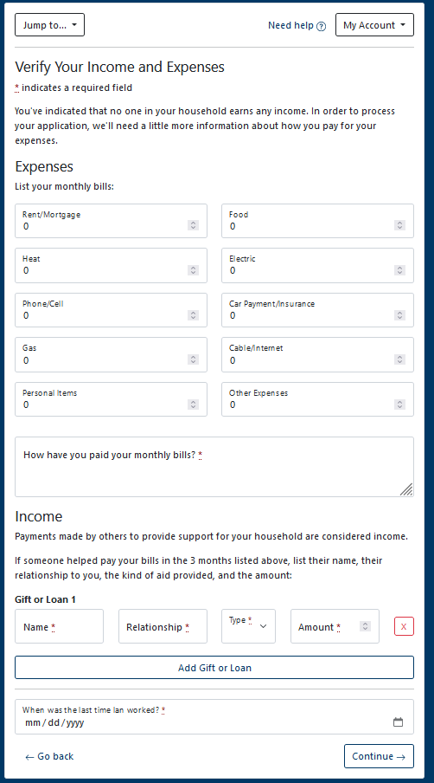
Online App Enhancements & Refresher
Online App VIE
Will be updated to look like the new paper VIE
Remove expense questions, add new questions for FFY26

Slide 9
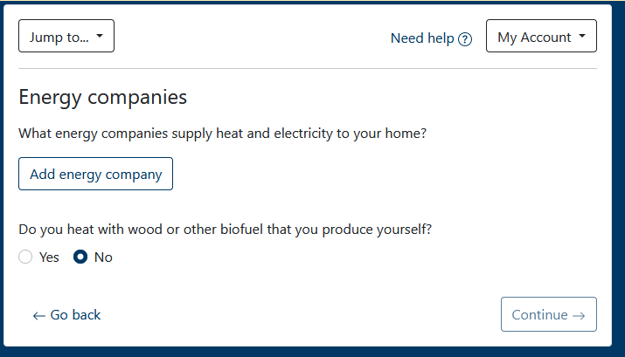
Online App Enhancements & Refresher
Energy Vendor Screen
Problem: HHs often enter just one vendor

Slide 10
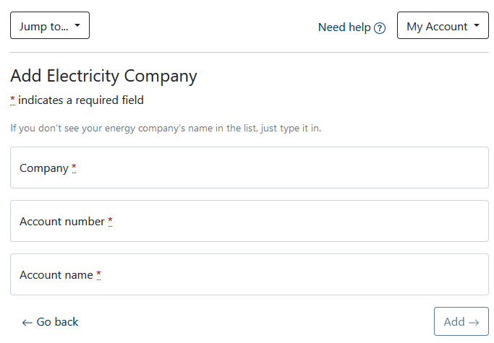
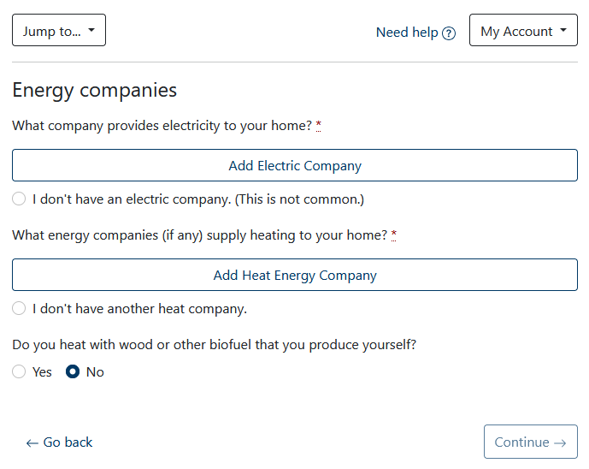
Online App Enhancements & Refresher
Energy Vendor Screen
Problem: HHs often enter just one vendor

Slide 11
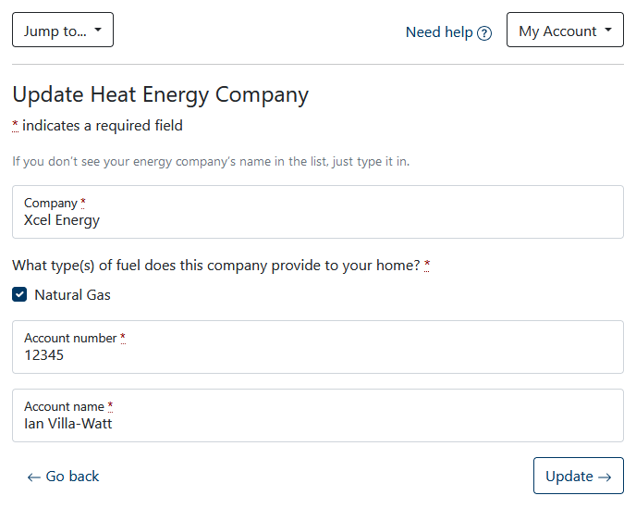
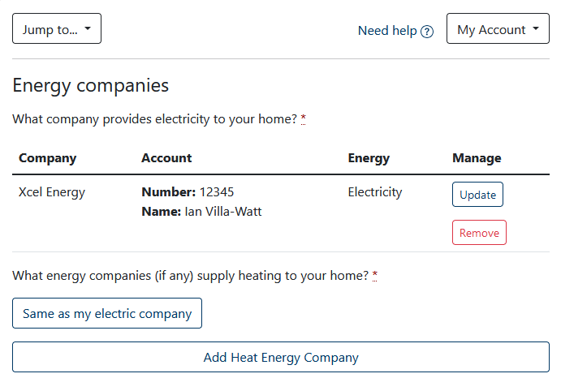
Online App Enhancements & Refresher

Slide 12
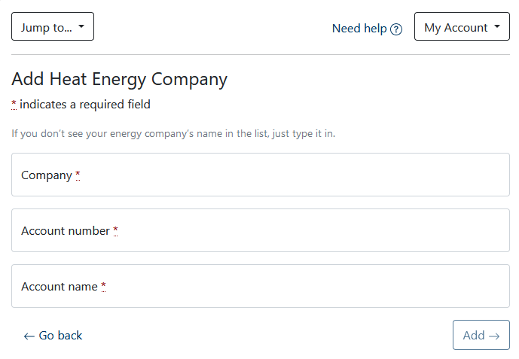
Online App Enhancements & Refresher

Slide 13
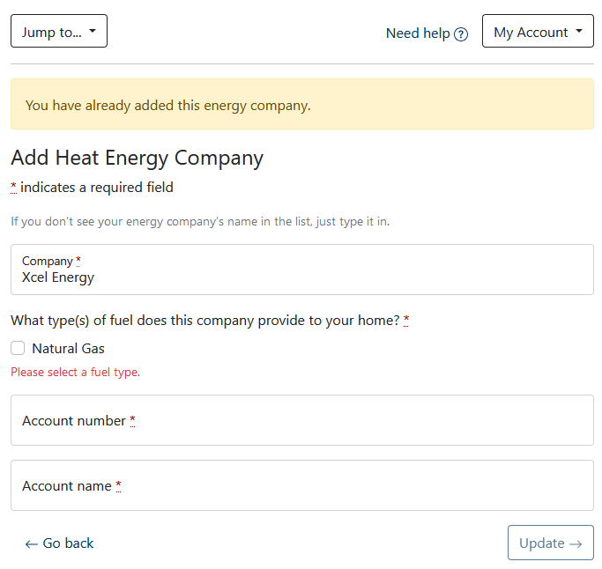
Online App Enhancements & Refresher

Slide 14
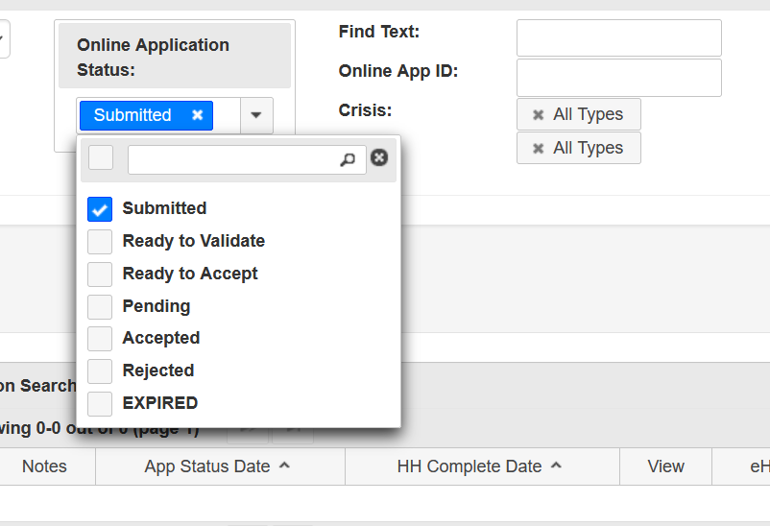
Online App Enhancements & Refresher
Searching for Online Apps
Must select at least 1 status
Submitted date = first date the app appeared in a search
HH Complete date = date HH submitted
Check crisis/ERR boxes to filter search results

Slide 15
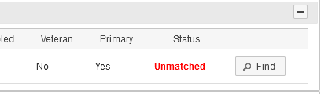
Online App Enhancements & Refresher
Matching People
Matching online app people to eHEAT people makes it possible to link online apps to existing HHs

Slide 16
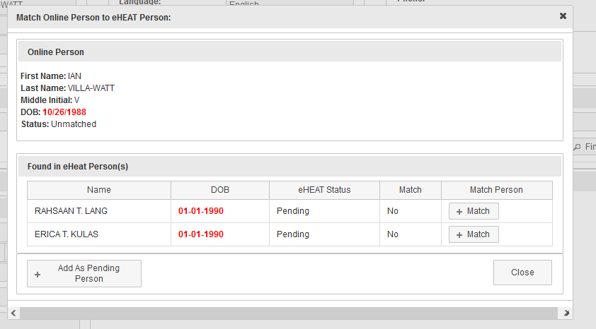
Online App Enhancements & Refresher
Matching People

Slide 17


Online App Enhancements & Refresher
Linking Households
“Linking” tells eHEAT what HH number to use once the online app is accepted
Accepting a linked app voids any pre-logged app for that HH number

Slide 18
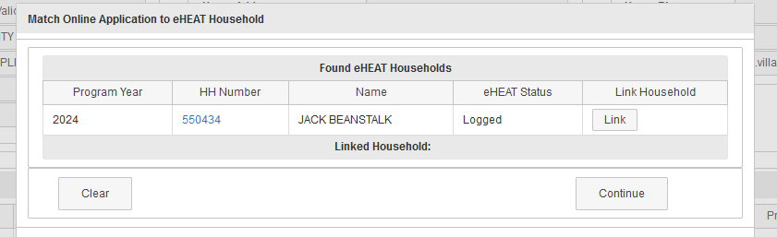
Online App Enhancements & Refresher
Linking Households
Notes:
Note: these are different HHs. You may need to look up these HHs individually to determine which HH to link to.

Slide 19

Online App Enhancements & Refresher
To Link or Not to Link?
Link possibilities = any HHs that any members have ever been in
Don’t link just because eHEAT gives you the option – make sure HHs are truly the same
  Ex: custody changes

Slide 20
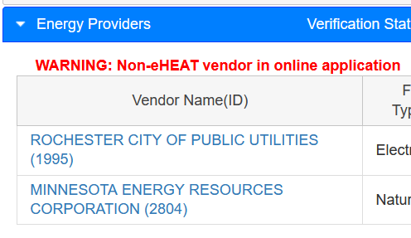
Online App Enhancements & Refresher
Non-eHEAT Vendors
HHs can enter vendors that are not in eHEAT
Ensure HH did not misspell the name of an existing vendor
If the vendor is truly new, they must register with Commerce EAP
Note: warning does not go away!

Slide 21
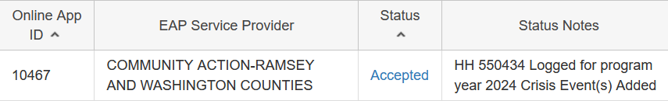
Online App Enhancements & Refresher
How Do Online App Emergencies Work?
If the household indicates a crisis, eHEAT will try to create the events automatically
If the vendor is not in eHEAT, you must add the events manually

Slide 22

Online App Enhancements & Refresher
What if I Log an Online App By Mistake?
Ex: You log the app but linked wrong HH
Void the app from manage app dropdown (indicate app was logged in error)
Online app automatically
returns to “Ready to Accept” Status
Make corrections and accept

Slide 23

Online App Enhancements & Refresher
Online App Resources
Online app processing guide
  Available via the Toolkit
Online app training video

Slide 24
Q&A

