Slide 1

Energy Assistance Program
FFY26 Annual Training
Monitoring

Slide 2
Monitoring
Mandy Braaten

Slide 3
Monitoring
MONITORING
Federal, State and Departmental | State Office | Service Provider (SP)
HHS State Auditor Self Monitoring Government Accountability Office | Program Audit Quality & Performance Control Desk Monitoring Staff Meetings Financial Reconciliation | Vendor Monitoring Self Monitoring Agency Fiscal Audit
It’s all one comprehensive system. It’s all about the money and the safeguards in place to protect it so its available for the families we serve.

Slide 4
Monitoring
Topics
Objective
Visit Details
Desk Monitoring
Initial Program Assessment Visit (iPAV)
Full Program Audit Visit (fPAV)

Slide 5
Objective of Monitoring

Slide 6
Objective of Monitoring
Determine SPs performance in achieving EAP stated goals and objectives
Examine the efficiency of utilizing EAP resources (time, money, personnel) to achieve EAP outcomes
Identify areas where the program is performing well and areas where improvements are needed

Slide 7
Objective of Monitoring
Provide constructive feedback to SP program coordinators and stakeholders on program performance
Use the monitoring review process as an opportunity for continuous learning and improvement within EAP program
Use the findings and reportable observations to make program improvements, adjustments, or modifications

Slide 8
Visit Details

Slide 9
Visit Details
On-site Visits
Commerce conducts two types of on-site visits
Initial Program Assessment Visit (iPAV)
Full Program Audit Visit (fPAV)

Slide 10
Visit Details
Prior to the Visit
Initial Program Audit Guide (iPAG) to SPs receiving iPAV
Details what to expect
Initial Program Assessment (iPAT) and Full Program Audit Tools (fPAT) to SP for completion and submission to commerce prior to visit.
These tools are utilized to evaluate SP capacity to deliver EAP and determine training needs.

Slide 11

Visit Details
Program Performance Auditor (PPA) completes pre-visit checklist and Effort Definition (ED)
File sample compiled and sent to SP
Desk Monitoring

Slide 12
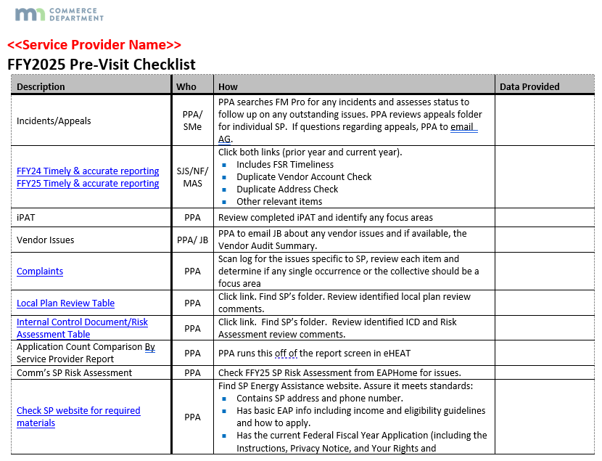
Visit Details
Incidents and Appeals
Timely accurate reporting
Complaints
Application Count Comparisons
Risk Assessment
Website Info

Slide 13
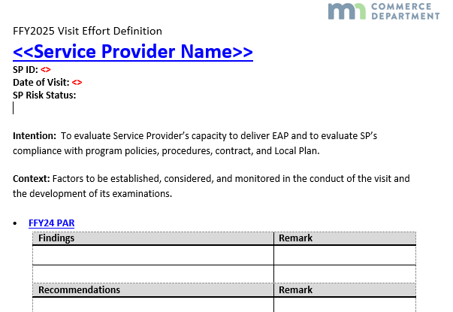
Visit Details
Effort Definition
Gathers relevant SP info for the visit
Details focus areas
Prepared by the PPA

Slide 14
Visit Details
Focus Areas of the Visit
Review of findings and recommendations from previous year(s)
Ensure SP has necessary resources
Staffing, program setup, etc.
Review Local Plan/ICD and address questions or changes
Provide training
Review policy changes for SP understanding
File review

Slide 15
Visit Details
How are Files Selected?
Data is queried from eHEAT
Primary heat
Crisis
ERR
Random sample is created

Slide 16
Visit Details
Files are Examined for Accuracy in the Following Areas:
Primary Heat | Crisis | ERR
Application Processing | Crisis Eligibility | Eligibility Determination
Eligibility Determination | SP Response | SP Response
Benefit Calculation | Benefit Amount | Benefit
 |  | Replacement Inspection (when applicable)
 |  | Completion Certificate
 |  | Invoice

Slide 17
File Sample Review – What Are We Looking For

Slide 18


Visit Details
File Review Looks For:
Patterns and outliers
Data entry accuracy
Conflicts of interest
Documentation
Adherence to policy

Slide 19
Primary Heat

Slide 20
Visit Details
Primary Heat
Application Processing
Eligibility Determination
Benefit Calculation
Correct application year
App date stamped and logged within 24 hours of receipt
Accurate income calculation
Complete documentation, verification, and case notes (who, what, where, when, & why) in HH file or eHEAT
Copies of any correspondence with the applicant, if applicable
Documentation of research done in response to a question, complaint, or appeal (if applicable)

Slide 21
Visit Details
Primary Heat
Application Processing
Eligibility Determination
Benefit Calculation
Data entry
Does app match eHEAT (notes to indicate changes)
Timely service delivery
EAP data security practices in line with policy
Accurate energy vendor info
Name on account
Consumption
Accurate Primary Heat determination

Slide 22
Visit Details
Primary Heat
Application Processing
Eligibility Determination
Benefit Calculation
HH member info
SSN
Verified and accepted
Excluded
HH income documentation, calculation and proper use of DEED and UI
Proper use of VIE
Income documentation accurate and complete
HH name, employer/bank name, appropriate timeframe
Housing type and status (e.g., subsidized, heat in rent)

Slide 23
Visit Details
Primary Heat
Application Processing
Eligibility Determination
Benefit Calculation
PH Benefit Amount Determination
Back-up Matrix
Cost Based Matrix
Fuel type
Home heating system status (e.g., dual fuel)

Slide 24
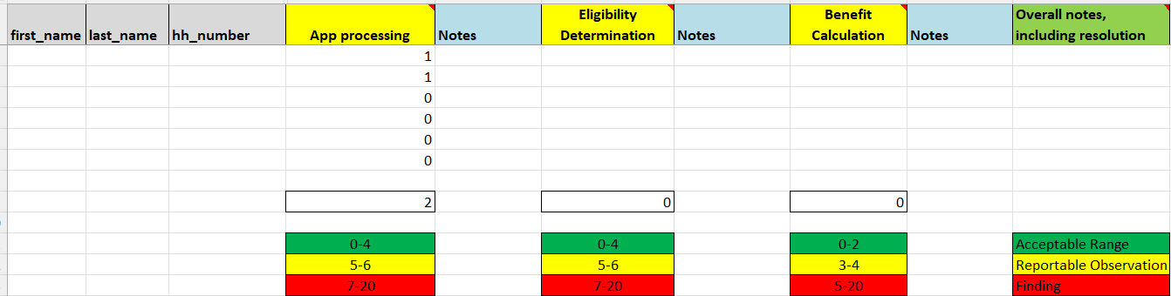
Visit Details
File Sample Review Scoring
Primary Heat

Slide 25
Crisis

Slide 26
Visit Details
Crisis
Crisis Eligibility
SP Response
Benefit Amount
Documentation of emergency (e.g., disconnect notice)
Documentation of energy vendor verification
Phone
Vendor validate
Available PH payments did not resolve the emergency
Check if PH payments were made payable after Crisis benefit determined
SP and HH correspondence note(s) in file or eHEAT
Check to be sure eHEAT crisis reason matches documented rationale
Did HH have an eligible crisis reason
Are SPs doing reasonability checks for delivered fuel? (optional)

Slide 27
Visit Details
Crisis
Crisis Eligibility
SP Response
Benefit Amount
Was threat of emergency removed within 18/48 hrs.
Crisis reported date
Date verified
Date pd
Was proper crisis triage followed
Were payments applied timely
Within 7 days of verification for connected utilities
Within 7 days of acceptance of post-delivery info for delivered fuels

Slide 28

Visit Details
Crisis
Crisis Eligibility
SP Response
Benefit Amount
Compare crisis amount with vendor verification documentation and PH benefit amount
Was the appropriate amount paid
Are the Crisis amount and fees boxes in eHEAT being properly used

Slide 29
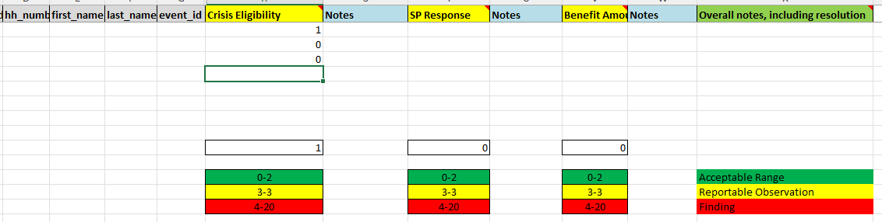
Visit Details
File Sample Review Scoring
Crisis

Slide 30
Energy Related Repair (ERR)

Slide 31
Visit Details
ERR
Eligibility Determination
SP Response
Benefit
Replacement Inspection (when applicable)
Completion Certificate
Invoice
Documentation of:
Proof of ownership (if required)
Qualified dwelling
Valid request for ERR (e.g., HH report of problem)
Eligible heating system (e.g., not redundant)
Is HH occupying home at time ERR benefit is determined
Does ERR related app match eHEAT info
Common example is housing type (mobile home vs house)
Verify any changes to app or eHEAT were documented.

Slide 32


Visit Details
ERR
Eligibility Determination
SP Response
Benefit
Replacement Inspection (when applicable)
Completion Certificate
Invoice
Was threat of emergency removed within 18/48 hrs.
ERR reported date
Award/completion date
Did HH have temporary heat
If not, was it provided appropriately
Did SP supply notes as to type of temp heat

Slide 33
Visit Details
ERR
Eligibility Determination
SP Response
Benefit
Replacement Inspection (when applicable)
Completion Certificate
Invoice
Documentation of the contractor’s assessment of the problem (e.g., need for repair or replacement)
Documentation of “Manual J” calculations or other sizing information (e.g., data plate for mobile homes)
Ensure completion of sizing info prior to system installation
Documentation of procurement steps
Ensure alignment with EAP Policy

Slide 34
Visit Details
ERR
Eligibility Determination
SP Response
Benefit
Replacement Inspection (when applicable)
Completion Certificate
Invoice
Check for ERR Furnace Replacement Inspection Tool (Appendix 6A)
Required for all inspections
Were required fields updated in eHEAT
50% of completed furnace replacements & retrofits must be inspected as well as one per contractor
Review of SP documentation to ensure compliance
Inspections must verify:
Replaced units and/or retrofits are those contracted for in the bid
Billed work was completed

Slide 35
Visit Details
ERR
Eligibility Determination
SP Response
Benefit
Replacement Inspection (when applicable)
Completion Certificate
Invoice
Check for ERR Furnace Replacement Inspection Tool (Appendix 6A)
Required for all inspections
Were required fields updated in eHEAT
50% of completed furnace replacements & retrofits must be inspected as well as one per contractor
Review of SP documentation to ensure compliance
Inspections must verify:
Replaced units and/or retrofits are those contracted for in the bid
Billed work was completed
Inspection was completed and paid prior to contractor payment
Do inspection costs align with policy
Were they documented on the Inspection Tool.

Slide 36
Visit Details
ERR
Eligibility Determination
SP Response
Benefit
Replacement Inspection (when applicable)
Completion Certificate
Invoice
Itemized invoice or itemized bid from contractor in HH file.
Must include details of cost for labor, parts and new equipment
ERR Invoice Template (Appendix 6D) is provided in the EAP Manual to help contractors meet the requirement
Repairs: Labor (rate x hours) and major parts with quantity and price
Replacements: System make, model, labor (rate x hours); major parts (with quantity and price )

Slide 37
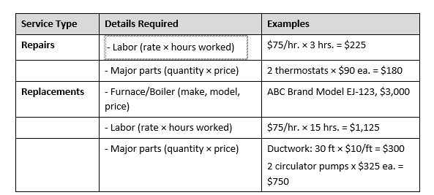
Visit Details
ERR
Eligibility Determination
SP Response
Benefit
Replacement Inspection (when applicable)
Completion Certificate
Invoice
Major parts refer to essential components necessary for the system’s functionality or safety, such as, but not limited to, ductwork, peripherals, thermostat, and abatement.
NEW

Slide 38
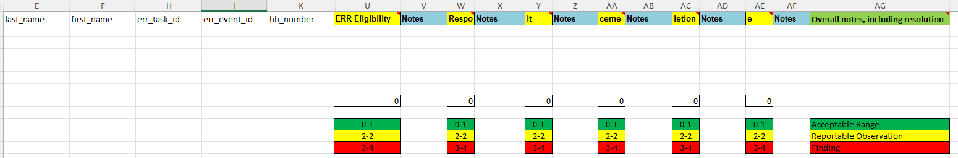
Visit Details
File Sample Review Scoring
ERR

Slide 39
Desk Monitoring

Slide 40
Desk Monitoring
Fiscal activities
Quality control efforts and reports (e.g., dup account checks)
Key risk mitigation activity
Allows for Program Integrity and audit-ability
Addresses problems early before they become critical
Vendor feedback and info

Slide 41

Desk Monitoring
eHEAT info
Aging applications
Aging ERR and Crisis
Aging Payments
Recuring customer complaints
Incidents and Appeals

Slide 42
The Visit

Slide 43


Visit Details
What PPAs need:
Internet access
Temporary password for network access
Workspace
Access to EAP files and records
Access to EAP Coordinator and other appropriate staff as needed

Slide 44
Visit Details
Discussion of Misc. Items
Local Plan & ICD | Staffing | Agency Support | Training Topics
Data Practices | Application Process | Employee App Process | Crisis Process
ERR Process | Outreach Materials | Outreach Activities and Event Listing | ESS Activities
Internal Communication | Equipment Inventory | Online Application | Self Monitoring

Slide 45
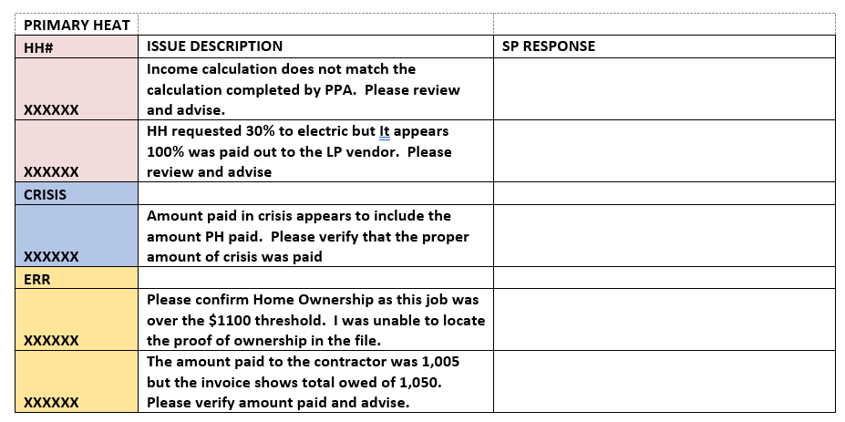
Visit Details
Question, answer and clarification from file review
File review follow up:
Compiled during file review
Sent to Coordinator for review and response
All questions must be resolved prior to audit finalization
Remember, a question does not mean there is an error, we might just need clarification or a better understanding of the situation

Slide 46

Visit Details
Exit interview
Review results of the visit with the Coordinator
Discuss the results of the file review
Resolution of any remaining questions or clarifications
Summarize next steps

Slide 47


Q&A and Break

Slide 48
Initial Program Assessment Visit (iPAV)

Slide 49
Initial Program Audit Visit
Schedule
PPA will contact you beginning in September to schedule your Initial Program Assessment Visit (iPAV)
Higher risk agencies will receive an in person visit
Lower risk agencies will receive a Teams visit, at minimum
Reviews will be underway by the beginning of October, much like EAP
We plan to finish initial visits by the end of December

Slide 50
Initial Program Audit Visit
EAP conducts in-person initial visits to some SPs based on risk and other assessments
To discuss improvement ideas, provide guidance and ensure SP readiness for the program year
All SPs, at minimum, receive a review without a visit
Typically, via Teams

Slide 51
Initial Program Audit Visit
File Selection
Control Activities | Data Source | Initial Random Sample Size | Additional Sample Size
Primary Heat | Population of approved PH | 5 | Case by case
Crisis | Population of completed Crisis | 3 | Case by case
ERR | Population of paid ERR Jobs over $10,000 | 3 All | Case by case
The additional sample is not random but is targeted based on what was discovered during review of the initial random sample.

Slide 52
Full Program Audit Visit (fPAV)

Slide 53

Full Program Audit Visit
Schedule
PPAs will begin contacting SPs to set up visit dates for Full Program Audit Visits (fPAV) starting in late December.
The goal is to have all fPAVs completed by mid-Summer
For those willing to be the first fPAV, we thank you!

Slide 54
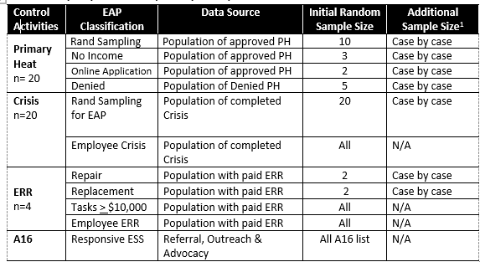
Full Program Audit Visit
File Selection
The additional sample is not random but is targeted based on what was discovered during review of the initial random sample.

Slide 55
Full Program Audit Visit
Why so Many Files?
Statistical significance
Each SP has a “population” of files
We can’t review them all
By reviewing a random sample, we can get a relatively good representation of the whole

Slide 56
Full Program Audit Visit
Enables Commerce to more accurately know the true nature of any identified issue, for example:
We review 5 files and 2 have an issue (40%)
Do 40% of all SP’s file have the same issue? We can’t say
We review 20 files and 2 have an issue (1%)
We can be more certain it is not a systemic issue
We review 20 files and 8 have an issue (40%)
In this case we would be more certain that SP files may have a systemic issue

Slide 57
Full Program Audit Visit
Post Visit
Finalize Effort Definition (ED)
Update with results and info from visit
Share any SP questions/concerns
Communicate with the SP
Request Audit Disclosure Letter
Due 7 days after conclusion of visit
Finalize any remaining questions or concerns
Collect any additional documents or info

Slide 58
Full Program Audit Visit
Draft the Program Audit Report (PAR)
After all info from the visit is gathered and analyzed
PAR remains open until end of program year (new 2024)
PAR Draft issued to SP with findings or reportable observations for review
Finalized PAR sent to SP mid-Summer
SP Response with action plan
Satisfactory response letter issued

Slide 59
Monitoring Results

Slide 60
Full Program Audit Visit
Findings and Reportable Observations
Highlight discrepancies, control weaknesses, and areas of non-compliance
Aimed to address the issues identified during review and prevent similar problems from recurring
Provide valuable insights for management to make informed decisions about resource allocation and process improvements

Slide 61
Full Program Audit Visit
Help to create a platform for open and honest communication between SP program coordinators, management and employees in resolving issues and plan for future improvement
Help to build trust and strengthening relationships between Commerce and Service Providers .

Slide 62
Full Program Audit Visit
Summary of FFY25 Findings and Reportable Observations
Category | Findings | Reportable Observations
Application Processing | 2
Benefit Determination | 1 | 1
Crisis Response | 1
ERR Itemized Invoice |  | 3
ERR Benefit |  | 1
Mechanical Contractor Agreement | 1
TOTAL | 5 | 5

Slide 63
Full Program Audit Visit
Cumulative PAR Results
 | 2022 | 2023 | 2024 | 2025
Findings | 17 | 19 | 7 | 5
Reportable Observations | 13 | 9 | 8 | 5
TOTAL | 30 | 28 | 15 | 10

Slide 64

Great Job Everyone!

Slide 65

Q&A

Slide 66
Q&A

