Slide 1
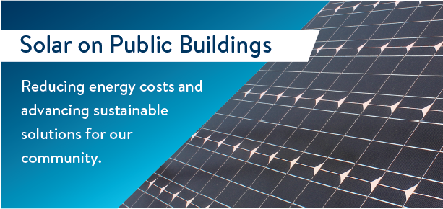
SOLAR power for xx
XX has received a grant from the Minnesota Department of Commerce Solar on Public Buildings program. We are adding solar to help power our buildings and to benefit our community now and into the future.
Benefits of Solar on Public Buildings
Adding solar reduces our buildings’ energy costs.
Our local economy benefits from jobs to install solar plus new infrastructure.
Solar power helps reduce electricity-based greenhouse gas emissions.
Solar power adds “homegrown” renewable sources of energy to our community and the state’s electrical grid, since Minnesota imports 100% of all fossil fuels.
More info: https://tinyurl.com/SolarOnPublicBuildingsMN
insert your
Government’s logo here

