Slide 1
Example Slides – Community Energy Planning
November 2025

Slide 2

Community Energy Planning
November 2025

Slide 3

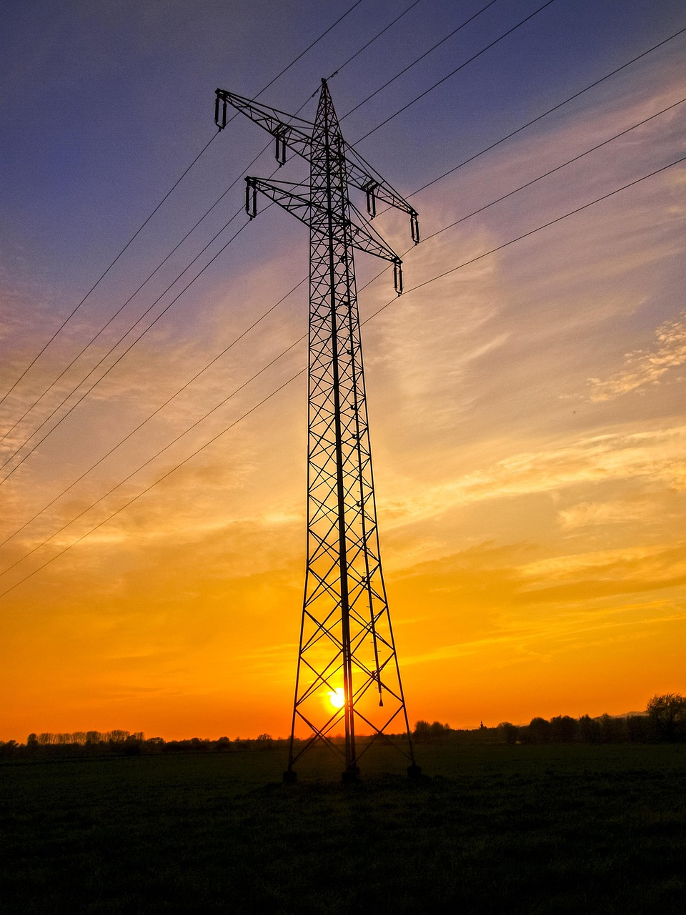

Energy disruptions are serious
Electricity systems are vulnerable to natural and
human-caused disruptions
Reliable and secure power is essential for economic and social welfare
Cell phones, work computers, hospitals, traffic lights, home heating and air conditioning are necessities
November 2025
mn.gov/commerce
3
Notes:
Image by Kathy Büscher from Pixabay

Slide 4
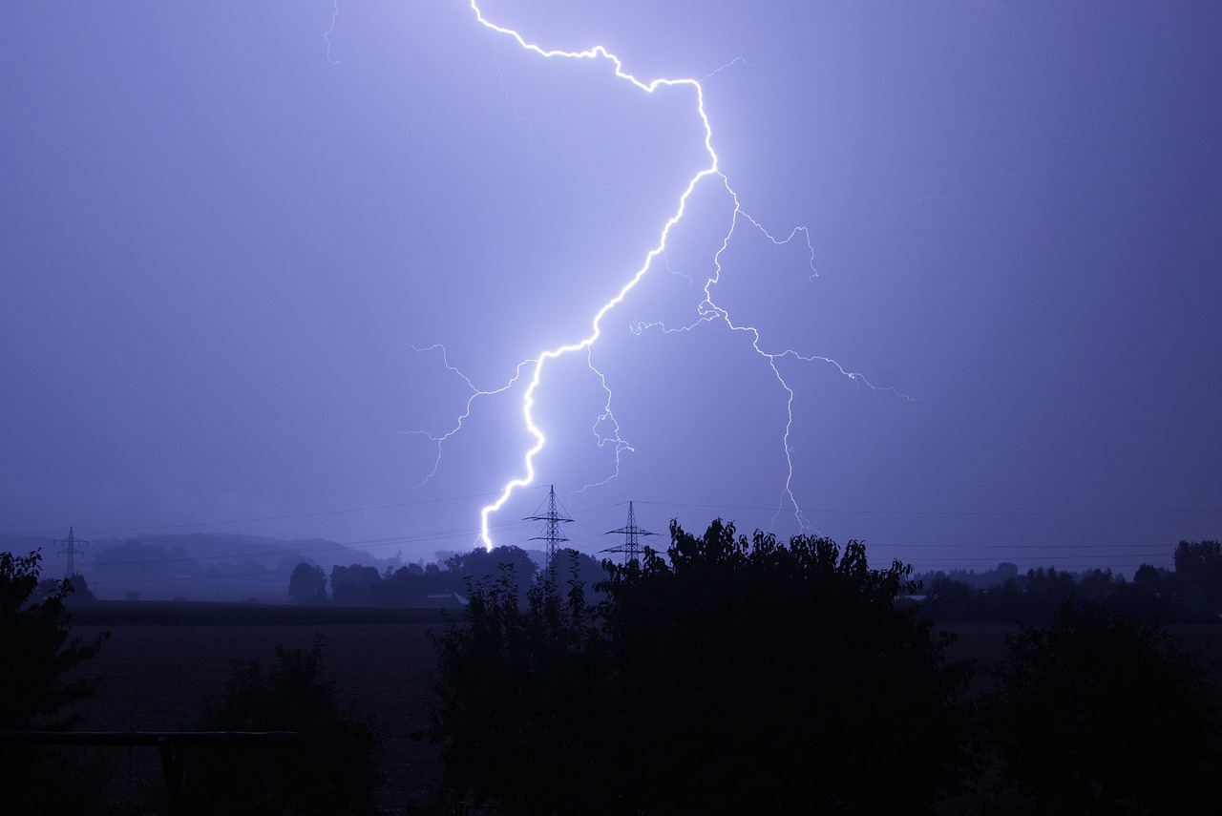
Energy disruptions are serious
Planning ahead is key
Most energy disruptions are brief – with heat, power or electricity restored in a matter of minutes.
Longer delays do occur.
The longer the recovery time, the more serious the situation can become.
November 2025
mn.gov/commerce
3
Notes:
Image by RPN from Pixabay

Slide 5

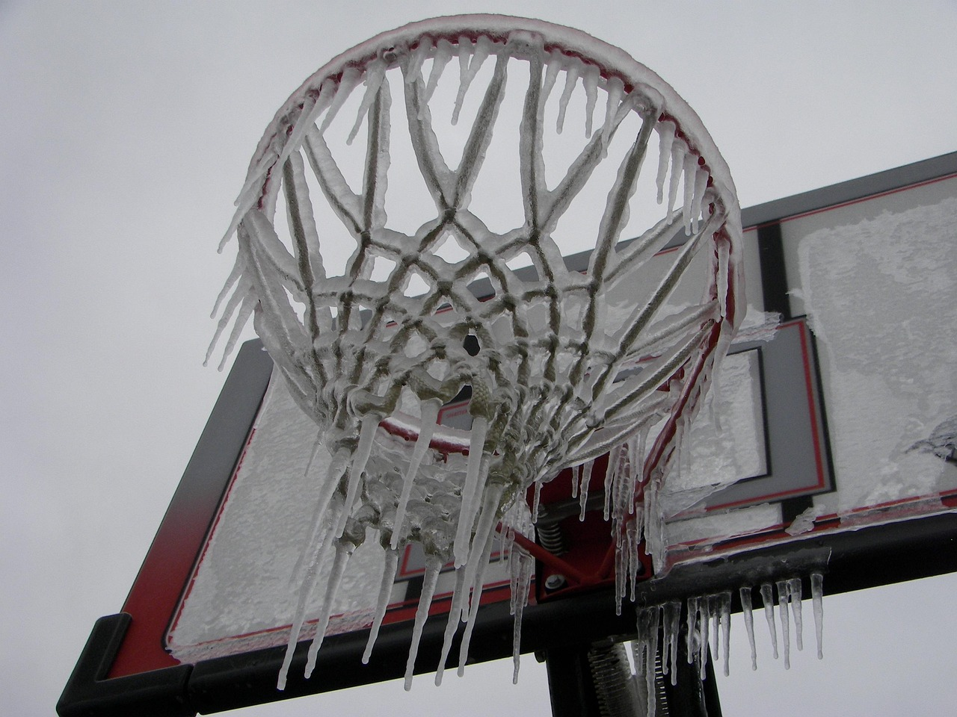
Severe weather affects the whole state
Minnesota has seen a significant uptick in
large-area, extreme rainstorms.
Warmer winter weather can mean heavy,
wet snow or more icing.
Every county in the state had at least five days
of extreme heat in 2022.
November 2025
mn.gov/commerce
3
Notes:
Heat-related Illness Weather: MNPH Data Access - MN Dept. of Health - MN Data
Park bench: no attribution given
Basketball net: Image by Pippin from Pixabay

Slide 6
How severe weather affects energy
Extreme heat and cold increase power demand.
Wash-outs topple power poles, prevent crews from getting to sites to make repairs, and delay fuel deliveries.
Ice and heavy snow can knock branches or trees onto power lines.
Power lines can sway in winds of 20-25 mph, causing them to break or touch each other, resulting in a power outage.
Hurricanes and extreme cold in the south can reduce natural gas production and distribution in Minnesota and across the country.
November 2025
mn.gov/commerce
3

Slide 7
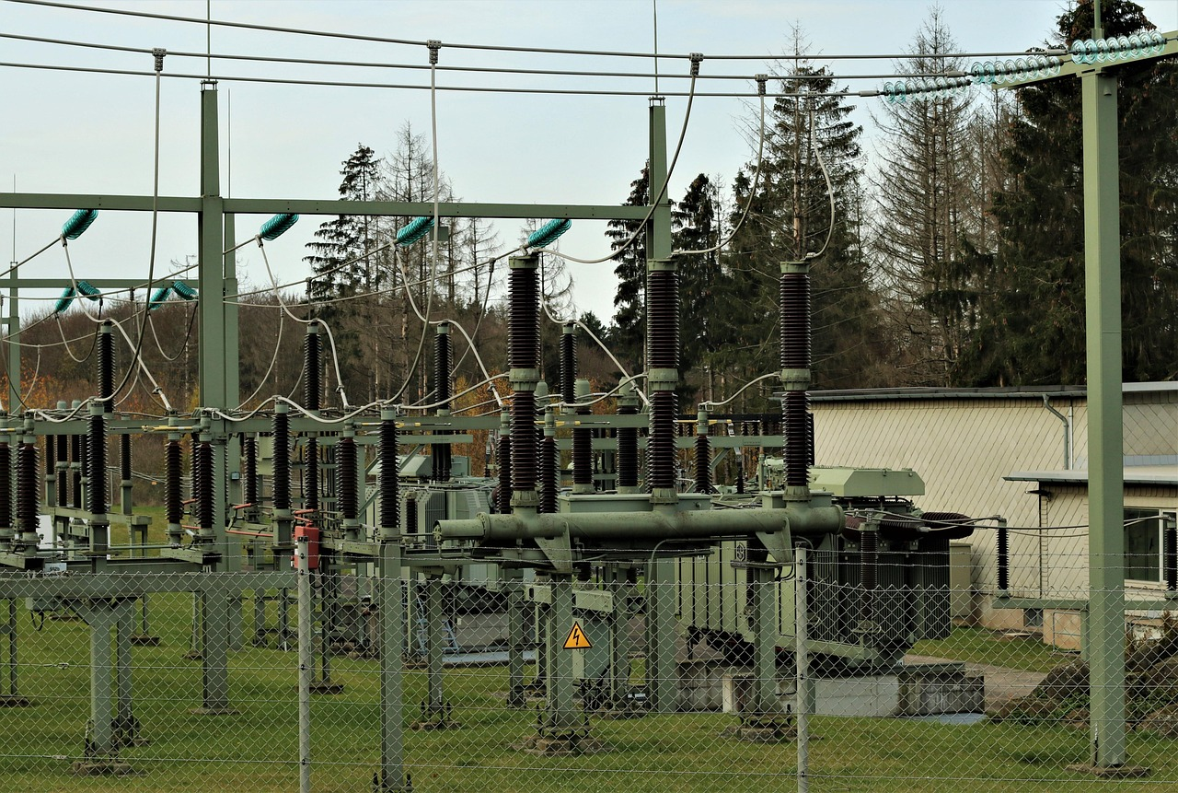
Other causes of energy disruptions
Physical damage or vandalism
“Animal interference” (often squirrels), copper theft, shooting, vehicles hitting poles
Hacking or cyber attacks ​
In 2024, U.S. utilities faced 1,162 cyberattacks through August, compared to 689 over the same period in 2023​
Delays in repair and maintenance
Supply chain issues, limitations in staffing or funding​
November 2025
mn.gov/commerce
3
Notes:
Image by René Schué from Pixabay
Cyberattacks on US utilities surged 70% this year, says Check Point | Reuters

Slide 8
Definitions
Energy Reliability: The ability of a power system to consistently deliver power to homes, buildings, and devices even during disruptive events
Energy Resilience: The ability of the grid, buildings, and communities to withstand and rapidly recover from power outages and continue operating with electricity, heating, cooling, ventilation, and other energy-dependent services
Energy Security: The ability to access electricity, natural gas, and petroleum products on demand and at an affordable price
November 2025
mn.gov/commerce
3

Slide 9
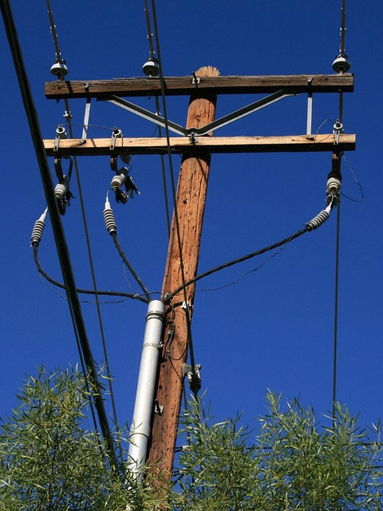
Reasons to prioritize energy reliability and resilience
Small actions in many communities help keep the energy system robust
Less exposure to energy price fluctuations or distant weather events
Ensure strategic locations or critical infrastructure maintain power
Protect vulnerable populations
November 2025
mn.gov/commerce
3
Notes:
Image by PublicDomainPictures from Pixabay

Slide 10
Improving energy reliability and resilience
Invest in local power systems (sometimes called energy independence)
Install transfer switches to allow quick connection of generators at critical facilities and fuel suppliers
Add primary power such as solar panels
Add backup power such as batteries or generators
Consider a microgrid (a small, local electricity system)
Bury electric distribution lines where feasible to reduce risk of damage from wind, ice, etc.
Prepare with community members – notification system, meeting place, go bags
November 2025
mn.gov/commerce
3

Slide 11
Local energy investments are worth it!
The Battle Lake Senior Center reduced heating costs about 30% with a combination of a heat pump and solar thermal panel
The City of Robbinsdale expects to have a 2-year payback on solar panels for City Hall, after state and federal incentives
MnTAP assistance helped Wastewater Treatment Facilities save from $4,100 - $93,300 per year with energy efficiency
The City of Comfrey saves about $5,600 annually with LED lights
The City of Long Beach built a resilience hub that is a meeting space, houses city offices, and can be a disaster relief center if needed.
November 2025
mn.gov/commerce
3

Slide 12
Resources for Community Energy Planning
November 2025

Slide 13
Planning resources
Minnesota Dept. of Commerce energy planning toolkit
Regional Development Organizations (RDOs) in Minnesota: Technical and grant writing assistance
Minnesota GreenStep Cities & Tribal Nations – Voluntary best practices and implementation tools
Minnesota Gold Leaf Challenge – High-priority, high-impact local climate action for communities of all types to consider
November 2025
mn.gov/commerce
3

Slide 14
Paying for energy projects
Energy Programs / Minnesota Department of Commerce
  Programs include solar on public buildings, solar for schools and colleges,
  school HVAC, electric grid resilience, geothermal planning
  MN Climate Innovation Finance Authority (A “green bank”)
  State Competitiveness Fund provides funds to match federal grants,
  certain loans, etc.
Grants to prepare Minnesota for climate change | Minnesota Pollution Control Agency for project planning or implementation and action steps for resilience
November 2025
mn.gov/commerce
3

Slide 15
Paying for energy projects
Electric and gas utilities
  Discounted energy audits and rebates on efficient equipment
Regional Development Organizations (RDOs)
Energy Saving Partnership
  St. Paul Port Authority – for cities, counties, schools, and regional governments
CERTs Seed Grants | Clean Energy Resource Teams
November 2025
mn.gov/commerce
3

