Slide 1


Fiscal Year 2025 Health Professionals Services Program
Kim Navarre, LMFT HPSP Program Director

Slide 2




Overview
HPSP Program Year in Review
Referrals
Participant Agreements
Discharges
Survey Feedback
Budget
Where are we now?
FY26 Goals

Slide 3
HPSP Program Year in Review
Team Changes
Team Additions
Team Consistency
Valerie Bashiri, Case Manager left in September 2025
Andrew Leinen, Case Manager joined October 2025
Katie Morgan, Temp Case Manager Assistant joined September 2025
Team Experience
23 years to one month
Kim celebrated three years on October 31st
8 of the 10 team members have been on the team for at least 18 months

Slide 4
HPSP Program Year in Review
Technology
Almost 80% of participants use the portal
Connection issues on-going ticket - MNIT Support engaged
Team Education
FSPHP and NOAP Conferences
Behavioral – Gambling, Gaming, Social Media, Food, Sexual, and Stealing
Ketamine
Alternative Toxicology
Hair, Nails, etc
Location
Space full

Slide 5

Referrals

Slide 6
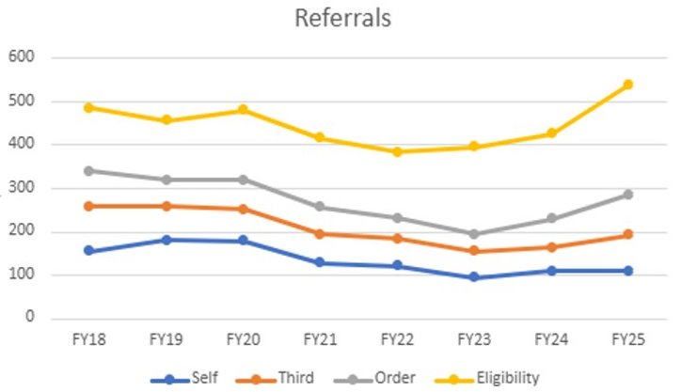

Slide 7
At a Glance: 4 Years Total Referrals
Fiscal Year4 Referral Source6 | FY22 | FY23 | FY24 | FY25 | Referrals increased over the past four fiscal years. The greatest increase was among board order referrals. Third party referrals went back up after a drop in FY24. This can be attributed to outreach efforts the HPSP team.
Board Voluntary | 151 | 200 | 200 | 255
Board Discipline | 48 | 40 | 65 | 98
Self | 121 | 92 | 113 | 110
Third Party | 62 | 60 | 54 | 79
Sum | 382 | 392 | 432 | 542

Slide 8
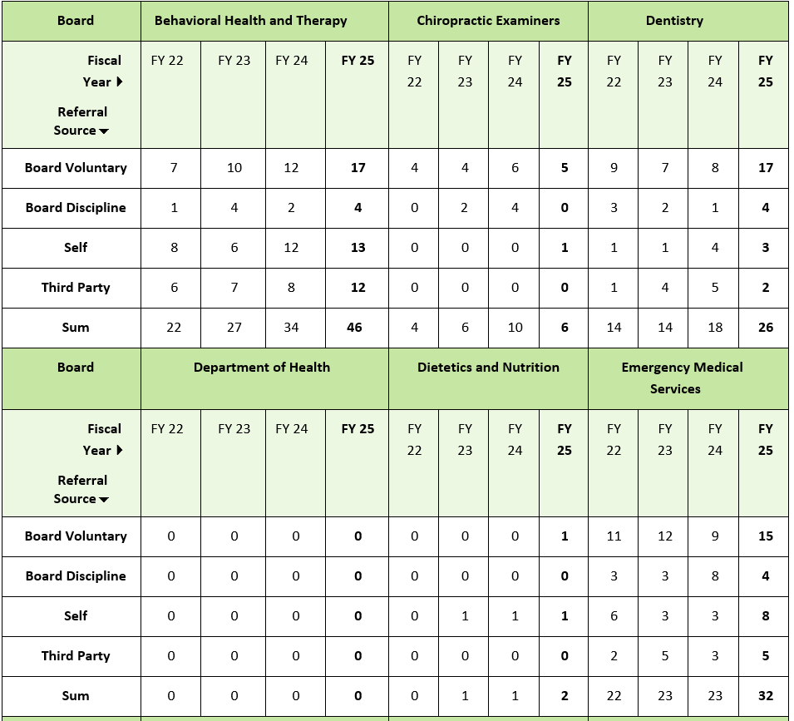
Referrals by Board

Slide 9
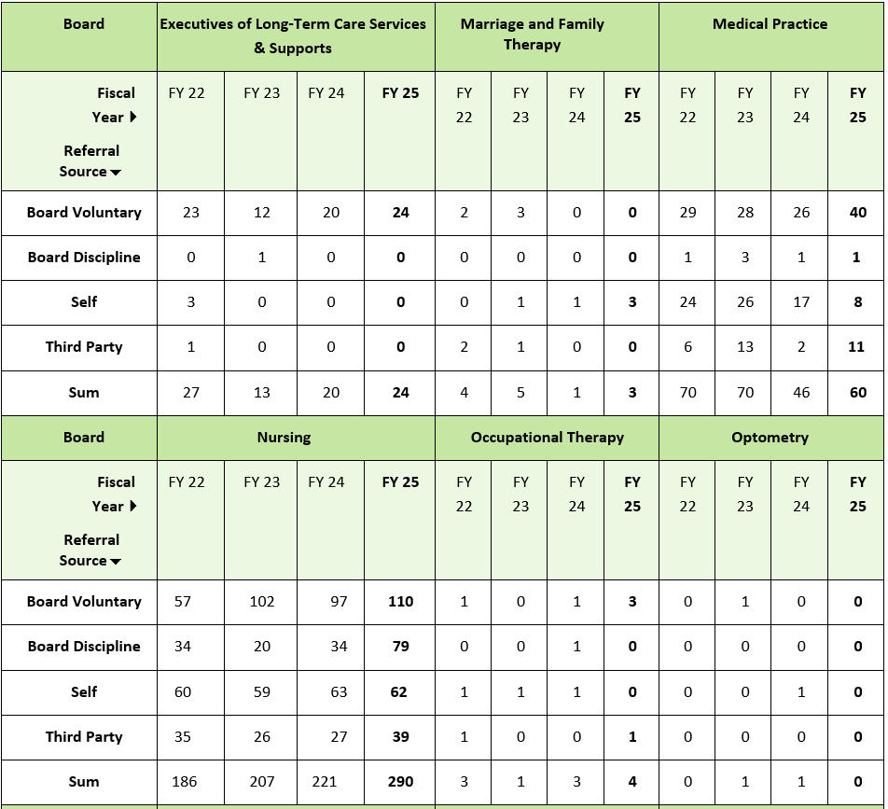
Referrals by Board

Slide 10
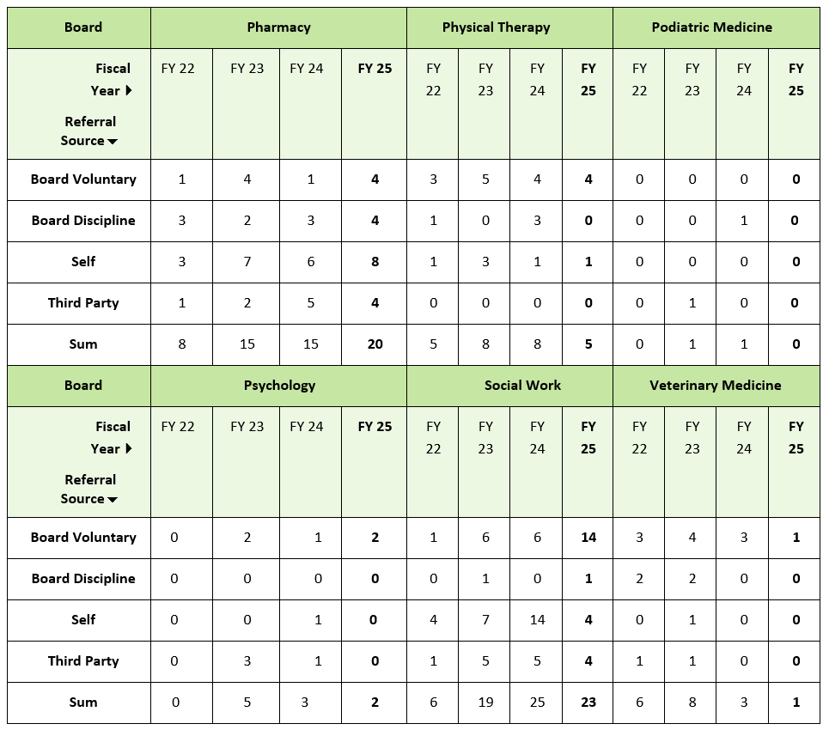
Referrals by Board

Slide 11
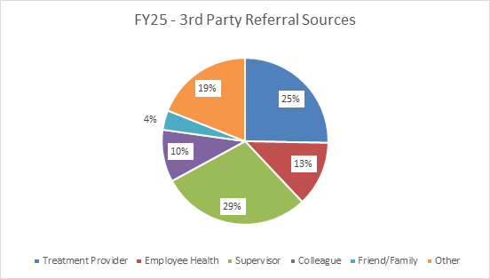
Third-Party Referrals
79 Individuals referred
25% referred by Treating Provider
52% work-related referrals
Supervisor (29%)
Employee Health (13%)
Colleague (10%)
23% Family/Friend or Undisclosed

Slide 12
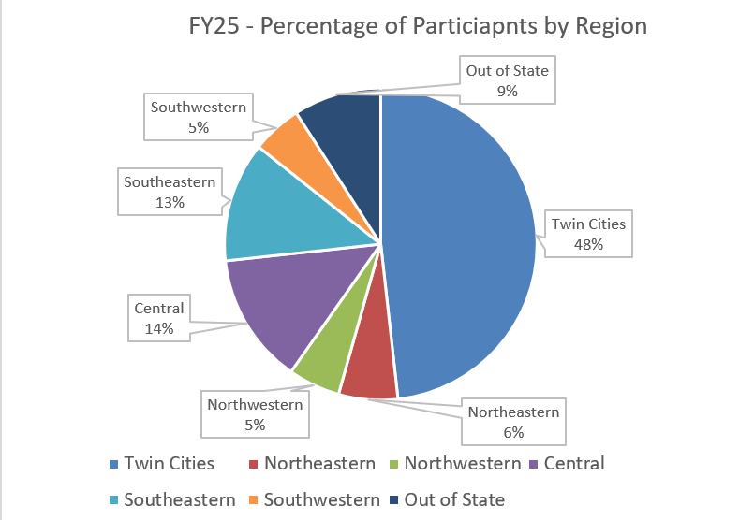
Additional Referral Information
Key Takeaways
Geography
110 total more referrals than FY24
10/18 Increased Referrals
1/18 Same # Referrals
7/18 Decreased Referrals
3/18 Zero Referrals
Approximately 49 participant reports addresses outside of Minnesota (~double FY24)

Slide 13

Participant Agreements

Slide 14
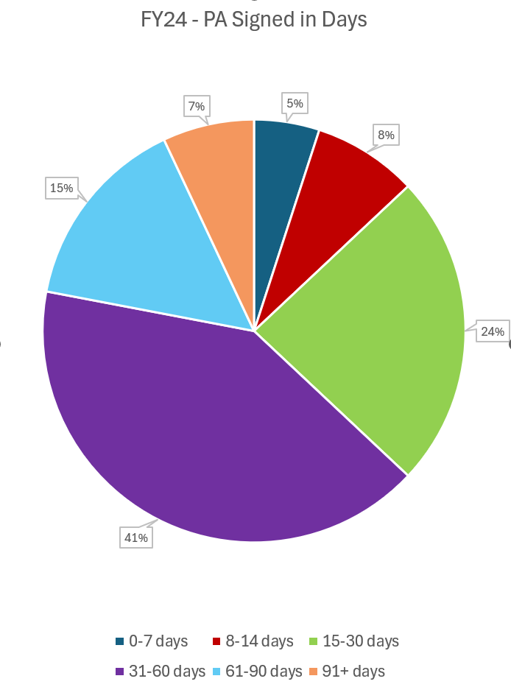
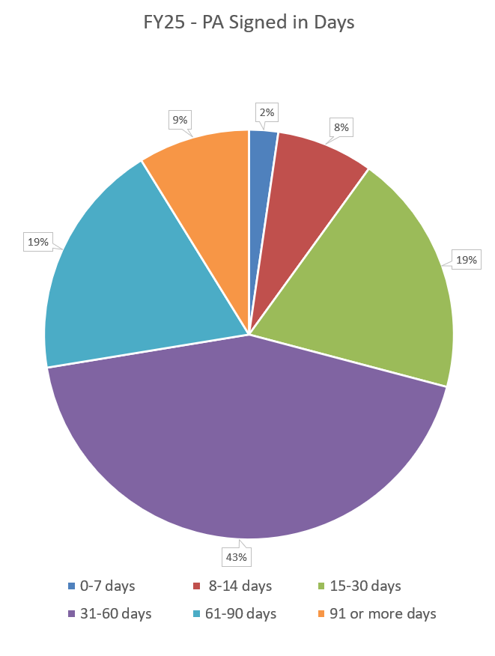
Signed Participation Agreements
FISCAL YEAR 2024
FISCAL YEAR 2025
Average days for signature of a PA = 41
Slight increase in days to signed PA
72% Signed within 60 days
Average 23 PAs signed per month

Slide 15
Enrollment/Participation
Board | Number Regulated | Number Active in HPSP | Number Active in HPSP per 1,000 Regulated
Nursing | 165,642 | 317 | 1.9
Medical Practice | 40,251 | 73 | 1.8
Office of EMS | 30,685 | 21 | .7
Pharmacy | 20,902 | 26 | 1.2
Dentistry | 18,029 | 22 | 1.2
Social Work | 17,899 | 25 | 1.4

Slide 16
Enrollment/Participation
Board | Number Regulated | Number Active in HPSP | Number Active in HPSP per 1,000 Regulated
Behavioral Health & Therapy | 9,824 | 52 | 5.3
Physical Therapy | 8,258 | 6 | .7
Occupational Therapy | 5,945 | 2 | .3
Psychology | 4,327 | 1 | .2
Marriage & Family Therapy | 3,571 | 6 | 1.7
Veterinary Medicine | 3,393 | 2 | .6

Slide 17
Enrollment/Participation
Board | Number Regulated | Number Active in HPSP | Number Active in HPSP per 1,000 Regulated
Chiropractic Examiners | 3,267 | 4 | 1.2
BELTSS (Administrative Long-Term Services and Supports) | 3,105 | 11 | 3.5
Dietetics/Nutrition Practice | 2,200 | 2 | .9
Optometry | 1,255 | 2 | 1.6
Podiatric | 603 | 0 | 0
Department of Health |  | 0 | 0

Slide 18

WHAT IS HPSP MONITORING?
Medical
Mental Health
Substance Use

Slide 19
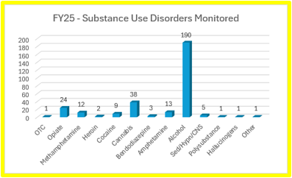
Substance Use Disorders
Use mild, moderate, and severe markers
Continue to work and remove abuse and dependence language

Slide 20
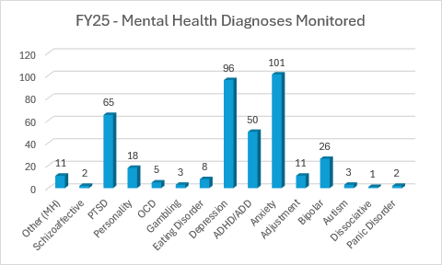
Mental Health Diagnoses

Slide 21
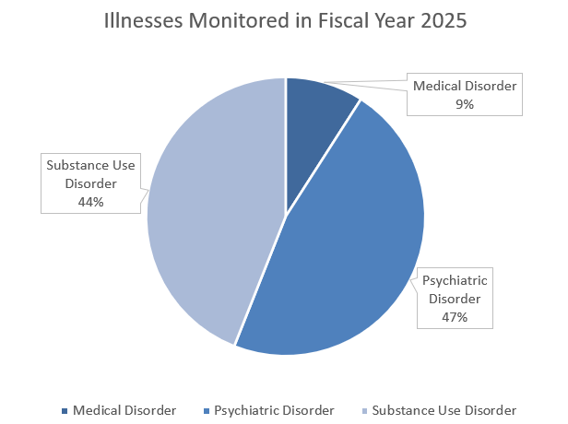
Additional Illness Data
More Mental Health Conditions diagnosed then Substance Use
Increase in Medical Conditions
Chronic Pain
Diabetes
Migraines
Pulmonary
Cardiac
Neurology

Slide 22

Discharges

Slide 23
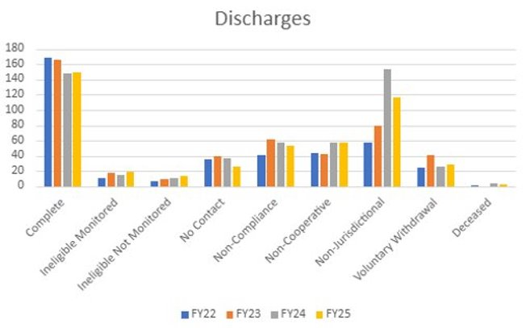
Total Discharges

Slide 24
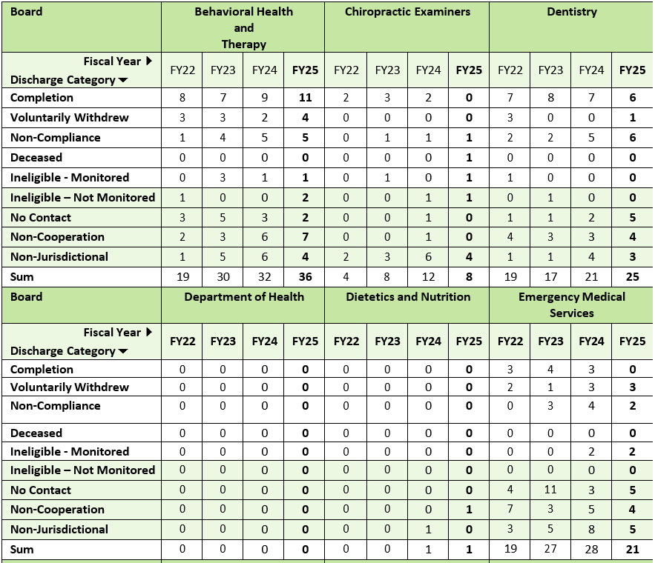
Discharges by Board

Slide 25
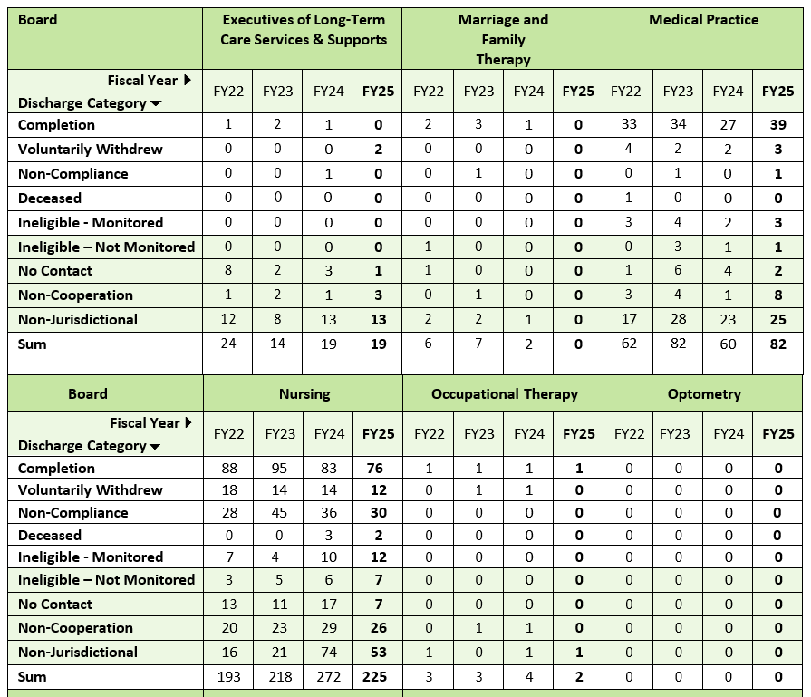
Discharges by Board

Slide 26
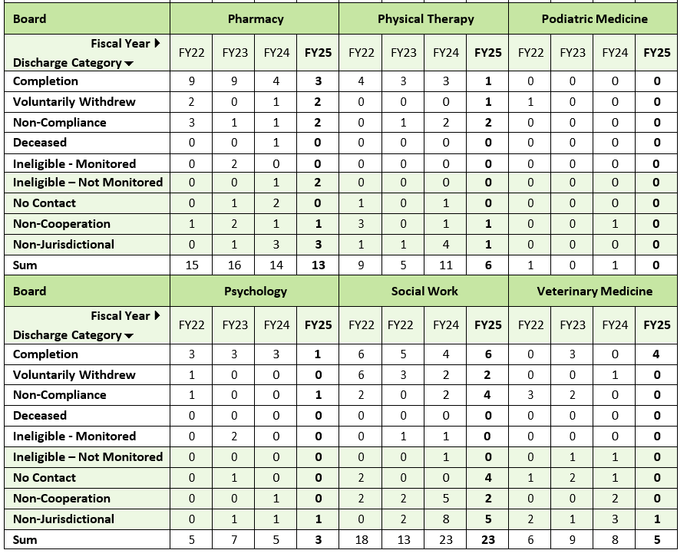
Discharges by Board

Slide 27
Discharges – Key Takeaways
470 total Discharges – 43 less than FY24
3/18 Increased # Discharges
Non-compliance and no contact – slight decreases
Deceased participant – unknown causes
20% Non-Jurisdictional (10% decrease from FY24)
60% Completion Rate (4% decrease from FY24)

Slide 28

Survey Feedback

Slide 29
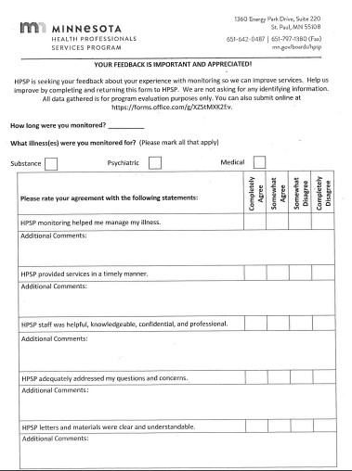
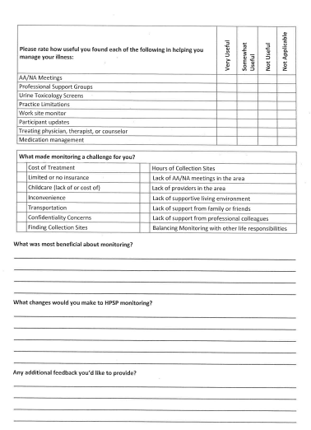
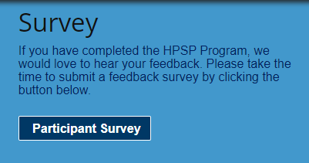
Participant Feedback

Slide 30
Data Review
78% who completed the survey and responded to the question – Would recommend HPSP to licensed professionals
Treating Providers (99%), Professional Support Groups (85%), and Toxicology Screens (85%) were reported as the most helpful to managing illness.
Participants identified the inconvenience as the biggest challenge to monitoring, followed by cost of treatment. Other reasons include cost of screening, insurance (limited/no), and balancing with life responsibilities
Only approximately 1% of participants complete or respond to the survey at discharge. This is sent out 95% of the time for all completions (successful/non)

Slide 31
Responses
Working with a program and case manager that was kind and understanding.
Overall HPSP was a blessing in disguise. I would not hesitate to tell others that need help to seek it out.
HPSP is a vital part of recovery for healthcare professionals.
I felt every time I contacted HPSP I was heard and understood. My caseworker was especially professional, but compassionate.
Even though toxicology screens were annoying, I liked them because they keep you honest.

Slide 32

Budget

Slide 33
Board Costs
$1,000/annual fee per Board = $83.33/monthly cost
Each Board pays a % towards HPSP expenditures based on enrollees, participants
71% of FY25 paid by Board of Nursing and Board of Medical Practice
BBHT, Pharmacy, Social Work, and EMS
HPSP Expenditures Total FY 25 = $1,186,969.39
Salary 87% (Increase 12% - contract raises, step increases)
Rent 4.5%
MNIT/ALIMS 5%
Staff Development 2%
Outreach <1%

Slide 34


Slide 35
Fiscal Year 2026 July 1, 2025-November 1, 2025
Referrals = 183
Discharges = 189
Total cases = 565
Enrollment Cases = 87
Participation Agreement = 478
October Referrals = 39

Slide 36
Goals Fiscal Year 2026
HPSP Team
Participants
Program
Staff Development
Conferences
Trainings/Education
Biannual Workshops
Caseload management
Transparency
Consistency
Portal access
Improve enrollment timeline
Increase self-referrals
Collection Site accessibility
Education on wellness
Committee Engagement
Annual Reviews of guidelines, paperwork, workflows
Financially responsible

Slide 37
QUESTIONS?

