Slide 1
Personnel Data Webinar 3: Complaints and Discipline Data
October 9, 2025

Slide 2
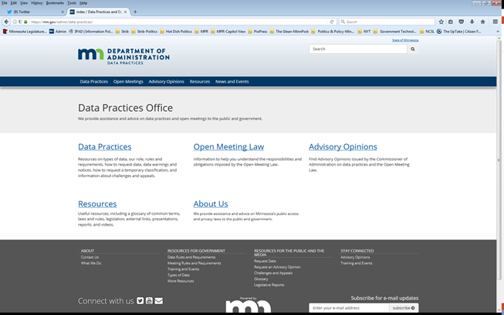
We are a statewide resource
Data Practices Office
Informal advice/technical assistance on data practices and the Open Meeting Law
Commissioner of Administration advisory opinions
Website and informational materials: https://mn.gov/admin/data-practices/
Listserv and newsletters
Legislative assistance
Training
Notes:
As many of you know, the Data Practices office is a resource for government and members of the public on data practices and the open meeting law. Most of what we do is answer questions about both of these laws. We also provide training on different DP and OML topics, and we are also offering short webinars on various topics.
We record our webinars and post them to the Data Practices Office YouTube page. So if you missed the first two parts of this series or would like to re-watch parts 1 and 2, you can find them on the DPO YouTube channel.
If you would also like to download a copy of today’s PowerPoint, I am sharing a file of the PowerPoint right now for you to download or save to your computer. [File Transfer] I will also do this later in the webinar for those of you who join later or miss it this time around. A pop up window will appear and then you can choose to download and save to your device.

Slide 3

Today’s agenda
11:00:
Complaint and discipline data
Employees
Public Officials
Settlement agreements
11:35: Q&A
11:45: end

Slide 4
Existence and status of a complaint or charge
The following personnel data are public:
The existence and status of any complaints or charges against the employee, regardless of whether the complaint or charge resulted in a disciplinary action.
Section 13.43, subd. 2(a)(4)
Notes:
Public presumption reminder
Reversal
Public list in subd. 2
13.43, subd. 2(a)(4) states that the existence and status of any complaints or charges against a public employee are always public, regardless of discipline.

Slide 5
What is a complaint or charge?
Not defined in C. 13
Entity discretion
Look to laws, policies, PDs around employee conduct
Generally, a complaint or charge is something that results in an investigation
What is an investigation?
Largely within the discretion of the entity
E.g., Conversation with the employee or formal review and interviews with witnesses

Slide 6
Existence and status – what can I say?
During an investigation, entity can say the complaint or charge:
Exists
Does not exist
If a complaint/charge exists, entity can say this about status:
Complaint received
Pending
Under investigation
Resolved/complete/closed
Revealing “with or without pay” status may be disciplinary
Advisory Opinion 04-047

Slide 7
Navarre v. South Washington County Schools 652 N.W.2d 9 (Minn. 2002)
Complaints by parents, students, co-workers about a teacher
School officials sent letters to parents, made statements in the media, while the complaints were pending.
Court: statements describing the “quality or characteristic,” “nature and character,” or the “severity” of a complaint prior to final disposition of disciplinary action goes beyond existence and status.

Slide 8
Navarre (2)
Prior to final disposition of discipline:
Letter to parents saying teacher was on “medical leave”
OK because the reasons for medical leave are private but the fact of the leave is not. (Section 13.43, subd. 2(a)(8))
Complaints were “numerous and sometimes alarming”
“Numerous” is fine, because the plain language says “complaints or charges” plural
“Sometimes alarming” not OK, because it is a quality or characteristic
“The allegations I heard were that the kids weren’t learning.”
Beyond existence and status. Even if oral statement, based on private personnel data

Slide 9
Navarre (3)
Prior to final disposition of discipline:
Statement that the school received complaints “from parents and students”
OK – public as complainants were described in a general manner. (Citing Demers v. City of Minneapolis, 468 N.W.2d 71 (Minn. 1991)
“This spring the concerns shifted from concern about student performance to concern about the teacher’s teaching methods. These concerns were investigated… and the investigation continues.”
First sentence beyond existence and status. Second = status.

Slide 10
During an investigation
Existence and status are always public
While the complaint is pending, all other related data are private (13.43, subd. 4)
Reminder: 13.43 does not contain a confidential classification – employee has access rights while investigation is pending
BUT what about civil investigative data?

Slide 11
Civil investigative data Minn. Stat. §13.39
Data that collected as part of an active investigation for the commencement or defense or retained in anticipation of a pending civil legal action
Requires a “pending civil legal action”
Chief attorney acting for the government entity determines
Including but not limited to judicial, administrative or arbitration proceedings
Confidential/protected non-public until inactive

Slide 12
Disciplinary data Non-public official employees
If no discipline following an investigation
No additional data become public, all related data remain private
Existence and status are public
If there is a final disposition of disciplinary action
Disciplinary action
The specific reasons for the action AND
Data that document the basis of the action are public
Data that are not relied on to discipline are private (AO 17-009)
Identities of entity employee witnesses are private

Slide 13
Final disposition – No CBA
For employees who are not subject to collective bargaining agreement, final disposition when:
Government entity makes its final decision about discipline regardless of later proceedings
Includes resignation if after final decision
Final decision depends on an entity’s decision-making process
Advisory Opinion 95-027

Slide 14
Final disposition - CBA
Final disposition for employees subject to collective bargaining agreements
Conclusion of arbitration proceedings OR
Failure of employee to elect arbitration
See Advisory Opinion 10-002
Disciplinary action data are private if:
Arbitrator sustains grievance, and
Reverses all aspects of discipline

Slide 15

Q1
Q. School District informs Crunch, who is not a public official or subject to a CBA of a complaint against him and that the District is beginning an investigation. Crunch quits immediately.
Are any data public?

Slide 16
A1
A. Only existence and status.

Slide 17

Q2
Q. Nordy is a City employee not subject to a CBA. A complaint alleges that Nordy is insubordinate and violated the City’s respectful workplace policy.
Based on the investigative report, the City suspends him for 3 days (a form of discipline) Nordy for insubordination. He did not violate the respectful workplace policy, for which he receives coaching.
Are any data public?

Slide 18
A2
Existence, status, the final disposition of disciplinary action, the specific reasons, and data documenting the basis of the action are public.
BUT
Only for the data that support the finding that Nordy was insubordinate. If coaching is not disciplinary, the data about the respectful workplace part of the complaint and investigation are private.
See Advisory Opinion 17-009

Slide 19

Q3
Q. T.C. Bear is subject to a collective bargaining agreement and elects to grieve his termination. Before the arbitrator issues her opinion, TC settles with his state agency employer. He agrees to accept a suspension (discipline) and returns to work.
Are any data public?

Slide 20
A3
Public data include:
Existence and status
Discipline
Data documenting the basis
Specific reasons for the suspension (redacted investigative report)
The settlement agreement
References to the termination are private.

Slide 21
Public Official Complaint Data Section 13.43, subd. 2(e) and (f)

Slide 22
Public officials – state agencies
Heads of state agencies and their deputies and assistants
Members of boards or commissions the governor must appoint or other elective officers
Executive or administrative heads of departments, bureaus, divisions, or institutions

Slide 23
Public officials – local government
Political subdivisions
Chief administrative officer, or equivalent
Three highest-paid employees in city or county with population over 15,000
Managers, chiefs, heads, or directors in cities and counties
School districts
Business managers, HR directors, ADs (50% of time in administration, supervision, etc.), chief financial officers, directors, superintendents, and principals

Slide 24
Public official complaints/discipline
All data related to a complaint or charge are public (except private data on other employees)…
State agencies
Upon completion of an investigation, or
If public official resigns or is terminated while complaint or charge is pending

Slide 25
Public official complaints/discipline, cont.
All data related to a complaint or charge are public…
Local government
If complaint or charge results in discipline, or
If public official resigns or is terminated while complaint or charge is pending
Employee releases entity from liability for any legal claims arising out of the conduct that is the subject of the complaint as part of a settlement agreement
Advisory opinions 25-003

Slide 26
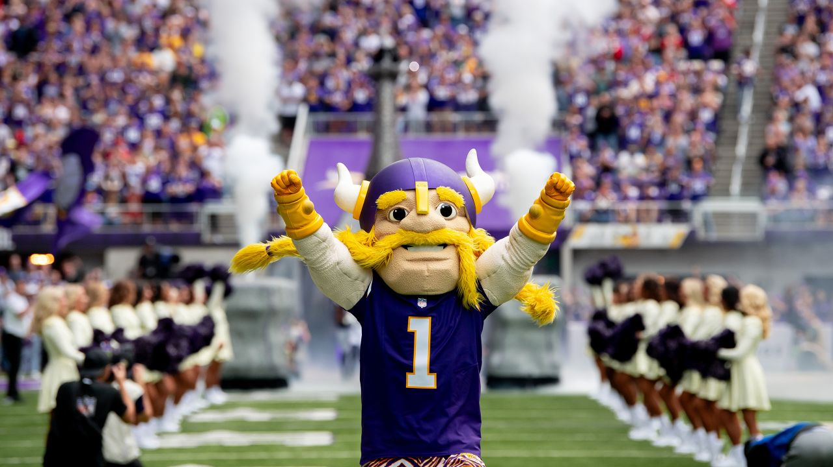
Q4
Q. Viktor the Viking is the deputy commissioner of the Minnesota Department of Sports. The Agency receives a complaint about Viktor and starts an investigation.
What is public after the investigation?

Slide 27
A4
Viktor is a state-level public official. Once the investigation is finished, all data related to the complaint become public except for data that identify employees or if it will interfere with an active investigation.
13.43, subd. 2(e)

Slide 28
Settlement agreements (all employees) Section 13.43, subds. 2(a)(6) and 10

Slide 29
Settlement agreements
The complete terms of an agreement settling a dispute arising out of the employment relationship are public.
Specific reasons must be included for a settlement agreement if payment is more than $10,000
Advisory Opinions 12-006, 97-017

Slide 30
Settlement agreements, cont.
Government entities cannot enter into settlement agreements to limit access to or disclosure of personnel data
This includes:
Agreement not to discuss, comment on data
Agreement limiting data subject’s release of their own data
Except:
Agreements may limit an employee from releasing private data that identify other employees

Slide 31

Q5
Q. Prowl emailed a complaint against a County employee to their supervisor two months ago and it did not result in discipline. She makes a data request for data about the complaint.
What should Prowl receive?

Slide 32
A5
Prowl can have existence and status of the complaint. She can also have her own complaint email.
13.43, subd. 2(d):
A complainant has access to a statement provided by the complainant to a government entity in connection with a complaint or charge against an employee.

Slide 33
Data about complainants
Complainant Identity
Advisory Opinion 06-010
“The names and address of the complainants are data about the complainants”
Demers v. City of Minneapolis, 468 N.W.2d 71 (Minn. 1991)
The identities of complainants who are members of the public are presumptively public
The identities of complainants who are public employees, their identities are private.
Complainant access to their own “statement”

Slide 34
Send us your questions
Type your questions in the Q&A Panel
If we don’t get to your question, we will follow up afterwards
Slides are available: https://mn.gov/admin/data-practices/news/events/webinars/
A recording of this webinar will be available at: https://www.youtube.com/user/INFOIPAD
Please fill out the evaluation in the Polling Panel

Slide 35
Stay in touch!
Phone: 651-296-6733
Email: info.dpo@state.mn.us
Website: mn.gov/admin/data-practices
YouTube: https://www.youtube.com/user/INFOIPAD

