Slide 1
Personnel Data Webinar 2: Sharing Personnel Data
September 18, 2025

Slide 2
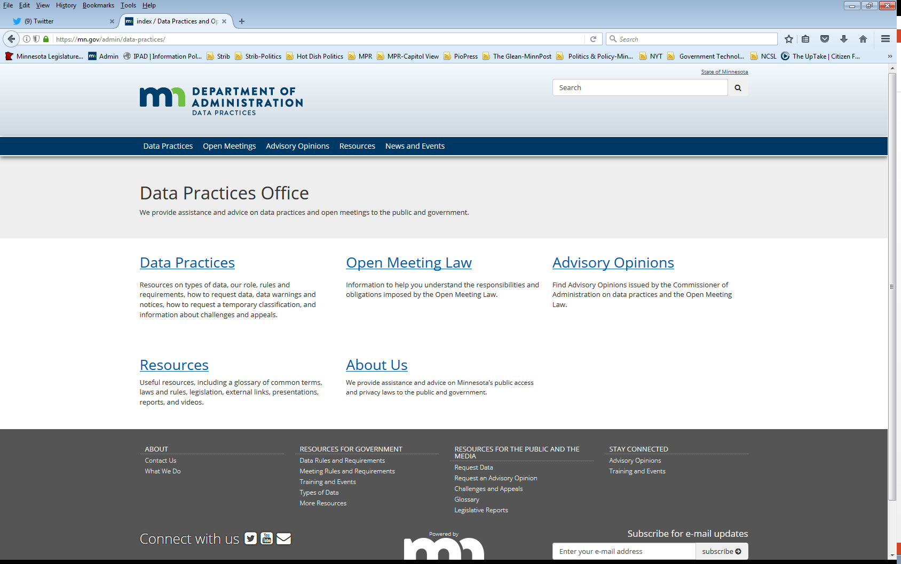
We are a statewide resource
Data Practices Office
Informal advice/technical assistance
Commissioner of Administration advisory opinions
Website and info pages: https://mn.gov/admin/data-practices/
Listserv and newsletters
Legislative assistance
Training

Slide 3
Today’s Agenda
11:00 a.m.- Sharing Personnel Data
11:35 a.m. - Q&A
11:45 a.m. - End

Slide 4
Today’s Topics
Sharing Personnel Data
Tennessen Warnings
Informed Consent
SSN Collection
Unions
Law Enforcement

Slide 5
Sharing Personnel Data – Basics (Minn. Rule 1205.0400)
Public data is available to anyone, for any reason
Not public data is only available
Within entity with work assignment
Statutory authority
Private data shared with informed consent
. . . but sharing is still limited by your own Tennessen Warnings

Slide 6
Tennessen Warning Notice (Minn. Stat. §13.04, subd. 2)
When collecting private or confidential data from an individual about that individual:
State the purpose and intended use of data
Inform the individual whether s/he may refuse or is legally required to provide the data
Explain known consequences of supplying or refusing to supply the data
Identify other persons or entities with statutory authority to access the data
Examples: SSN, employee home address

Slide 7
Example #1
The City of Medium Lake asks Luis, an employee, to provide his home phone number.
Q: Does the City need to provide Luis a Tennessen Warning?
A:

Slide 8
Example #1 - Answer
The City of Medium Lake asks Luis, an employee, to provide his home phone number.
Q: Does the City need to provide Luis a Tennessen Warning?
A: Yes, the City must provide a Tennessen Warning because it is collecting private data about Luis.

Slide 9
Example #2
The City of Medium Lake asks Luis for information on what honors and awards he has received.
Q: Does the City need to provide Luis a Tennessen Warning?
A:

Slide 10
Example #2 - Answer
The City of Medium Lake asks Luis for information on what honors and awards he has received.
Q: Does the City need to provide Luis a Tennessen Warning?
A: No. Honors and awards are public data under 13.43 subd. 2(a)(7), so a Tennessen Warning is not needed when collecting this data.

Slide 11
Example #3
Now that the City HR has Luis’s number, they would like to share it with Luis’s supervisor in case she needs to contact him outside of business hours.
Q: Can the City share Luis’s number with his supervisor?

Slide 12
Example #3 - Answer
Now that the City HR has Luis’s number, they would like to share it internally to Luis’s supervisor in case she needs to contact him outside of business hours
Q: Can the City share Luis’s number with his supervisor?
A: Maybe!
Is there a work assignment to access the data?
What does the Tennessen Warning say?

Slide 13
Limitations on Collection and Use of Data
Private or confidential data on an individual shall not be collected, stored, used, or disseminated by government entities for any purposes other than those stated to the individual at the time of collection in accordance with section 13.04…
Minn. Stat. §13.05, subd. 4

Slide 14
Limitations on Collection and Use of Data (Minn. Stat. §13.05, subd. 4)
Exceptions to limitations on collection and use:
Collected prior to Aug. 1, 1975, not treated as public, approved as necessary to public health, safety, or welfare
Authorized by a new law
New or different use/sharing approved by Commissioner as necessary to carry out function assigned by law
Informed consent
Notes:
The final exception is to obtain informed consent. Let’s talk more about this one right now --

Slide 15
Informed Consent Minn. Stat. §13.05, subd. 4 & Minn. R. 1205.1400
Permission for a new use or release of private government data
Informed consent is necessary when:
The individual asks the entity to release private data to another entity or person
The entity wants to release private data to another entity or person
The data subject received a Tennessen warning notice and the entity now wants to use or release the data in a different way
Informed consent must be in writing and cannot be coerced

Slide 16
Social Security Numbers Federal Privacy Act of 1974, 5 U.S.C. 522a note, Minn. Stat. §13.355
State and federal notification requirements when collecting
Only collect when necessary
Federal law requires SSN collection for certain applications or services
Without federal authority, individuals may choose not to give their full SSN
When not required by federal law, government entities are limited by Minn. Stat. §13.05, subd. 3
Private classification in § 13.3555

Slide 17

Statutory Sharing of Personnel Data

Slide 18

Sharing with Unions Minn. Stat. §13.43, subd. 6
Entity must share data regardless of classification to:
Conduct elections
Investigative and process grievances
Implement Chapters 179 and 179A
Does not include social security numbers

Slide 19
Sharing with Unions, Cont. Minn. Stat. §13.43, subd. 6
Entity must data share with labor organizations, the Public Employment Relations Board, and BMS per BMS or PERB order
Union is not subject to liability under Minn. Stat. §13.08, but remedies under 325E.61 may apply

Slide 20
Sharing with Law Enforcement Minn. Stat. §13.43, subds. 11, 15
Entity may share personnel data with law enforcement:
To protect an employee from self harm (subd. 11)
To protect another person from harm by an employee (subd. 11)
Background investigative data shared with POST Board and law enforcement (subd. 12)
To report a crime or alleged crime committed by an employee (subd. 15)
To assist law enforcement in investigation of a crime committed or allegedly committed by an Employee (subd. 15)

Slide 21
Miscellaneous sharing provisions Minn. Stat. § 13.43
Private personnel data
Must be shared with DEED for unemployment benefits (subd. 13)
Must be provided by schools to MDE on employee perpetrators of student maltreatment (subd. 14)
Must be shared between schools about employees who commit certain acts toward students (subd. 16)
May be used/shared for continuity of operations purposes. (subd. 17)
Must be disclosed to the Dept of Admin for workers’ compensation. (subd. 18)

Slide 22
Traveling Data Minn. Stat. §13.03, subd. 4
When government shares data with another government entity, the data either:
Maintain the same classification at the entity receiving the data as the entity providing the data, or
If the receiving entity has its own classification for the data, the classification shall change to the applicable classification at the receiving entity
Traveling data webinar on DPO’s YouTube page

Slide 23
Advisory Opinion 19-011
Example of traveling personnel data to a law enforcement agency
Private personnel data at the school district
“Traveled” to the City Police Department as part of a law enforcement investigation
Data retained private personnel classification at the school district, but changed classifications at the City PD, as 13.82 classified the data at the receiving entity

Slide 24
Questions?
Phone | 651-296-6733
Email | info.dpo@state.mn.us
Website | https://mn.gov/admin/data-practices/
YouTube | https://www.youtube.com/user/INFOIPAD
Newsletter | https://mn.gov/admin/data-practices/news/newsletters/

