Slide 1
Personnel Data Webinar 1: Section 13.43 Basics
September 4, 2025

Slide 2
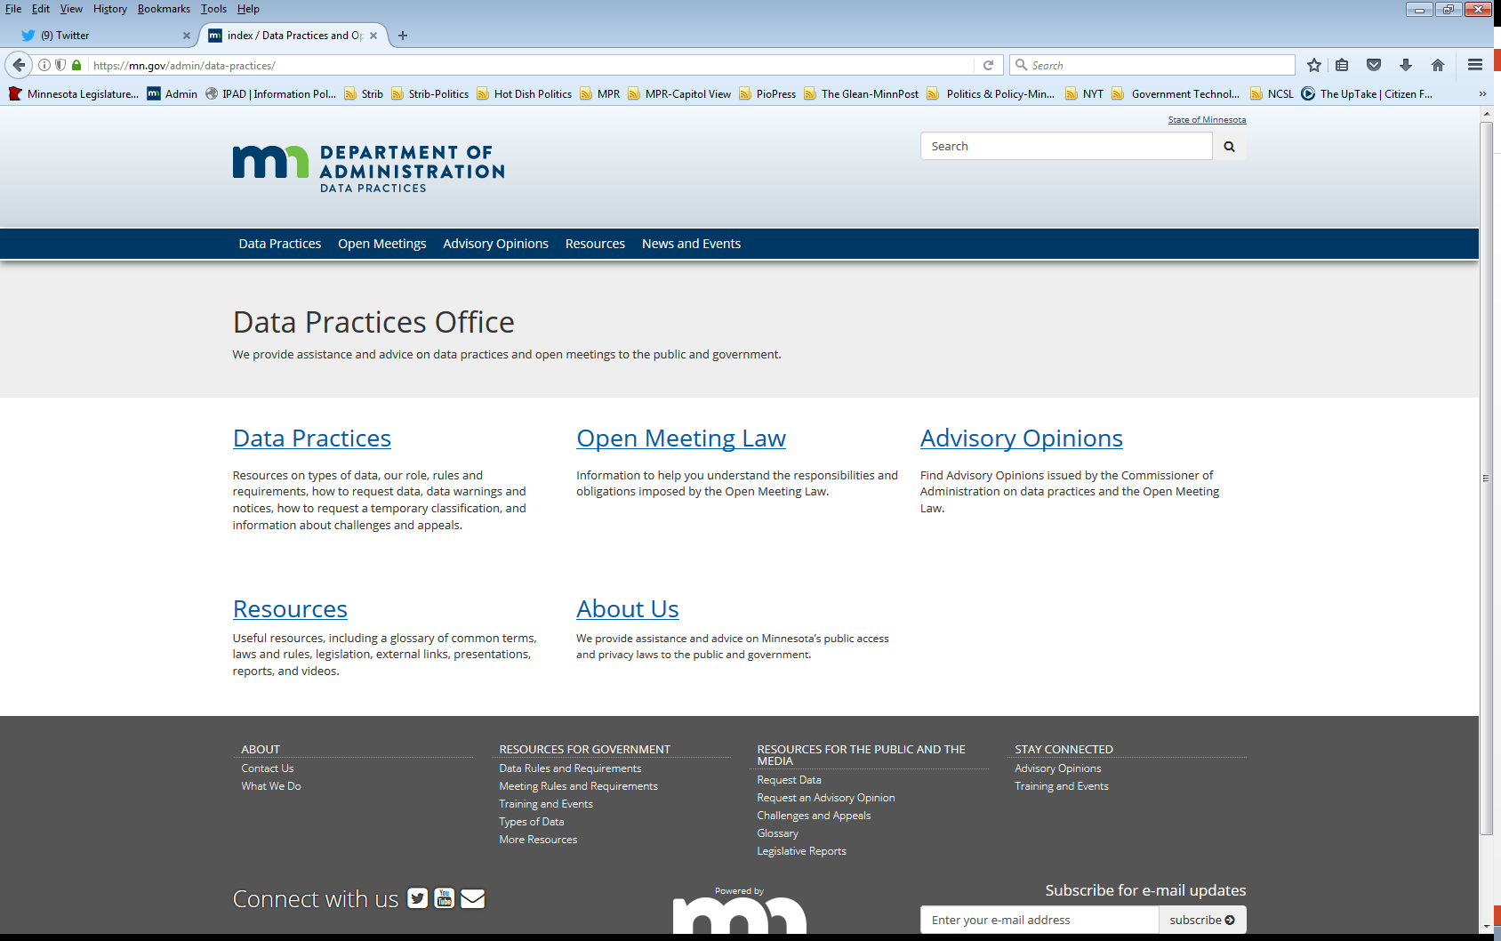
We are a statewide resource
Data Practices Office
Informal advice/technical assistance
Commissioner of Administration advisory opinions
Website and info pages: https://mn.gov/admin/data-practices/
Listserv and newsletters
Legislative assistance
Training

Slide 3
Today’s agenda
11:00 a.m.- Overview of Personnel Data and Section 13.43
11:35 a.m. - Q&A
11:45 a.m. - End

Slide 4

What we’ll cover today
MN Government Data Practices Act
Definition of personnel data
Application
Public elements
Elected officials

Slide 5
Government data practices
MN Government Data Practices Act, Ch. 13
Presumes government data are public
Classifies data that are not public
Access rights for the public and data subjects
Data on individuals are accurate, complete, current, and secure
Minnesota Rules Chapter 1205
We are currently updating these rules!

Slide 6
Personnel data - definition Section 13.43
Government data on individuals maintained because an individual is or was an employee of a government entity, applicant for employment, volunteer, or independent contractor

Slide 7
Personnel data – government data Section 13.43
Government data on individuals maintained because an individual is or was an employee of a government entity, applicant for employment, volunteer, or independent contractor
Recorded information regardless of form or storage medium

Slide 8
Personnel data – data on individuals Section 13.43
Government data on individuals maintained because an individual is or was an employee of a government entity, applicant for employment, volunteer, or independent contractor
Data about a natural person where that person is the identifiable subject of the data unless name is incidental

Slide 9
Personnel data – who is included Section 13.43
Government data on individuals maintained because an individual is or was an employee of a government entity, applicant for employment, volunteer, or independent contractor

Slide 10
Not everything is personnel data
Employee must be the individual subject of the data
Consider:
Meeting notes
Reports
Correspondence about an official activity
Remember: Personnel data are unique to a specific employee

Slide 11
Personal data
Data on an employee’s personal matters, unrelated to job duties or operation of government.
Government data?
Policy for incidental use
Advisory opinions 01-075, 02-049

Slide 12
Personnel data - classification Section 13.43
Reverses general public presumption (see subdivision 4)
All personnel data are private except data specifically classified as public

Slide 13
Public personnel data
Name; employee ID; actual gross salary; salary range; terms and conditions of employment relationship; contract fees; actual gross pension; the value and nature of employer paid fringe benefits; and the basis for and the amount of any added remuneration, including expense reimbursement

Slide 14
Public personnel data (cont.)
Job title and bargaining unit; job description; education and training background; and previous work experience
Date of first and last employment
Existence and status of any complaints or charges against the employee, regardless of whether the complaint or charge resulted in a disciplinary action

Slide 15
Public personnel data (cont. part 2)
Final disposition of any disciplinary action together with the specific reasons for the action and data documenting the basis of the action
Complete terms of any agreement settling any dispute arising out of an employment relationship, including a buyout agreement; except that the agreement must include specific reasons for the agreement if it involves the payment of more than $10,000 of public money

Slide 16
Public personnel data (cont. part 3)
Work location; a work telephone number; badge number; work-related continuing education; and honors and awards received
Payroll time sheets or other comparable data that are only used to account for employee's work time for payroll purposes, except to the extent that release of time sheet data would reveal the employee's reasons for the use of sick or other medical leave or other not public data

Slide 17
Advisory opinions - employees
97-049: Employee work email address is public as part of work location.
04-017: Dollar value of employee’s health insurance benefit is public as “fringe benefit.”
08-029: Added remuneration, outside income unrelated to employment are private personnel data.
13-002: Requester entitled to redacted application and supplement.
21-005: Work-sponsored training that offers continuing education credits and other benefits is “work-related continuing education.”

Slide 18

Public personnel data - applicants
Everything is private except:
Veteran status
Relevant test scores
Rank on eligible list
Job history
Education and training
Work availability
Names are private until a finalist
Finalist = selected for interview by appointing authority

Slide 19
Advisory opinions - applicants
Names/Finalists
06-028 and 10-006: finalists’ names are public when selected, not when accepting interview
00-049 and 00-065: applicants are not “finalists” if selected and interviewed by a group other than the appointing authority
Interview notes
01-028: applicant gets access private data in interviewers notes that are about the applicant, but not data about the government employee interviewer.
Relevant test score
05-035: a quantifiable, objective, as opposed to subjective, score from an evaluation/test that is a requirement of the job for which an individual has applied.

Slide 20
Public personnel data and context
Public elements when paired with private elements can result in public elements that are not accessible.
Advisory Opinions 07-004 and 08-005: Context of request might limit access to names.

Slide 21
Elected officials
Are elected officials employees covered by the personnel data section?
Entity determination
Krout v. City of Greenfield, No. A11-1200, (Minn. Ct. App. April 16, 2012) (unpublished)
Confirms guidance in advisory opinions that entity should decide whether elected officials are employees
If not employees, data are presumptively public
See Minn. Stat. section 13.601

Slide 22
Advisory opinions – elected officials
95-041, 03-011, 02-013, 01-039, and 18-008: Entity makes determination of whether elected officials are employees and subject to section 13.43 protections
10-023, 11-006, and 18-013: Correspondence with elected officials

Slide 23
Send us your questions
Type your questions in the Q&A Panel
If we don’t get to your question, we will follow up afterwards
Slides are available: https://mn.gov/admin/data-practices/news/events/webinars/
A recording of this webinar will be available at: https://www.youtube.com/user/INFOIPAD
Please fill out the evaluation in the Polling Panel

Slide 24
Stay in touch!
Phone: 651-296-6733
Email: info.dpo@state.mn.us
Website: mn.gov/admin/data-practices
YouTube: https://www.youtube.com/user/INFOIPAD

