Slide 1
Thank you for joining our Webinar! We will begin shortly.
If you have any questions during the event, please utilize the Q&A panel to send questions to “all panelists.” We will leave time at the end of the presentation to answer your questions.

Slide 2
Personnel Data Webinar 4: Recap and FAQs
October 16, 2025

Slide 3
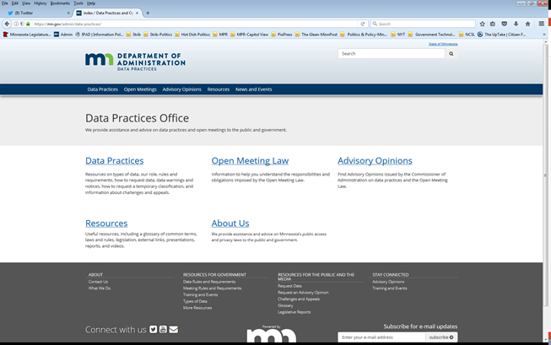
We are a statewide resource
Data Practices Office
Informal advice/technical assistance on data practices and the Open Meeting Law
Commissioner of Administration advisory opinions
Website and informational materials: https://mn.gov/admin/data-practices/
Listserv and newsletters
Legislative assistance
Training

Slide 4

Today’s agenda
Recap of Personnel Data Series
Frequently asked questions DPO receives re: personnel data
Q&A

Slide 5
YouTube Reminder
Parts 1-3 of our Personnel Data Series Webinar series are available on our YouTube page:
https://www.youtube.com/@INFOIPAD
Government Personnel Data Webinar Series Playlist

Slide 6
Personnel Data Series: Webinar #1 Recap
Chapter 13 – public presumption
Minn. Stat. 13.43 (Personnel Data) – reverses public presumption
Public personnel data (subds. 2 & 3)
Personal data versus personnel data
Advisory Opinion 01-075
Elected Officials

Slide 7
Personnel Data Series: Webinar #2 Recap
Sharing Personnel Data
Tennessen Warnings
Informed Consent
SSN Collection
Unions
Law Enforcement
Traveling Data

Slide 8
Personnel Data Series: Webinar #3 Recap
Complaint and discipline data (employees and public officials)
Settlement agreements

Slide 9
Common Personnel Data Questions and Issues
FAQ #1: Can an entity post all upcoming employee resignations and retirements prior to the employees’ last days?

Slide 10
Common Personnel Data Questions and Issues
FAQ #1: Can an entity post all upcoming employee resignations and retirements prior to the employees’ last days?
A: It depends. Data are private. Who are you sharing it with and why?

Slide 11
Common Personnel Data Questions and Issues
FAQ #2: Is leave coded as FMLA or PFML public data?

Slide 12
Common Personnel Data Questions and Issues
FAQ #2: Is leave coded as FMLA or PFML public data?
A: Probably.

Slide 13
Common Personnel Data Questions and Issues
FAQ #3: For employees who work fully or partially remotely from home, is their home address public as work location?

Slide 14
Common Personnel Data Questions and Issues
FAQ #3: For employees who work a hybrid schedule, is their home address public as work location?
A: No.

Slide 15
Common Personnel Data Questions and Issues
FAQ #4: How are personal cell phone numbers of employees classified when employees use their personal cell phones for government work?

Slide 16
Common Personnel Data Questions and Issues
FAQ #4: How are personal cell phone numbers of employees classified when employees use their personal cell phones for government work?
A: Generally, private.

Slide 17
Common Personnel Data Questions and Issues
FAQ #5: Must confidential civil investigative data be provided to the Union under section 13.43, subd. 6?

Slide 18
Common Personnel Data Questions and Issues
FAQ #5: Must confidential civil investigative data be provided to the Union under section 13.43, subd. 6?
A: Yes, to the extent personnel data has been pulled into a civil investigation, that data must be provided.

Slide 19
Common Personnel Data Questions and Issues
FAQ #6: Does the employee who is the subject of the complaint get access to data identifying the complainant and any witnesses?

Slide 20
Common Personnel Data Questions and Issues
FAQ #6: Does the employee who is the subject of the complaint get access to data identifying the complainant and any witnesses?
A: It depends if the complainants or witnesses are public employees.

Slide 21
Common Personnel Data Questions and Issues
FAQ #7: After there has been a final disposition of discipline, the employee who was disciplined asks for the file related to the complaint – what data do they get?

Slide 22
Common Personnel Data Questions and Issues
FAQ #7: After there has been a final disposition of discipline, the employee who was disciplined asks for the file related to the complaint – what data do they get?
A: There is no confidential classification for personnel data. The complaint file will likely contain public data and private data. The employee gets access to public data and private data about themselves.

Slide 23
Common Personnel Data Questions and Issues
FAQ #8: Can a government entity disclose whether an employee is on paid or unpaid leave related to complaints against that employee?

Slide 24
Common Personnel Data Questions and Issues
FAQ #8: Can a government entity disclose whether an employee is on paid or unpaid leave related to complaints against that employee?
A: Not while a complaint is pending, or if there has been no discipline.

Slide 25
Send us your questions
Type your questions in the Q&A Panel
If we don’t get to your question, we will follow up afterwards
Slides are available: https://mn.gov/admin/data-practices/news/events/webinars/
A recording of this webinar will be available at: https://www.youtube.com/user/INFOIPAD
Please fill out the evaluation in the Polling Panel

Slide 26
Stay in touch!
Phone: 651-296-6733
Email: info.dpo@state.mn.us
Website: mn.gov/admin/data-practices
YouTube: https://www.youtube.com/user/INFOIPAD

