Slide 1
2023 Legislative Update: Data Practices and Open Meeting Law & Data Practices Potpourri
July 13, 2023

Slide 2
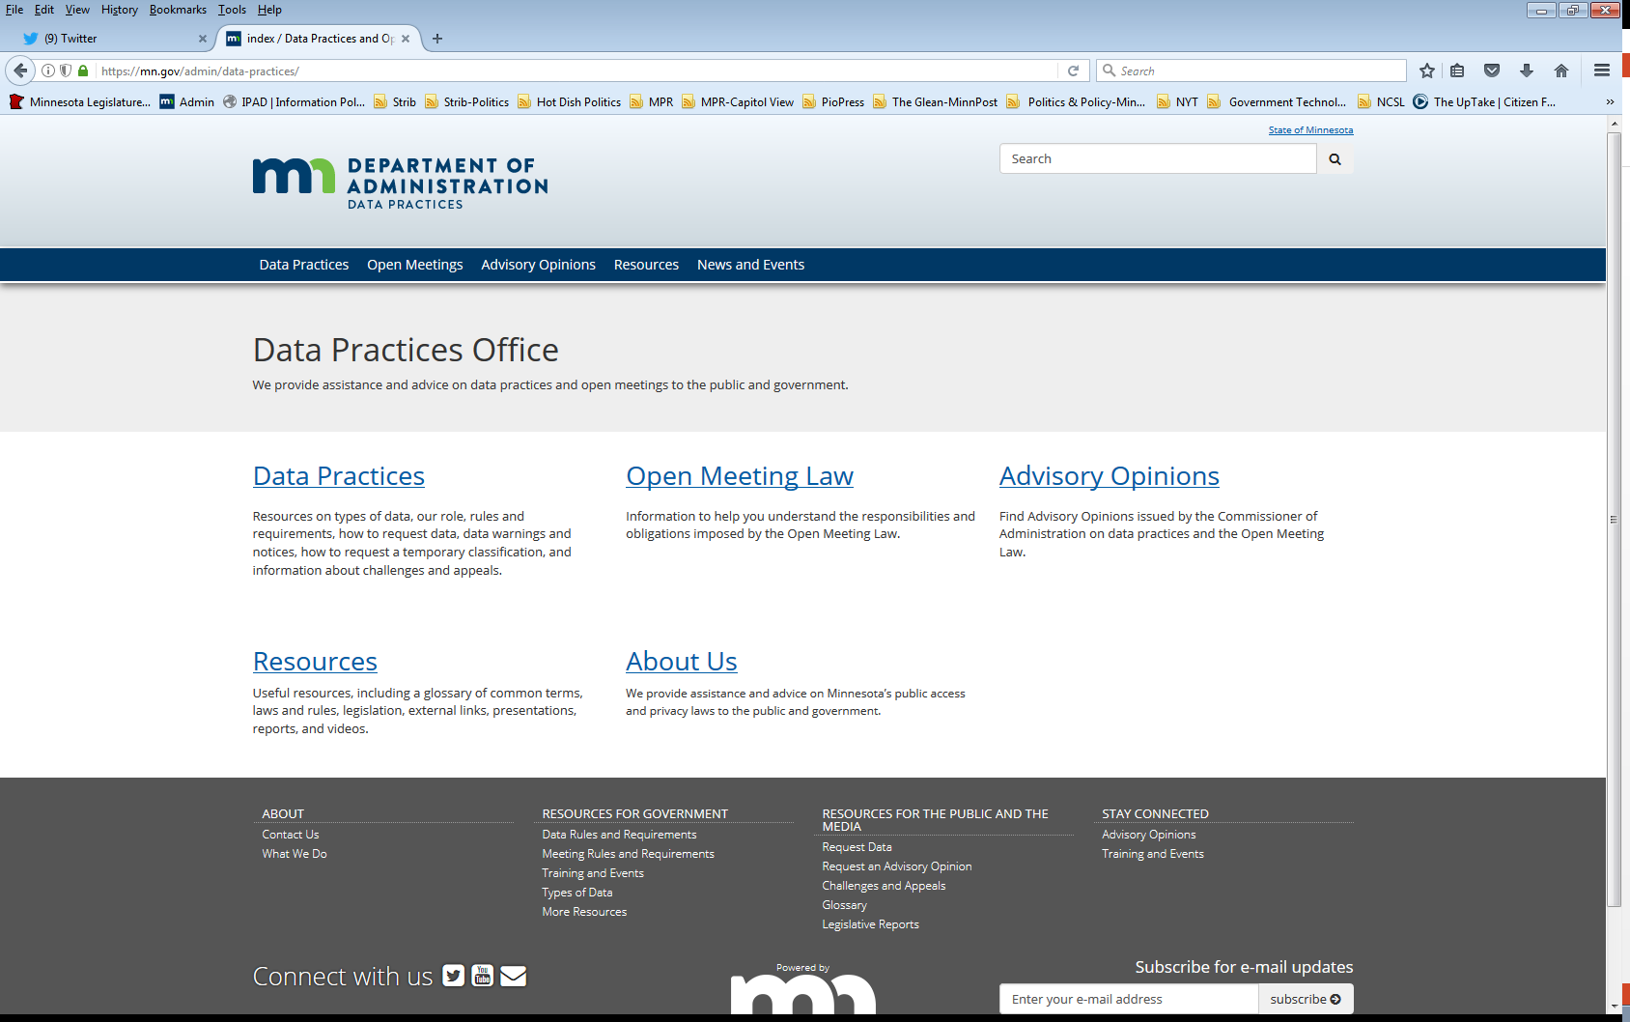
Who we are and what we do
Data Practices Office
Informal advice/technical assistance
Commissioner of Administration advisory opinions
Website and informational materials: https://mn.gov/admin/data-practices/
Listserv and newsletters
Legislative assistance
Training

Slide 3
Today’s agenda – 11am – 11:45am
11:00 a.m. – Legislative Updates
11:20 a.m. – Policy updates
11:25 a.m. – Potpourri
11:35 a.m. – Q&A
11:45 a.m. – End

Slide 4
Legislative Changes to Data Practices & OML
All changes effective July 1, 2023, unless otherwise noted

Slide 5
Personnel data
Minn. Stat. § 13.43, subd. 6
Government entities are authorized to disclose data to the Public Employment Relations Board
Required to disclose data to labor organizations to the extent necessary to conduct elections, investigate and process grievances, and implement Chapters 179 and 179A
Clarifies that specific data elements about employees as well as employee communications with labor organizations are private data

Slide 6
Political subdivision licensing data
Minn. Stat. § 13.204
Data in tax returns and bank account statements that are submitted to a political subdivision for a license are classified as private or nonpublic data
These data must be destroyed within 90 days from final decision on the license application
This requirement is retroactive to data collected before enactment, which must be destroyed within 90 days of May 20, 2023

Slide 7
Educational data
Minn. Stat. § 13.32, subd. 5
Schools are prohibited from designating personal contact information as public directory information
Effective on May 20, 2023, regardless of previous designations
This provision does not apply to post-secondary institutions
Schools must still share private contact information with MDE as required for federal reporting purposes

Slide 8
Educational data (cont.)
Minn. Stat. § 13.32, subd. 3
Schools may disclose student’s private personal contact data to a library for purposes of issuing a library card
Schools may disclose private educational data to tribal nations about tribally-enrolled or descendant students to support educational attainment

Slide 9
Body camera data
Minn. Stat. § 13.825, subds. 2 & 3
Law enforcement agencies must allow family of individual who is killed as a result of an officer’s use of force and their legal representative to inspect body camera data documenting incident within five days of request
Agency may deny access if there’s a compelling reason why inspection would interfere with active investigation
Must provide prompt, written denial and inform that relief may be sought from district court under section 13.82, subd. 7
Agencies must disclose body camera data (with applicable redactions) to the public within 14 days after a deadly use-of-force incident
Agency may withhold access if it asserts disclosure would interfere with active investigation (data then remain confidential)
Body camera data documenting deadly use-of-force incident must be maintained indefinitely

Slide 10
Body camera policies
Minn. Stat. § 626.8473, subd. 3
New provisions must be incorporated into agency’s policy for body worn cameras
Prohibition on altering, erasing, or destroying body camera data or related metadata prior to expiration of applicable retention periods
Body cameras must be worn at or above mid-line of waist in a position to maximize recording
Mandate that officers comply with written policies
Implement compliance with section 13.825’s requirements for next of kin access and public disclosure
POST Board may inspect agencies to ensure compliance with policy requirements and sanction agencies and licensees for failures to comply

Slide 11
Sharing data with POST Board
Minn. Stat. § 626.8457, subd. 4
Chief law enforcement officer, city, county, or other public official must cooperate with Board’s licensing investigations and any data requests
Must provide public and private data about alleged misconduct to Board upon request
May provide confidential data (i.e., active criminal or civil investigative data) when Board specifies data are necessary to conduct investigation
Agencies may withhold data in certain situations

Slide 12
Miscellaneous provisions
Minn. Stat. § 13.72, subd. 19
Transit customer data collected by telephone or via third-party software programs to book and use public transit services are private.
Expungement requirements
Ch. 52, Art. 7 – automatic expungements for certain offenses
Ch. 63, Art. 5 – expungements related to certain cannabis offenses
Minn. Stat. § 626.89, subd. 17
Data collected, created, received, maintained, or disseminated by law enforcement civilian oversight councils are governed under section 13.43

Slide 13
Commissioner of Administration’s authority
Minn. Stat. § 13.04, subd. 4
Entities must inform data subjects of right to appeal challenge determination
Commissioner may dismiss appeal if it is not timely, data was presented as evidence in court, or appellant is not the data subject.
Minn. Stat. § 13.072
$200 fee for OML opinion is removed
Opinions must be issued within 50 days

Slide 14
Open Meeting Law
Minn. Stat. § 13D.02, subd. 1
Local public body members attending meetings remotely from a location that is not publicly accessible for medical reasons is no longer limited only to when there is a Chapter 12 emergency or the 60 days after removal of emergency

Slide 15
Data Practices Requirements Reminders

Slide 16
Update Policies by August 1
Minn. Stat. § 13.025 requires all government entities to create policies about access to public data and the rights of data subjects
These policies must be reviewed and updated by August 1 each year
The policies must be easily accessible to the public
Remember: If you don’t have policies, it’s a violation of the Data Practices Act!

Slide 17
Data Practices Potpourri

Slide 18
Question #1 – Court orders
We received a court order, signed by a judge, directing our agency to disclose public and not public data.
What should we do?

Slide 19
Answer #1 – Court orders
A signed court order may allow your entity to disclose not public data. Here are the steps to respond:
Contact legal counsel
Determine classification
Public data can be disclosed
Determine appropriate response for not public data
Section 13.03, subd. 6 provides process to oppose disclosure
See https://mn.gov/admin/data-practices/data/rules/courts/courtsoverview/

Slide 20
Question #2 – Subpoenas
We received a subpoena, signed by an attorney, directing our agency to disclose public and not public data.
What should we do?

Slide 21
Answer #2 – Subpoenas
Subpoenas do not carry the same legal authority as a court order. Here are the steps to respond:
Contact legal counsel
Determine classification
Public data can be disclosed
Not public data cannot be disclosed
Exception: Some authorized statutory sharing requests may come in the form of an administrative subpoena
Determine appropriate response under applicable rules of procedure
Note: Rules for federal subpoenas or subpoenas for education data may differ. See https://mn.gov/admin/data-practices/data/rules/courts/subpoenas/

Slide 22
Question #3 – Access to private data
Our school district surveyed all employees about ways to improve the district’s administrative structure.
School board members are asking to see the raw data responses, which contain identifying information and are private data under section 13.43, subd. 7a.
Can the school board members access this private data?

Slide 23
Answer #3 – Access to private data
Private data are accessible to “individuals within the entity whose work assignments reasonably require access.” (Minn. Rule 1205.0400, subp. 2; section 13.02, subd. 12). So, consider:
Are elected officials “within the entity”?
Do elected officials have “work assignments [that] reasonably require access”?
If the responsible authority determines the answer is yes to both questions, then elected officials can have access.

Slide 24
Send us your questions
Type your questions in the Q&A Panel
If we don’t get to your question, we will follow up afterwards
Slides are available: https://mn.gov/admin/data-practices/news/events/webinars/
A recording of this webinar will be available at: https://www.youtube.com/user/INFOIPAD
Please fill out the evaluation in the Polling Panel

Slide 25
Stay in touch!
Phone: 651-296-6733
Email: info.dpo@state.mn.us
Website: mn.gov/admin/data-practices
Twitter: @MNgovdata
YouTube: https://www.youtube.com/user/INFOIPAD
Newsletter: https://mn.gov/admin/data-practices/news/newsletters/

