Slide 1
2026 Legislative Update
& Data Practices Potpourri
July 21, 2026

Slide 2
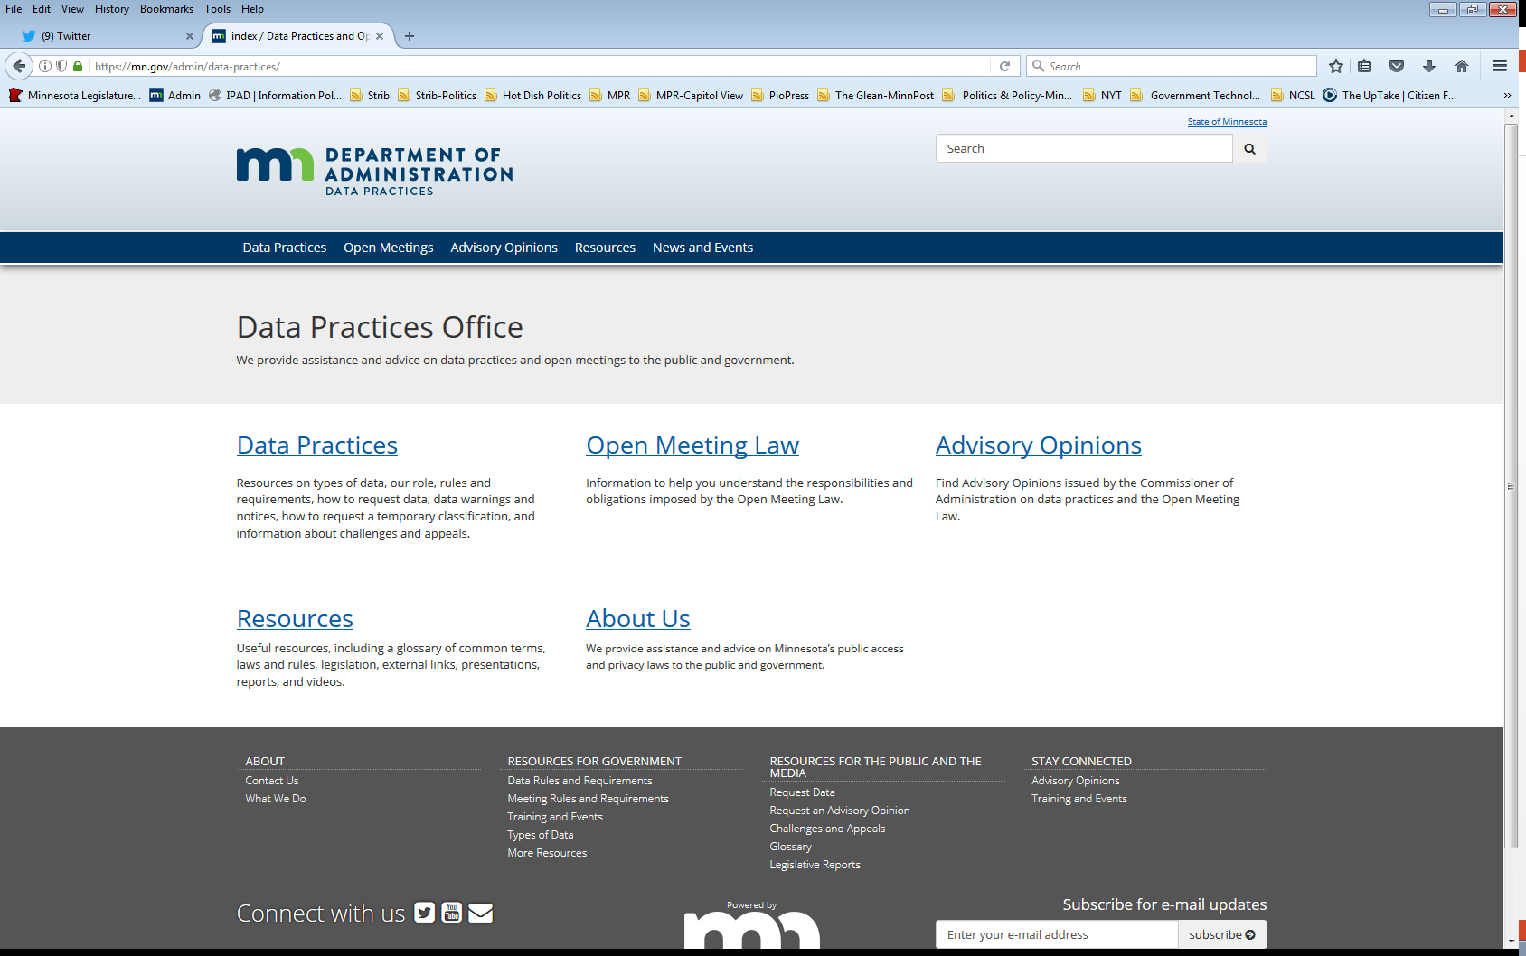
Who we are and what we do
Data Practices Office
  Informal advice/technical assistance
  Commissioner of Administration advisory opinions
  Website and informational materials: https://mn.gov/admin/data-practices/
  Listserv and newsletters
  Legislative assistance
  Training

Slide 3
Today’s agenda – 11am – 11:45am
11:00 a.m. – Legislative Updates
11:15 a.m. – Potpourri
11:35 a.m. – Q&A
11:45 a.m. – End

Slide 4
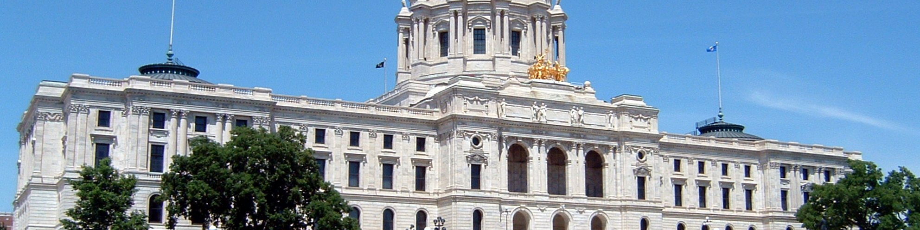
Legislative Changes to Data Practices & OML
All changes effective July 1, 2026, unless otherwise noted

Slide 5
Office of the Inspector General
Minn. Stat. Chapter 15E (various effective dates)
  Establishes the Office of the Inspector General (OIG)
    Inspector General must be appointed by Feb. 1, 2027, and office must be operational by Sept. 1, 2027
    OIG may create a law enforcement unit beginning January 1, 2028

Slide 6
Office of the Inspector General (cont.)
Minn. Stat. Chapter 15E
  OIG data practices considerations (§ 15E.40)
    May access data of any classification
    May disseminate data of any classification
    Must share with Office of the Legislative Auditor as requested
    Classifications for active/inactive investigations
      Law enforcement data classified separately

Slide 7
Anonymous Threat Reporting System
Minn. Stat. § 121A.0361
  Requires school districts and charter schools to adopt a policy related to implementing use of an “anonymous threat reporting system”
  Defines “anonymous threat reporting system data” as data related to either a local or DPS’ statewide anonymous threat reporting system
    Includes data created by schools, MDE, law enforcement agencies, and noncriminal justice partners

Slide 8
Anonymous Threat Reporting System (cont.)
Minn. Stat. § 121A.0361
  Anonymous threat reporting system data are classified as confidential/protected nonpublic while anonymous report is active
    Data may be shared among school district or charter school, DPS, MDE, law enforcement agencies, and noncriminal justice partners.
  When report is inactive:
    Data maintained by local system are governed under section 13.32
    Data maintained by statewide system governed under section 13.82, subd. 7

Slide 9
Other data practices changes of note
Minn. Stat. § 122A.20, subd. 2
  Law enforcement agencies must notify PELSB or BOSA when a teacher is charged with certain criminal offenses
Minn. Stat. § 211A.015 (eff. May 19, 2026)
  Classifies street addresses in financial reports and statements candidates must file with a county, municipality, school district or other political subdivision as private or nonpublic data

Slide 10
Other data practices changes of note (cont.)
Minn. Stat. § 480.40, subd. 1; § 480.50, subd. 1
  Adds judges and employees of DEED’s Unemployment Insurance and Paid Leave Appeals Division to definition of “judicial officials,” and section 13.991 will apply to these individuals
  These employees are excluded from the real property protections under section 480.50

Slide 11
Open Meeting Law
  No legislative changes to note!

Slide 12

Data Practices Potpourri

Slide 13
Question #1 – Policies
Our entity has no changes to our data practices policies. Do we have to update them annually?

Slide 14
Answer #1 - Policies
Minn. Stat. § 13.025 requires all government entities to create policies about access to public data and the rights of data subjects
These policies must be reviewed and updated by August 1 each year
The policies must be easily accessible to the public
Answer: Yes, check your policy annually by the Aug. 1 deadline. If no changes are made, document it is still accurate.

Slide 15
Question #2 – Data requests
Our office keeps receiving data requests that appear to be generated by AI or some type of automatic bot. The requests use the same language, but the requesters’ names are different. The requesters ask us to send data to addresses that don’t seem to exist.
Do we need to keep responding to these requests?

Slide 16
Answer #2 – Data requests
Reminder: The Data Practices Act doesn’t have language to outright deny responding to a request.
However, it’s not reasonable to send data to addresses that the entity knows does not exist.
If entity sends data to address but the data are returned, it’s reasonable to ask for correct addresses and inform requesters that the request will be considered abandoned if no correct info is provided.

Slide 17
Question #3 – Inspection
A data requester was inspecting data and began taking photos of the data. Are we required to allow this?
If so, can we charge the individual copy cost fees related to the copies they made?

Slide 18
Answer #3 – Inspection
A requester can make their own copies of data during inspection for free. (See AO 01-086, 04-051, and Issue 4 in 04-059.)
Exceptions:
      Plugging in devices (AO 02-036)
      Data copyrighted by a third-party (AO 08-009)
      Body camera data (section 13.825, subd. 4)
Remember: Entities cannot charge for inspection, even when requesters make their own copies.

Slide 19
Question #4 – Body Camera Copy Costs
Our agency charges $30 per body camera video. This fee is set by the city council, and we cannot make changes to that fee schedule. However, data requesters are disputing whether they need to pay this amount for copies.
Can we charge $30 per video?

Slide 20
Answer #4 – Body Camera Copy Costs
Any copy costs that are assessed must comply with the limits the Data Practices Act sets for “actual costs.” (See section 13.04, subd. 3; section 13.03, subd. 4(c).)
Note: Body camera data requests typically come from data subjects, which limits fees to “actual costs of making and certifying the copies.”

Slide 21
Question #5 – MAARC Reports
We received a request for all data related to an incident of vulnerable adult abuse. Do we need to include the MAARC report as part of the response to the data request?

Slide 22
Answer #5 – MAARC Reports
It depends:
MAARC reports maintained in the state’s common entry point are classified as confidential and should not be gathered as part of data request.
Reports (or portions of reports) that are included in law enforcement agency’s investigative data are subject to section 13.82 requirements. Some data may then be accessible depending on who is requesting and outcome of investigation.

Slide 23
Question #6 – Correspondence
We have a data request for all emails that a representative of a tech company sent to our planning commission about permit applications for a planned data center.
Can we classify these emails as private correspondence under section 13.601, subd. 2?

Slide 24
Answer #6 – Correspondence
The emails would not fall under section 13.601, subd. 2 for two reasons:
The language does not apply to correspondence with appointed officials
The language does not apply when an individual is representing an organization (see, e.g., AO 18-013)
Emails are presumptively public unless another section would classify the data.

Slide 25
Question #7 – Open Meeting Law
Can a public body adjourn a meeting while in a closed session?

Slide 26
Answer #7 – Open Meeting Law
The Open Meeting Law is silent on whether a public body must adjourn its meetings in an open session.
However, the Commissioner has opined that meetings should be adjourned in open session so the public can know when the meeting has ended. (See AO 12-008.)

Slide 27
Send us your questions
Type your questions in the Q&A Panel
If we don’t get to your question, we will follow up afterwards
Slides are available: https://mn.gov/admin/data-practices/news/trainings/webinars/
A recording of this webinar will be available at: https://www.youtube.com/user/INFOIPAD

Slide 28
Webinar evaluation
Click this link and fill out the evaluation
  What topics should we cover in future webinars?
  Suggestions for making webinars more effective.

Slide 29
Stay in touch!
Phone: 651-296-6733
Email: info.dpo@state.mn.us
Website: mn.gov/admin/data-practices
YouTube: https://www.youtube.com/user/INFOIPAD

