Slide 1
2025 Legislative Update
& Data Practices Potpourri
July 15, 2025

Slide 2
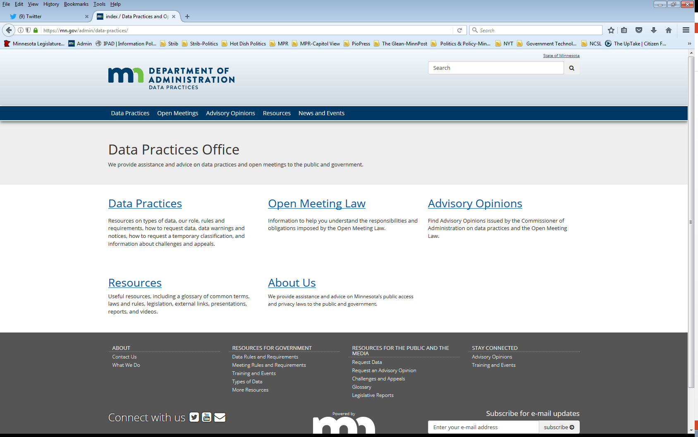
Who we are and what we do
Data Practices Office
  Informal advice/technical assistance
  Commissioner of Administration advisory opinions
  Website and informational materials: https://mn.gov/admin/data-practices/
  Listserv and newsletters
  Legislative assistance
  Training

Slide 3
Today’s agenda – 11am – 11:45am
11:00 a.m. – Legislative Updates
11:30 a.m. – Potpourri
11:40 a.m. – Q&A
11:45 a.m. – End

Slide 4

Legislative Changes to Data Practices & OML
All changes effective July 1, 2025, unless otherwise noted

Slide 5
Too Many Specific Bills to List!
Patient Registry Data
Family and Medical Benefit Data
VA Data Sharing
Business Filing Fraud Complaints
Election Candidate Data
Midwife licensing data sharing
State Pharmacy Benefit Data
Child care center footage
Truancy data sharing
Compensatory Revenue Task Force meetings
Water appropriate data
Data center fees
Restorative practice participant data
Task Force on Mandatory Minimum Sentences
Offender letter of apology
BCA Use of Force investigative data posting

Slide 6
Suspended Data Requests
Minn. Stat. §13.03, subd. 3(g)
  Entities can suspend further responses to a request if data requester has not collected copies or gone in to inspect data within five business days
  Include information on this process in your policies

Slide 7
Personnel Data and Public Officials
Minn. Stat. §13.43, subd. 2(e)
  Removes population limits for cities and counties when determining who is a public official under Minn. Stat. sec. 13.43 subd. 2.
  Expands definition of what is a public official to include different employees of Metropolitan Council

Slide 8
Parent Directory Information
Minn. Stat. §13.32, subds 2, 5
  Prohibits designating a parent’s home address, telephone number, email address, or other personal contact information as directory information
  Effective May 24, 2025

Slide 9
Data Challenge Appeals
Minn. Stat. §13.04 subd. 4
  Government entities may now share private data with the Commissioner of Administration in order to respond to a data subject’s appeal to the Commissioner.
  Data submitted to the Commissioner by data subject or entity will have same classification as the data maintained by the government entity
  Private classification for data maintained by the Commissioner that was changed or destroyed as part of the informal resolution process

Slide 10
Traffic Accident Body Worn Camera Data
Minn. Stat. §13.825, subd. 4(c)
  Active or inactive BWC data used in a collision investigation are available to persons entitled to a state accident report under Minn. Stat. §169.09 subd. 13.
  Unredacted data available to requesters for limited purposes. Subject to DPA penalties for misuse.
  May withhold from requester if there is a compelling reason access would interfere with an active investigation, if the data are clearly offensive to common sensibilities, or if classified elsewhere as not public
  Does not apply to State Patrol

Slide 11
Judicial Official Real Property Records
Minn. Stat. §§ 13.991, 480.40, 480.45 480.50
  Classifies personal information in real property records on judicial branch officials as private data.
  Real Property Records = as defined in Safe at Home statute 13.045 subd 1(5); UCC filings and tax liens, other records by county recorder or other gov entities

Slide 12
Judicial Official Real Property Records
Minn. Stat. §§ 13.991, 480.40, 480.45 480.50
  For real property records, protections apply to:
    MN District Court judges, retired judges, COA judges, and every active, senior, recalled, or retired federal judge who resides in MN.
    MN Supreme Court justice
    Judicial referees and magistrate judges
    +Spouse, domestic partner, adult child of a judicial official

Slide 13
Judicial Official Real Property Records
Minn. Stat. §§ 13.991, 480.40, 480.45 480.50
  Judicial officials must send a written notice to county recorder and SOS, or other government entity that holds real property records to receive these protections
  Spouse, domestic partner, or adult child of a judicial official would submit notice if personal information is about them

Slide 14
Judicial Official Real Property Records
Minn. Stat. §§ 13.991, 480.40, 480.45 480.50
  If you receive written notification, then classification and protections in 480.50 apply
  Remedies under Data Practices Act only apply if written notification is received
  Specific access provisions for title examination
  Effective January 1, 2026

Slide 15
Fraud Data
Minn. Stat. §13.357
  Government entities may disclose data related to suspected or confirmed fraud in a public program to any other government entity if the access would promote the protection of public resources, promote the integrity of public programs, or aid the law enforcement process

Slide 16
Fraud Data – State Agencies
Minn. Stat. §299C.061
  Requires state agencies that make a mandatory or discretionary referral to the BCA’s Financial Crimes and Fraud Section to provide any data related to the suspected fraudulent activity regardless of classification
Minn. Stat. §15.013
  Classifies data at state agencies relating to evidence of fraud as confidential or protected nonpublic data, allows agencies to disclose these data to federal, state, or local government agencies or a law enforcement agency if disclosure will help prevent fraud against public programs or aid in the law enforcement process

Slide 17
State Contracts
Minn. Stat. §16C.05 subd. 8
  State contracts may not contain terms that are inconsistent with Chapter 13

Slide 18
Open Meeting Law – Remote Meetings
Minn. Stat. §13D.02
  Applies to meetings of local public bodies using interactive technology
  Physical location of members attending remotely no longer noticed or open to the public
  Other requirements for remote meetings still apply
  Effective May 24, 2025

Slide 19

Data Practices Potpourri

Slide 20
Question #1 – Policies
Our entity has no changes to our data practices policies, do we have to update them annually?

Slide 21
Answer #1 - Policies
Minn. Stat. § 13.025 requires all government entities to create policies about access to public data and the rights of data subjects
These policies must be reviewed and updated by August 1 each year
The policies must be easily accessible to the public
Answer: Yes, check your policy annually by the Aug. 1 deadline. If no changes are made, document it is still accurate.

Slide 22
Question #2 – Email Addresses
Can a government entity cite Minn. Stat. section 13.356 to redact all email addresses it maintains about individuals when responding to a data request?

Slide 23
Answer #2 – Email Addresses
Minn. Stat. §13.356 applies only to individuals’ telephone numbers, email addresses, and online account information submitted for “notification purposes or as part of a subscription list for an entity’s electronic periodic publications.” (See AO 20-006.)
Answer: No, email addresses are presumptively public unless a specific section classifies the data as not public.

Slide 24
Question #3 – Resignation Letter
Is a resignation letter submitted by an employee public data?

Slide 25
Answer #3 – Resignation Letter
Minn. Stat. §13.43 subd. 4 classifies data on employees as private data, unless explicitly called out as public data in 13.43.
Under 13.43 subd. 2, only the first and last dates of employment are public data.
Resignation letters are not included in the public data listed.
Answer: Resignation letters are private data on the employee.

Slide 26
Question #4 – Body Camera Inspection
A data subject asked whether they may bring someone with them (who is not a data subject) to view/inspect private body camera videos. Is this permissible?

Slide 27
Answer #4 – Body Camera Inspection
Answer: No. Only the data subject has “access” (right to view) to private/nonpublic video, including others in video.
Minn. Stat. 13.825, subd 4(b)

Slide 28
Question #5 – Medical Records
A member of the public requested an inactive investigative file. The file contains medical information. Can we release this data?

Slide 29
Answer #5 – Medical Records
Inactive criminal investigative data are public under § 13.82 subd. 7
Health records received from a provider may only be released if authorized under Minn. Stat. §144.293
Answer: data in the inactive file received directly from a health care provider would not be disclosed in response to a public data request. All other data are public

Slide 30
Send us your questions
Type your questions in the Q&A Panel
If we don’t get to your question, we will follow up afterwards
Slides are available: https://mn.gov/admin/data-practices/news/events/webinars/
A recording of this webinar will be available at: https://www.youtube.com/user/INFOIPAD
Please fill out the evaluation in the Polling Panel

Slide 31
Stay in touch!
Phone | 651-296-6733
Email | info.dpo@state.mn.us
Website | https://mn.gov/admin/data-practices/
YouTube | https://www.youtube.com/user/INFOIPAD
Newsletter | https://mn.gov/admin/data-practices/news/newsletters/

