Slide 1
2024 Legislative Update & Data Practices Potpourri
July 18, 2024
Notes:
[

Slide 2
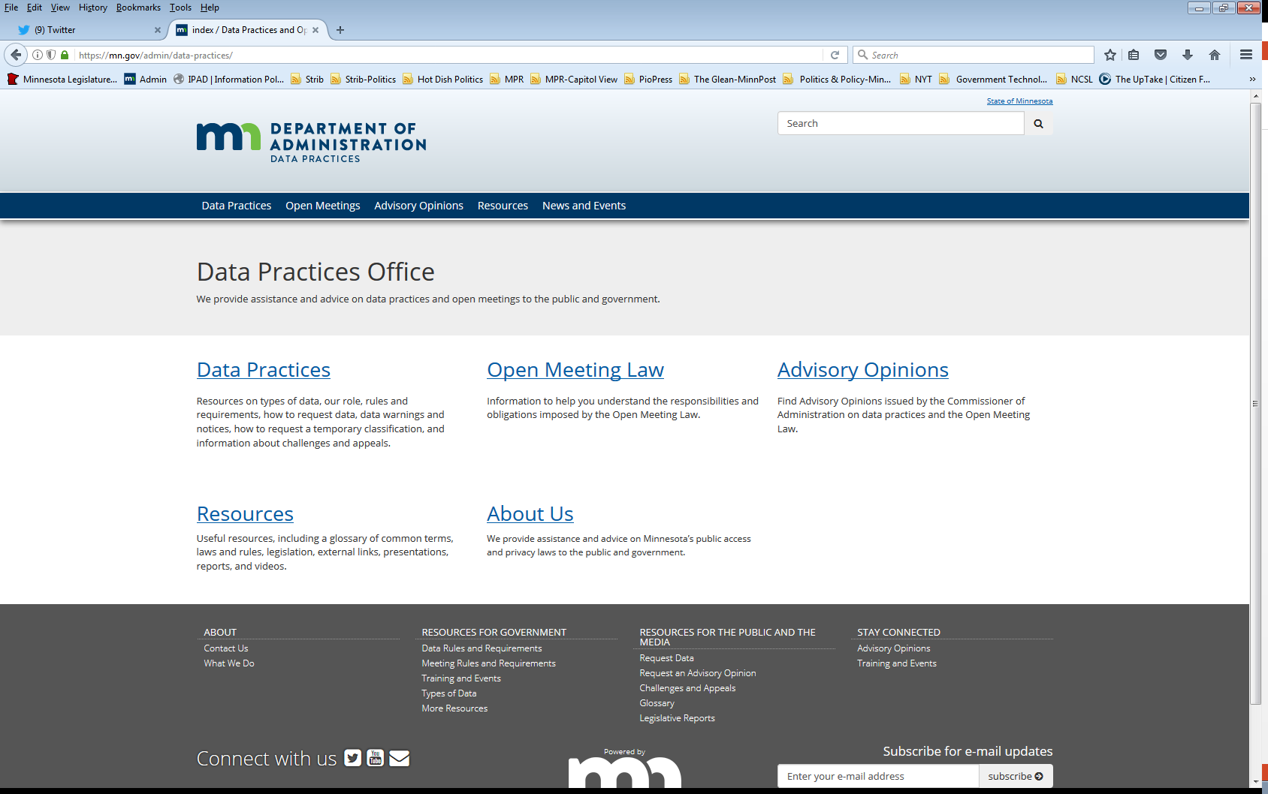
Who we are and what we do
Data Practices Office
Informal advice/technical assistance
Commissioner of Administration advisory opinions
Website and informational materials: https://mn.gov/admin/data-practices/
Listserv and newsletters
Legislative assistance
Training

Slide 3
Today’s agenda – 10am – 10:30am
10:00 a.m. – Legislative Updates
10:20 a.m. – Potpourri
10:25 a.m. – Q&A
10:30 a.m. – End

Slide 4
Legislative Changes to Data Practices & OML
All changes effective July 1, 2024, unless otherwise noted

Slide 5
Too Many Specific Bills to List!
Forest Industry Data
Packaging Waste and Cost Reduction Act data
Lawns to legumes program data
Petition for sentence adjustment data sharing
Directory information sharing with DEED
Safe place infant data
GIS mapping data for school facilities
MDE OIG data access authority
Board of Nursing medical record access
Family and medical benefit data
Combative sports health records
Office of Restorative Practices
Traffic safety camera pilot program
Natural organic reduction facility data
MN paid leave appeal data sharing

Slide 6
Personnel data
Minn. Stat. § 13.43, subd. 6
Government entities must share personnel data with labor organizations and the Public Employee Relations Board to the extent necessary to conduct elections, investigate and process grievances, and implement the provisions of chapters 179 and 179A regardless of the classification of the data

Slide 7
Personnel data – cont.
Minn. Stat. § 179A.13, subd. 2
Upon request from an exclusive representative of the labor organization, public employers must provide information by certain deadlines:
Information relevant to contract enforcement within 30 days
Information relevant to contract negotiation within 60 days, from the date of request by an exclusive representative.
May request for extension of timelines to the Commissioner of the Bureau of Mediation Services

Slide 8
Judicial Personal Information
Minn. Stat. §§ 13.991, 480.40
Classifies personal information on judicial branch and administrative court employees as private data.
Prohibits knowingly disseminating judicial officials’ personal information online
Creates mechanisms for requesting removal of publicly posted information

Slide 9
Judicial Personal Information – cont.
Minn. Stat. §§ 13.991, 480.40
Penalties and remedies under the Data Practices Act are only available if the judicial employee provided the government entity with written notification
Effective Aug. 1, 2024

Slide 10
Health Records
Minn. Stat. §144.2925, 144.293
Requires authorization in Minnesota law to release patient health records
Clarifies that the Minnesota Health Records Act is more stringent than federal law regarding disclosure of individually identifiable health information
Effective May 25, 2024

Slide 11
Administrative Courts
Minn. Stat. § 13.95
Work product data created by the administrative courts is confidential or protected nonpublic data
Health data in administrative court files are private data on individuals

Slide 12
Safe at Home Data
Minn. Stat. § 13.045
Identity and location data on Safe at Home participants not already classified as not public are now private
DPO Webinar with Safe at Home Program: https://youtu.be/nvVUgVKGA6k?si=dckDkakSQFxRAvG9

Slide 13
Cybersecurity Reporting
Minn. Stat. § 16E.36
Requires public agencies and government contractors to report cybersecurity incidents to the Minnesota Department of Information and Technology Services (MNIT)
Reporting begins December 1, 2024

Slide 14
Miscellaneous sharing provisions
Minn. Stat. § 626.5534
Mandatory data sharing for officer use of force investigations
Minn. Stat. § 324.15
Discretionary sharing with the Office of Cannabis Management for licensing investigations
Minn. Stat. § 13.02 subd. 3a, §192.67
Mandatory sharing of confidential or private data with National Guard’s Office of the State Judge Advocate. Adds the National Guard to the definition of “criminal justice agencies.”

Slide 15
MN Consumer Data Privacy Act
Minn. Stat. §§ 325O.01 – 325O.11
Requirements for collection and use of consumer data
Does not apply to government entities

Slide 16
Open Meeting Law
No substantive changes to the Open Meeting Law
If you are a new public body subject to OML:
Open Meeting Law Webinar

Slide 17
Data Practices Potpourri

Slide 18
Question #1 – Policies
Our entity has no changes to our data practices policies, do we have to update them annually?

Slide 19
Question #1 - Policies
Minn. Stat. § 13.025 requires all government entities to create policies about access to public data and the rights of data subjects
These policies must be reviewed and updated by August 1 each year
The policies must be easily accessible to the public
Answer: Yes, check your policy annually by the Aug. 1 deadline. If no changes are made, document it is still accurate.

Slide 20
Q. Question #2 – Copy costs
Question: Can government entities charge copy costs when sharing not public data with another government entity as authorized by law?

Slide 21
Answer #2 – Copy costs
Yes, government entities may charge copy costs when supplying data to another government entity.
Not public data: may charge actual costs (Minn. Stat. § 13.05, subd. 9)
Public data: actual costs, or 25 cents for 100 or fewer pages of data (Minn. Stat. § 13.03, subd. 3)

Slide 22
Question #3 – Signatures
What are the classification of personal signatures? We have a contract with a signature on it. Can we redact the signature before providing this document in response to a data request?

Slide 23
Answer #3 – Signatures
In this instance, you would not redact the signature when providing the contract.
There is no specific classification for signatures, so look to your data to determine classification.
Executed contracts are presumptively public
Security concerns can look at private security information classification (Minn. Stat. § 13.37, subd. 1(a))

Slide 24
Question #4 – Body Camera Data
We have inactive body camera data that our entity would like to use for training. Can we show this body camera data as part of our training?

Slide 25
Answer #4 – Body Camera Data
Inactive body camera data are classified as private (Minn. Stat. § 13.825 subd. 2(a))
Private data may only be accessing internally within the entity if there is a work assignment (Minn. Stat. § 13.05 subd. 5(a)(2))
Private data may only be shared outside the entity if there is statutory authority or informed consent from the data subjects (Minn. Stat. § 13.05 subd. 4)

Slide 26
Answer #4 – Body Camera Data
Statutory Authority for sharing BWC data:
13.825 subd. 8
13.825 subd. 7
Answer: You may use footage for internal training if the responsible authority determines there is a work assignment and if follows the procedures in 13.825 subd. 7. To use footage externally you will need to also follow the procedures in 13.825, subdivision 7. Both trainings must be for a legitimate, specified law enforcement purpose.

Slide 27
Send us your questions
Type your questions in the Q&A Panel
If we don’t get to your question, we will follow up afterwards
Slides are available: https://mn.gov/admin/data-practices/news/events/webinars/
A recording of this webinar will be available at: https://www.youtube.com/user/INFOIPAD
Please fill out the evaluation in the Polling Panel

Slide 28
Stay in touch!
Phone: 651-296-6733
Email: info.dpo@state.mn.us
Website: mn.gov/admin/data-practices
Twitter: @MNgovdata
YouTube: https://www.youtube.com/user/INFOIPAD
Newsletter: https://mn.gov/admin/data-practices/news/newsletters/

