Slide 1
Data Practices Potpourri Webinar
August 27, 2026

Slide 2
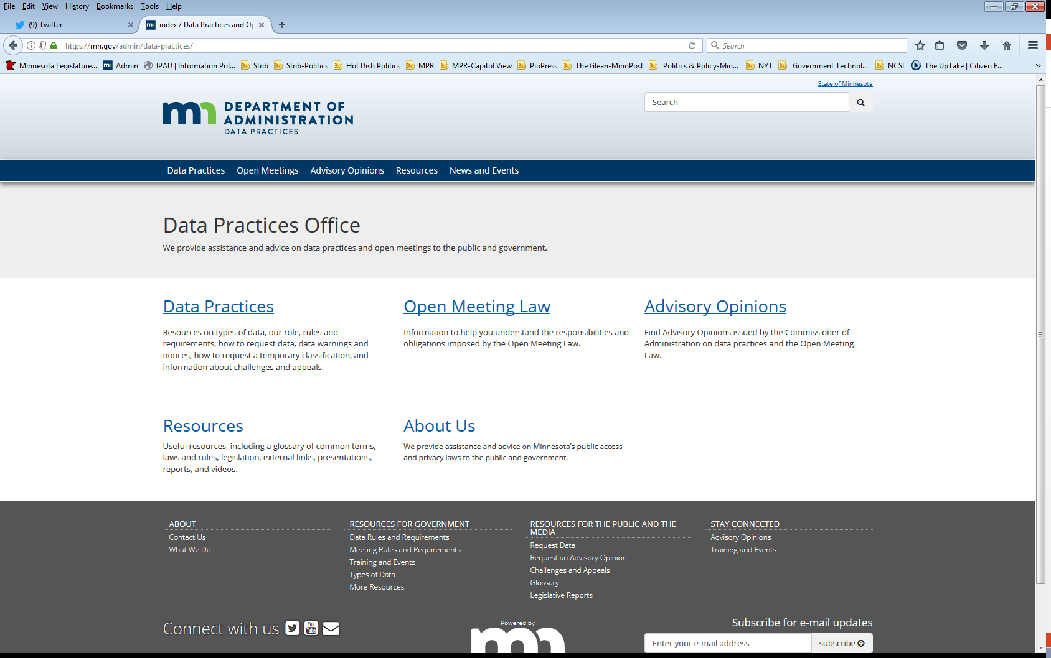
Who we are and what we do
Data Practices Office
  Informal advice/technical assistance
  Commissioner of Administration advisory opinions
  Website and informational materials: https://mn.gov/admin/data-practices/
  Listserv and newsletters
  Legislative assistance
  Training

Slide 3


Today’s agenda – 11:00 am – 11:30 am
11:00 a.m. – Data Practices Potpourri: A discussion of the top questions the Data Practices Office has received
11:20 a.m. - Q&A
11:30 a.m. End

Slide 4
Question #1 – Data Request Response Time
Question: A School District receives a data request from a parent about their minor child.
Family Educational Rights and Privacy Act (FERPA)?
How long does the District have to respond to the request?

Slide 5
Answer #1 – Data Request Response Time Answer
Answer: 10 business days.
Minn. Stat. § 13.02, subd. 8: “Individual” means a natural person. An individual includes a parent or guardian acting as a parent or guardian in the absence of a parent or guardian
While FERPA allows for a different timeline, the Data Practices Act requires a 10-day response per MN Statute 13.04.

Slide 6
Question #2 – Large Data Requests
Question: A local government administrator receives a request for a large quantity of email copies.
The requestor is not the subject of the data and the emails cover a two-year period.
How long does the agency have to respond to the request?

Slide 7
Answer #2 – Large Data Requests
Answer: Appropriate, prompt, and reasonable amount of time.
Minn. Stat. § 13.03, subd. 1 requires that the responsible authority in every government entity keep data in such an arrangement and condition to make the data easily accessible
Minn. Stat. § 13.03, subd. 2 requires that a request for public data are received and complied within an appropriate and prompt manner.

Slide 8

Question #3 – Open Meeting Law - Classification
Question: How does the Open Meeting Law classify recordings made during open meetings?

Slide 9
Answer #3 – Open Meeting Law - Classification
Answer: Classified as Public.
13D.05, subd. 1(c)
The Open Meeting Law has NO requirement to record open meetings.
Closed meetings do need to be recorded (except those closed pursuant to Attorney-client privilege).

Slide 10
Question #4 – Data Copy Costs
Question: A member of the public makes a data request for copies of a 200-page paper document that is public information.
Can the city charge $0.25 per page to copy the 200-page document?

Slide 11
Answer #4 – Data Copy Costs
Answer: No. Copy costs are limited to $0.25 per page for 100-pages or fewer.
Copy costs for over 100-pages must comply with the limits that the Data Practices Act sets for “actual costs.”

Slide 12
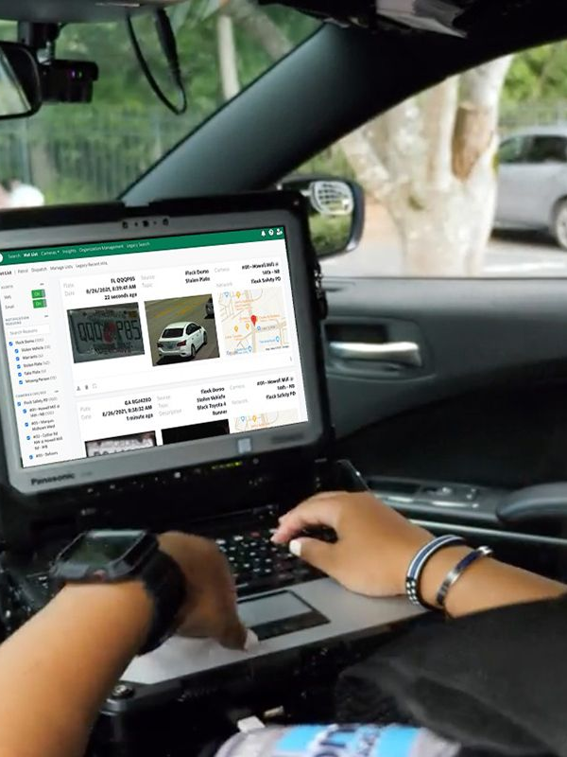
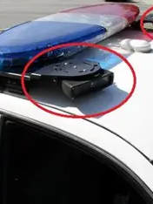
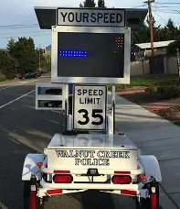
Question #5 – Automated License Plate Reader Classification
Question: What is the classification of Automated License Plate Reader (ALPR) query and response data?

Slide 13
Answer #5 – Automated License Plate Reader Classification
Answer: Queries and responses are public data, unless otherwise classified, Minn. Stat. § 13.824, subd. 7.
License plate data appearing in an ALPR query and response, are also private or non public.
Under Minn. Stat. § 13.82, subd. 7: if there is an active investigation, ALPR data is classified as not public.
AO 26-006

Slide 14
Question #6 – Can I release not public data by subpoena?
QUESTON: I received a subpoena, signed by an attorney, directing our agency to disclose not public data.
What should I do?

Slide 15
Answer #6 – Can I release not public data by subpoena?
Answer: Subpoenas do not carry the same legal authority as a court order.
Not public data can only be released through a court order or by a statutory authority.

Slide 16
Send us your questions
Type your questions in the Q&A Panel
If we don’t get to your question, we will follow up afterwards
Slides are available: https://mn.gov/admin/data-practices/news/trainings/webinars/
A recording of this webinar will be available at: https://www.youtube.com/user/INFOIPAD

Slide 17
Webinar evaluation
Click this link and fill out the evaluation
  What topics should we cover in future webinars?
  Suggestions for making webinars more effective.

Slide 18
Stay in touch!
Phone: 651-296-6733
Email: info.dpo@state.mn.us
Website: mn.gov/admin/data-practices
YouTube: https://www.youtube.com/user/INFOIPAD

