Slide 1
Data Practices Potpourri Webinar
October 8, 2026
11:00 – 11:30 AM

Slide 2
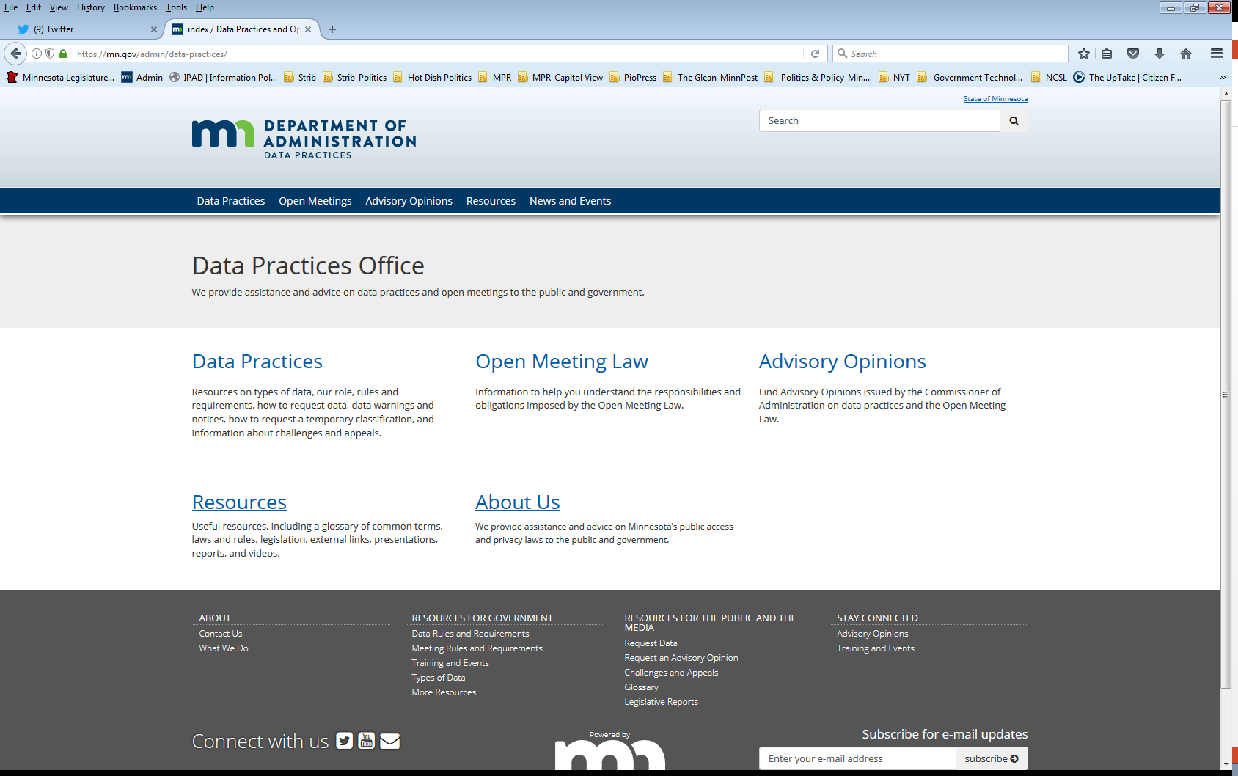
We are a statewide resource
Data Practices Office
  Informal advice/technical assistance
  Commissioner of Administration advisory opinions
  Website and info pages: https://mn.gov/admin/data-practices/
  Listserv and newsletters
  Legislative assistance
  Training

Slide 3
Today’s agenda
11:00 a.m.- Data Practices Potpourri: A discussion of questions that DPO has recently received
11:20 a.m. - Q&A
11:30 a.m. - End

Slide 4
Q. #1 – Copy Costs
Question: A person who has been receiving social services from our agency makes a request for “all data about me that the agency maintains.” It takes many hours to search and retrieve the data; can we charge for this time?

Slide 5
A. #1 – Copy costs
Answer: No. Copy costs for data subject requests are limited to the actual costs of making and certifying the copies & the cost of materials.
Costs for data subject requests are set out in
Minn. Stat., sec. 13.04, subd. 3 & Minn. R. 1205.0400, subp. 5
Minn. Stat., sec. 13.03 governs public data requests and specifically allows the responsible authority to charge for the actual costs of searching for and retrieving government data
Minn. Stat., sec. 13.04 does NOT include this language

Slide 6
Q. #2 – Data on minors
Question: A father has requested his minor child’s private data. We know that he is currently involved in a custody dispute and he may want to use this as evidence. Can he access his child’s private data?

Slide 7
A. #2 – Data on minors
Answer: Yes, unless:
(1) Your entity is aware of a court order that terminated the father’s parental rights; or,
(2) Your entity is aware of a court order that specifically limits the father’s data access rights; or,
(3) The minor child has requested that you not release their data to their father, and your entity has determined that withholding the data is in the child’s best interest.

Slide 8
A. #2 cont.– Data on minors
In the case of a minor, “individual” includes a parent or guardian (Minn. Stat., sec. 13.02, subd. 8)
Parents are presumed to have access to their minor children’s private data (Minn. R. 1205.0500, subp. 2)
Parent’s step into the shoes of the minor child for data access purposes
Minor children can request that the data not be provided to their parent (Minn. Stat., sec. 13.02, subd. 8 & Minn. R. 1205.0500, subp. 3)
When the child is no longer a minor, parents no longer get access

Slide 9
A. #2 Note
We analyze the provisions of Data Practices Act & other laws related to data access. The information we provide is based on that analysis.
We do not give legal advice.
If you have serious concerns that are outside Data Practices Act considerations (e.g. the safety of the minor), please reach out to your legal counsel.

Slide 10
Q. #3 – Townships
Question: I requested data from my township, and they are not working with me at all. Aren’t they required to respond to data requests?

Slide 11
A. #3 – Townships
Answer: It depends.
The Data Practices Act only applies to townships located within the seven-county metropolitan area exercising powers under Ch. 368.
  Minn. Stat., sec. 13.02, subd. 11
  Minn. Stat., sec. 473.121, subd. 2
Townships located outside the metro area are NOT subject to the Data Practices Act

Slide 12
Q. #3 BONUS – Townships
Question: What can I do?

Slide 13
A. #3 BONUS– Townships
Answers:
Contact your legislators. It would require a change in the law to make townships outside the metropolitan area subject to the Data Practices Act.
  Who represents me? tool on MN legislature’s website: https://gis.lcc.mn.gov/iMaps/districts/
  Legislative Commission on Data Practices: https://www.lcc.mn.gov/lcdp/
Consider what data is available via the OML (e.g. record of votes). The OML is not limited to metro-area townships exercising powers under Ch. 368.
Consider whether the county might have some of the data you are looking for and submit a data request to the county.

Slide 14
Q. #4 – Data in which a name appears
Question: I requested all emails from the past 5 years that contain my name. How long does the city have to respond?

Slide 15
A. #4 – Data in which a name appears
Answer: It depends.
Data subject: immediately or within 10 business days
Not the data subject: reasonable amount of time
Appearance of your name does not automatically mean you are the data subject
Your name could be incidental to the data
“data on individuals” - Minn. Stat., sec. 13.02, subd. 5

Slide 16
Q. #5 – BWC & traffic accidents
Question: A person has requested copies of all BWC footage from a fender bender that they were involved in. There was no criminal investigation. A state accident report was not completed. We do have an incident report at our department. What footage can they access?

Slide 17
A. #5 – BWC & traffic accidents
Answer: Only the data which they are the subject of.
Footage where they are seen or heard. Other individuals who are not on-duty peace officers must be redacted from the copy.
Minn. Stat., sec. 13.825, subd. 4(c) allows individuals who are entitled to a copy of a state accident report to receive unredacted copies of BWCs used in the collision investigation.
To request data under this provision, the person must make their request in writing & include a copy of the state accident report.
If there is no state accident report, this subdivision does not apply – the person is treated like any other person who requests BWC footage under section 13.825.

Slide 18
Q. #6 – Councilmember emails
Question: Does the OML allow city councilmembers to email each other one-on-one without including the city clerk?

Slide 19
A. #6 – Councilmember emails
Answer: The OML doesn’t prohibit one-to-one communications among members so long as not a quorum.
  However, public body bylaws may govern members behavior, which is not an OML consideration.

Slide 20
Just one more thing…
DPO is currently understaffed
  Your patience is appreciated!
Interested in joining our team?
  please look for position postings on the state careers website!

Slide 21
Send us your questions
Type your questions in the Q&A Panel
If we don’t get to your question, we will follow up afterwards
Slides are available: https://mn.gov/admin/data-practices/news/trainings/webinars/
A recording of this webinar will be available at: https://www.youtube.com/user/INFOIPAD

Slide 22
Webinar evaluation
Click this link and fill out the evaluation
  What topics should we cover in future webinars?
  Suggestions for making webinars more effective.

Slide 23
Stay in touch!
Phone: 651-296-6733
Email: info.dpo@state.mn.us
Website: mn.gov/admin/data-practices
Twitter: @MNgovdata
YouTube: https://www.youtube.com/user/INFOIPAD

