Slide 1

Welcome to Personnel Data 201!
We will begin shortly.
Please mute yourself, turn on your camera, and say “Hi” in the Chat Panel to let us know you are here.
If you are an attorney and would like CLE credits, please enter your attorney ID # into the chat panel as well.
Camera and mute buttons are in the Participant Panel next to your name and at the bottom of the presentation screen.

Slide 2
Personnel Data 201
Complaints and Discipline Data
May 12, 2026

Slide 3

Introductions
Please introduce yourself in the chat:
Your name
Your entity
Your data practices role
Any burning questions you would like to discuss this morning.

Slide 4
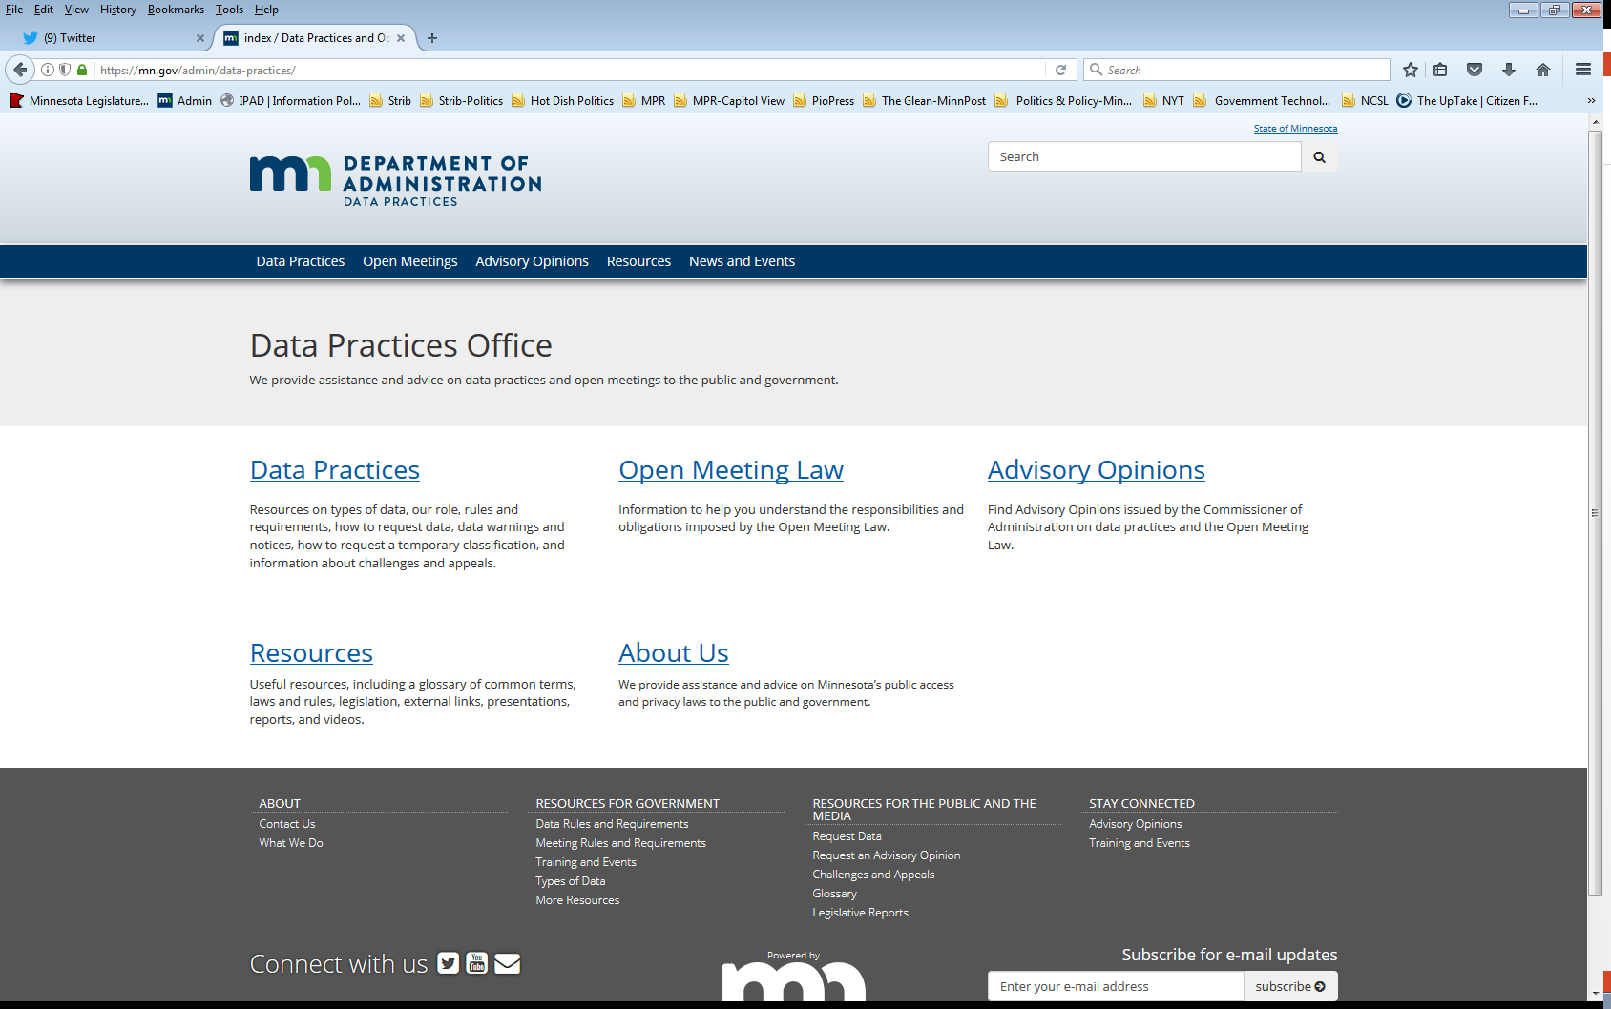
Who we are and what we do
Data Practices Office
  Informal advice/technical assistance
  Commissioner of Administration advisory opinions
  Website and informational materials: https://mn.gov/admin/data-practices/
  Listserv and newsletters
  Legislative assistance
  Training

Slide 5
Agenda
Time | Topic
9:00 | Welcome and introductions
9:05 | Complaint and discipline data overview
10:20 | Break
10:30 | Introduction to Scenario
10:35 | Breakout 1 & Debrief
11:15 | Breakout 2 & Debrief
11:50 | Full group debrief and evaluations
12:00 | Workshop end

Slide 6
Complaint and Discipline Data

Slide 7
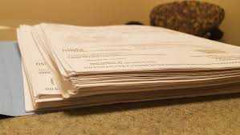



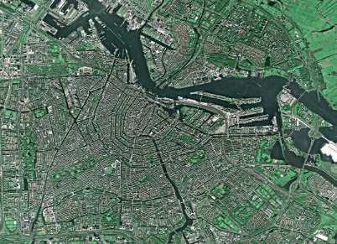
Government Data Defined
“All data collected, created, received, maintained or disseminated by any government entity regardless of its physical form, storage media or conditions of use.”
(Minn. Stat. § 13.02, subd. 7)

Slide 8
Classification of government data
Classification | Meaning of classification | Examples
Public | Available to anyone for any reason | Employee name and salary
Private/Nonpublic | Available to: Data subject Those in the entity whose work assignment requires access Entities authorized by law Those authorized by data subject | Employee home address and telephone number
Confidential/ Protected nonpublic | Available to: Those in the entity whose work assignment requires access Entities authorized by law NOT available to the data subject | Data collected as part of an active civil legal action

Slide 9

Personnel Data Defined
“Government data on individuals maintained because an individual is or was an employee of a government entity, applicant for employment, volunteer, or independent contractor . . .”
Minn. Stat. § 13.43, subd. 1

Slide 10
Personnel Data Classified
Public presumption is reversed
All personnel data are classified as private unless explicitly classified as public
  Minn. Stat. § 13.43, subd. 4
Personnel data are public if designated as such under subdivision 2 or 3

Slide 11
What is a Complaint or Charge?
Not defined in the law
Largely within the discretion of the entity
Something that results in an investigation or reported to HR
What is an investigation?
  Dependent on the circumstances, entity decision
  E.g., Conversation with the employee or formal review and interviews with witnesses

Slide 12
What is Discipline?
Not defined in the law
Largely within the discretion of the entity
Discipline:
  Review collective bargaining agreements and HR policies
  Minnesota Coalition on Government Information v. City of Minneapolis, et al., No. 27-CV-21-7237

Slide 13

Disciplinary Data
While the complaint or charge against an employee is pending, the existence and status are public.
All other related data are private during the investigation
  Reminder: personnel data are not confidential – employee has access rights while investigation is pending

Slide 14
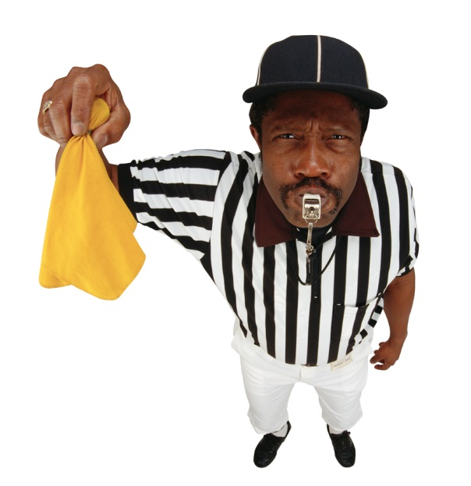
Existence and status
During an investigation, entity can say the complaint/charge:
  Exists
  Does not exist
If a complaint/charge exists, entity can say this about status:
  Complaint received
  Pending
  Under investigation
  Resolved/complete/closed
Note: Revealing “with or without pay” status

Slide 15
Navarre v. South Washington County Schools
652 N.W.2d 9 (Minn. 2002)
Complaints by parents, students, co-workers about a teacher
School officials sent letters to parents, made statements in the media, while the complaints were pending.
Court: statements describing the “quality or characteristic,” “nature and character,” or the “severity” of a complaint prior to final disposition of disciplinary action go beyond existence and status.

Slide 16
Disciplinary Data, Part 2
If no discipline following an investigation:
  No additional data become public, all related data remain private
If there is a final disposition of disciplinary action:
  Specific reasons for the disciplinary action and data that document the basis of the action are public

Slide 17
Final Disposition
For employees who are not subject to collective bargaining agreement, final disposition when:
  Government entity makes its final decision about discipline regardless of later proceedings
  Includes resignation if after final decision

Slide 18

Final Disposition, cont.
Final disposition in collective bargaining agreements
  Conclusion of arbitration proceedings, or
  Failure of employee to elect arbitration
Disciplinary action data are not public if:
  Arbitrator sustains grievance, and
  Reverses all aspects of discipline

Slide 19
Complainant Identities
Advisory Opinion 06-010
  “The names and address of the complainants are data about the complainants”
Demers v. City of Minneapolis
  If a government employee makes a complaint about another government employee, the complainant’s identity is private personnel data on the complainant
  If a member of the public makes a complaint about a government employee, his/her ID is public
    Cannot be classified as personnel data, so presumptively public

Slide 20
What Do You Think #1
You are investigating a teacher for misconduct and your Communications Department wants to release the following statement. What do you think?
I am writing to let you know about a situation that affects our school community.
We received a complaint against Mr. Anderson, an English teacher. The complaint is under investigation and Mr. Anderson is on leave, which is standard practice.
Due to privacy laws and the ongoing investigation, I am unable to provide additional details about the situation. The safety of our students is always a top priority.
We hope you'll take this opportunity to encourage your child to talk to a trusted adult if they have concerns about school. Thank you for supporting your child and our school.

Slide 21
What Do You Think #2
City decides to suspend employee with a collective bargaining agreement following an investigation
What data are public if:
  Grievance process is pending?
    Existence and status
  The time to file a grievance expires?
    Existence, status, specific reasons for the action and data documenting
  Employee resigns before the decision to suspend?
    Existence and status
  Employee resigns after the decision to suspend and an arbitrator upholds the suspension?
    Existence, status, specific reasons for the action and data documenting

Slide 22
Public Officials – State Agencies
Heads of state agencies and their deputies and assistants
Members of boards or commissions the governor must appoint or other elective officers
  Executive or administrative heads of departments, bureaus, divisions, or institutions

Slide 23
Public Officials – Local Government
Political subdivisions
  Chief administrative officer, or equivalent
  Three highest-paid employees in city or county with population over 15,000
  Managers, chiefs, heads, or directors in cities and counties * 2025 change
School districts
  Business managers, HR directors, ADs (50% of time in administration, supervision, etc.), chief financial officers, directors, superintendents, and principals
Some Met Council employees added *2025 change

Slide 24
Public Official Complaints/Discipline
All data related to a complaint or charge are public…
  State agencies
    Upon completion of an investigation, or
    If public official resigns or is terminated while complaint or charge is pending

Slide 25
Public Official Complaints/Discipline, cont.
All data related to a complaint or charge are public…
  Local government
    If complaint or charge results in discipline, or
    If public official resigns or is terminated while complaint or charge is pending. See AO 25-003.
    Employee releases entity from liability for any legal claims arising out of the conduct that is the subject of the complaint as part of a settlement agreement

Slide 26
What do you think #3
A complaint comes in about a former employee. Your entity does an investigation to determine whether there was misconduct. How are the complaint and investigative data classified?
  If the employee was not a public official, then the data are private, because there can’t be a final disposition of disciplinary action. Existence and status are public.
  If the employee was a public official, some data might be public and some might be private depending on whether employee is State-level (all data related to the complaint are public) or local-level (only existence and status).

Slide 27
Settlement Agreements
The complete terms of an agreement settling a dispute arising out of the employment relationship are public.
Specific reasons for a settlement agreement if payment is more than $10,000
Advisory Opinion 12-006

Slide 28
Settlement Agreements, cont.
Government entities cannot enter into settlement agreements to limit access to personnel data
This includes:
  Agreement not to discuss, comment on data
  Agreement limiting data subject’s release of data
Except:
  Provision that limits employee from releasing private data that identified other employees

Slide 29
Relevant case law
Schwanke v. Minn. Dept. of Administration, 851 N.W.2d 591 (Minn. 2014)
  Public employee can challenge performance evaluation data as inaccurate or incomplete under the data challenge appeal process
Harlow v. State of Minn. Dept. of Human Services, et al., 883 N.W. 2d 561 (Minn. 2016)
  Identical data may simultaneously exist as both public and not public when classified differently in distinct locations or contexts

Slide 30
Relevant case law, cont.
KSTP-TV v. Metro. Council, 884 NW 2d 342 (Minn. 2016).
  The video data are personnel data, if “maintained” exclusively because the subject of the data is a government employee
Burks v. Metro. Council, 884 NW 2d 338 (Minn. 2016).
  The right of access to data extends to “the individual subject” even if the data identifies other individuals

Slide 31
Resources
Appropriate Use of Electronic Communication and Technology
  https://mn.gov/mmb/assets/1423-appropuseoftech_tcm1059-322068.pdf
General personnel data guidance and relevant advisory opinions
  https://mn.gov/admin/data-practices/data/types/personnel/
Minnesota Management and Budget Data Practices Manual
  https://mn.gov/mmb/assets/Data-Practices-Personnel-Records_tcm1059-127062.pdf
MN municipalities – Crisis communications team at League of Minnesota Cities

Slide 32
Break!

Slide 33

What questions do you have?

Slide 34
Redaction Exercises
Small group discussion

Slide 35

Redaction
Separate not public data from responsive data
  Personnel context = Private data on others
At the data element level, not document
Identity can be more than a name
Provide specific citation in support of redaction
  Does not need to be by redaction/by line

Slide 36
Practical tips
Work as a team, if possible, to compare notes & redactions
Identify data subjects
  Names
  Pronouns
  Characteristics
    Titles that could only be one person
    Location of desk/workstation
Document justifications on close calls in case of challenges later
Be consistent

Slide 37

Costs and timing
What can you charge?
  You can charge for copies
  You cannot charge to redact
    Redaction = separating public from not public data or not public data about others from data subject’s data
Data subjects get data in 10 business days
Members of the public =
a reasonable amount of time

Slide 38
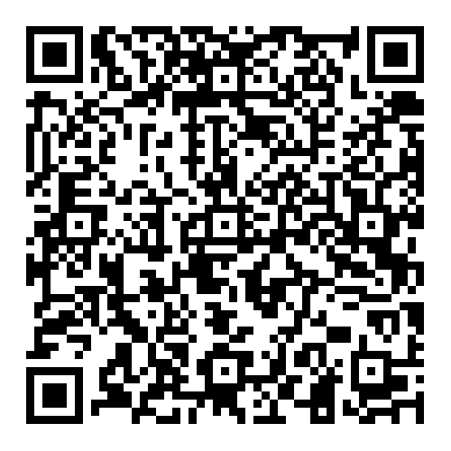
Introduction to the scenario
Personnel investigation of Abbott Elementary janitor, James Johnson. Scenario packet includes:
  Complaint and emails
  Investigator contract
  Investigator’s notes
  Investigative report
  Discipline letter

Slide 39
Breakout Room 1 – Newspaper Reporter
Introduce yourselves and pick a spokesperson (or person farthest from St. Paul)
Take 20 minutes to review, redact, and discuss with the group.
Use “Ask for Help” button in the Participant Panel, if you need assistance.
Click the red circle at the bottom of screen to exit.

Slide 40
Breakout Room 1 – Newspaper Reporter
Foua Vang calls your office and says, “I would like copies of all data about the complaint against Mr. Johnson and any discipline.” Foua identifies herself as a reporter with the local newspaper and says she interviewed Jacob Hill about workplace concerns at the school.
What data must you provide?

Slide 41
Breakout Room 1 – Newspaper Reporter
Foua Vang calls your office and says, “I would like copies of all data about the complaint against Mr. Johnson and any discipline.” Foua identifies herself as a reporter with the local newspaper and says she interviewed Jacob Hill about workplace concerns at the school.
What data must you provide?
Considerations
  Is this a data request?
  Reporter = member of the public
  ID of Mr. Hill in “request”
  Can receive public data
    Final disposition of any disciplinary action
    Data documenting basis of action
    Redaction of identifying data about employees other than Johnson

Slide 42
Breakout Room 1 – Newspaper Reporter
Foua Vang calls your office and says, “I would like copies of all data about the complaint against Mr. Johnson and any discipline.” Foua identifies herself as a reporter with the local newspaper and says she interviewed Jacob Hill about workplace concerns at the school.
What data must you provide?
Discipline letter – final disposition, basis, specific reasons
Redacted investigative report – basis, specific reasons
  Identifying information on Mr. Hill redacted
    Informed consent
  Identifying info on other employees redacted
Interview summaries?
Contract?

Slide 43
Breakout Room 2 – Employee
Introduce yourselves and pick a spokesperson (or person with the closest birthday)
Take 15 minutes to review, redact, and discuss with the group.
Use “Ask for Help” button in the Participant Panel, if you need assistance.
Click the red circle at the bottom of screen to exit.

Slide 44
Breakout Room 2 – Employee
Mr. Johnson contacts your office and asks for all data on complaints against him and this investigation.
What must you provide?

Slide 45
Breakout Room 2 – Employee
Mr. Johnson contacts your office and asks for all data on complaints against him and this investigation.
What data must you provide?
Considerations:
  No confidential personnel data
  Data subject request
  Multiple data subjects

Slide 46
Breakout Room 2 – Employee
Mr. Johnson contacts your office and asks for all data on complaints against him and this investigation.
What data must you provide?
Redacted complaint emails. Identifying data on Janine redacted
Redacted interview notes
  Other employees not about Mr. Johnson redacted.
Investigative report with data on Mr. Hill redacted
Discipline letter?

Slide 47
Other requests – Complainant
Janine Teague contacts your office. She says: “I want to make sure the school properly investigated my complaint. Provide me with all data related to my complaint against Mr. Johnson.”
What must you provide?

Slide 48
Other requests – Complainant
Janine Teague contacts your office. She says: “I want to make sure the school properly investigated my complaint. Provide me with all data related to my complaint against Mr. Johnson.”
What must you provide?
Considerations
  Janine is a member of the public and a data subject
    Complainants and witnesses do not have special access to all data related to an incident they were involved with
  Some data Janine provided are about others
  Identifying data on other employees must be redacted
  Can obtain access to her own statement in connection with the complaint or charge against Mr. Johnson (section 13.43, subd. 2(d))

Slide 49
Other requests – Complainant
Janine Teague contacts your office. She says: “I want to make sure the school properly investigated my complaint. Provide me with all data related to my complaint against Mr. Johnson.”
What must you provide?
Discipline letter – final disposition, basis, specific reasons
Redacted notes from her interview
  Data on herself provided & her complaint statement
  Data on Mr. Hill and other employees redacted
Investigative report?

Slide 50
Other considerations
What are identifying data on other employees?
  Name
  Work location
  Position/titles
  Other examples?
Email signatures
Identifying data in interviews

Slide 51
Who we are and what we do
Data Practices Office
  Informal advice/technical assistance
  Commissioner of Administration advisory opinions
  Website and informational materials: https://mn.gov/admin/data-practices/
  Listserv and newsletters
  Legislative assistance
  Training

Slide 52
Questions?
Phone: 651-296-6733
Email: info.dpo@state.mn.us
Website: mn.gov/admin/data-practices
Twitter: @MNgovdata
YouTube: https://www.youtube.com/user/INFOIPAD

