Slide 1
Thank you for joining our Webinar! We will begin shortly.
If you have any questions during the event, please utilize the Q&A panel to send us questions. We will leave time at the end of the presentation to answer your questions.

Slide 2
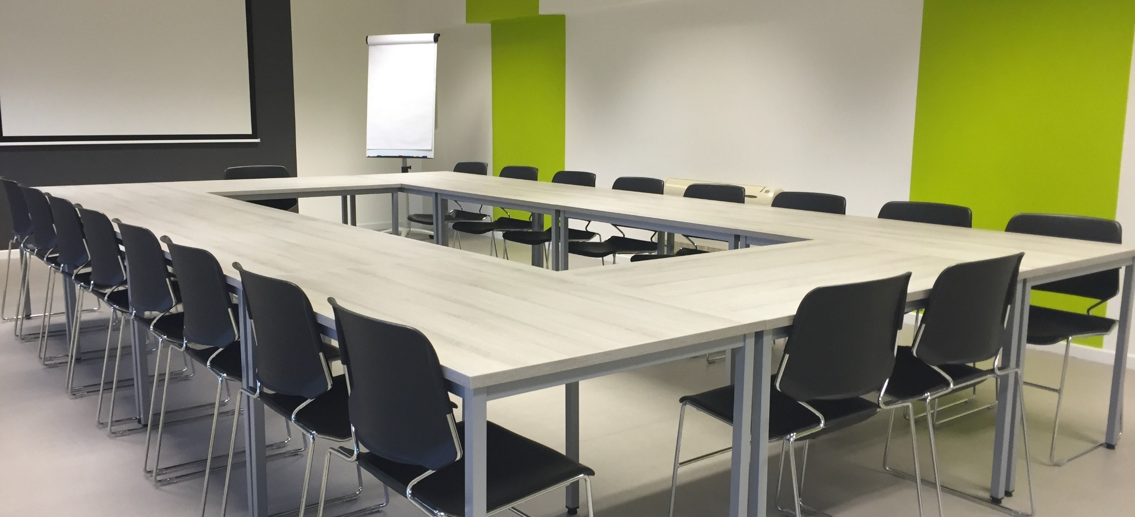

Open Meeting Law Potpourri Webinar
January 29, 2026
11 a.m. – 11:45 a.m.

Slide 3
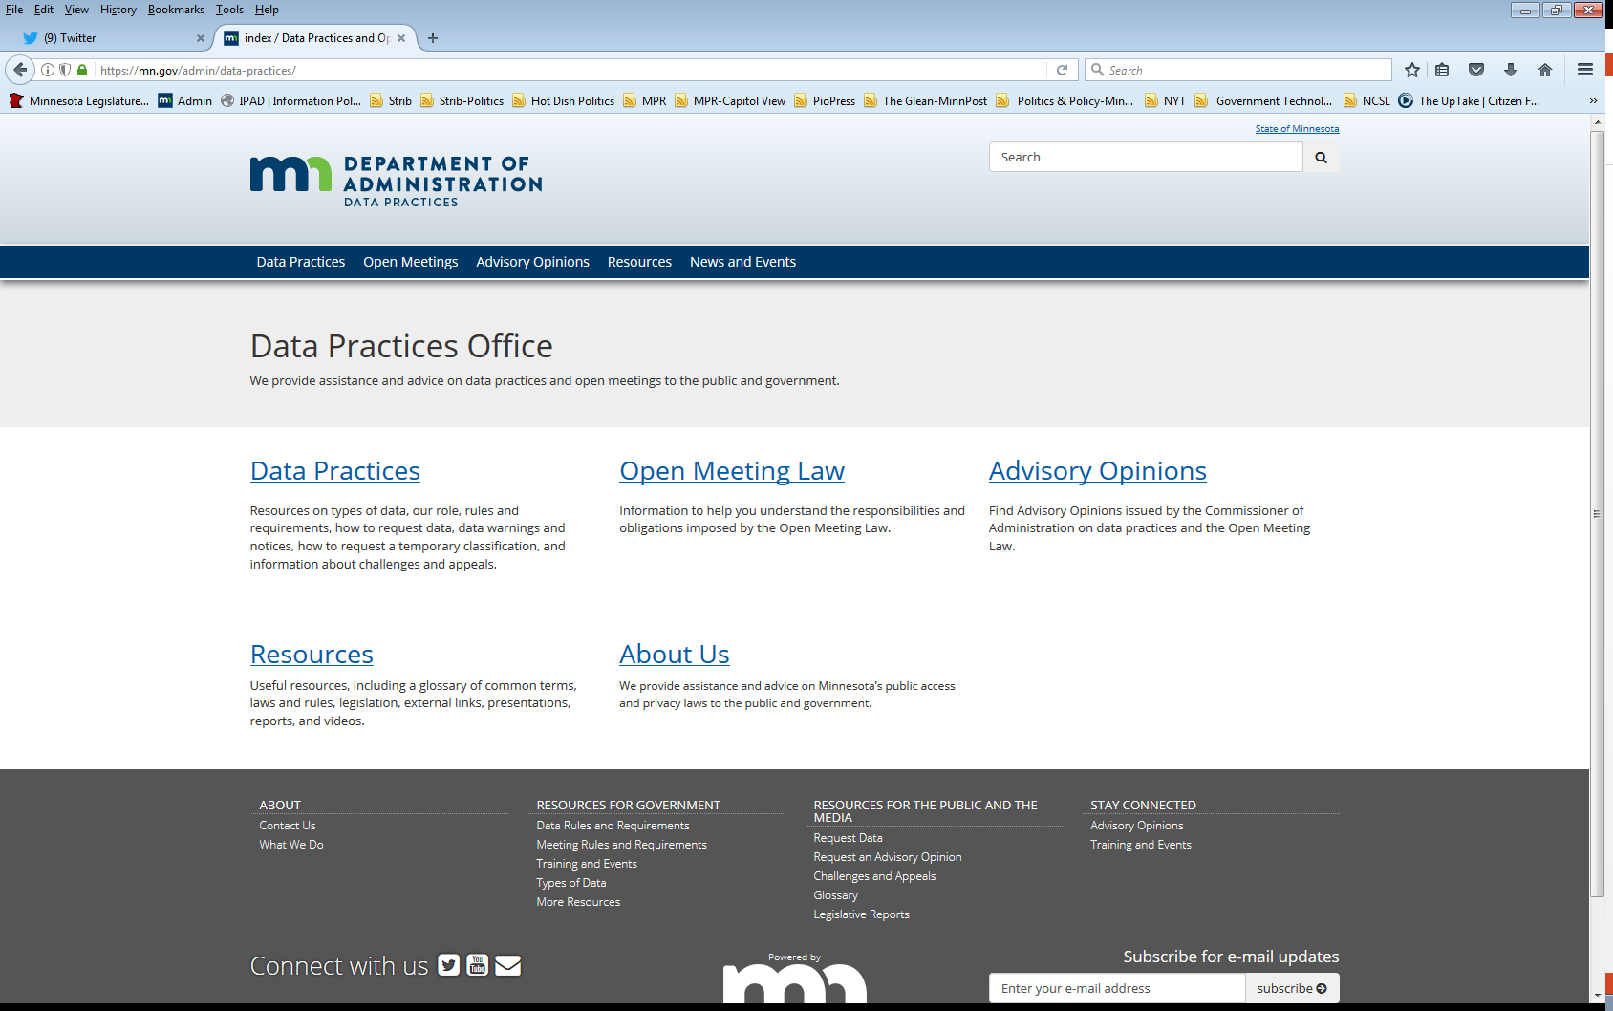
We are a statewide resource
Data Practices Office
  Informal advice/technical assistance
  Commissioner of Administration advisory opinions
  Website and info pages:
  https://mn.gov/admin/data-practices/
  Listserv and newsletters
  Legislative assistance
  Training

Slide 4
Today’s agenda
11:00 a.m. -11:45 a.m.
11:00 a.m. – Review of recent OML Advisory Opinions
11:20 a.m. – OML Potpourri: A discussion of the top questions the Data Practices Office has received
11:35 a.m. - Q&A

Slide 5
Resources reminder
Several OML resources are available:
Past OML webinars on YouTube
OML webpages on DPO website
  Closing a meeting
  Providing notice
  Remote meetings
  Myths and misconceptions
Advisory opinion library

Slide 6
OML Advisory Opinions

Slide 7
Advisory Opinion 25-010
Facts
A private group of residents hosted an invite-only event about an upcoming school bond referendum
The invitations stated the Superintendent and School Board members would be present
At the event, the Superintendent discussed school funding and plans for improvements and changes to the District, a presenter discussed curriculum opportunities, and a Board member provided information on voting for the related school bond.
The Board chair and three other Board members were present at the event. The Board had seven members in total.
Issue
Did the School Board comply with the OML when members attended this event?

Slide 8
Advisory Opinion 25-010 (cont.)
Opinion
The School Board did not comply with the OML.
Analysis
A gathering is subject to the OML if: 1) a quorum or more of public body members are present, and 2) those members discuss, decide, or receive information related to the official business of that public body.
There is no intent or formal action requirement.
While chance or social gatherings are not subject to the requirements of the OML, Moberg held that “a quorum may not, as a group, discuss or receive information on official business in any setting under the guise of a private social gathering.”
4/7 Board members attended the event = a quorum of Board members & this quorum received information related to the official business of the Board.

Slide 9
Advisory Opinion 25-008
Facts
A city council held an emergency meeting to approve a wastewater services contract.
At this meeting, one member abstained, and the remaining members voted to approve the contract with MMS Environmental to perform regular wastewater services for three years.
Issue
Did the city council comply with the OML when they had an emergency meeting to consider a contract?

Slide 10
Advisory Opinion 25-008 (cont.)
Opinion
The City Council did not comply with the OML.
Analysis
One of the mechanisms to ensure a public body’s meetings are open is to provide appropriate notice of its meetings.
Notice of emergency meetings is limited because these meetings are held to address issues that require immediate consideration by the public body (Minn. Stat., § 13D.04, subd. 3).
Emergency meetings should be held in rare circumstances where public safety is at risk and meeting the three-day notice required for a special meeting is not possible.
It did not appear that the City’s need to sign a contract required immediate attention, or that waiting three days would jeopardize public safety.

Slide 11
Advisory Opinion 25-002
Facts
A County Board of Commissioners (Board) held a regularly scheduled meeting at the county government center starting at 8:30 AM.
All of the commissioners then went to tour a county-owned building with potential tenants to explore options for a new childcare center.
Neither the regular meeting notice nor the agenda mentioned the scheduled tour.
A recording of the regular meeting did not mention the tour and stated that the meeting was adjourned.
The draft regular meeting minutes did not originally mention the tour but were later corrected to document that the regular meeting was recessed and would continue at the tour location.
Issue
Did the Board comply with the OML when commissioners gathered to tour the county-owned building after the Board’s regular meeting?

Slide 12
Advisory Opinion 25-002 (cont.)
Opinion
The Commissioner could not determine whether the Board complied with the OML due to a factual dispute.
Analysis
Minn. Stat., § 13D.04, subd. 4(a): “If a meeting is a recessed or continued session of a previous meeting, and the time and place of the meeting was established during the previous meeting and recorded in the minutes of that meeting, then no further published or mailed notice is necessary.”
If the Board adjourned the meeting, then the Board members’ special meeting with potential tenants to tour the county-owned building violated the OML.
If the Board announced the time and place of the tour before recessing the regular meeting, then the Board members reconvening the regular meeting to tour the county-owned building with potential tenants did not violate the OML.
Commissioner noted the importance of keeping accurate records.

Slide 13
Advisory Opinion 25-001
Facts
On December 12, 2024, a township board of supervisors (Board) held a special meeting to interview candidates for an open supervisor position.
During the interviews, the two Supervisors and the Town Clerk filled out score sheets for each candidate. These scoring sheets were sealed and provided to the Town Clerk at the end of the interviews.
Before the next meeting, the Town clerk and the Town Treasurer opened each of the envelopes and tallied the results.
At the Board’s next meeting on January 9, 2025, the individual receiving the highest score from the scoring sheets was present and appointed to fill the vacancy. This appointment was done by a public vote.
Issue
Did the Board comply with the OML when it made a final decision on appointing a new board supervisor outside of an open meeting?

Slide 14
Advisory Opinion 25-001 (cont.)
Opinion
The Board of Supervisors did not comply with the OML.
Analysis
Appointing a new supervisor when a position becomes vacant is part of the Board’s official business.
The Board chose a process where candidates would be interviewed and evaluated at a meeting.
Minn. Stat., § 13D.01, subd. 4(a): “The votes of the members of the […] board […] on an action taken in a meeting required by this section to be open to the public must be recorded in a journal or minutes.”
No exception to close the meeting applied.
Although the appointment happened at an open meeting on January 9th, the selection of the candidate happened outside an open meeting. The score sheets determined who would be appointed to the position. Therefore, the selection of the candidate happened when the score sheets were tallied (sometime between the December 12th and January 9th meetings).
The score sheets communicated the vote of each Supervisor and were required to be public at the December 12th open meeting.

Slide 15
OML Potpourri

Slide 16

Q. #1 – Remote attendance and camera settings (local public bodies)
Question:
Are local public body members required to have their cameras on when they attend meetings remotely?

Slide 17
A. #1 – Remote attendance and camera settings (local public bodies)
Answer: Yes, when local public body members attend meetings remotely, they are required to have their cameras on.
Under Minn. Stat., § 13D.02, subd. 1, local level public bodies may conduct meetings by interactive technology so long as the specified conditions are met.
Minn. Stat., § 13D.02, subd. 1(1) requires that all members of the body participating in the meeting, wherever their physical location, can hear and see one another…
"Interactive technology" means a device, software program, or other application that allows individuals in different physical locations to see and hear one another (Minn. Stat., § 13D.001, subd. 2)

Slide 18
Q. #2 – Remote attendance and camera settings (state-level public bodies)
Question:
Are state-level public body members required to have their cameras on when they attend meetings remotely?

Slide 19
A. #2 – Remote attendance and camera settings (state-level public bodies)
Answer: No – there is not the same on-camera requirement for state-level public body members attending meetings remotely.
Under Minn. Stat., § 13D.015 state-level public bodies may conduct meetings by telephone or interactive technology so long as the specified conditions are met.
Minn. Stat., § 13D.015, subd. 2(1) requires that all members of the entity participating in the meeting, wherever their physical location, can hear one another…

Slide 20
Q. #3 – Reasons to participate remotely
Question: Can a county board member participate in a board meeting from a location outside of the United States?

Slide 21

A. #3 – Reasons to participate remotely
Answer: Yes.
Public body members can participate in meetings remotely, for any reason, as long as statutory requirements are met.
No limitations as to where a public body member can be located when attending a meeting remotely.
Local Public Bodies:
Minn. Stat., § 13D.02
  Subd. 6 requires meeting minutes to reflect the
  names of any members appearing by interactive
  technology and state the reason(s) for the
  appearance by interactive technology
State Public Bodies:
Minn. Stat., § 13D.015

Slide 22

Q. #4 – Live video feed
Question: Are public bodies required to provide a live video feed for members of the public to remotely view open meetings?

Slide 23
A. #4 – Live video feed
Answer: If members are participating remotely, “the entity, to the extent practical, shall allow a person to monitor the meeting electronically from a remote location.”
Minn. Stat., § 13D.015, subd. 4 & Minn. Stat., § 13D.02, subd. 3
If entity is able to accommodate members participating remotely – it is likely “practical” to meet this requirement
Live video link or call-in phone number
If all members are physically present at the meeting location, this requirement does not apply

Slide 24

Q. #5 – Members of the Public livestreaming
Question: Do we need to allow members of the public who attend meetings to livestream the meetings on their phones?

Slide 25
A. #5 – Members of the Public livestreaming
Answer: Probably, as long as not disruptive.
OML is silent as to whether members of the public can record or livestream an open meeting.
1972 Opinion from the Attorney General’s Office concluded that members of the press (who are also members of the public) could record the open meetings of a city council as long as the recording was not disruptive to the meeting.

Slide 26
Send us your questions
Type your questions in the Q&A Panel
If we don’t get to your question, we will follow up afterwards
Slides are available: https://mn.gov/admin/data-practices/news/trainings/webinars/
A recording of this webinar will be available at: https://www.youtube.com/user/INFOIPAD
Please fill out the evaluation in the Q&A Panel

Slide 27
Stay in touch!
Phone: 651-296-6733
Email: info.dpo@state.mn.us
Website: mn.gov/admin/data-practices
YouTube: https://www.youtube.com/user/INFOIPAD

