Slide 1
Essentials of Data Practices for Responsible Authorities
Data Practices Office
Taya Moxley-Goldsmith
Grace Baehren

Slide 2
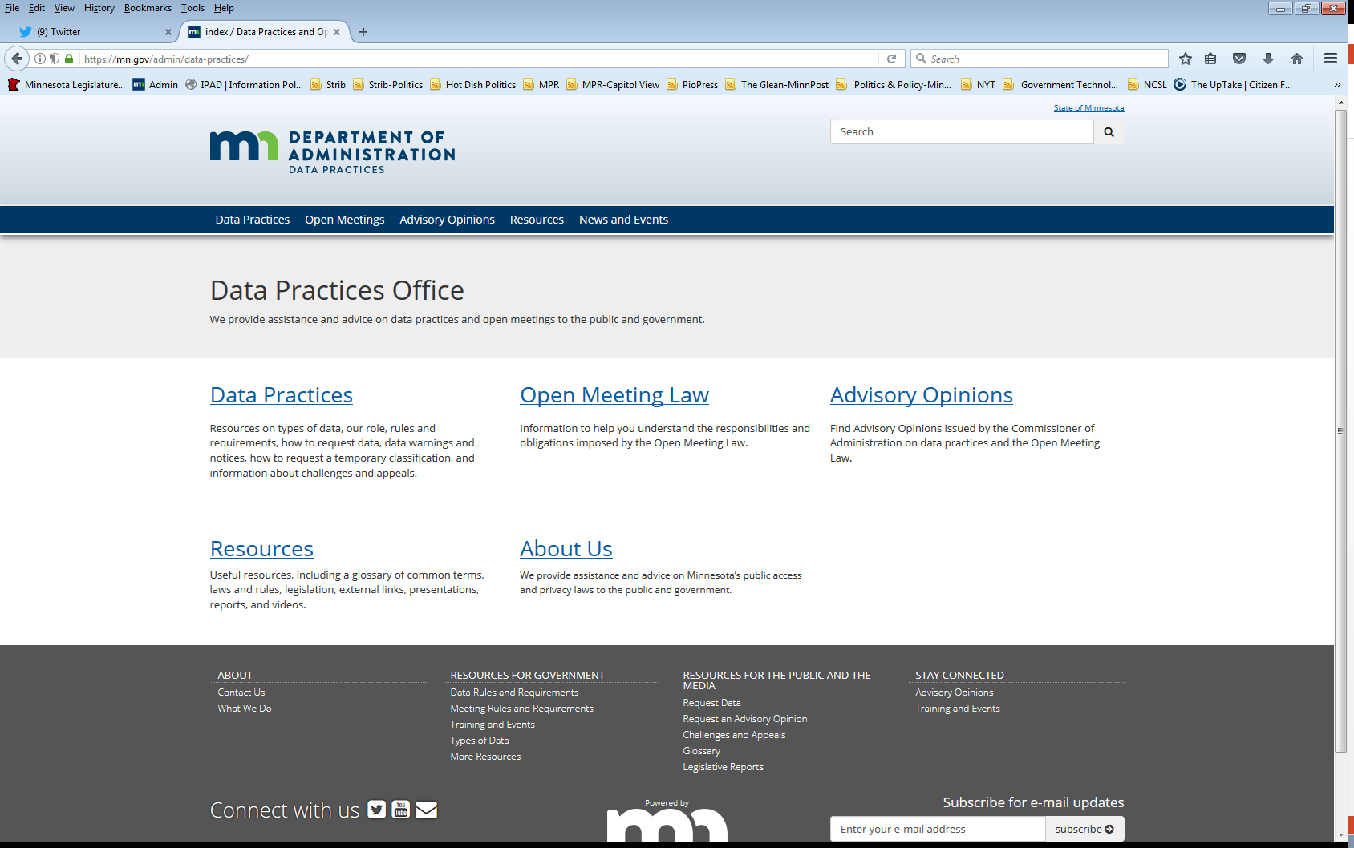
Who we are and what we do
Data Practices Office
  Informal advice/technical assistance
  Commissioner of Administration advisory opinions
  Website and info pages: https://mn.gov/admin/data-practices/
  Email list and newsletters
  Legislative assistance
  Training

Slide 3
Workshop Agenda
9:00 | Data practices basics and best practices in responding to data requests
10:45 | Morning break
11:00 | Morning scenarios
11:30 | Data practices policies, procedures, and training
Noon | Lunch
12:45 | Personnel data/redaction exercise
2:00 | Afternoon break
2:15 | Accuracy and completeness data challenges and appeals
2:30 | Data breach requirements – investigation and notification
2:45 | Afternoon scenarios
3:15 | Final Q&A and evaluations

Slide 4
Topics
Overview of requirements
Best practices in responding to requests
Remedies and penalties
Policies and procedures
Data breaches
Data challenges
Hot topics

Slide 5
Data Practices Basics

Slide 6

Data practices policy
Maintain proper balance
  Public’s right to access public government data
  Privacy rights of individuals
  Government’s need to conduct business properly and efficiently
Notes:
Policy goals – maintain proper balance three important, and sometimes competing, interests

Slide 7
Minnesota Government Data Practices Act
Minnesota Statutes, Chapter 13
  Presumes government data are public
  Classifies data that are not public
  Provides rights for the public and data subjects
  Requires that data on individuals be accurate, complete, current, and secure
Minnesota Rules, Chapter 1205
  Take note: We are updating these rules!

Slide 8
Application
Applies to statewide agencies, statewide systems, or political subdivisions
Does not apply to the legislative or judicial branches
  Minn. Stat. §13.02, subd. 7a., Minn. Stat. §13.90
Does not apply to townships outside the metro area
  Minn. Stat. §13.02 subd. 11; Minn Stat. §473.121 subd. 2

Slide 9
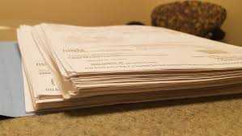

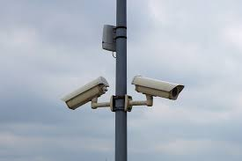
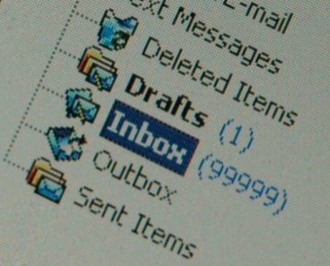
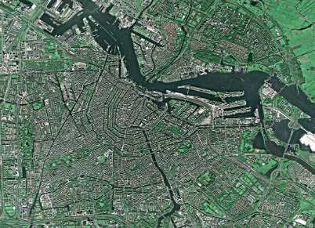
Government data defined
“All data collected, created, received, maintained or disseminated by any government entity regardless of its physical form, storage media or conditions of use.”
(Minn. Stat. § 13.02, subd. 7)

Slide 10


Other data practices related laws
    Official Records Act
    (Minn. Stat., section 15.17)
      Make and preserve all records necessary to a full and accurate knowledge of official activities
    Records Management Statute (Minn. Stat., section 138.17)
  Maintain records according to schedule
  MNGRIN: https://sites.google.com/site/mngrin/
  MN State Archives website: https://www.mnhs.org/preservation/state-archives

Slide 11

Lifecycle of government data
Government Data Practices Act
Administer Data
Official Records Act
Create and Maintain Data
Records Management Statute
Destroy data

Slide 12
Official records vs. government data
Government data
Official records (Subject to records retention schedule)

Slide 13
Chapter 13 check!
You have three versions of a report from last year including the final report.
  What is the official record?
  Are all the drafts government data?
  Can you destroy the drafts?

Slide 14
Chapter 13 check!
You have three versions of a report from last year including the final report.
  What is the official record?
    Final report (exceptions)
  Are all the drafts government data?
    Yes
  Can you destroy the drafts?
    Yes

Slide 15


Maintaining government data
No requirement to maintain data in a particular format or organization system
However…
  Data must be “easily accessible for convenient use”

Slide 16
Staff with data practices duties
Responsible authority (RA):
  A county-level elected official
  Director of county social services agency
  County Veterans Services Officer
  For other County data, individual appointed by the county board –if none, then the RA is the county coordinator or administrator or, if the county does not have a coordinator or administrator, the county auditor.
Data practices compliance official (DPCO)
Designees (optional, consider police department)
All staff have some data practices responsibilities

Slide 17
Duties of the RA
Duties:
  Create policies and procedures
  Provide training
  Coordinate responses to data requests
  Appoint the data practices compliance official
  Designate designees

Slide 18
DPCO duties
§ 13.05, subd. 13
The data practices compliance official is the designated employee of the government entity to whom persons may direct questions or concerns regarding problems in obtaining access to data or other data practices problems. The responsible authority may be the data practices compliance official.

Slide 19
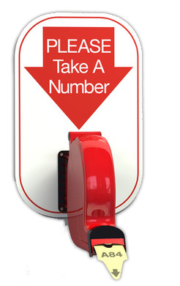
Requests for data
(Minn. Statutes §§13.03 and 13.04)
Members of the public and data subjects can request data – to inspect or get copies
  Written requests
  Accepting requests
    Designated email
    address for data requests
    Forms
    Use of portal/vendor

Slide 20
Resources
Developing Data Practices Training
Data Practices Basics Webinar
What All Responsible Authorities Need to Know
What All Employees Need to Know

Slide 21
Government data
Data on individuals | Data not on individuals
Data that identify someone Employee’s telephone number Name and address of adult arrestee Athlete of the week photograph | Data that do not identify someone Makes and models of fleet trucks Names of companies that are preferred vendors List of government websites De-identified data on individuals

Slide 22
Classification of government data
Classification | Meaning of classification | Examples
Public | Available to anyone for any reason | Employee name & salary
Private/ Nonpublic | Available to: Data subject Those in the entity whose work assignment requires access Entities authorized by law Those authorized by data subject | Employee home address & home phone number
Confidential/Protected nonpublic | Available to: Those in the entity whose work assignment requires access Entities authorized by law Not available to the data subject | Data collected as part of an active civil legal action

Slide 23
Response time
 | Member of the Public (Section 13.03, subd. 2; Minn. Rules, part 1205.0300) | Data Subject (Section 13.04, subd. 3)
Inspection and/or copies | Appropriate and prompt, a reasonable amount of time | Immediately, if possible, or 10 business days

Slide 24
Charging for government data
 | Member of the Public | Data Subject
Inspection | No charge or fee allowed | No charge or fee allowed
Copies | 25¢ per page 100 or fewer, black and white, legal/letter size paper copies Actual cost All other copies Time for search and retrieval Time to make and transmit Materials No charge to separate public from not public data Electronic data | Actual cost Time to make and transmit Materials No charge for search and retrieval No charge to separate public from not public data No charge to redact private or confidential data about others

Slide 25
Other cost considerations
Consistent application
  Charge all requesters OR
  Have conditions for when charges will apply in policies
    E.g., If over $X, copy costs apply/prepayment of 50% applies
Show your work – how did you arrive at the estimate
Do you have a process for refunding?
Requesters can pivot to inspection at any time

Slide 26
Responding to data requests
Member of the public §13.03
Guidelines for responding to requests
  Clarify if not clear
  Responses:
    Data do not exist
    Provide access to public data
    Data are not public
      Must give statutory basis for denying access
  If asked, must explain meaning (technical terminology, abbreviations, acronyms, etc.)

Slide 27
Responding to data requests
Data subject §13.04
Guidelines for responding to requests
  Clarify if not clear
  Data do not exist
  Data exist and are accessible
    Verify identity
    Six-month “exception”
  Data are confidential or private about someone else, or otherwise not public
    Must give statutory basis for denying access
  If asked, must explain (technical terminology, abbreviations, acronyms, etc.)

Slide 28
Handling large data requests
No “overly burdensome” exception to deny access
Practical considerations:
    Copies or inspection
    Contact requester to clarify scope of request
    Give context on length of time it will take to compile responsive data
    Ask whether to prioritize certain data
    Consider providing data on a rolling basis
    Connect with IT to clarify scope of searching
    Require reasonable prepayment

Slide 29
Suspension of response
Minn. Stat. § 13.03, subd. 3(g)
Suspend further responses if requester has not collected copies or come in to inspect data within 5 business days of notification
  Include information on this process in your policies
  Policies can go further and set out when a data request will be considered abandoned (should provide for a reasonable amount of time after suspension of response)
  Document, document, document

Slide 30
Burdensome vs. harassing
Burdensome requests are not inherently harassing
Respectful workplace policy extends to how our teams are treated
Document behavior and consult with HR and legal counsel
Modifications to process
  Direct communication to particular employee
  Communicate in writing
  Communicate via US Post
  Limit in-person contact including inspection (free copies)
Extreme cases – no longer data practices issue
  Law enforcement
  HRO

Slide 31
Outside of the Data Practices Act
Creating data
  Not required to create data to respond
  Considerations: databases, voluntary creations
  Exception: summary data (§13.05, subd 7)
Responding to questions
  “Why did you cancel the park project?”
  “Correspondence discussing park project between the Clerk and Parks Director”
  Exception: DPCO must respond to questions about how to get access to data and if there are issues.

Slide 32

Chapter 13 check!
A member of the public asks for your notes taken during a staff meeting.
  Are they public?
  How long do you have to respond?

Slide 33
Chapter 13 check!
A member of the public asks for your notes taken during a staff meeting.
  Are they public?
    Probably, but depends on the content.
  How long do you have to respond?
    Public - within a reasonable amount of time (if requester is the data subject – then within 10 days).

Slide 34
Limitation on collection of government data
Minn. Stat. §13.05, subd. 3 and Minn. Rules part 1205.1500, subp. 4
Collection and storage of data on individuals and
Use and dissemination of private/confidential data:
  Limited to data that are “necessary for the administration and management of programs specifically authorized by the Legislature, local governing body, or federal government.”

Slide 35
Tennessen warning notice
(Minn. Stat. §13.04, subd. 2)
When collecting private or confidential data from an individual about that individual:
  State the purpose and intended use of data
  Inform the individual whether they may refuse or are legally required to provide the data
  Explain known consequences of supplying or refusing to supply the data
  Identify other persons or entities with statutory authority to access the data
Examples: SSN, employee home address

Slide 36
Informed consent
Minn. Stat. §13.05, subd. 4 & Minn. R. 1205.1400
Informed consent is necessary when:
  The individual asks the entity to release private data to another entity or person
  The entity wants to release private data to another entity or person
  The data subject received a Tennessen warning notice and the entity now wants to use or release the data in a different way
Informed consent must be in writing and cannot be coerced

Slide 37
Penalties and remedies
Remedies (Minn. Stat. §13.08)
  Action for damages, costs, and attorneys fees
  Action to compel compliance
  Injunctive relief
Administrative remedy (Minn. Stat. §13.085)
  Administrative complaint filed within 2 years of alleged violation
  Action to compel compliance
Penalties (Minn. Stat. §13.09)
  Willful violation or knowing unauthorized acquisition of not public data = misdemeanor
  Dismissal or suspension

Slide 38
Morning break

Slide 39
Morning Scenarios

Slide 40
Data practices polices and procedures

Slide 41
Data policies v. procedures
Data access policies ≠ Procedures
Policies + Procedures = compliance
Data access policies
  How someone makes a request
Data procedures
  How the government entity responds

Slide 42
Access policies
Sections 13.025
Government entities must have access policies
  Responding to public data requests
  Data subject rights and responding to data subject requests
Additional policies & procedures for law enforcement agencies:
  https://mn.gov/admin/data-practices/data/types/lawenforcement/policies/

Slide 43
Requirements for data access policies
Must adopt written access policies
  Cannot simply rely on compliance with Data Practices Act (see AO 05-003; 13-007; 22-001)
Must be updated regularly
  By August 1 of each year or “at any other time necessary to reflect changes in personnel, procedures, or other circumstances that impact the public’s ability to access data”

Slide 44
Requirements for data access policies, cont.
Must be easily available to the public
  Distribute free copies to the public
  Place in conspicuous spot within the entity
  Post on entity’s website
Additional requirements for data subject policy
  Describe rights under 13.04
  Government entity’s specific procedures to provide data subject with access to public or private data

Slide 45
When has a requester made a request?
Request is submitted under the identified process in data access policies OR
Request is submitted to responsible authority OR
Request is submitted to data practices designee

Slide 46
When has a requester not made a request?
  Request is not submitted according to written policies
    E.g. over the phone instead of in writing
  Request is submitted to an employee of entity that is not the RA or designee
  Requester asks a question instead of requests data

Slide 47
Required data procedures
Sections 13.03, subd. 2(a); 13.05; Minn. Rule 1205.0300
Procedures to ensure data requests are received and complied with in an appropriate and prompt manner
Procedures to ensure accuracy of data on individuals
Establish appropriate security safeguards
  Procedure for ensuring not public data on individuals are only accessed by employees with a work assignment and for purposes stated

Slide 48
Required data procedures – minors
Sections 13.02, subd. 8; 13.05; Minn. Rule 1205.0500
Entities must have a procedure to allow parent access and provide notice to minors of the right to withhold
Parents may exercise the access rights of their children
Minors may restrict parental access to data about themselves if it is in the best interest of the child
Access by parents is presumed

Slide 49
Considerations for data procedures
Will your procedures be written?
  If not, can your entity demonstrate that requests are processed in appropriate and prompt manner and data are secure?
How will you delegate responsibilities for response?
  The entity can determine who responds to the request according to its procedures
  RA or designee can delegate response BUT
  RA or designee is still responsible for compliance

Slide 50
Considerations for data procedures, cont.
How do you track request was received, data was compiled, and access provided?
Do you use a “data request portal”? What accommodations are in place if someone cannot access the portal?
What steps are taken when receiving data accuracy challenge? (See §13.04, subd. 4)
How do you ensure internal access to not public data is limited?

Slide 51
Developing security procedures
Are the data “data on individuals”?
  If no, entity determination about how to protect
If yes, what is the classification?
  If public, no security requirements
If the data are private or confidential:
  Required procedures on data security (13.05, subd. 5)
  Listed on the data inventory (13.025, subd. 1)
  Optional – policy on who may access data outside the entity

Slide 52
Model policies/procedures
Model documents:
https://mn.gov/admin/data-practices/data/rules/policies/
Model Data Access Policies
  Required by section 13.025
  Model Policy for the Public
  Model Policy for Data Subjects
Model Data Inventory
  Required by section 13.025
  Identifies and describes private and confidential data maintained by the entity
Model Policy for Ensuring the Security of Not Public Data
  Required pursuant to Section 13.05
  Methods of incorporating access policy into position descriptions

Slide 53
Training Employees on Data Practices

Slide 54
Responsible authority duties
Minnesota Rules 1205.1100 and 1205.1300
The RA is required to provide training to designees and to educate entity personnel on private and confidential data.
The RA may:
  Distribute written materials
  Develop a training programs for all staff
  Require attendance by designees at internal or external training

Slide 55
Goals of employee training
Data protection and security is responsibility of government entity
Create awareness that data employees create may be public
Helps to avoid or mitigate data breaches under section 13.055
Entities cannot discipline employees for data practices violations if they are not trained
Developing Data Practices Training

Slide 56
What all employees should know
Classifications of data they work with and can access
Availability of access policies and procedures
Key staff for data practices questions & requests
Consequences for not adhering to data practices requirements or causing a breach
Use DPO YouTube videos
  Data Practices Act: What All Employees Need to Know
  Data Practices Potpourri series

Slide 57
Lunch Break!

Slide 58
What is public?
Your payroll timesheet
Your gross salary
Your education background
Your home address
Your employee identification number
Work email address
Your ID badge photo

Slide 59

Personnel data, §13.43

Slide 60
What do you think: Definition
Personnel data?
  Job posting for an administrative assistant
  Email from Data Practices Office staff to you about a copy cost question
  Applicant resume
  Report on website design vendors with a staff member’s name on it

Slide 61
Personnel data
Government data on individuals maintained because an individual is or was an employee of a government entity, applicant for employment, volunteer, or independent contractor
General public presumption is reversed:
  All personnel data are private except data specifically classified as public

Slide 62
Not everything we create is personnel data
Employee must be the identifiable subject of the data
Consider:
  Meeting notes
  Reports
  Correspondence about an official activity
Some “personal” data

Slide 63
Personal data
Data on an employee’s personal matters, unrelated to job duties or operation of government.
  Government data?
  Policy for incidental use
Advisory opinions 01-075, 02-049

Slide 64
What do you think: Contracts
The County has signed a contract with the county administrator.
A member of the public would like a copy of the contract.
Can the requester have it?

Slide 65
Public personnel data includes
§13.43, subd. 2
Name
Actual gross salary
Terms and conditions of employment
Value and nature of employer paid fringe benefits
Basis amount of added remuneration, including expense reimbursement
Education and training background and previous work experience

Slide 66
Public personnel data, cont.
Work location and a work telephone number
Work-related continuing education
Payroll time sheets or other comparable data that are only used to account for employee's work time for payroll purposes
  Except if disclosure would reveal the employee's reasons for the use of sick or other medical leave or other not public data

Slide 67
Public complaint and disciplinary data
Existence and status of complaints or charges, regardless of disciplinary action
Final disposition of any disciplinary action plus the specific reasons for and data documenting the basis of the action
Complete terms of any agreement settling any dispute arising out of an employment relationship, including a buyout agreement
  The agreement must include specific reasons for the agreement if more than $10,000

Slide 68
Public disciplinary data – local public officials
Chief administrative office, three highest paid employees, managers; chiefs; heads or directors of departments, divisions, bureaus, or boards
“All data” become public if they
  Resign while complaint is pending
  Are terminated while complaint is pending
  Are disciplined
  Settle and releases employer for liability related to the complaint or charge
Employee witness IDs remain private

Slide 69
What is disciplinary action?
Some entity discretion: entity HR policies and review collective bargaining agreements.
Minnesota Coalition on Government Information vs. City of Minneapolis, et al., No A25-0919 (Minn. App. May 18, 2026), nonprecedential.
  An action imposed by the MPD to punish, penalize, or correct behavior in response to a complaint or charge against the employee, consistent with the rights and obligations as established by PELRA.
  Minneapolis has petitioned the Supreme Court for review

Slide 70
Advisory opinions – personnel data
97-049: Employee work email address is public as part of work location.
04-017: Dollar value of employee’s health insurance benefit is public as “fringe benefit.”
08-029: Added remuneration, outside income unrelated to employment are private personnel data.
13-002: Requester entitled to redacted application and supplement.
21-005: Work-sponsored training that offers continuing education credits and other benefits is “work-related continuing education.

Slide 71
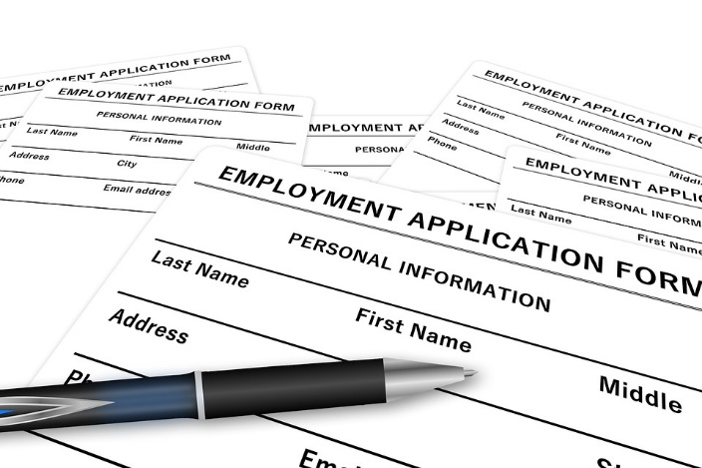
Data on applicants
§13.43, subd. 3
Everything is private except:
  Veteran status
  Relevant test scores
  Rank on eligible list
  Job history
  Education and training
  Work availability
Names are private until a finalist
  Finalist = selected for interview by appointing authority

Slide 72
Elected officials
Entity determines whether they are employees
  Krout v. City of Greenfield, A11-1200, (Minn. App. April 16, 2012), nonprecedential
  Advisory Opinions 26-003 (citing 5 other opinions)
  Document decision – resolution, bylaw, memo
If no determination, data about them data are presumptively public
Exception in Minn. Stat. §13.601
  Correspondence with individual constituents is private
  Required financial disclosures are public

Slide 73
What do you think: Personal devices
A Government employee sends a work-related email from their personal email address on their phone.
  Are the data on their personal email account and/or phone government data?

Slide 74

What do you think: Personal devices - answer
Employees can create government data on personal devices
Employers might consider:
  Policy on compliance with records retention and data requests
  Policy on usage

Slide 75
4-Part webinar series on personnel data
Webinar series
  Introduction to personnel data
  Sharing personnel data
  Complaints and discipline
  Recap

Slide 76
Redaction exercise
Small group discussion
Handouts

Slide 77
Redaction
Separate responsive data from those data not accessible
At the data element level
Identity can be more than a name
Provide specific citation in support of redaction
  At data element level or at document level?

Slide 78
Afternoon break

Slide 79
Data Challenges and Appeals
Minnesota Statutes, section 13.04, subd. 4 & Minnesota Rule 1205.1600

Slide 80
Challenging the accuracy and completeness of data
Data subjects have the right to challenge the accuracy and completeness of data about themselves.
Data being challenged must be:
  Public or private
  About the person submitting the challenge (or minor child)
The data challenge itself must be:
  In writing
  Addressed to the Responsible Authority

Slide 81
What do you need to do when you receive a data challenge?
RA must respond within 30 days by:
  Correcting data that are inaccurate/incomplete and notify past recipients of the inaccurate/incomplete data OR
  Notifying the data subject that the data are accurate and complete, and their right to appeal
    Disputed data can only be disclosed if a statement of disagreement is included with the data

Slide 82
Data challenge appeals
  Data subject can appeal to the Commissioner of Administration
A complete appeal that is not resolved through informal resolution is set for a contested case hearing
  Entity pays for hearing
Commissioner may dismiss appeal if it is not timely, data was presented as evidence in court, or appellant is not the data subject.

Slide 83
Data Breaches

Slide 84

Data Breaches
(Minn. Stat. § 13.055)
Statute defines “breach of the security of the data”
  Unauthorized acquisition by an unauthorized person that compromises security and classification of data
  Unauthorized acquisition = obtained, accessed, or viewed data with intent to use data for nongovernmental purposes
  Unauthorized person = any person who accesses data without a work assignment

Slide 85
When has there been a data breach?
There has been a breach that generally triggers a notice under section 13.055 when ALL of the following apply:
  A person,
  Views or takes private or confidential data,
  Without permission or statutory authority, and
  With the intent to use the private or confidential data for nongovernmental purposes

Slide 86
What should a breach notice look like?
In writing
Inform the individual that a report will be prepared about the breach investigation
State that an individual may request a copy of the report by mail or email
Sent without unreasonable delay

Slide 87
How must an entity provide notice?
First class mail or electronic notice
Substitute notice is an option if:
  Cost of written notice exceeds $250,000 or the group exceeds 500,000, or
  Entity does not have sufficient contact information
Substitute notice must include:
  Email notice if the entity has an email address for affected individuals
  Post the notice on the website of the entity, if the entity maintains a website
  Provide notification to major media outlets within the entity’s jurisdiction
Entity must notify consumer reporting agencies if a breach requires notification to more than 1,000 individuals

Slide 88
What type of report is required following a breach investigation?
Entity must complete an investigation and prepare a report, including facts and the results of the investigation
If the breach involved unauthorized access by an employee, the report must include:
  Description of the data that were accessed or acquired
  Number of individuals affected
If there is a final disposition of disciplinary action against an employee, the report must include:
  Name of each responsible employee
  Final disposition of discipline taken in response

Slide 89
Data breach annual security assessment
Yearly security assessment of any personal information entity maintains
“Personal information” is an individual's first name or first initial and last name in combination with one or more of these elements when unencrypted:
  Social security number
  Driver's license number or Minnesota ID card number
  Account number or credit/debit card number in combination with the security code, access code, or password
Security assessment will vary depending on personal information maintained

Slide 90
Data breaches?
 | Corrective Action | 13.055 Notice
Accidentally accesses not public database | Yes | No
Incorrectly types email address and sends not public data to wrong government employee | Yes | No
Inadvertently reads report with not public data without appropriate work assignment | Yes | No
Looks up driver’s license data about new neighbor without appropriate work assignment | Yes | Yes

Slide 91
Cybersecurity incidents
(Minn. Stat. §16E.36)
https://mn.gov/mnit/about-mnit/security/cir/
Requires notification of any cybersecurity incidents to MNIT. New requirement beginning Dec. 1, 2024
Applies to all public agencies
Cybersecurity incident
  An action taken through the use of an information system or network
  That results in an actual or potentially adverse effect on an information system, network, or information residing therein

Slide 92
Scenarios
Small group discussion

Slide 93
Contact DPO
651-296-6733
info.dpo@state.mn.us
https://mn.gov/admin/data-practices/
YouTube training videos: user/infoipad

