Slide 1
Introduction to ARCHIBUS
ENTERPRISE REAL PROPERTY
ERP Team: Jedd Prokash (presenter), Emilie Casebolt, & Abdi Ahmed

Slide 2
Agenda Items
Order | Topic
1) | Introductions
2) | What is ERP
3) | What is ARCHIBUS
4) | Short ARCHIBUS Demo
5) | Questions

Slide 3
What is the Enterprise Real Property (ERP) Division?
Enterprise Real Property Mission:
  To assist the State in making critical decisions for property assets at an enterprise level by collaboratively setting and enforcing policy, procedures, standards and guidelines concerning coordination and cooperation between agencies on real property matters, and clearly communicating these strategies within State agencies and legislative groups.
  Enterprise Real Property goal: To provide the tools and information necessary for a data-driven facility investment and management strategy across State government to promote fiscal accountability and measurable results.

Slide 4
What is the Enterprise Real Property (ERP) Division?
ERP Background
2005 Executive Order 05-06: To consolidate all silo real property management systems into an Enterprise solution.
2007 funding was appropriated – ERP was established
2008 An Enterprise Facility Management System (ARCHIBUS) was selected, and the METT group was formed
Enterprise ARCHIBUS was not fully implemented until 2012.
Since this time ARCHIBUS was gone through 3 major upgrades.
Includes 19 State agency’s data for approximately 6,000 State-owned buildings consisting of more than 36 million square feet, and more than 3.1 million acres of land
Notes:
• Tracks an average of 125,000 maintenance and work orders annually for State facilities
• Manages and tracks more than 850 active leases
• Inventories and tracks maintenance history of more than 45,000 facility-supporting equipment
• More than 2,500 active users

Slide 5
What does ERP do?
Take enterprise facility management business needs and initiatives (new statutes an executive orders) and try to come up with practical solutions through the use of the ARCHIBUS software.
Setting facility data policies, procedures, standards, guidelines, and making modifications to the software to fit needs.
Keep the software functioning as intended
Provide train-the-trainer-training
Consist of 3 team members and METT group

Slide 6
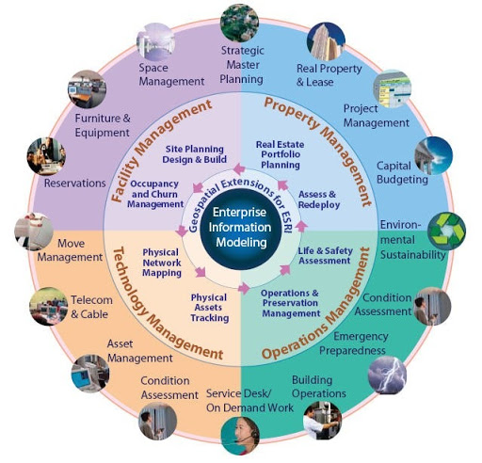
What is ARCHIBUS?
Compliance Module

Slide 7
What is ARCHIBUS?
Computer Aided Facility Management (CAFM) software system
With technology, ARCHIBUS attempts to bring all information regarding facilities and the management of facilities into one place.
Includes: space management, building operations, Facility Condition Assessments (FCAs), employee moves, project management, asset management, emergency preparedness, and lease management. Coming soon: Compliance management, environmental health and safety management, and ESRI GIS Extension
ARCHIBUS is a toolbox with many tools to assist facility managers and strategic planners with information needed to make critical business decisions.
Notes:
Around 35 modules

Slide 8

ARCHIBUS as a Toolbox
Make your job easier
Assist in producing better quality work
Increase production
Increase efficiency
Reduce costs
Designed to help us succeed
It is not designed to create more work or to promote micromanagement

Slide 9

Why use ARCHIBUS?
Addresses turnover and knowledge transfer issues (senior level employees with institutional Knowledge)
Consistency reduces training needs
Protects against audits
Saves time with accessible information to all and not just one subject matter expert (encourages transparency).
Opportunity to help get organized (Provides basis for good recorded keeping practices).
Promotes good communication with automated email notification functions
Creates autonomy and accountability
Only as good as the data that goes in.

Slide 10
ARCHIBUS Toolboxes
ARCHIBUS Platforms (User Interface)
Smart Client (built in wall cabinets)
  Windows desktop application
Web-Central (rolling tool chest)
Mobile (handheld toolbox)
ARCHIBUS Environments
Reference (Ref2023)
Development (Dev2023)
Test (Test2023)
Production

Slide 11
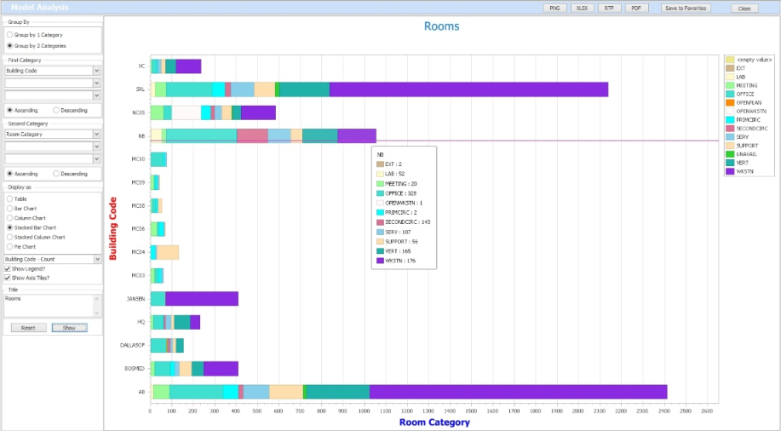
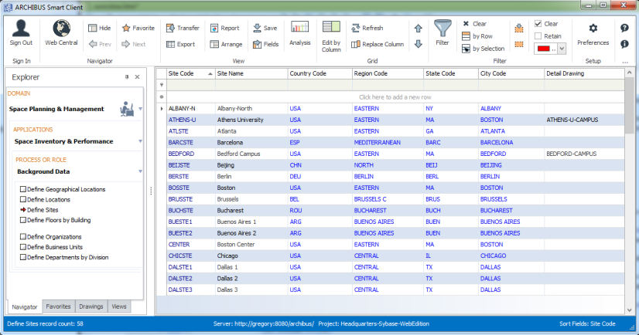
ARCHIBUS Smart Client
Create and edit database records.
Perform bulk data updates
Review and analyze data using interactive features,
Filter inventory tables
Compare and analyze data
Transfer your data
Generate paginated reports
Manage your CAD drawings
Notes:
View Analysis Command. ARCHIBUS users have a reputation for being able to deliver solid information quickly and respond to ad hoc data calls from senior management. How many hospital recovery rooms might be subject to a new change in inspection oversight? How much bioengineering lab space is available in the East Campus for a high-priority project? What research areas might be affected by high vibrations from a renovation next door? What is our total warehouse capacity in Dallas? Which specimen test machines are currently unallocated?
Edit by Columns Command. Often, Smart Client users manage intensive data with a large number of fields. The Edit by Columns command adds a record-style panel that can view and edit all fields of even very large tables at once. You can page through the records either with the Page up and Page down actions in the record-style panel or by filtering and clicking on rows of the table-style data. For example, the below image shows a table in three columns.
Select Fields Command. Tables often have dozens of fields, making a specific field or set of fields hard to find. The Select Fields command adds the ability to filter the field list by a prefix or wildcard to find all related fields in one step. For instance, you can filter for all cost fields or area fields in one step. For instance, you can filter for all cost fields or area fields in one step or find that field you know ends in "Service Code".
HTTPS Compatible. The Smart Client and the Smart Client Extensions for AutoCAD and Revit can now support either .Net 4.0 or 4.5, with the result that sites whose IT governance rules dictate the use of TLS 1.1/TLS 1.2 protocols when using HTTPS can do so by using version of Smart Client for .Net 4.5. .Net 4.0 is still supported for those

Slide 12
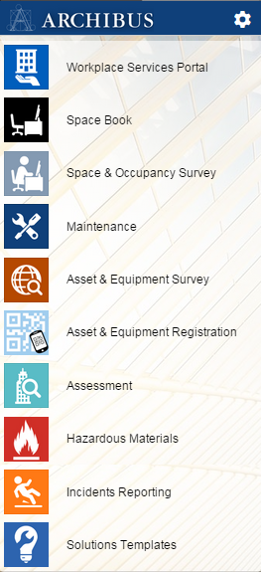
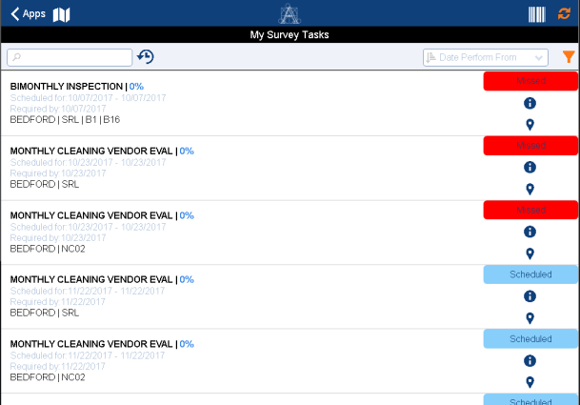
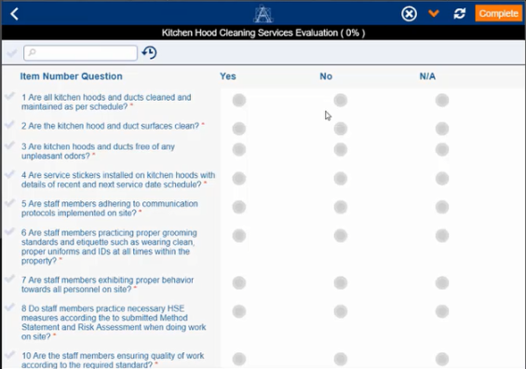
ARCHIBUS Mobile
Meet the needs of users who are on-the-go
Improve your space and facility discussions by having space plans at your fingertips.
Improve the accuracy of and speed the collection of data in the field.
Improve the accuracy of field reports and increase productivity by reducing the time spent on paperwork and note-taking.

Slide 13
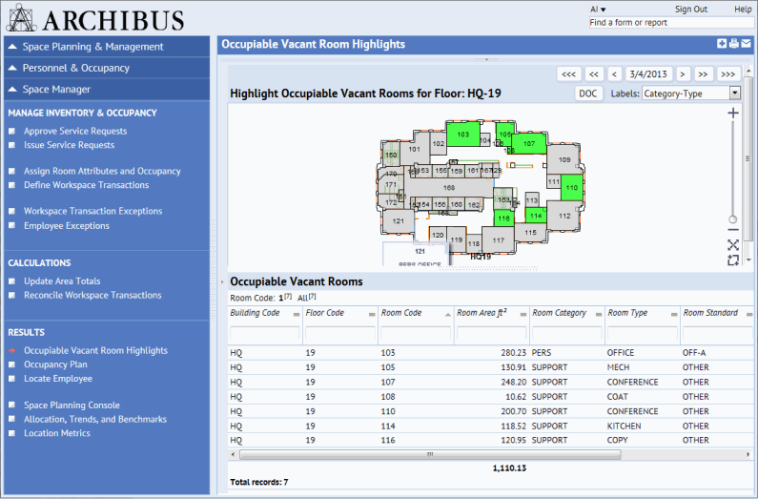
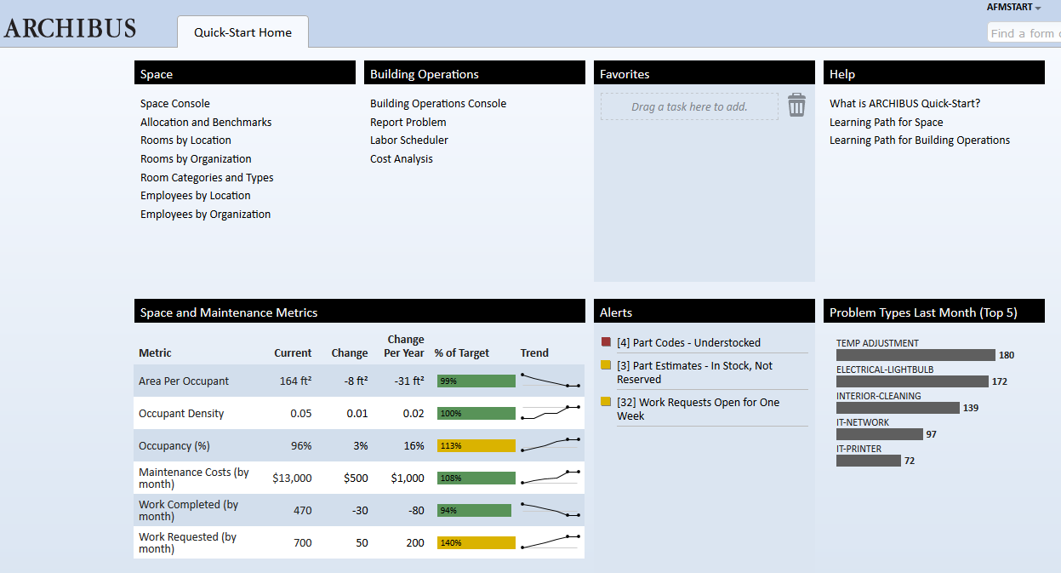
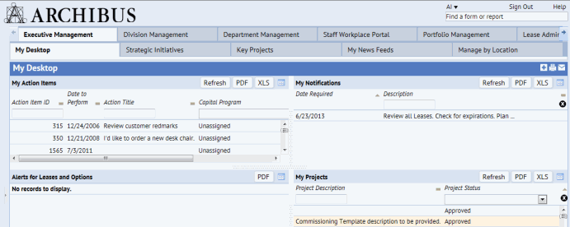
ARCHIBUS Web-Central
User Interfaces
Process Navigator
Home Page – Page Navigator
Dashboard
Accessible Navigator

Slide 14
ARCHIBUS Web-Central Demo
https://test2023.realprop.admin.state.mn.us/archibus/login.axvw

Slide 15
ARCHIBUS: Home Pages and Metrics
Use home page for simpler use of Archibus
Don’t need to see or navigate through what you don’t use
Metrics to help to stay on top of work with alerts
Shows performance with key indicators

Slide 16
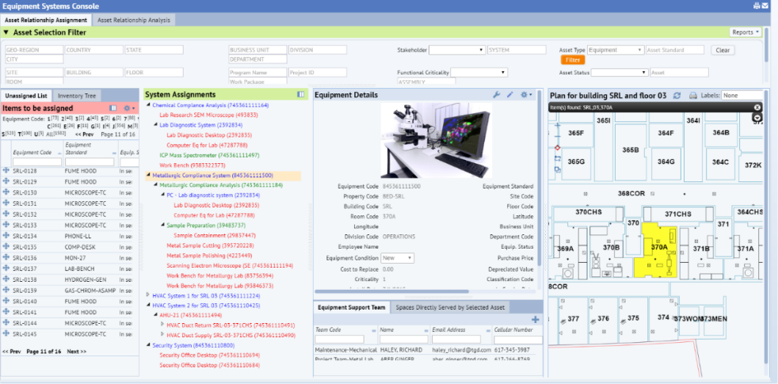
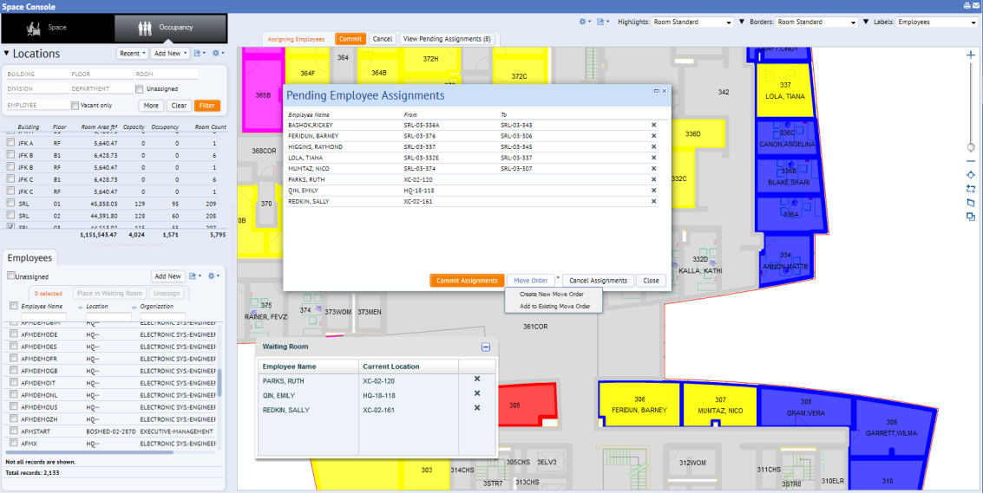
ARCHIBUS Modules
Space Management
  Utilized by all agencies and Space Management Services
  Contains floor plans (AutoCAD/Revit), building background data, and land inventory
    CAD drawings are the foundation of Archibus
  Maximizes space utilization by efficient inventory, planning, management and allocation of space
Asset Management
  Equipment useful life is monitored
  History of equipment maintenance can easily be retrieved to see preventive maintenance log or reoccurring issues
  Used to identify equipment for overhaul or replacement before failure
  Equipment and furniture can be tracked by account code, location, type, useful life, manufacturer, age, warranty expirations and incidents
Notes:
Path: Space Planning & Management / Space Inventory & Performance / Space Manager / Space Console Ref – HQ – Floor 11
Path: Asset Management/Asset Management/Asset Manager/Equipment Systems Console Ref

Slide 17
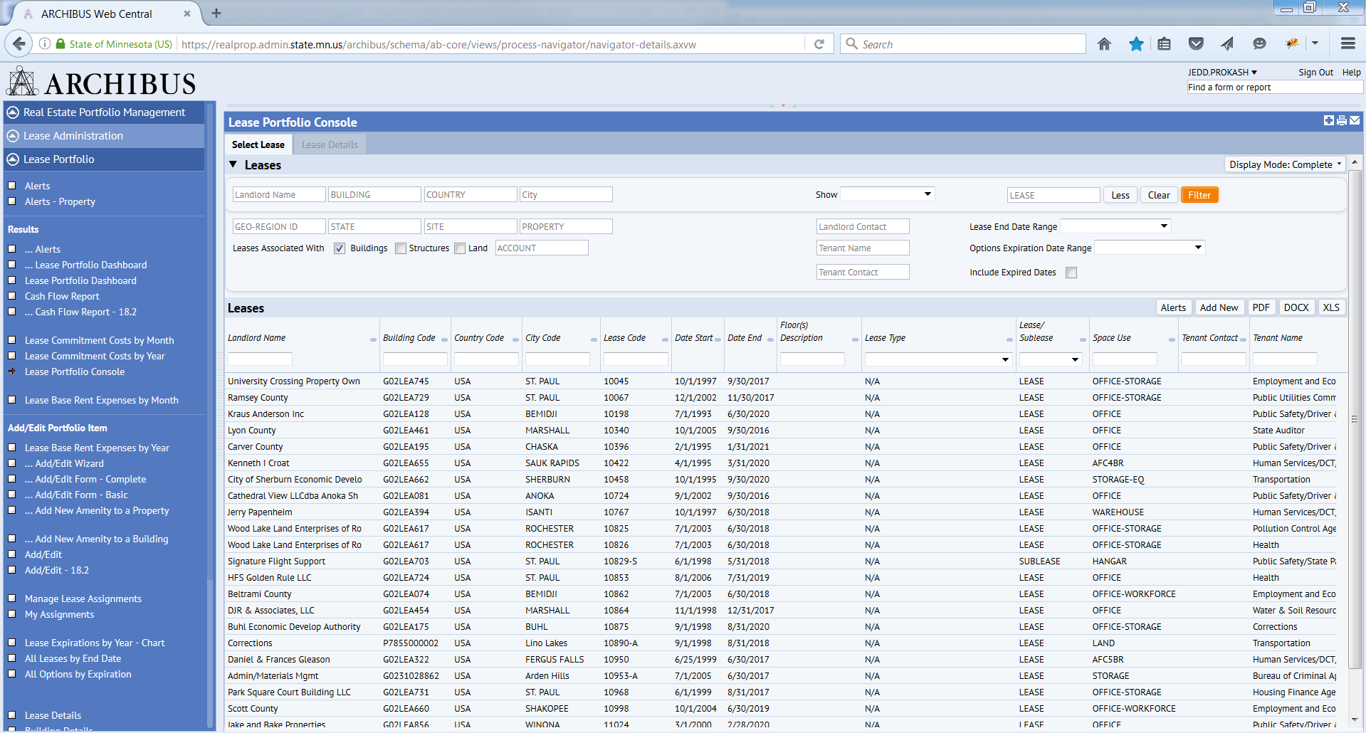
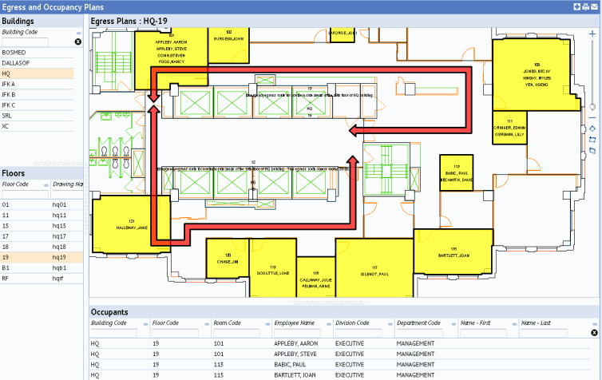
ARCHIBUS Modules
Emergency Preparedness
  Prepare your facility and your FM staff to respond to and manage all types of emergencies
  Record, access, and update the critical facility information that you need in the event of an emergency.
  Communicate with email bulletins to keep emergency team and staff informed of ongoing emergency.
  Easily locate and record COOP available rooms to use for staff relocation.
Lease Management
  Leasing Services utilize this module
  Enables efficient management of agency leases by tracking expiration dates, lessor and lessee duties, and lease assignments to leasing staff
  Accurate real time reporting capabilities
  Customer access to lease reports online
Notes:
Path: Move Management / Enterprise Move Management / Move Coordinator / Examine Move Calendar Ref - group moves – 12/1/2019 (use Firefox)
Path: Real Estate Portfolio Management / Lease Administration / Lease Portfolio / Lease Portfolio Console
Path: Real Estate Portfolio Management/Lease Administration/Executive Reports/Buildings Dashboard
Path: Real Estate Portfolio Management/Lease Administration/Lease Portfolio/... Lease Portfolio Dashboard Ref - Lease Code: L-HQ-0102

Slide 18
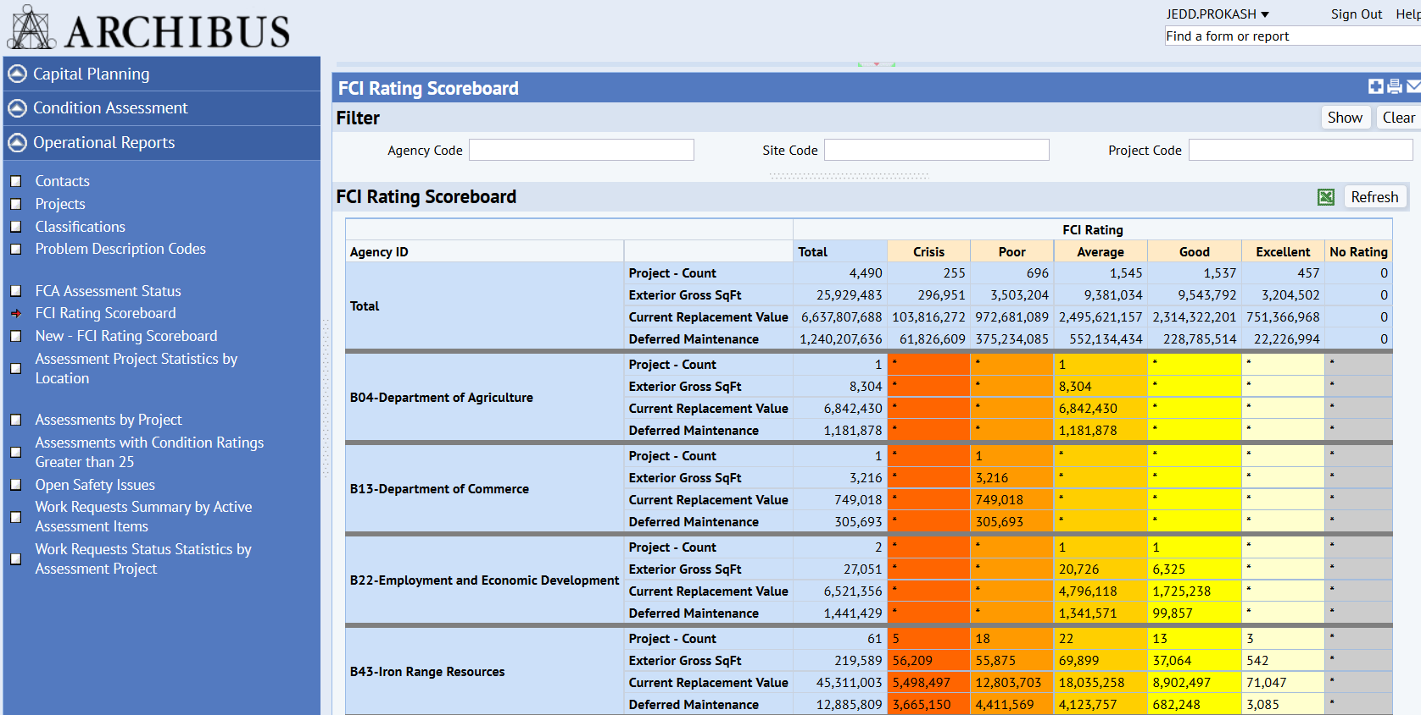
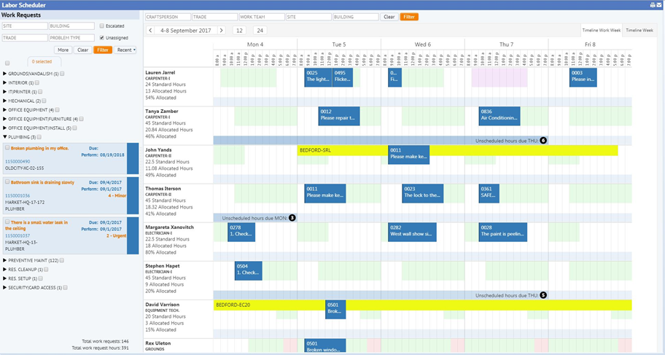
ARCHIBUS Modules
Building Operations
  Self-service process for requesting work
  Schedule preventative maintenance work
  Respond quickly to on demand work
  Prolong life cycle of equipment
  Document common causes of equipment breakdown
  Forecast future operating costs and budgeting
Facility Condition Assessment
  Standardized assessment process to determine overall facility conditions
  Ability to compare facility conditions across the State and determine which buildings are in the most critical condition.
  Objectively make decisions regarding maintenance fund distributions.
  Determines deferred maintenance quantitatively and use to generate asset preservation requests
  Utilized by agencies to plan and prioritize projects
Notes:
Path: Building Operations / On Demand Work / Client / Create Request
Path: Building Operations / On Demand Work / Client / Building Operations Console Test
Path: Capital Project Management / Condition Assessment / Assessment Manager / Condition Assessment Console Test – B1300000001

Slide 19
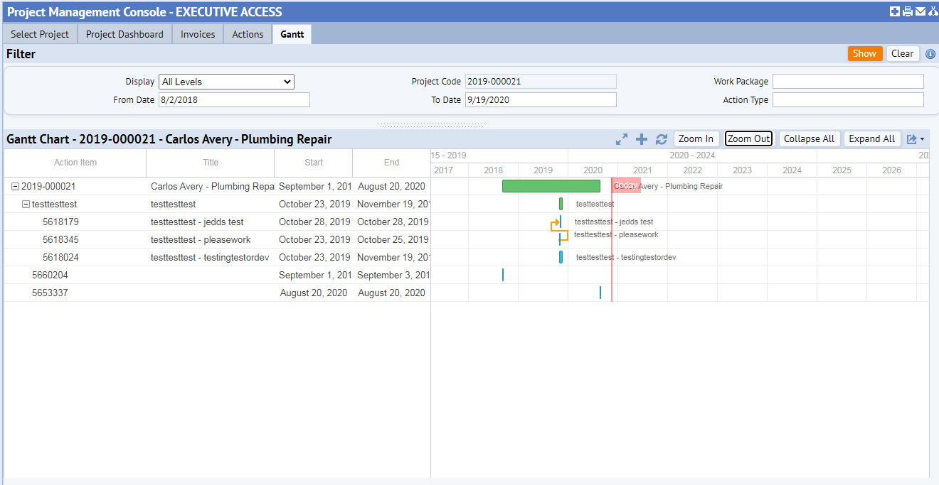
ARCHIBUS Modules
Project Management
Create a central repository for a “Top-Down” perspective of program and project priorities, actions, and costs
Facilitate a collaborative process to allow project members to synchronize information at different locations or organizational units
Provide clear, weighted performance scorecard views of multiple programs and/or projects to identify late or over-budget components at a glance
Streamline project oversight via consolidated views displaying milestones, tasks, and status changes to all project members
Notes:
Path: Capital Project Management / Project Management / Manage / Management Console Test – R29-2020-000006
Path: Environmental & Risk Management / Emergency Preparedness / First Responders / Call Up Egress Plans Test – B0420000445
Path: Environmental & Risk Management / Emergency Preparedness / Executive / Locate COOP Buildings Map Test – Arden Hills

Slide 20
References
ARCHIBUS Website https://archibus.com/products/
ARCHIBUS Help https://help.archibus.com/user_en/archibus.htm
ARCHIBUS Reference Environment https://ref2023.realprop.admin.state.mn.us/archibus/login.axvw
ARCHIBUS Development Environment https://dev2023.realprop.admin.state.mn.us/archibus/login.axvw
ARCHIBUS Test Environment https://test2023.realprop.admin.state.mn.us/archibus/login.axvw
ARCHIBUS Production Environment https://realprop.admin.state.mn.us/archibus/login.axvw

Slide 21
Thank you!
Jedd Prokash
Jedd.Prokash@state.mn.us
651-201-2554

