Slide 1
Law Enforcement Data Workshop
June 4, 2026
Morning

Slide 2
WebEx Walkthrough
Mute/Unmute
Cameras
Chat, Participant, and Polling panels
Breakout sessions

Slide 3

Introductions
Please introduce yourself:
Your name
Your entity
Your role in data practices
Any burning questions you would like to discuss today

Slide 4
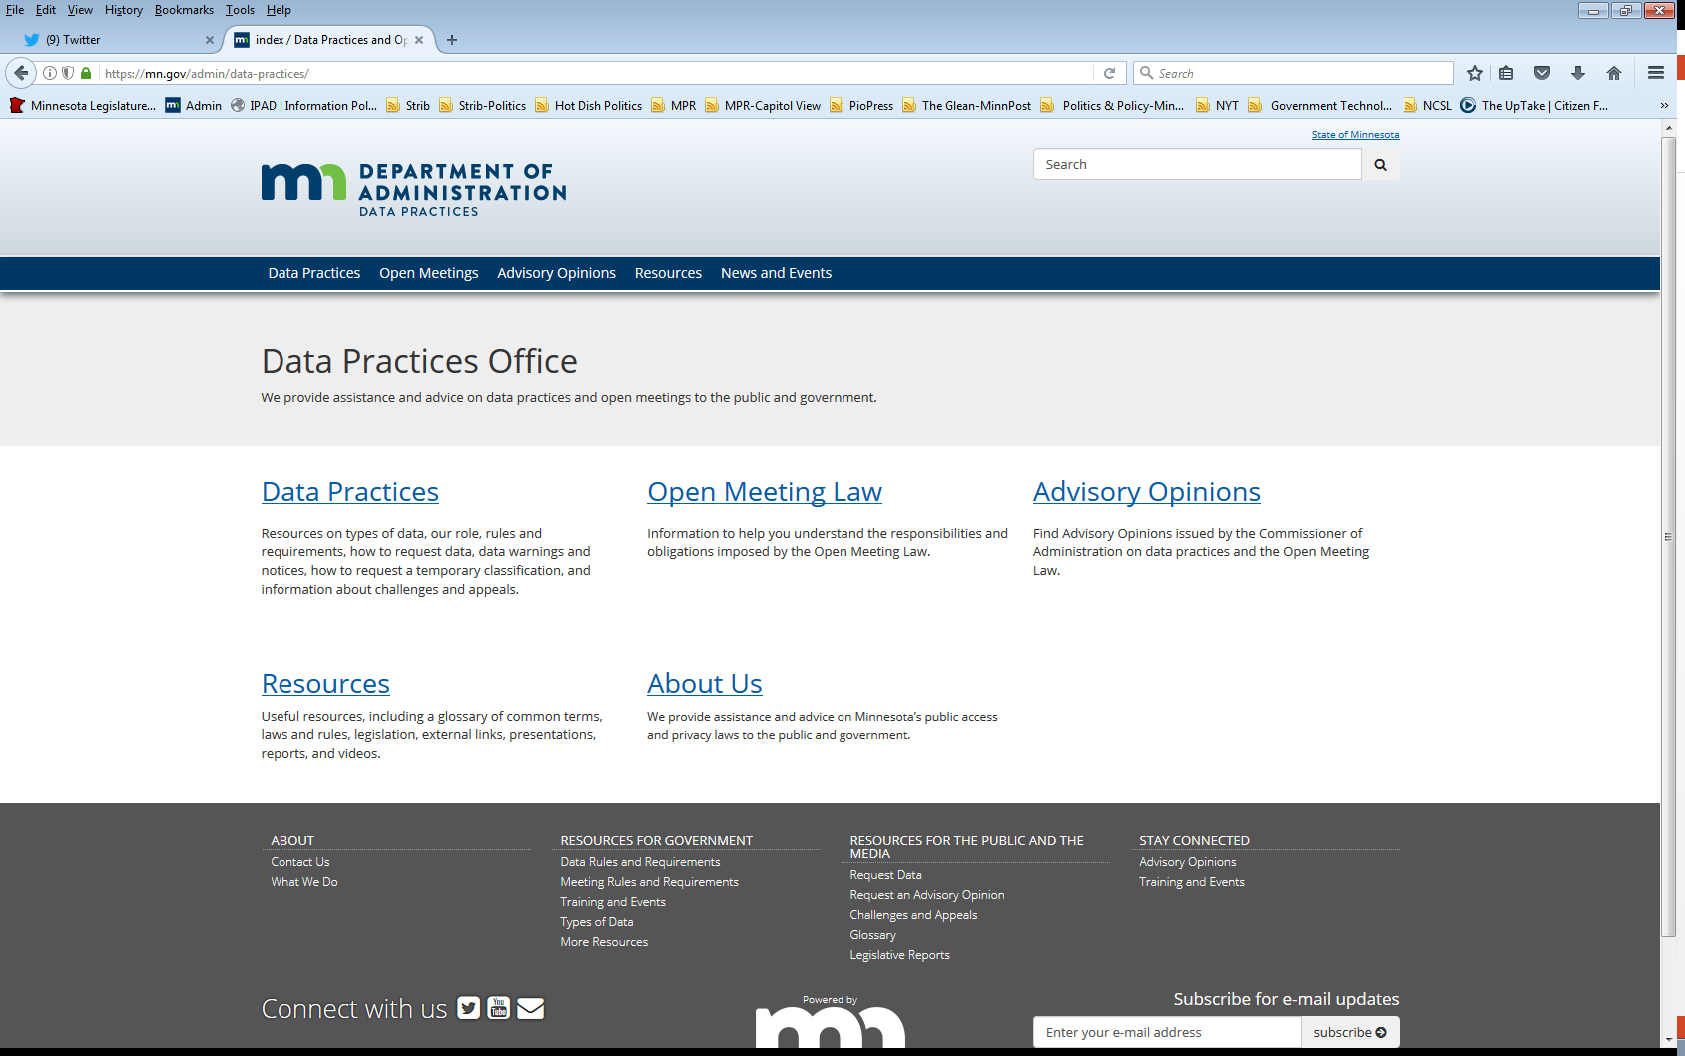
Who we are and what we do
Data Practices Office
  Informal advice/technical assistance
  Commissioner of Administration advisory opinions
  Website and informational materials: https://mn.gov/admin/data-practices/
  Listserv and newsletters
  Legislative assistance
  Training

Slide 5
Agenda
8:30 | Welcome and Introductions
8:45 | Law Enforcement Data Overview
10:00 | Break
10:15 | Protected Identities & Morning Scenarios
11:30 | Maltreatment data
Noon | Lunch
1:00 | Law enforcement video discussion
1:45 | Miscellaneous provisions
2:00 | Break
2:15 | Miscellaneous provisions, cont.
2:45 | Afternoon law enforcement data scenarios
3:15 | Final debrief, general Q&A, evaluations
3:30 | End of day

Slide 6
Today’s Objectives
Identify LE data provisions & requirements in the Minnesota Government Data Practices Act and other applicable statutes
  Investigative data
  Law enforcement videos
  Miscellaneous provisions that apply to law enforcement work
Apply Data Practices Act requirements in different situations

Slide 7
Data practices laws
MN Government Data Practices Act, Ch. 13
  Presumes government data are public
  Classifies data that are not public
  Access rights for the public and data subjects
  Data on individuals are accurate, complete, current, and secure
Official Records Act requires preservation of all records necessary to a full and accurate knowledge of official activities
Records Management Statute requires records retention schedules approved by records disposition panel
  MN State Archives: www.mnhs.org/preserve/records/gov_services.htm

Slide 8





Government data defined
Minn. Stat. §13.02, subd. 7
“All data collected, created, received, maintained or disseminated by any government entity regardless of its physical form, storage media or conditions of use.”

Slide 9
Classification of government data
Classification | Meaning of Classification | Examples
Public | Available to anyone for any reason | Adult arrest information
Private/ Nonpublic | Available to: Data subject Those in entity whose work requires access Entities authorized by law Those authorized by data subject | Inactive body camera footage, 911 audio
Confidential/ Protected Nonpublic | Available to: Those in entity whose work requires access Entities authorized by law Not available to data subject | Active criminal investigative data

Slide 10
Redaction Exercise
Handout 102

Slide 11

Adult Law Enforcement Data
Minn. Stat. §13.82 (Handout 103)

Slide 12
Application
Applies to agencies which carry on a law enforcement function
Does not include prosecuting attorneys
Informal AG opinion disagrees with advisory opinion 01-079
Public prosecutors in original provision; removed in 1981 amendment
Section 13.393 applies to data held by government attorneys
Local prosecution authorities are criminal justice agencies
Municipal police and county sheriff departments
Fire departments
BCA, state patrol, POST
Other agencies (DNR, DHS)

Slide 13
What’s public?
Is there an active investigation?
Yes:
The following data are public, subject to protection of certain identities:
Arrest data (subd. 2)
Request for service data (subd. 3)
Response or incident data (subd. 6)
Criminal investigative data presented in court (subd. 7)
No:
All inactive investigation data are public (subject to several exceptions)
No investigation = Data are presumptively public

Slide 14
Arrest data
Section 13.82, subd. 2
Actions taken to cite, arrest, incarcerate or otherwise substantially deprive an adult individual of liberty shall be public at all times in the originating agency:
  If adult:
    Name, age, sex, and last known address of adults
    Time, date, and place of action
    Resistance, pursuit, weapons
    Legal basis for action (charge, arrest or search warrant)
    Agency, units and individuals taking action
    Custody info (whether and where)
    Use of ALPR, body cam, wiretapping (unless jeopardize investigation)
    Manner received info leading to arrest and names of informants (unless protected identities)
  If juvenile (hearing not public): age and sex only

Slide 15
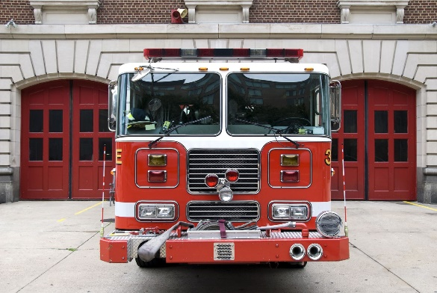


Request for service data
Section 13.82, subd. 3
Requests by the public for law enforcement services shall be public:
  Nature of the request or the activity
  Name and address of the individual making the request (unless protected identity)
  Time and date of the request or complaint
  Response initiated and the response or incident report number

Slide 16
Response or incident data
Section 13.82, subd. 6
Data describing the agency’s response to a request for service, or actions taken by the agency on its own initiative shall be public:
  Date, time and place of the action
  Agencies, etc. participating in the action (unless protected identities)
  Any resistance encountered, pursuit engaged in, or weapons used
  Brief factual reconstruction of events associated with the action
  Names and addresses of witnesses to agency action or incident (unless protected identities)

Slide 17
Response or incident data, cont.
  Names and addresses of any victims (unless protected identities)
  Name and location of the health care facility to which victims were taken
  Response or incident report number
  Use of body camera to document the agency’s response
  Specific to traffic accidents:
    Dates of birth of the parties involved
    Whether the parties involved were wearing seat belts
    Alcohol concentration of each driver

Slide 18
Criminal investigations
Section 13.82, subd. 7
Active investigative data - data collected or created by law enforcement to prepare a case against a person are confidential/protected nonpublic
Except:
    Arrest, request for service, response or incident data (public)
    Protected identities (private)
    Public benefit data (discretion to release)
    Exchange of information by law enforcement agencies – “pertinent and necessary” to an investigation
    Prosecutor shall release to victim upon written request
    Data presented as evidence in court

Slide 19
Inactive investigative data
Inactive investigative data are public
Except:
    Jeopardize ongoing investigation (confidential/protected nonpublic)
    Reveal protected identities (private)
    Images and recordings (photographs, video, audio records) offensive to common sensibilities (private)
    Certain child or vulnerable adult abuse data (private)
    Certain body camera data (private)

Slide 20

When are investigations inactive?
Decision not to further pursue or prosecute the case
Time to charge expires
All rights to appeal exhausted or expired
Not guilty/exonerated*

Slide 21
Public benefit data
§ 13.82, subd. 15
Applies to all confidential/protected nonpublic active investigative data (not protected IDs) AND any not public body camera or drone video data
Public benefit data may be shared to
  Aid in the law enforcement process,
  Promote public safety, or
  Dispel widespread rumor or unrest.

Slide 22

What do you think?
Reporter Mary Richards requests a copy of a photo of Petunia, the famously ugly dog. The photo is related to an incident that was not part of a criminal investigation.
Can the Mary have the photo?
What if the photo is part of an active investigation?
What about when the case becomes inactive?

Slide 23
What do you think - answer
Reporter Mary Richards requests a copy of a photo of Petunia, the famously ugly dog. The photo is related to an incident that was not part of a criminal investigation.
Can the Mary have the photo?
  Yes, the photo is presumptively public
What if the photo is part of an active investigation?
  No, active investigative data and not subds. 2, 3, or 6
What about when the case becomes inactive?
  Yes, unless – offensive to common sensibilities ☺

Slide 24

What questions do you have for us so far?

Slide 25
Morning Break!

Slide 26
Protecting identities
Section 13.82, subdivision 17 (Handout 105)
Must have procedures to acquire and protect certain identities
Protected identities are private
Identity is more than a name

Slide 27
Identities you must protect
Undercover law enforcement officer
Victim or alleged victim of criminal sexual conduct or sex trafficking
Deceased person unlawfully removed from a cemetery
Mandated reporter
Person making a 911 call or name and phone number of service subscriber if either:
  Reason is for help in a mental health emergency; OR
  Determine revealing identity would threaten safety of person or property

Slide 28
Identities you may protect
Document determinations to protect:
  Paid or unpaid informant – threat to personal safety
  Victim or adult witness to a crime
    Must ask AND
    LEA determines that disclosure would threaten the personal safety or property of the individual
  Juvenile witness – LEA determines subject matter of the investigation justifies protection

Slide 29

911 Calls
Section 13.82, subd. 4
Recording of 911 call
  Private data on the caller
Transcript of 911 call
  Public
    Unless it reveals a protected ID under subd. 17
  Person requesting transcript shall pay actual cost of transcription
AO 25-009
  LEA did not respond appropriately to data request for 911 transcript when it initially denied the request & later provided a redacted transcript

Slide 30

What do you think?
What is the classification of a recording of a call made to a police department non-emergency line (i.e., not 911)?

Slide 31
What do you think - Answer
The content of the call will determine classification.
  Active criminal investigation = confidential/protected nonpublic
  Property complaint data – identity of caller is confidential, § 13.44
  Other calls likely subject to public presumption
No requirement to make a transcript

Slide 32
What do you think?
A 13-year-old called 911 for assistance in a medical emergency. Her 9-year-old brother was having an allergic reaction.
What can be released to a media requester?

Slide 33
What do you think - Answer
Data about minors
There is not a general protection for government data on minors (exception – DNR)
There is not a general classification of medical data
Audio of the 911 call is private
Media/public can access the rest of the data about this call.
Other classification for juvenile witnesses, juvenile victims, or juvenile bad actors (delinquents)

Slide 34
Peace officer records of children resources
Law enforcement Data on Juveniles (35 minutes):
  https://youtu.be/fuxkM0yC53Y?si=vJjal23Y9nZYwOeS
Law enforcement data and school sharing
  https://mn.gov/admin/data-practices/data/types/lawenforcement/law-enforcement-schools/

Slide 35
Morning Law Enforcement Scenarios
Handout 106
Breakout Session Discussion

Slide 36
Breakout Rooms
Handout 106 – Morning adult scenarios
Click button to join group.
Spokesperson = the person with the next birthday
Take 15-20 minutes to review and discuss the scenarios and questions with the group.
To exit breakout session - click the red circle at the bottom of screen and choose leave break out.

Slide 37
Child and Adult Maltreatment Investigative Data

Slide 38
Criminal maltreatment investigations
Minn. Stat. §13.82, subds. 8-11
ID of a victim or alleged victim of child maltreatment or vulnerable adult maltreatment is always private (active or inactive)
ID of a mandated reporter is private (subd. 17)
ID of non-mandated reporters
  Child maltreatment = confidential
  Vulnerable adult maltreatment = private
Active Investigative data are confidential/protected nonpublic (subd. 7)

Slide 39
Criminal maltreatment investigations – inactive
Minn. Stat. §13.82, subds. 8-11
Inactive investigative data = private when:
  Statute of limitations has run or
  There was a decision not to move forward with an investigation or prosecution
Inactive investigative data = public when there has been a court process and appeal rights have been exhausted or expired

Slide 40
Maltreatment investigations – vulnerable adults
Minn. Stat. §626.557
LEA may exchange not public data with:
A tribal agency, facility, service provider, vulnerable adult, primary support person for a vulnerable adult, state licensing board, federal or state agency, the ombudsman for long-term care, or the ombudsman for mental health and developmental disabilities, and local county agencies
IF the data are pertinent and necessary to:
Prevent further maltreatment of a vulnerable adult
Safeguard a vulnerable adult
For an investigation under §626.557

Slide 41
Maltreatment investigations – child maltreatment
Minn. Stat. §§260E.20, 260E.35
LEA may exchange not public data with
Local welfare agencies
To coordinate investigations and avoid duplication
Broad authority to share not public data includes active investigative data
Department of Health
Department of Human Services
Department of Education
State and local child mortality review panel
Must notify PELSB (teacher licensure board)
When a licensee has been found to have abused a student (§260E.12)
The civil investigatory entity will maintain LE data as confidential/protected non-public until it is inactive.

Slide 42
What do you think?
Mom reported that Dad abused their child. Ultimately, no criminal charges are filed. The case is now closed.
Dad requests access to the police file. What can he access?

Slide 43
What do you think - Answer
Minn. Stat. § 13.82, subds. 8 & 9
ID of victim child maltreatment under C. 260E = private.
No charges OR statute of limitations has run = investigative data are private.
Dad can have access to data about himself and his child (unless there is a court order limiting his rights, e.g., termination of parental rights).
Mom would not get access to any data about Dad in these circumstances

Slide 44
What do you think?
A member of the public requested a case file. The case is inactive but involved an investigation into maltreatment of a vulnerable adult by their caretaker.
What can the public access?

Slide 45
What do you think - Answer
Answer:
13.82 subd. 7: Inactive data are public
But
13.82 subd. 10: Identifying data on victim and reporter of vulnerable adult maltreatment are private.
13. 82 subd. 11: Inactive data related to alleged maltreatment of a vulnerable adult by a caregiver or facility are private in certain circumstances.

Slide 46
What do you think?
A police department receives an inquiry from county social services. They are investigating suspected maltreatment of a child by their parent. You have one active case and two inactive cases that did not result in charges.
What should the PD provide?

Slide 47
What do you think - Answer
Answer:
260E.20 and 260E.35: Social services may have access to active investigative data on the same incident, as well as inactive investigative data related to alleged maltreatment by the parents or of the child.

Slide 48
What do you think?
911 receives a call that a stranger has assaulted a vulnerable adult. Law enforcement investigates. A member of the public asks for the report.
Should you redact the vulnerable adult’s name?

Slide 49
What do you think - Answer
Answer:
Subd. 10 – A victim of vulnerable adult maltreatment is private.
However, this is not an instance of vulnerable adult maltreatment under section 626.557.
Victim ID is public under subds. 6 (response or incident)
Consider if subd. 17 protected IDs for victims applies

Slide 50
What other questions do you have?

Slide 51

Lunch break!
1 hour

