Slide 1
Introduction to Data Practices
Data Practices Office
April 2026

Slide 2
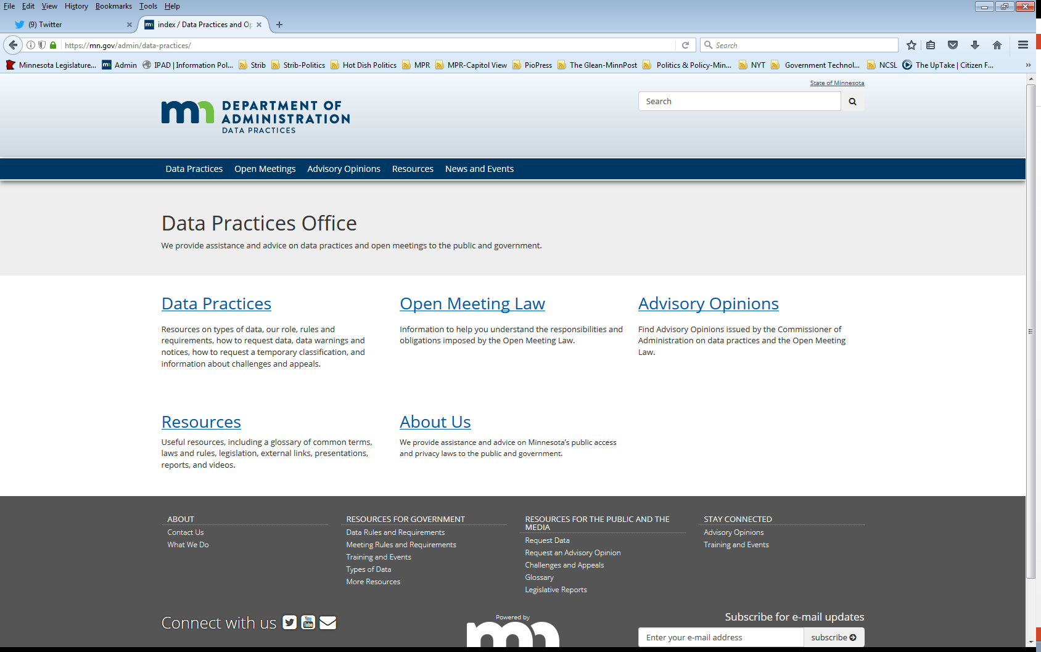
Who we are and what we do
Data Practices Office
Informal advice/technical assistance
Commissioner of Administration advisory opinions
Website and informational materials: https://mn.gov/admin/data-practices/
Listserv and newsletters
Legislative assistance
Training

Slide 3
Agenda
Time | Topic
1:00 | Welcome and introductions
1:10 | Data Practices Act Overview
2:15 | Break
2:25 | Data Practices Act scenario #1
2:55 | Continue Data Practices Act Overview
3:15 | Data Practices Act scenario #2
3:45 | Developing Policies
3:55 | Final questions and complete evaluations
4:00 | Workshop complete

Slide 4
Today’s Objectives
Identify the broad requirements of the Minnesota Government Data Practices Act
Understand general responsibilities under the Data Practices Act
Maintaining government data
Responding to data requests
Identifying employees with data practices responsibilities
Apply Data Practices Act requirements in different situations

Slide 5
Data Practices Act Overview

Slide 6

Data practices policy
Maintain proper balance
Public’s right to access public government data
Privacy rights of individuals
Government’s need to conduct business properly and efficiently

Slide 7
Minnesota Government Data Practices Act
Minnesota Statutes, Chapter 13
Presumes government data are public
Classifies data that are not public
Provides rights for the public and data subjects
Requires that data on individuals be accurate, complete, current, and secure
Minnesota Rules, Chapter 1205
*Note: We are updating these rules!

Slide 8
Minnesota Government Data Practices Act continued
Applies to statewide agencies, statewide systems, and political subdivisions
Does not apply to the legislative or judicial branches
(Minn. Stat. § 13.02, subd. 7a, Minn. Stat. § 13.90)
Does not apply to townships outside the metro area
(Minn. Stat. § 13.02, subd. 11; Minn Stat. § 473.121, subd. 2)

Slide 9
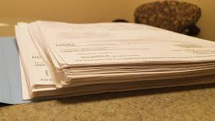

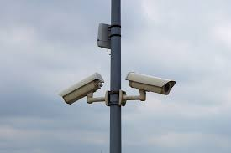
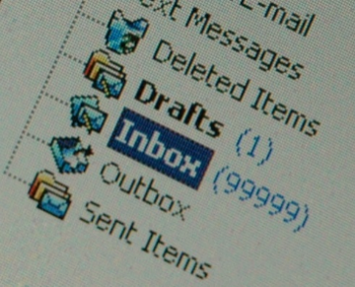
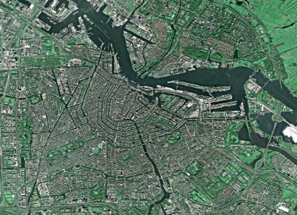
Government data defined
“All data collected, created, received, maintained or disseminated by any government entity regardless of its physical form, storage media or conditions of use.”
(Minn. Stat. § 13.02, subd. 7)

Slide 10
Exception: Personal Data
“Personal data” is not government data and not subject to the Data Practices Act
AO 01-075: data maintained by a government entity may be personal data, rather than government data
What constitutes “personal data” depends on what the entity has authorized for personal use
-incidental use policy
Not government data because the employee did not create the data in their capacity as a government employee

Slide 11


Other data practices related laws
Official Records Act (Minn. Stat. § 15.17)
Make and preserve all records necessary to a full and accurate knowledge of official activities
Records Management Statute (Minn. Stat. § 138.17)
Records retention schedules and records disposition panel
MN State Archives website: https://www.mnhs.org/preservation/state-archives

Slide 12
Lifecycle of government data
Official Records Act
Government Data Practices Act
Administer data
Records Management Statute
Destroy data
Create and maintain data

Slide 13
Official records vs. government data
Government data
Official records (Subject to records retention schedule)

Slide 14
What do you think? (# 1)
You have three versions of a report from last year, including the final report.
What is the official record?
Are all the drafts government data?
Can you destroy the drafts?

Slide 15
What do you think? (#1) Answer
You have three versions of a report from last year, including the final report.
What is the official record?
Final report (exceptions)
Are all the drafts government data?
Yes
Can you destroy the drafts?
Yes

Slide 16
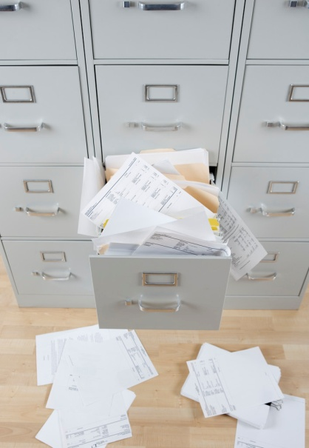
Maintaining government data
No requirement to maintain data in a particular format or organization system; however,
Data must be “easily accessible for convenient use”

Slide 17
Government data
Data on Individuals
Data that identify someone
Employee’s telephone number
Name and address of adult arrestee
Athlete of the week photograph
Data not on Individuals
Data that do not identify someone
Makes and models of fleet trucks
Names of companies that are preferred vendors
List of government websites

Slide 18
Classification of government data
Classification | Meaning of classification | Examples
Public | Available to anyone for any reason | Employee name and salary
Private/Nonpublic | Available to: Data subject Those in the entity whose work assignment requires access Entities authorized by law Those authorized by data subject | Employee home address and telephone number
Confidential/ Protected nonpublic | Available to: Those in the entity whose work assignment requires access Entities authorized by law NOT available to the data subject | Data collected as part of an active civil legal action

Slide 19

Staff with data practices duties
Responsible authority (RA)
Data practices compliance official (DPCO)
Designee
Other staff

Slide 20
Responsible authority (Minn. Stat. § 13.02, subd. 16 & Minn. R. 1205.0200)
State agency
Commissioner, Constitutional Officer, Chief Executive Officer, or an official appointed by the agency’s governing body
County
Elected officials (county attorney, sheriff, etc.)
Employee appointed for data outside elected officials’ offices
County social services agency director (§ 13.46, subd. 10)
County veterans service officer (§ 197.603, subd. 2)
City
Person appointed by city council or the city clerk
School District
Person appointed by school board or the superintendent

Slide 21
Requests for data (Minn. Stat. §§ 13.03 and 13.04)
Members of the public and data subjects can request inspection or copies of data
Written requests
Accepting requests
Online portals
Designated email address for data requests
“Remote inspection” - a request for copies

Slide 22
Disability Accommodations (42 U.S.C. §§ 12131-12150; Minn. Stat. § 363A.42)
Title II of the ADA
state and local government entities are subject
requires reasonable modifications to policies, practices, and procedures where needed to make sure that a person with a disability can access the entity’s services
Minn. Stat. § 363A.42
requires reasonable modifications to any policies, practices, and procedures that might otherwise deny equal access to records to individuals with disabilities
Accommodation request procedures

Slide 23
Responding to data requests Members of the public (Minn. Stat. § 13.03)
Guidelines for responding to requests:
Clarify if not clear
Data do not exist
Data exist and are public
Data are not public
Must give statutory basis for denying access
If asked, must explain meaning (technical terminology, abbreviations, acronyms, etc.)
Directing requestors to websites (AO 04-024)

Slide 24
Responding to data requests Data subjects (§ 13.04)
Guidelines for responding to requests:
Clarify if not clear
Data do not exist
Data exist and are accessible
Verify identity
Six-month “exception”
Data are confidential or private about someone else, or otherwise not public
Must give statutory basis for denying access
If asked, must explain (technical terminology, abbreviations, acronyms, etc.)

Slide 25
Handling large data requests
The Data Practices Act does not contain an “overly burdensome” exception to deny access
Practical considerations when processing large data requests:
Contact requester to clarify scope of request
Give context on length of time it will take to compile responsive data
Ask whether to prioritize certain data
Consider providing data on a rolling basis

Slide 26
Suspension of Response (Minn. Stat. § 13.03, subd. 3(g))
Entities can suspend further responses to a request if data requester has not collected copies or gone in to inspect data within 5 (five) business days
Include information on this process in your policies
Policies can go further and set out when a data request will be considered abandoned (should provide for a reasonable amount of time after suspension of response)

Slide 27


Requests outside of the Data Practices Act
Creating Data
*Exception: summary data (Minn. Stat. § 13.05, subd. 7)
Responding to Questions

Slide 28
Response Time (Inspection or Copies)
Member of the Public
Appropriate and prompt, reasonable amount of time (Minn. Stat. § 13.03, subd. 2, Minn. R. 1205.0300)
Data Subject
Immediately, if possible; otherwise, 10 business days (Minn. Stat. § 13.04, subd. 3)

Slide 29
Charging for Government Data - Inspection
No charge or fee is allowed for inspection of government data.
Inspection is always FREE
This is true whether the data requester is a data subject or a member of the public

Slide 30
Charging for Government Data - Copies
Members of the public
25¢ per page for 100 or fewer pages of black/white, legal/letter size paper copies
“Actual cost” for all other copies
Time for search and retrieval
Time to make and transmit the copies
Materials
(Minn. Stat. § 13.03, Minn. R. 1205.0300)
Data subjects
“Actual cost”
Time to make and transmit the copies
Materials
(Minn. Stat. § 13.04, Minn. R. 1205.0400)

Slide 31
Actual Cost does NOT include redaction time
A government entity may NOT charge to separate public from not public data or to redact private or confidential data about others
(Minn. Stat. § 13.03, subd. 3(c), Minn. Stat. § 13.04, subd. 3)

Slide 32

What Do You Think? (#2)
A member of the public asks for your notes taken during a staff meeting.
Are they public?
How long do you have to respond?

Slide 33
What Do You Think? (#2) Answer
A member of the public asks for your notes taken during a staff meeting.
Are they public?
Depends on the content.
How long do you have to respond?
Within a reasonable amount of time (unless requester is the data subject – then within 10 days).

Slide 34
Questions/Break #1

Slide 35
Scenarios

Slide 36
Data Practices Act Overview, Cont.

Slide 37
Tennessen Warning (Minn. Stat. §13.04, subd. 2)
When collecting private or confidential data from an individual about that individual:
State the purpose and intended use of data
Inform the individual whether they may refuse or are legally required to provide the data
Explain known consequences of supplying or refusing to supply the data
Identify other persons or entities with statutory authority to access the data
Examples: SSN, employee home address

Slide 38
Informed Consent (Minn. Stat. §13.05, subd. 4 & Minn. R. 1205.1400)
Informed consent is necessary when:
The individual asks the entity to release private data to another entity or person
The entity wants to release private data to another entity or person
The data subject received a Tennessen warning, and the entity now wants to use or release the data in a different way
Informed consent must be in writing and cannot be coerced

Slide 39
Penalties and Remedies
Civil Remedies (Minn. Stat. §13.08)
Action for damages, costs, and attorney fees
Action to compel compliance
Administrative Remedy (Minn. Stat. §13.085)
Complaint must be filed within 2 years of alleged violation
Action to compel compliance, attorney fees
Penalties (Minn. Stat. §13.09)
Willful violation or knowing unauthorized acquisition of not public data = misdemeanor
Dismissal or suspension of public employee
Advisory opinions (Minn. Stat. §13.072)

Slide 40
Data Challenges and Appeals Minnesota Stat. § 13.04, subd. 4; Minn. R. 1205.1600

Slide 41
Challenging the Accuracy and Completeness of Data
Data being challenged must be:
Public or private
Data about the person submitting the challenge (or their minor child)
The data challenge itself must be:
In writing
Addressed to the Responsible Authority

Slide 42
What to do when you receive a data challenge
RA must respond within 30 days
Correct data if it is inaccurate/incomplete and notify past recipients of the inaccurate/incomplete data, OR
Notify the data subject that it is the RA’s position that the data are accurate and complete
Disputed data can only be disclosed if a statement of disagreement is included with the data

Slide 43
Data Challenge Appeals (Minn. Stat. § 13.04, subd. 4(d)-(e))
Data subject can appeal to the Commissioner of Administration
Entities must inform data subjects of right to appeal
Commissioner may dismiss appeal if:
it is not timely,
data was presented as evidence in court, or
appellant is not the data subject.

Slide 44
Data Challenge Appeals continued (Minn. Stat. § 13.04, subd. 4(f))
Data submitted to the Commissioner, and the data subject's descriptions of the challenged data, have the same classification as maintained by the government entity
RA may submit private data to the Commissioner
Commissioner may disclose private data within the appeal record to the Court of Administrative Hearings
Data maintained by the Commissioner that have been completed, corrected, or destroyed by an RA as a result of an appeal are private

Slide 45
Data Breaches

Slide 46

Breach in Data Security (Minn. Stat. §13.055)
Applies to all government entities
Defines “breach of the security of the data”
Unauthorized acquisition/unauthorized person accesses
Private or confidential data, with
Intent to use data for nongovernmental purposes
RA must investigate and create a report that details any data breach
Annual security assessment for “personal information” (defined in § 325E.61)

Slide 47
OLA notification (Minn. Stat. § 3.971, subd. 9)
Only applies to state-level entities
Agencies subject to OLA audit must notify OLA when not public government data may have been:
Accessed or
Provided to a person,
Without lawful authorization
Broader reporting obligation than is required by Minn. Stat. § 13.055
Reporting Guide available on OLA website: https://www.auditor.leg.state.mn.us/sreview/reporting-guide.htm

Slide 48
What do you think? (#3)
What action is required for each of the following events at a state agency?

Slide 49
Event #1
Employee accidentally accesses not public database
Corrective action?
Notice to OLA?
13.055 notice?

Slide 50
Event #1 answers
Employee accidentally accesses not public database
Corrective action?
YES
Notice to OLA?
YES
13.055 notice?
NO

Slide 51
Event #2
Employee incorrectly types email address and sends not public data to wrong government employee
Corrective action?
Notice to OLA?
13.055 notice?

Slide 52
Event #2 answers
Employee incorrectly types email address and sends not public data to wrong government employee
Corrective action?
YES
Notice to OLA?
YES
13.055 notice?
NO

Slide 53
Event #3
Employee inadvertently reads report with not public data without appropriate work assignment
Corrective action?
Notice to OLA?
13.055 notice?

Slide 54
Event #3 answers
Employee inadvertently reads report with not public data without appropriate work assignment
Corrective action?
YES
Notice to OLA?
YES
13.055 notice?
NO

Slide 55
Event #4
Employee looks up driver’s license data about new neighbor without appropriate work assignment
Corrective action?
Notice to OLA?
13.055 notice?

Slide 56
Event #4 answers
Employee looks up driver’s license data about new neighbor without appropriate work assignment
Corrective action?
YES
Notice to OLA?
YES
13.055 notice?
YES

Slide 57
Cybersecurity Incidents (Minn. Stat. § 16E.36)
Requires notification of any cybersecurity incidents to MNIT
Applies to all public agencies
Cybersecurity incident:
An action taken through the use of an information system or network
That results in an actual or potentially adverse effect on an information system, network, or information residing therein

Slide 58
Scenarios

Slide 59
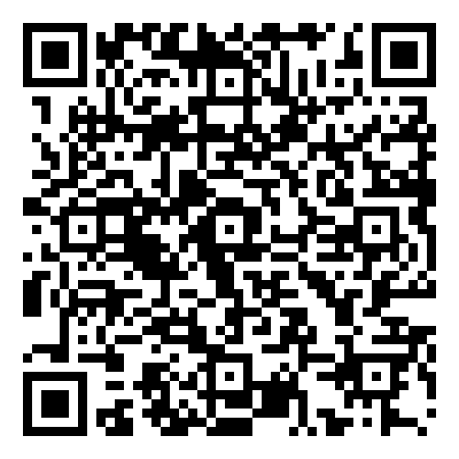
Data Access Policies Handouts 5-8

Slide 60
Policies, Procedures, Inventory
Government entities must have:
Public data access policy (Minn. Stat. § 13.025)
Data access policy for data subjects (Minn. Stat. § 13.025)
Procedures to ensure data requests are received and complied with in an appropriate & prompt manner (Minn. Stat. § 13.03)
Procedures to ensure that only those who have a work assignment can access not public data (Minn. Stat. § 13.05)
Inventory listing private and confidential data (Minn. Stat. § 13.025)

Slide 61
Model Policies/Procedures
Model documents:
https://mn.gov/admin/data-practices/data/rules/policies/
Model Data Access Policies
Model Policy for the Public
Model Policy for Data Subjects
Example Data Inventory
Identifies and describes private and confidential data maintained by the entity
Example Policy for Ensuring the Security of Not Public Data
Methods of incorporating access policy into position descriptions

Slide 62
Questions?
Data Practices Office
651-296-6733
info.dpo@state.mn.us
https://mn.gov/admin/data-practices/
YouTube: @INFOIPAD

