Slide 1
Introduction to Data Practices
Data Practices Office
September 2026

Slide 2
WebEx Walkthrough
Mute/Unmute
Cameras
Chat, Participant, and Polling panels
Breakout sessions
Notes:
Share meeting window to walk through various features and show where everything is.

Slide 3
Introductions
Please introduce yourself:
Your name
Your entity
Your data practices role
Any burning questions you would like to discuss this morning.

Slide 4
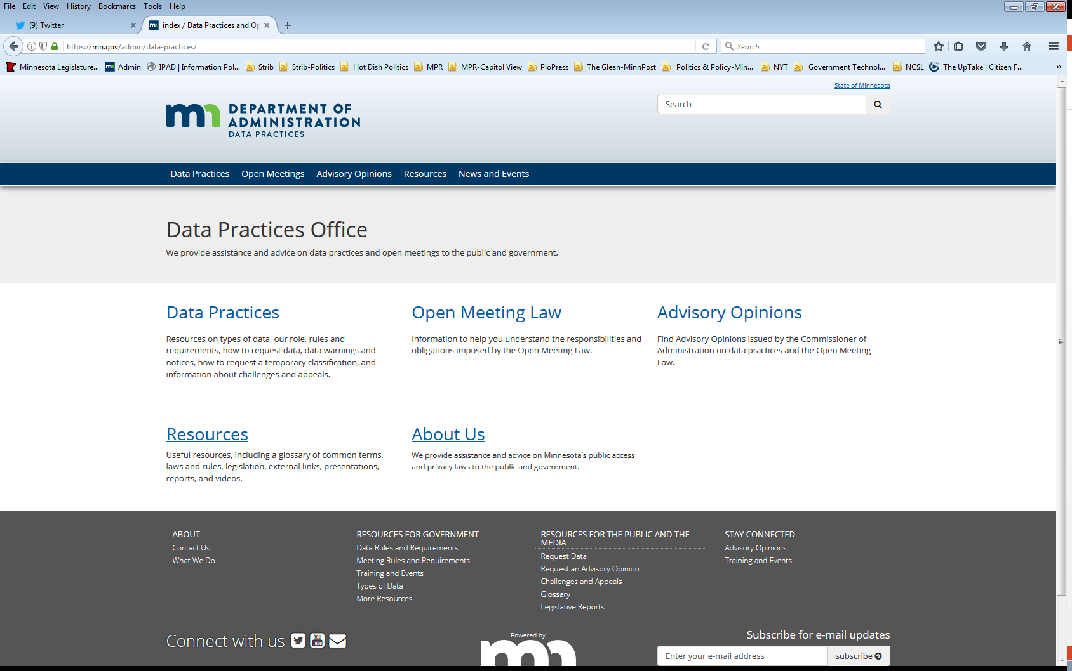
Who we are and what we do
Data Practices Office
  Informal advice/technical assistance
  Commissioner of Administration advisory opinions and other statutory duties
  Website and informational materials: https://mn.gov/admin/data-practices/
  Listserv and newsletters
  Legislative assistance
  Training

Slide 5
Agenda
Time | Topic
8:30 | Welcome and introductions
8:45 | Data Practices Act Overview
10:00 | Break
10:10 | Data Practices Act scenario #1
10:40 | Continue Data Practices Act Overview
11:00 | Break
11:10 | Data Practices Act scenario #2
11:40 | Developing Policies
11:55 | Final questions and complete evaluations
12:00 | Workshop complete

Slide 6
Today’s Objectives
Identify the broad requirements of the Minnesota Government Data Practices Act
Understand general responsibilities under the Data Practices Act
  Maintaining government data
  Responding to data requests
  Identifying employees with data practices responsibilities
Apply Data Practices Act requirements in different situations

Slide 7
Data Practices Act Overview

Slide 8
Data practices policy
Maintain proper balance
  Public’s right to access public government data
  Privacy rights of individuals
  Government’s need to conduct business properly and efficiently
Notes:
balance between Three distinct and sometimes competing interests

Slide 9
Minnesota Government Data Practices Act
Minnesota Statutes, Chapter 13
  Presumes government data are public
  Classifies data that are not public
  Provides rights for the public and data subjects
  Requires that data on individuals be accurate, complete, current, and secure
Minnesota Rules, Chapter 1205

Slide 10
Minnesota Government Data Practices Act continued
Applies to statewide agencies, statewide systems, and political subdivisions
Does not apply to the legislative or judicial branches
  (Minn. Stat. § 13.02, subd. 7a, Minn. Stat. § 13.90)
Does not apply to townships outside the metro area
  (Minn. Stat. § 13.02, subd. 11; Minn Stat. § 473.121, subd. 2)

Slide 11





Government data defined
All data collected, created, received, maintained or disseminated by any government entity regardless of its physical form, storage media or conditions of use.
(Minn. Stat. § 13.02, subd. 7)
Notes:
Even though government data can be maintained in different forms, it has to be recorded data. Employee thoughts or verbal conversations that are not recorded are not government data subject to the DPA.

Slide 12
Exception: Personal Data
“Personal data” is not government data and not subject to the Data Practices Act
  AO 01-075: data maintained by a government entity may be personal data, rather than government data
  What constitutes “personal data” depends on what the entity has authorized for personal use
  -incidental use policy
  Not government data because the employee did not create the data in their capacity as a government employee
Notes:
One exception is when recorded data is actually PersonAL data. In AO o1-075, the Commissioner opined that data maintained by a government entity may be personal data, rather than government data What constitutes “personal data” depends on what the entity has authorized for personal use
-incidental use policy
Not govt data because employee did not create the data in their capacity as a government employee and the purpose of the data is not related to the operation of government. Examples – email to meet up for lunch, text message about child’s soccer tournament win
Personal data” is not government data and not subject to the Data Practices Act

Slide 13
Other data practices related laws
    Official Records Act
    (Minn. Stat. § 15.17)
  Make and preserve all records necessary to a full and accurate knowledge of official activities
    Records Management Statute
    (Minn. Stat. § 138.17)
  Records retention schedules and records disposition panel
  MN State Archives website: https://www.mnhs.org/preservation/state-archives
Notes:
Our Office is limited to providing technical assistance on questions related to the Data Practices Act and the Open Meeting Laws – so we cannot provide assistance on issues regarding official records and records management. That said, to comply with the requirements of the DPA it is important to know your official records and retention requirements as well. So, we encourage you to review your entities’ retentions schedule and reach out the MN State Archives if you have questions

Slide 14
Lifecycle of government data
Official Records Act
Government Data Practices Act
Administer data
Records Management Statute
Destroy data
Create and maintain data

Slide 15
Official records vs. government data
Government data
Official records (Subject to records retention schedule)
Notes:
All official records are government data, but not all government data are official records. Helpful visual. Government data includes much more that your official records. Again government data are All data collected, created, received, maintained or disseminated by any government entity

Slide 16
What do you think? (# 1)
You have three versions of a report from last year, including the final report.
  What is the official record?
  Are all the drafts government data?
  Can you destroy the drafts?
Notes:
Open poll #1

Slide 17
What do you think? (#1) Answer
You have three versions of a report from last year, including the final report.
  What is the official record?
    Final report (exceptions)
  Are all the drafts government data?
    Yes
  Can you destroy the drafts?
    Yes
Notes:
Poll 1

Slide 18

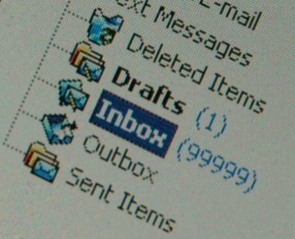
Maintaining government data
No requirement to maintain data in a particular format or organization system; however,
  Data must be “easily accessible for convenient use”
Notes:
Part of making sure data are easily accessible for convenient use it to know what data you have and where the data are maintained. This is easier to do if you are not maintaining data that you do not need to. So, it’s important to know what data are official records and need to be maintained per your retention schedule and what data are not. For data that are not official records, you should be regularly deleting/destroying that data unless you want to keep it because it is useful to your work. And for data that are on your retention schedule, you should be following those schedules in terms of retention and destruction. For instance, at DPO are technical assistance emails are subject to a one-year retention schedule. After that, we can delete these emails – though if some of them would be helpful for our work, we can choose to maintain them. But not maintaining years worth of emails is important in making it possible to promptly respond to data requests.

Slide 19
Government data
Data on Individuals
Data that identify someone
Employee’s telephone number
Name and address of adult arrestee
Athlete of the week photograph
Data not on Individuals
Data that do not identify someone
Makes and models of fleet trucks
Names of companies that are preferred vendors
List of government websites
Notes:
There are two main categories of Government data. Data on individuals and data not on individuals.

Slide 20
Classification of government data
Classification | Meaning of classification | Examples
Public | Available to anyone for any reason | Employee name and salary
Private/Nonpublic | Available to: Data subject Those in the entity whose work assignment requires access Entities authorized by law Those authorized by data subject | Employee home address and telephone number
Confidential/ Protected nonpublic | Available to: Those in the entity whose work assignment requires access Entities authorized by law NOT available to the data subject | Data collected as part of an active civil legal action
Notes:
The Data Practices Act presumes government data are classified as public, unless the data are classified differently by state or federal law. The possible classifications of government data in the Data Practices Act are public, private/nonpublic, confidential or protected nonpublic. Private and confidential are classifications that are used to data on individuals. While nonpublic and protected nonpublic are used to classify data not on individuals.

Slide 21

Staff with data practices duties
Responsible authority (RA)
Data practices compliance official (DPCO)
Designee
Other staff
Notes:
Each entity must identify, designate, or appoint one person as its responsible authority (RA). The RA is the person who ultimately is responsible for the collection, use, and dissemination of all entity data, and for all the entity’s data practices decisions. The RA must also make sure the entity complies with the requirements of the Data Practices Act and the Administrative Rules. If an entity violates the Act, both the entity and the RA are liable.
The responsible authority (RA) must designate or appoint one employee to be the entity’s data practices compliance official (DPCO). Instead of making this appointment, the RA may choose to serve as the DPCO. The DPCO receives and responds to questions or concerns about data practices problems, including issues accessing data that the entity keeps. When we assist members of the public who have questions about their data request, we often suggest they reach out to the DPCO as a first step.
A designee is a person designated by the responsible authority (RA) to help administer and implement the requirements of the Data Practices Act and the Administrative Rules. (Minnesota Statutes, Chapter 13, Minnesota Rules, Chapter 1205)
A designee can be responsible for receiving and complying with requests for government data, and for answering questions from the public. Often a designee are heads of departments or divisions within the entity and are responsible for responding to data requests for data their division maintains.
Other staff- all government employees are creating and accessing government data and may be called upon to retrieve data in response to a data request. For instance, I am not an RA, DPCO , or designee, but a member of the public has requested copies of my emails – so I pull those emails from my account to respond to the request.

Slide 22
Responsible authority
(Minn. Stat. § 13.02, subd. 16 & Minn. R. 1205.0200)
State agency
  Commissioner, Constitutional Officer, Chief Executive Officer, or an official appointed by the agency’s governing body
County
  Elected officials (county attorney, sheriff, etc.)
  Employee appointed for data outside elected officials’ offices
  County social services agency director (§ 13.46, subd. 10)
  County veterans service officer (§ 197.603, subd. 2)
City
  Person appointed by city council or the city clerk
School District
  Person appointed by school board or the superintendent
Notes:
Who is the RA depends on the type of entity. Set out in Minn. Stat. 13.02, subd. 16 and Minn. R. 1205.0200

Slide 23
Requests for data
(Minn. Stat. §§ 13.03 and 13.04)
Members of the public and data subjects can request inspection or copies of data
Written requests
Accepting requests
  Online portals
  Designated email address for data requests
“Remote inspection” - a request for copies
Notes:
[Online Portals]
Government entities may have reasonable procedures for accepting data requests, including using an online portal. The Data Practices Act doesn't establish specific processes or procedures for how government entities must receive data requests, so the use of online portals are generally okay.
Section 13.03, subdivision 2 requires that entities establish procedures to ensure that requests for government data are received and complied with in an appropriate and prompt manner. If online portals are overly complicated or glitchy, they may not satisfy this requirement. Also, note that there must be a way to submit anonymous requests for public data. Additionally, section 13.03 and 13.04 use the language “upon request to a responsible authority” when discussing an entity’s obligation to provide data to data requesters. So, requests sent directly to the RA should still be honored. Lastly, you will need to comply with the ADA & Minn. Law re: disability accommodations which we will talk more about on our next slide.
[Designated Email Address]
Consider the ability to monitor and access this email account
[“Remote Inspection”]
If data is maintained electronically and not publicly accessible – a person does not have the right to demand remote inspection– can inspect it at the entity on a laptop/ - & can limit inspection time to time during which normal operations of the agency are conducted (1205.0300)
But section 13.03, subdivision 3(b) clarifies that if a government entity chooses to post public data on its website, it cannot charge a member of the public a fee for accessing those data and printing or downloading copies on the individual's own computer equipment…this type of access fits within the definition of inspection.

Slide 24
Disability Accommodations
(42 U.S.C. §§ 12131-12150; Minn. Stat. § 363A.42)
Title II of the ADA
  state and local government entities are subject
  requires reasonable modifications to policies, practices, and procedures where needed to make sure that a person with a disability can access the entity’s services
Minn. Stat. § 363A.42
  requires reasonable modifications to any policies, practices, and procedures that might otherwise deny equal access to records to individuals with disabilities
Accommodation request procedures
Notes:
Government entities should have procedures in place for a member of the public to make an accommodation request. If you are unsure of who to contact about this process, the person who handles accommodations for your employees would be a good place to start.
And as we talked about with the last slide, these obligations still must be met by entities who utilize online portals for data requests.

Slide 25
Responding to data requests
Members of the public (Minn. Stat. § 13.03)
Guidelines for responding to requests:
  Clarify if not clear
  Data do not exist
  Data exist and are public
  Data are not public
    Must give statutory basis for denying access
  If asked, must explain meaning (technical terminology, abbreviations, acronyms, etc.)
  Directing requestors to websites (AO 04-024)
Notes:
Guidelines for responding to requests from members of the public. Government entity cannot require a member of the public to access data on a public website instead of receiving copies. However, the government entity can offer the data requester the option of obtaining the data directly from a public website. If they are going to do this, the entity to make the offer very early in the process of responding to the request. That way, if the requestor prefers to receive a copy directly from the entity, the entity can ensure the requestor will get the copy in a timely manner.

Slide 26
Responding to data requests
Data subjects (§ 13.04)
Guidelines for responding to requests:
  Clarify if not clear
  Data do not exist
  Data exist and are accessible
    Verify identity
    Six-month “exception”
  Data are confidential or private about someone else, or otherwise not public
    Must give statutory basis for denying access
  If asked, must explain (technical terminology, abbreviations, acronyms, etc.)
Notes:
Guidelines for responding to requests from data subjects. After an individual has been shown the private data and informed of its meaning, the data need not be disclosed to that individual for six months thereafter unless a data challenge is pending or additional data on the individual has been collected or created.

Slide 27
Handling large data requests
The Data Practices Act does not contain an “overly burdensome” exception to deny access
Practical considerations when processing large data requests:
    Contact requester to clarify scope of request
    Give context on length of time it will take to compile responsive data
    Ask whether to prioritize certain data
    Consider providing data on a rolling basis
Notes:
There is no overly burdensome standard.

Slide 28
Suspension of Response
(Minn. Stat. § 13.03, subd. 3(g))
Entities can suspend further responses to a request if data requester has not collected copies or gone in to inspect data within 5 (five) business days
  Include information on this process in your policies
  Policies can go further and set out when a data request will be considered abandoned (should provide for a reasonable amount of time after suspension of response)
Notes:
Another reason to consider rolling production
-abandoned requests are not addressed by DPA – policy decision for entities – our guidance is it should allow for a reasonable amount of time. Admin’s policy provides for 15 days.

Slide 29
Requests outside of the Data Practices Act
Creating Data
*Exception: summary data
(Minn. Stat. § 13.05, subd. 7)
Responding to Questions
Notes:
These are a couple of requests that we often see or hear about which are outside of the data practices act.

Slide 30
Response Time
(Inspection or Copies)
Member of the Public
  Appropriate and prompt, reasonable amount of time
  (Minn. Stat. § 13.03, subd. 2, Minn. R. 1205.0300)
Data Subject
  Immediately, if possible; otherwise, 10 business days
  (Minn. Stat. § 13.04, subd. 3)

Slide 31
Charging for Government Data -
Inspection
No charge or fee is allowed for inspection of government data.
Inspection is always FREE
  This is true whether the data requester is a data subject or a member of the public

Slide 32
Charging for Government Data -
Copies
Members of the public
25¢ per page for 100 or fewer pages of black/white, legal/letter size paper copies
“Actual cost” for all other copies
  Time for search and retrieval
  Time to make and transmit the copies
  Materials
(Minn. Stat. § 13.03,
Minn. R. 1205.0300)
Data subjects
“Actual cost”
  Time to make and transmit the copies
  Materials
(Minn. Stat. § 13.04, Minn. R. 1205.0400)
Notes:
Did you notice the difference between the actual cost calculation for members of the public vs. data subjects? You can only charge for search and retrieval time when the data request is made by a member of the public. You can not charge for search and retrieval when the data requester is a data subject.
Also note that under Minnesota Statutes Section 611.271, public defenders are entitled to free copies of certain data related to the defense of their client that they receive from court administrators, prosecutors, and law enforcement agencies.

Slide 33
Actual Cost does NOT include redaction time
A government entity may NOT charge to separate public from not public data or to redact private or confidential data about others
(Minn. Stat. § 13.03, subd. 3(c), Minn. Stat. § 13.04, subd. 3)
Notes:
I know this can feel frustrating and this often takes the most amount of time to complete, but the DPA is clear that entities can not charge for redaction.

Slide 34

What Do You Think? (#2)
A member of the public asks for your notes taken during a staff meeting.
  Are they public?
  How long do you have to respond?
Notes:
Open Poll #2

Slide 35
What Do You Think? (#2) Answer
A member of the public asks for your notes taken during a staff meeting.
  Are they public?
    Depends on the content.
  How long do you have to respond?
    Within a reasonable amount of time
    (unless requester is the data subject – then within 10 days).

Slide 36
Questions/Break #1

Slide 37
Data Practices Act Overview, Cont.

Slide 38
Tennessen Warning
(Minn. Stat. §13.04, subd. 2)
When collecting private or confidential data from an individual about that individual:
  State the purpose and intended use of data
  Inform the individual whether they may refuse or are legally required to provide the data
  Explain known consequences of supplying or refusing to supply the data
  Identify other persons or entities with statutory authority to access the data
Examples: SSN, employee home address

Slide 39
Informed Consent
(Minn. Stat. §13.05, subd. 4 & Minn. R. 1205.1400)
  Informed consent is necessary when:
    The individual asks the entity to release private data to another entity or person
    The entity wants to release private data to another entity or person
    The data subject received a Tennessen warning, and the entity now wants to use or release the data in a different way
  Informed consent must be in writing and cannot be coerced
Notes:
So a Tennessen Warning is given before you collect private or confidential data. Informed consent is used after you already have the data, and want or need to share it or use it in a new way. See handout #4 for information on when to provide a TW and when consent is needed for use of data you have on individuals

Slide 40
Penalties and Remedies
Civil Remedies (Minn. Stat. §13.08)
  Action for damages, costs, and attorney fees
  Action to compel compliance
Administrative Remedy (Minn. Stat. §13.085)
  Complaint must be filed within 2 years of alleged violation
  Action to compel compliance, attorney fees
Penalties (Minn. Stat. §13.09)
  Willful violation or knowing unauthorized acquisition of not public data = misdemeanor
  Dismissal or suspension of public employee
Advisory opinions (Minn. Stat. §13.072)
Notes:
Okay, penalties and remedies. What happens or can happen when there is a violation of the Data Practices Act?

Slide 41
Data Challenges and Appeals
Minnesota Stat. § 13.04, subd. 4; Minn. R. 1205.1600

Slide 42
Challenging the Accuracy and
Completeness of Data
Data being challenged must be:
  Public or private
  Data about the person submitting the challenge (or their minor child)
The data challenge itself must be:
  In writing
  Addressed to the Responsible Authority
Notes:
The DPA provides a mechanism for individuals to challenge government data about themselves that they believe are inaccurate or incomplete.

Slide 43
What to do when you receive a data challenge
RA must respond within 30 days
  Correct data if it is inaccurate/incomplete and notify past recipients of the inaccurate/incomplete data, OR
  Notify the data subject that it is the RA’s position that the data are accurate and complete
Disputed data can only be disclosed if a statement of disagreement is included with the data

Slide 44
Data Challenge Appeals
(Minn. Stat. § 13.04, subd. 4(d)-(e))
  Data subject can appeal to the Commissioner of Administration
Entities must inform data subjects of right to appeal
Commissioner may dismiss appeal if:
  it is not timely,
  data was presented as evidence in court, or
  appellant is not the data subject.

Slide 45
Data Challenge Appeals continued
(Minn. Stat. § 13.04, subd. 4(f))
Data submitted to the Commissioner, and the data subject's descriptions of the challenged data, have the same classification as maintained by the government entity
RA may submit private data to the Commissioner
Commissioner may disclose private data within the appeal record to the Court of Administrative Hearings
Data maintained by the Commissioner that have been completed, corrected, or destroyed by an RA as a result of an appeal are private
Notes:
For example, challenged private personnel data submitted as part of an appeal will be maintained as private data by the Commissioner.

Slide 46
Data Breaches

Slide 47

Breach in Data Security
(Minn. Stat. §13.055)
  Applies to all government entities
  Defines “breach of the security of the data”
    Unauthorized acquisition/unauthorized person accesses
    Private or confidential data, with
    Intent to use data for nongovernmental purposes
  RA must investigate and create a report that details any data breach
  Annual security assessment for
  “personal information”
  (defined in § 325E.61)
Notes:
“personal information” is defined in § 325E.61

Slide 48
OLA notification
(Minn. Stat. § 3.971, subd. 9)
Only applies to state-level entities
Agencies subject to OLA audit must notify OLA when not public government data may have been:
  Accessed or
  Provided to a person,
  Without lawful authorization
Broader reporting obligation than is required by Minn. Stat. § 13.055
Reporting Guide available on OLA website: https://www.auditor.leg.state.mn.us/sreview/reporting-guide.htm
Notes:
Only state-level entities are subject to OLA audit

Slide 49
What do you think? (#3)
What action is required for each of the following events at a state agency?
Notes:
Open Poll #3

Slide 50
Event #1
Employee accidentally accesses not public database
  Corrective action?
  Notice to OLA?
  13.055 notice?

Slide 51
Event #1 answers
Employee accidentally accesses not public database
  Corrective action?
    YES
  Notice to OLA?
    YES
  13.055 notice?
    NO

Slide 52
Event #2
Employee incorrectly types email address and sends not public data to wrong government employee
  Corrective action?
  Notice to OLA?
  13.055 notice?

Slide 53
Event #2 answers
Employee incorrectly types email address and sends not public data to wrong government employee
  Corrective action?
    YES
  Notice to OLA?
    YES
  13.055 notice?
    NO

Slide 54
Event #3
Employee inadvertently reads report with not public data without appropriate work assignment
  Corrective action?
  Notice to OLA?
  13.055 notice?

Slide 55
Event #3 answers
Employee inadvertently reads report with not public data without appropriate work assignment
  Corrective action?
    YES
  Notice to OLA?
    YES
  13.055 notice?
    NO

Slide 56
Event #4
Employee looks up driver’s license data about new neighbor without appropriate work assignment
  Corrective action?
  Notice to OLA?
  13.055 notice?

Slide 57
Event #4 answers
Employee looks up driver’s license data about new neighbor without appropriate work assignment
  Corrective action?
    YES
  Notice to OLA?
    YES
  13.055 notice?
    YES

Slide 58
Cybersecurity Incidents
(Minn. Stat. § 16E.36)
Requires notification of any cybersecurity incidents to MNIT
Applies to all public agencies
Cybersecurity incident:
  An action taken through the use of an information system or network
  That results in an actual or potentially adverse effect on an information system, network, or information residing therein
Notes:
“Public agencies” is broadly defined as: Any state agency, political subdivision, school districts, charter schools, intermediate districts, cooperative units under sec. 123A.24 subd. 2, and public postsecondary institutions

Slide 59
Questions/Break #2

Slide 60
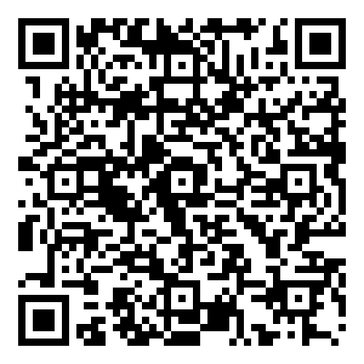
Data Access Policies
Handouts 5-8
Notes:
Handouts 5-8 include model access policies, a policy and procedures development worksheet, and an example policy for ensuring the security of not public data.

Slide 61
Policies, Procedures, Inventory
Government entities must have:
  Public data access policy (Minn. Stat. § 13.025)
  Data access policy for data subjects (Minn. Stat. § 13.025)
  Procedures to ensure data requests are received and complied with in an appropriate & prompt manner (Minn. Stat. § 13.03)
  Procedures to ensure that only those who have a work assignment can access not public data (Minn. Stat. § 13.05)
  Inventory listing private and confidential data (Minn. Stat. § 13.025)
Notes:
13.025 Subd. 2 & 3
13.03 subd. 2 – procedures
13.05 Subd. 5 – procedures
13.025 - inventory

Slide 62
Model Policies/Procedures
Model documents:
https://mn.gov/admin/data-practices/data/rules/policies/
Model Data Access Policies
  Model Policy for the Public
  Model Policy for Data Subjects
Example Data Inventory
  Identifies and describes private and confidential data maintained by the entity
Example Policy for Ensuring the Security of Not Public Data
  Methods of incorporating access policy into position descriptions
Notes:
There is a line in the example policy – “Position descriptions may contain provisions identifying any not public data accessible to the employee when a work assignment reasonably requires access.” So this envisions that the position descriptions themselves would describing what roles require access to not public data and what type of nonpublic data.
Employees also need to be aware of their duties around accessing not public data.

Slide 63
Questions?
Data Practices Office
651-296-6733
info.dpo@state.mn.us
https://mn.gov/admin/data-practices/
YouTube: @INFOIPAD
Notes:
Open Poll #4

