Slide 1
Developing Data Practices Training
Data Practices Office

Slide 2
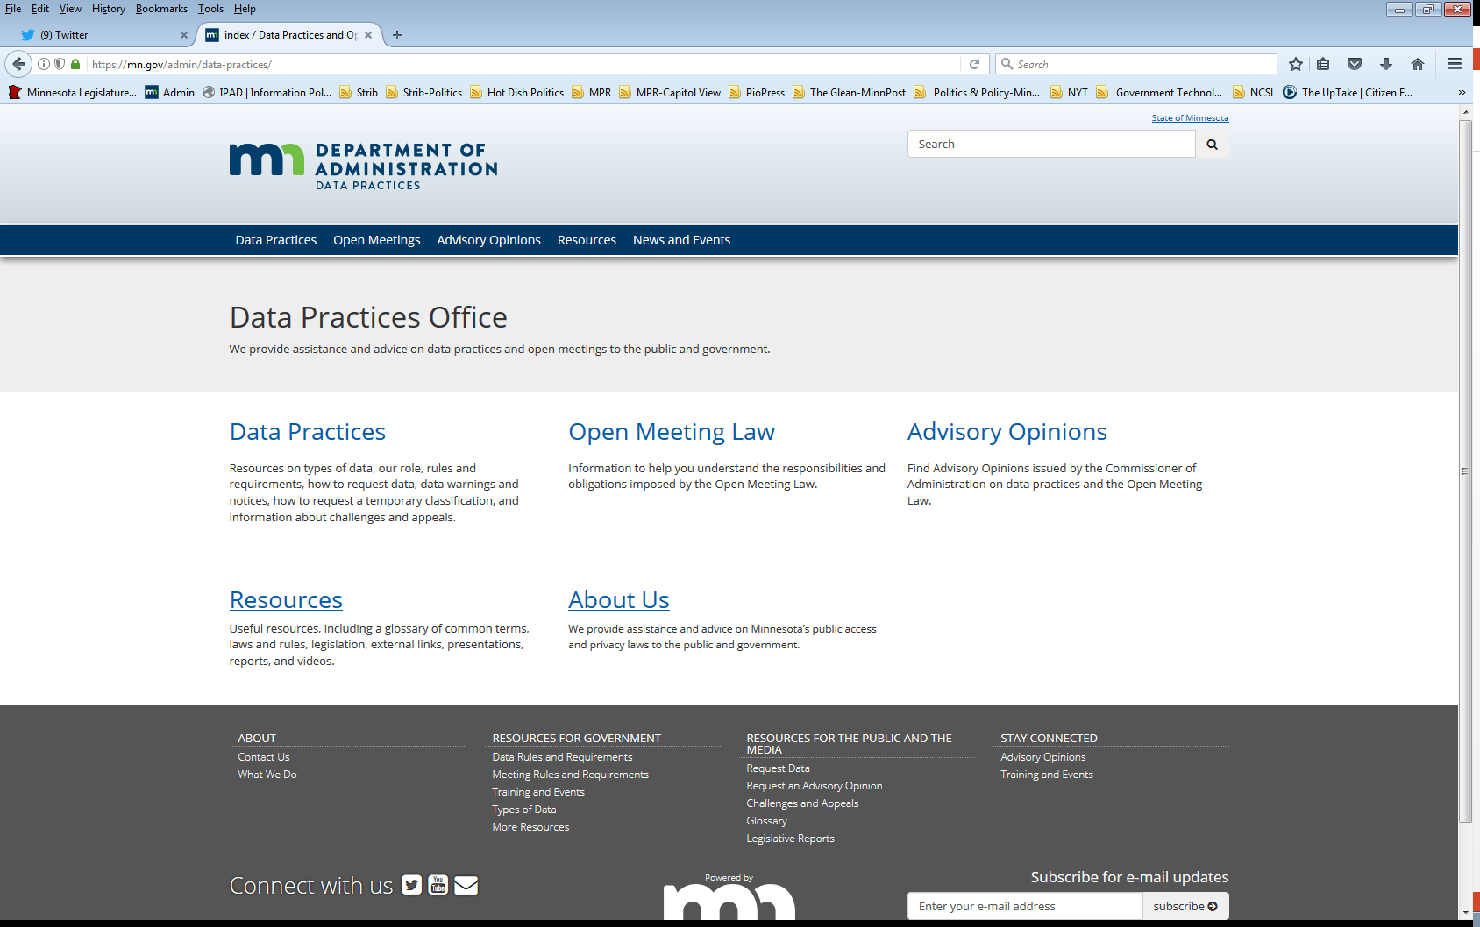
We are a statewide resource
Data Practices Office
  Informal advice/technical assistance
  Commissioner of Administration advisory opinions
  Website and info pages:
  https://mn.gov/admin/data-practices/
  Listserv and newsletters
  Legislative assistance
  Training

Slide 3
Today’s agenda
11:00 a.m. -11:45 a.m.
Goals of training
Legal requirements for training
Developing training
Sample training plans
Resources for developing training
Q&A

Slide 4
Goals of employee data practices training
Facilitate and expedite fulfilling data requests by setting expectations and awareness
Promote protection of not public data
Advise employees of public presumption
Help avoid or mitigate data breaches under Minn. Stat. §13.055
Support disciplinary decisions for noncompliance
Develop and retain institutional knowledge

Slide 5
Responsible authority (RA) duties
Minnesota Rules 1205.1100 and 1205.1300
The RA is required to provide training to designees and to educate entity personnel on private and confidential data.
  Consider police departments
The RA may:
  Distribute written materials
  Develop a training program for all staff
  Require attendance by designees at internal or external training

Slide 6
Internal procedures to respond to data requests
Minn. Stat. §13.03, subd. 2
The responsible authority in every government entity shall establish procedures, consistent with this chapter, to insure that requests for government data are received and complied with in an appropriate and prompt manner.

Slide 7
Access, use, and protection of data
Minn. Stat. §13.05
Required procedure to ensure the protection of not public data
  Required policy on employee access to private or confidential data
Limitation on collection and use of data on individuals
Data on individuals must be accurate, current, complete, and secure

Slide 8
Audience/role
Responsible Authority (RA)
Data Practice Compliance Official (DPCO)
Designees
Everyone
Others?
  Contractors
  Grantees
  Volunteers

Slide 9
Who can provide training?
Within your entity:
  RA
  Data Practices Compliance Official (DPCO)
  Legal counsel
  HR
  You?
External trainers
  DPO
  Membership groups (LMC, MSBA, AMC, etc.)

Slide 10
Components of training
Tailor to audience
  Plain language and statutory language
Overview of the law
Expectations/requirements
Consequences of non-compliance
Where to go for help

Slide 11
Training for all employees

Slide 12
Components and considerations
At on-boarding
Then 5-15 minutes/year and as needed
Data requests
Location of access policies and procedures
Key staff for data practices questions & requests
Consequences for not complying

Slide 13
Training for all employees
Sample training 1
Play a video
  Data Practices Act: What All Employees Need to Know (9 minutes)
  Data Practices Basics (30 minutes)
Reiterate that team members may be asked to help respond to data requests
Provide access policies
Identify your data practices contacts

Slide 14
Training for all employees
Sample 2 (7 slides)
The Minnesota Government Data Practices Act
Regulates how government handles information
Helps to maintain a proper balance of:
  Government’s need to have and use data to do its work
  Public’s right to know about the activities of their government
  Privacy rights of individuals
Notes:
Not going thru this training, but slides for editing and use

Slide 15
Public data vs. not public data
All government data (recorded information) are presumed to be public.
Access to public data
  Anyone may access for any reason
  Identification not required
Access to not public data
  Release only to authorized people
  Share with other staff only if related to their job responsibilities

Slide 16
Examples of public and private government data
Some examples of public data about you
  Your name, salary, job title, and dates of employment
  Your work location, work phone number, and time sheets
Some examples of not public data about you
  Your home address and home phone number
  The reason you used sick time or medical leave

Slide 17
Your data practices responsibilities
Create and keep official records
Protect not public data
Dispose of data appropriately
Assist in responding to data requests
Ask your supervisor/manager if you have data practices questions
Failure to comply may result in consequences for employees and [the entity]

Slide 18
Data requests
When someone asks for access to data, it’s called a “data request”
You may review [the entity’s] access policies: [insert link/location of policies]
Follow instructions for fulfilling data requests
We must respond within a certain amount of time – 10 business days for data subjects
Connect your supervisor or manager if you get a “data request”

Slide 19
Tips for protecting not public data
Electronic data
  Lock computer screen when away from your desk
  Create strong passwords and don’t share them
  Limit access to shared drives
Paper data
  Place copies of not public data outside of plain view
  Use locked file cabinets for not public data
  Do not leave copies of not public data on a shared printer/copier
Telework considerations
Proper disposal of both types of data

Slide 20
Data practices contacts
Responsible authority (RA)
  [Name of RA]
Data practices compliance official (DPCO)
  [Name of RA]
Designees
  [Name, if any]
Your own manager or supervisor

Slide 21
Training for all employees
Sample 3
All employees at [entity] must follow the Minnesota Government Data Practices Act
The law requires us to follow specific requirements to provide access to and protect government information.
If [entity] does not comply with the requirements, we can be sued and responsible employees can be disciplined.

Slide 22
[Entity] roles and contacts
Responsible authority (RA)
  [Name of RA]
Data practices compliance official (DPCO)
  [Name of RA]
Designees
  [Name, if any]
Legal
  [Name]
Your own manager or supervisor

Slide 23
Training for a DPCO or designee

Slide 24
Components and considerations
Everything for employees above
More comprehensive data practices overview (30-60 minutes)
Review of entity access policies
Review roles
  DPCO, 13.05, subd. 13
  Designees, 13.02, subd. 6
Review internal procedures to ensure prompt and appropriate responses
Review procedures for protecting not public data

Slide 25
Components and considerations, cont.
Training on internal procedures to process requests
  Tracking requests
  Tracking copy costs
  Where to go with legal questions
  Who will respond (program area, designee, RA?)
Data breaches
Consequences/remedies for noncompliance
Official records/records management considerations

Slide 26
Training for a DPCO or designee
Sample training
Play Data Practices Basics Webinar
Follow up with slides documenting your internal procedures (examples following)

Slide 27
Data requests
Entity access policies are [insert link/location]
Requests must be submitted to [identify designees]
[Alternate] Insert link and guidance on using portals or software/vendors to receive data requests
Requesters can be directed to [DPCO] to resolve issues.

Slide 28
Data request responses
When a designee receives a request they should…
Request/response tracking [insert entity expectation on tracking requests based on how requests are received – could be a spreadsheet, through the portal, etc.]
We charge copy costs [under these circumstances]
  Possibly provide guidance on calculating costs/tracking time.
Notes:
If you use a portal, there still needs to be clear direction on who has access to the portal, who is monitoring responses…

Slide 29
Records management
Designees are in charge of maintaining official records related to data requests.
Our records retention schedule says that we need to keep responses [X amount of time]
[Y is responsible for data destruction and filling out the record of destruction]

Slide 30
Where to go with questions
If you have legal questions contact [name]
If you have process questions go to [RA, DPCO, other designees?]
If you are having trouble with employees providing data go to [HR contact]
Notes:
If you use a portal, there still needs to be clear direction on who has access to the portal, who is monitoring responses…

Slide 31
Training for a responsible authority

Slide 32
Training for the responsible authority
Will vary by entity size and structure
RAs that have the practical responsibility for implementing the law (City Clerks, executive directors of State boards and councils, etc.) should have training similar to DPCOs/designees
RAs that have more of a supervisory role where most tasks are delegated (State agency commissioners), consider the following.

Slide 33
Training for the responsible authority
Sample training
Prepare a packet with links to:
  Access policies
  Data Practices Act: What All Responsible Authorities Need to Know
  Introduction to Data Practices for State Commissioners [if applicable]

Slide 34
Additional resources and ideas

Slide 35
Additional ideas for training/discussion
Practical walk-through – pick a recent data request and go through response
Identify and discuss three classifications that come up in your work
Ask for feedback on your entities data practices processes – what’s working, what can improve
Monthly/Quarterly data practices topics discussions
Start or participate in a community of practice with other similar entities roles (don’t share not public data!)

Slide 36
Additional resources
YouTube channel
  Recorded webinars
  Narrated PowerPoints
  Videos
Training materials
  DP Training Worksheet
DPO workshops
DPO webinars
Partner trainings

Slide 37
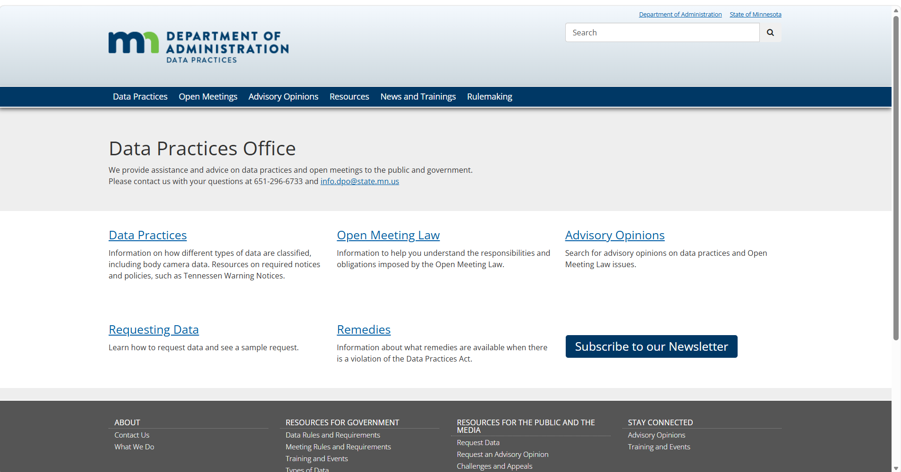
Locating resources on DPO website
https://mn.gov/admin/data-practices/

Slide 38
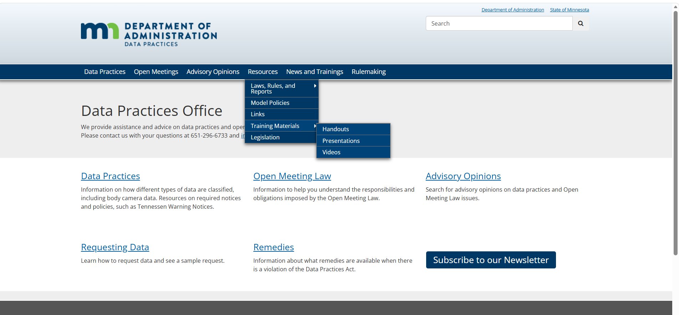
DPO website resources: training materials
https://mn.gov/admin/data-practices/resources/training-materials/

Slide 39
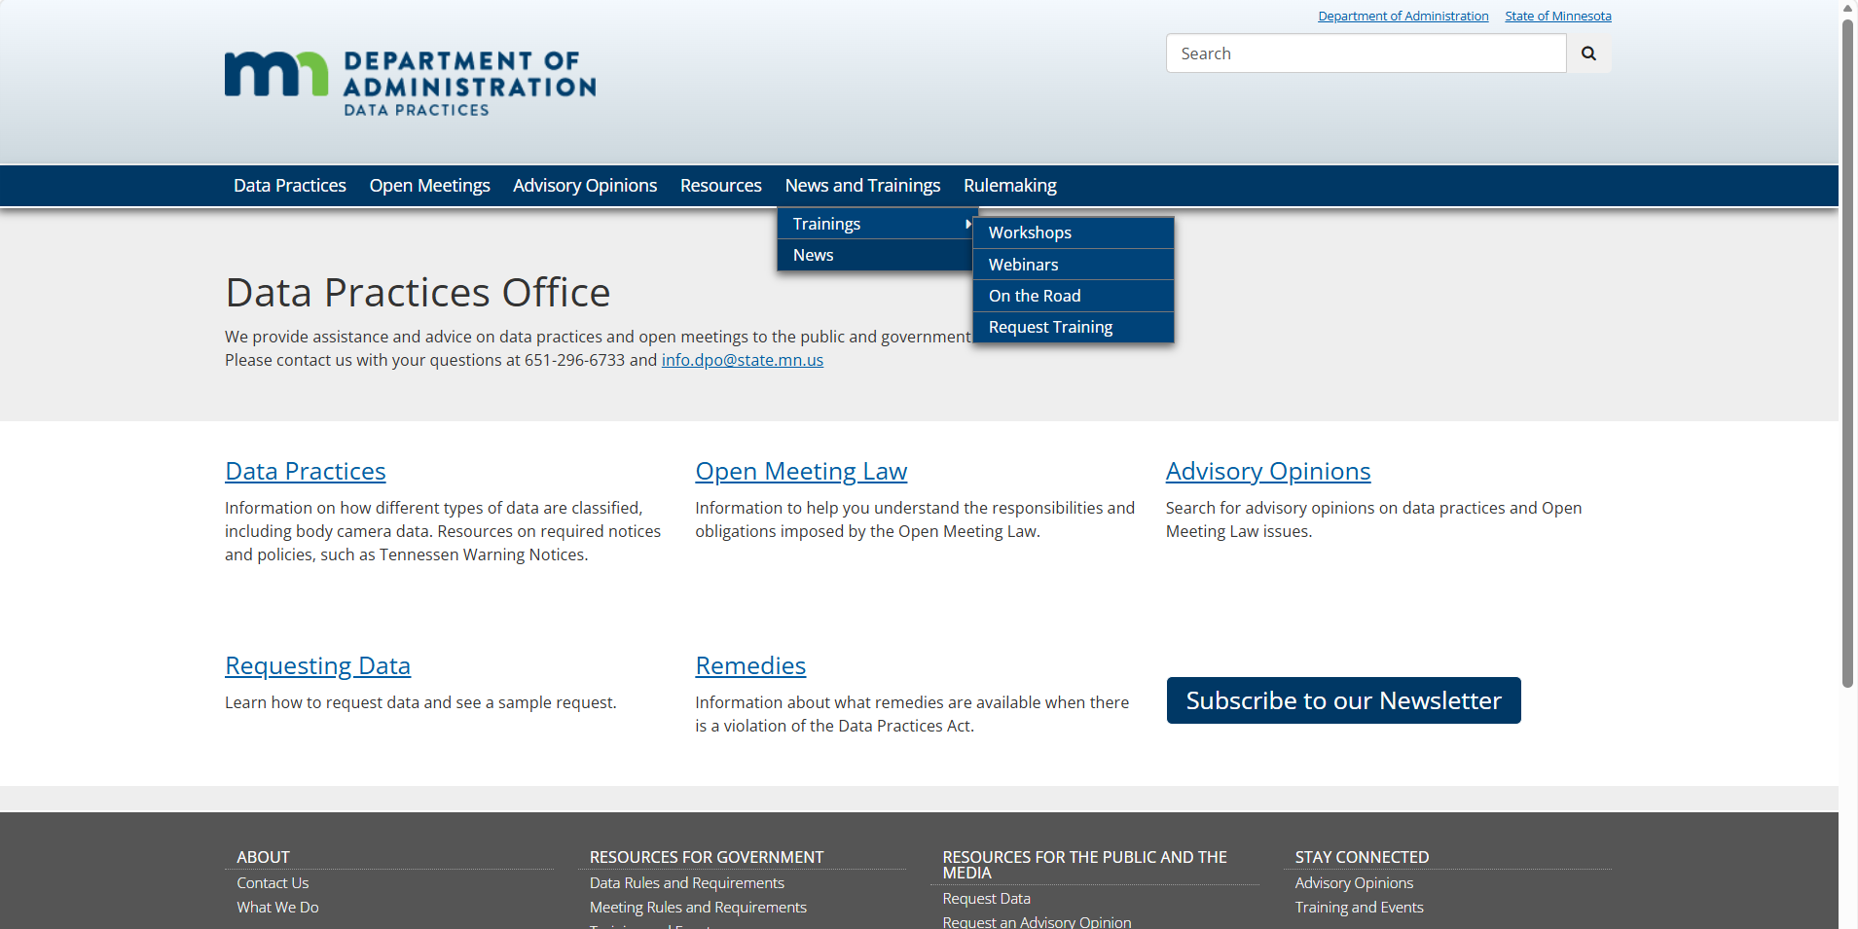
DPO website resources: trainings
https://mn.gov/admin/data-practices/training

Slide 40
Send us your questions
Type your questions in the Q&A Panel
If we don’t get to your question, we will follow up afterwards
Slides are available: https://mn.gov/admin/data-practices/news/trainings/webinars/
A recording of this webinar will be available at: https://www.youtube.com/user/INFOIPAD
Please fill out the evaluation in the Q&A Panel

Slide 41
Stay in touch!
Phone: 651-296-6733
Email: info.dpo@state.mn.us
Website: mn.gov/admin/data-practices
YouTube: https://www.youtube.com/user/INFOIPAD

