Slide 1
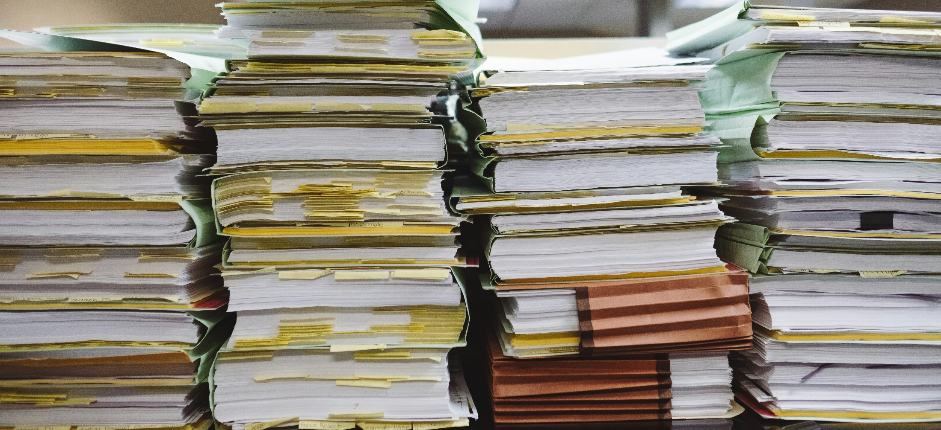

Data Practices Act Basics Webinar
March 19, 2026
11 a.m. – 11:45 a.m.

Slide 2
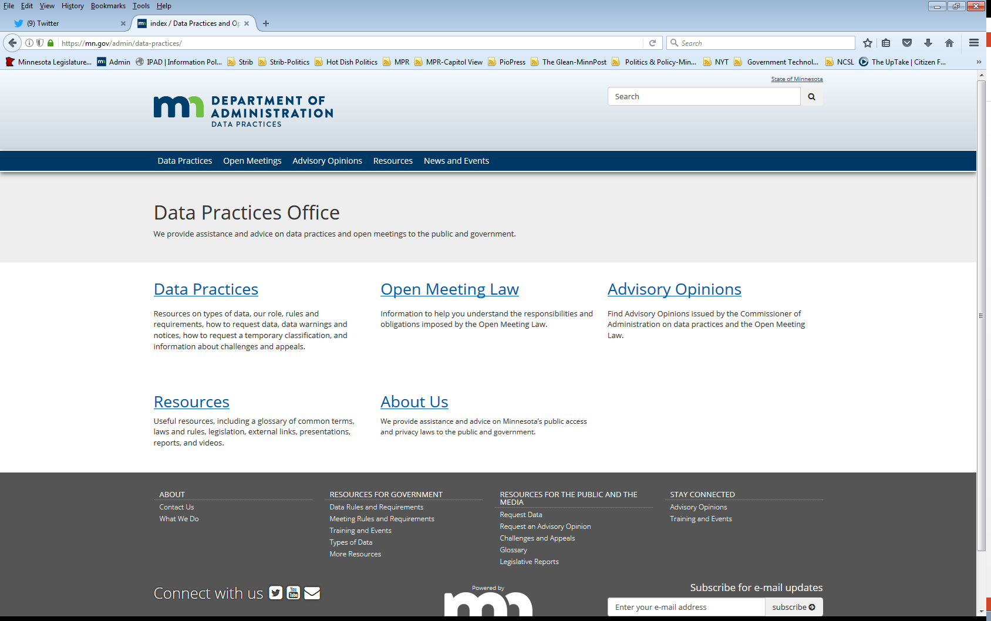
We are a statewide resource
Data Practices Office
Informal advice/technical assistance
Commissioner of Administration advisory opinions
Website and info pages: https://mn.gov/admin/data-practices/
Listserv and newsletters
Legislative assistance
Training

Slide 3
Today’s agenda 11:00 a.m. -11:45 a.m.
11:00 a.m. – Overview of the Data Practices Act’s Requirements
11:35 a.m. - Q&A

Slide 4
Data Practices Act Overview

Slide 5

Data practices policy
Maintain proper balance
Public’s right to access public government data
Privacy rights of individuals
Government’s need to conduct business properly and efficiently

Slide 6
Minnesota Government Data Practices Act
Minnesota Statutes, Chapter 13
Presumes government data are public
Classifies data that are not public
Provides rights for the public and data subjects
Requires that data on individuals be accurate, complete, current, and secure
Minnesota Rules, Chapter 1205

Slide 7
Application of Data Practices Act
Applies to statewide agencies, statewide systems, and political subdivisions
Does not apply to the legislative or judicial branches
(Minn. Stat. § 13.02, subd. 7a, Minn. Stat. § 13.90)
Does not apply to townships outside the metro area
(Minn. Stat. § 13.02, subd. 11; Minn Stat. § 473.121, subd. 2)

Slide 8
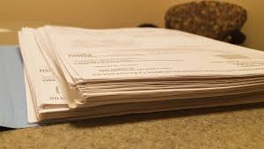


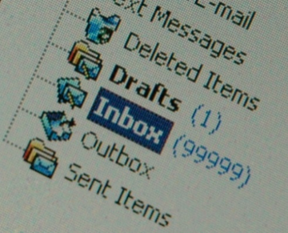
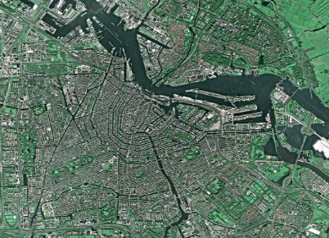
Government data defined
“All data collected, created, received, maintained or disseminated by any government entity regardless of its physical form, storage media or conditions of use.”
(Minn. Stat. § 13.02, subd. 7)

Slide 9


Other data practices related laws
Official Records Act (Minn. Stat. § 15.17)
Make and preserve all records necessary to a full and accurate knowledge of official activities
Records Management Statute (Minn. Stat. § 138.17)
Records retention schedules and records disposition panel
MN State Archives website: https://www.mnhs.org/preservation/state-archives

Slide 10
Lifecycle of government data
Official Records Act
Government Data Practices Act
Administer data
Records Management Statute
Destroy data
Create and maintain data

Slide 11
Official records vs. government data
Government data
Official records (Subject to records retention schedule)

Slide 12

Maintaining government data
No requirement to maintain data in a particular format or organization system; however,
Data must be “easily accessible for convenient use”

Slide 13
Government data
Data on Individuals
Data that identify someone
Employee’s telephone number
Name and address of adult arrestee
Athlete of the week photograph
Data not on Individuals
Data that do not identify someone
Makes and models of fleet trucks
Names of companies that are preferred vendors
List of government websites

Slide 14
Classification of government data
Classification | Meaning of classification | Examples
Public | Available to anyone for any reason | Employee name and salary
Private/Nonpublic | Available to: Data subject Those in the entity whose work assignment requires access Entities authorized by law Those authorized by data subject | Employee home address and telephone number
Confidential/ Protected nonpublic | Available to: Those in the entity whose work assignment requires access Entities authorized by law NOT available to the data subject | Data collected as part of an active civil legal action

Slide 15

Staff with data practices duties
Responsible authority (RA)
Data practices compliance official (DPCO)
Designee
Other staff

Slide 16
Responsible authority (Minn. Stat. § 13.02, subd. 16 & Minn. R. 1205.0200)
State agency
Commissioner, Constitutional Officer, Chief Executive Officer, or an official appointed by the agency’s governing body
County
Elected officials (county attorney, sheriff, etc.)
Employee appointed for data outside elected officials’ offices
County social services agency director (§ 13.46, subd. 10)
County veterans service officer (§ 197.603, subd. 2)
City
Person appointed by city council or the city clerk
School District
Person appointed by school board or the superintendent

Slide 17
Requests for data (Minn. Stat. §§ 13.03 and 13.04)
Members of the public and data subjects can request inspection or copies of data
Written requests
Accepting requests
Online portals
Designated email address for data requests

Slide 18
Disability Accommodations (42 U.S.C. §§ 12131-12150; Minn. Stat. § 363A.42)
Title II of the ADA
state and local government entities are subject
requires reasonable modifications to policies, practices, and procedures where needed to make sure that a person with a disability can access the entity’s services
Minn. Stat. § 363A.42
requires reasonable modifications to any policies, practices, and procedures that might otherwise deny equal access to records to individuals with disabilities
Accommodation request procedures

Slide 19
Responding to data requests Members of the public (Minn. Stat. § 13.03)
Guidelines for responding to requests:
Clarify if not clear
Respond
Data do not exist
Data exist and are public
Data are not public
Must give statutory basis for denying access
If asked, must explain meaning (technical terminology, abbreviations, acronyms, etc.)

Slide 20
Responding to data requests Data subjects (§ 13.04)
Guidelines for responding to requests:
Clarify if not clear
Respond
Data do not exist
Data exist and are accessible
Verify identity
Six-month “exception”
Data are confidential or private about someone else, or otherwise not public
Must give statutory basis for denying access
If asked, must explain (technical terminology, abbreviations, acronyms, etc.)

Slide 21
Handling large data requests
The Data Practices Act does not contain an “overly burdensome” exception to deny access
Practical considerations when processing large data requests:
Contact requester to clarify scope of request
Give context on length of time it will take to compile responsive data
Ask whether to prioritize certain data
Consider providing data on a rolling basis

Slide 22


Requests outside of the Data Practices Act
Creating Data
*Exception: summary data (Minn. Stat. § 13.05, subd. 7)
Responding to Questions

Slide 23
Response Time (Inspection or Copies)
Member of the Public
Appropriate and prompt, reasonable amount of time (Minn. Stat. § 13.03, subd. 2, Minn. R. 1205.0300)
Data Subject
Immediately, if possible; otherwise, 10 business days (Minn. Stat. § 13.04, subd. 3)

Slide 24
Charging for Government Data - Inspection
No charge or fee is allowed for inspection of government data.
Inspection is always FREE
This is true whether the data requester is a data subject or a member of the public

Slide 25
Charging for Government Data - Copies
Members of the public
25¢ per page for 100 or fewer pages of black/white, legal/letter size paper copies
“Actual cost” for all other copies
Time for search and retrieval
Time to make and transmit the copies
Materials
(Minn. Stat. § 13.03, Minn. R. 1205.0300)
Data subjects
“Actual cost”
Time to make and transmit the copies
Materials
(Minn. Stat. § 13.04, Minn. R. 1205.0400)

Slide 26
Other Copy Costs Reminders
A government entity may NOT charge to separate public from not public data or to redact private or confidential data about others
(Minn. Stat. § 13.03, subd. 3(c), Minn. Stat. § 13.04, subd. 3)
These copy costs are the maximum that an entity may charge, and an entity may opt to charge less

Slide 27
Tennessen Warning (Minn. Stat. §13.04, subd. 2)
When collecting private or confidential data from an individual about that individual:
State the purpose and intended use of data
Inform the individual whether they may refuse or are legally required to provide the data
Explain known consequences of supplying or refusing to supply the data
Identify other persons or entities with statutory authority to access the data
Examples: SSN, employee home address

Slide 28
Informed Consent (Minn. Stat. §13.05, subd. 4 & Minn. R. 1205.1400)
Informed consent is necessary when:
The individual asks the entity to release private data to another entity or person
The entity wants to release private data to another entity or person
The data subject received a Tennessen warning, and the entity now wants to use or release the data in a different way
Informed consent must be in writing and cannot be coerced

Slide 29
Other requirements of note
Data access policies and inventory (Minn. Stat. §13.02)
Access policy for members of the public
Access policy for data subjects
Data inventory
Data breaches (Minn. Stat. §13.055)
Specific obligations when “breach of the security of the data”
Notice to affected individuals, investigation, report
Data challenges and appeals (Minn. Stat. §13.04, subd. 4)
Data subjects can challenge data about themselves alleged to be inaccurate or incomplete
Entity must determine whether data are correct, and subject can appeal to Commissioner of Administration

Slide 30
Penalties and Remedies
Civil Remedies (Minn. Stat. §13.08)
Action for damages, costs, and attorney fees
Action to compel compliance
Administrative Remedy (Minn. Stat. §13.085)
Complaint must be filed within 2 years of alleged violation
Action to compel compliance, attorney fees
Penalties (Minn. Stat. §13.09)
Willful violation or knowing unauthorized acquisition of not public data = misdemeanor
Dismissal or suspension of public employee
Advisory opinions (Minn. Stat. §13.072)

Slide 31
Send us your questions
Type your questions in the Q&A Panel
If we don’t get to your question, we will follow up afterwards
Slides are available: https://mn.gov/admin/data-practices/news/trainings/webinars/
A recording of this webinar will be available at: https://www.youtube.com/user/INFOIPAD
Please fill out the evaluation in the Q&A Panel

Slide 32
Stay in touch!
Phone: 651-296-6733
Email: info.dpo@state.mn.us
Website: mn.gov/admin/data-practices
YouTube: https://www.youtube.com/user/INFOIPAD

