Slide 1
Proprietary Statement
Copyright 2023
Office of the Minnesota Secretary of State
All Rights Reserved
Safe at Home Minnesota’s Address Confidentiality Services
November 1st, 2023
Dianna Umidon, Director of Safe at Home

Slide 2
Proprietary Statement
Copyright 2023
Office of the Minnesota Secretary of State
All Rights Reserved
Safe at Home
Dianna Umidon, Director of Safe at Home
Mike Buchanan, Deputy Director of Safe at Home
Alyssa Schacht, Communications Coordinator
Main Line: 651-201-1399
Safe.athome@state.mn.us

Slide 3
Main legal governance
Minnesota Statutes, Chapter 5B and Section 13.045
and Minnesota Administrative Rules, Chapter 8290.

Slide 4
Sometimes, people misunderstand Safe at Home.
Untrue
True
Safe at Home is a Witness Protection Program.
Safe at Home is a Division of the OSS that provides Address Confidentiality Services.
Safe at Home is a resource to find and provide housing.
Safe at Home is a tool for someone with extreme safety needs.
Safe at Home issues “fake” addresses.
Safe at Home issues a special PO Box address that others are required to accept.
Safe at Home is an advocacy program and the staff are victim advocates.
Safe at Home is Administered by the Office of the Minnesota Secretary of State.

Slide 5
Who does Safe at Home help?
IT’S A TOOL FOR PEOPLE
TO HELP THEMSELVES.
Survivors of domestic violence
People with professional safety concerns
Survivors of sexual assault

Slide 6
Safe at Home Statistics
Current Participants
approx. 4,200
Current Households
1,900+
Number Served Annually
approx. 6,000+
Application Assistants
320+

Slide 7
How do the services work?
A participant is issued an alternate address that all private and public entities must accept as their legal, physical, and mailing address. This allows them to keep their real address unknown and inaccessible to the person they fear.

Slide 8
Safe at Home assigns an alternate address that, by law, must be accepted as a participant’s home, work or school address.

Slide 9
By law, all public and private entities in the state of Minnesota are prohibited from requiring that a participant provide their real address along with their assigned Safe at Home address.

Slide 10
Eligibility
Reside in Minnesota
Be afraid for their personal safety or reside with someone who fears for their safety
Not be a registered predatory offender

Slide 11
150+ Application Locations Statewide
Application locations are listed on our website at www.sos.state.mn.us

Slide 12
THERE IS ONLY ONE SAFE AT HOME ADDRESS. IT’S LOCATED IN SAINT PAUL.
NO MATTER WHERE THE PARTICIPANT LIVES, THEIR ADDRESS WILL BE THIS LOCATION.

Slide 13
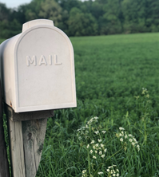
A Safe at Home address looks like:
LOT ####
PO BOX 17370
SAINT PAUL MN 55117-0370
The only Safe at Home PO Box is in Saint Paul.

Slide 14
Lot Number
All participants share the same PO Box. However, each household is assigned a unique Lot Number.
A Safe at Home address is incomplete without a Lot Number.
If you mail something to a Safe at Home participant and do not indicate a Lot Number, the mail will be returned to you.

Slide 15
Name is Required
You must also include the Safe at Home participant’s name. If you do not, the mail will be returned to you.
FIRST AND LAST NAME
LOT ####
PO BOX 17370
SAINT PAUL MN 55117-0370

Slide 16
Required Use
By law, senders are required to send a participant’s mail to them using the assigned Safe at Home post office box address, even if the real address is known.

Slide 17
How does the mail work?
Safe at Home is required to forward a participant’s First-Class Mail, which comes through our office and is sent back out again through the USPS mail stream. Safe at Home processes about one million pieces of mail annually.
Sender
The sender will mail their correspondence to the participant’s Safe at Home address (PO Box with a Lot Number).
Safe at Home
Safe at Home re-sends mail to all participants from the Safe at Home office by placing it in a brown envelope and sending it to the home.
Participant
A participant receives all their mail in a sealed brown envelope delivered to their home.

Slide 18
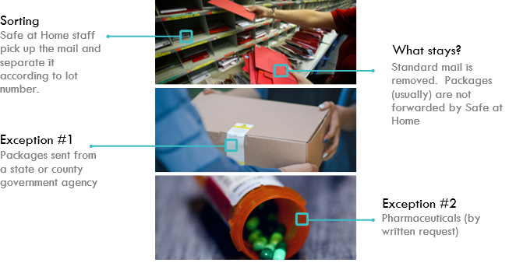
Mail Processing
Mail is received daily and processed by the Safe at Home staff. Being “processed” means sorting mail and verifying participant information on the envelope before forwarding it. This is done every day and ensures accuracy so participants can receive their mail confidentially and safely.
Sorting
Safe at Home staff pick up the mail and organize it according to Lot Number.
What Stays?
First-Class Mail stays. Standard mail, periodicals, “junk” mail is removed. With some exceptions, packages are not forwarded.
Exception #1
Packages sent from a federal, state, or county government office
Exception #2
Non-Refrigerated Pharmaceuticals (by written request)

Slide 19
Status Changes
Withdrawal
Participants can withdraw at any time.
Cancellation
There are a few reasons a participant can be canceled from Safe at Home.
The most common:
They moved and did not update our office.
and…
Other reasons include phone/name change

Slide 20
Privacy & Security
The Safe at Home office…
can
Aside from a participant’s name and assigned Safe at Home address, all Safe at Home data is classified as private data.
All private data is kept on a secure network within the Safe at Home office. It is completely inaccessible outside of the Safe at Home office.
tell you whether someone is an active participant if you provide a name and Lot Number or name and DOB.
cannot
share any other data with you.
Proprietary Statement
Copyright 2023
Office of the Minnesota Secretary of State
All Rights Reserved

Slide 21
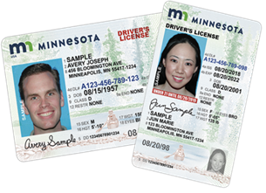
Drivers License
Safe at Home participants
cannot be required to
disclose their actual address when applying for a driver’s license or
state ID card.
They should have their Safe at Home address indicated on their driver’s license or ID card.
Proprietary Statement
Copyright 2023
Office of the Minnesota Secretary of State
All Rights Reserved

Slide 22
Including, but not limited to:
Address Disclosure
Drivers License
By law, a participant CANNOT BE REQUIRED to disclose his/her real address.
Insurance
Law Enforcement
Employer

Slide 23
If law enforcement needs an actual address, there are two options:
A court order requiring the participant to disclose is needed.
OR
A request to Safe at Home can be made through the BCA Duty Officer if there is an emergency.

Slide 24
BCA Request
If there is an emergency, law enforcement can submit a request to obtain a participant’s real address or phone number by calling the Duty Officer at the BCA. The Duty Officer will contact Safe at Home.
Safe at Home has the discretion to deny the request.

Slide 25
Stop participants from sharing their address.
Discourage a participant from telling their real address if they start to tell you.
This will minimize complications later.
If a participant discloses their physical address, they typically call Safe at Home afterwards and we provide them with a Notice to Government Entity.

Slide 26
Notice to Government Entity
If a participant provides a government entity with a completed Notice to Government Entity form, it means that entity knows sensitive information about the participant. Receiving this Notice legally prohibits that entity from sharing the data indicated on the form.
Limited Exceptions:
Court order
Subject’s signed consent
County of residence is needed to provide public assistance (or allocate financial responsibility of)
Data is necessary for health and safety (e.g., 911 calls)
Law enforcement emergency through BCA
Active law enforcement investigation of participant

Slide 27
Service of Process & Court
Service of Process
The Office of the Secretary of State is a participant's agent to receive mail and service of process.
Service is accepted via mail or personal service.
Court
Courts must accept a participant’s Safe at Home address.
Proprietary Statement
Copyright 2023
Office of the Minnesota Secretary of State
All Rights Reserved

Slide 28
Service of Process & Court
Subd. 6.Service of process upon program participants.
Notwithstanding any law to the contrary, after a government entity receives a notice under subdivision 2 or 4a, if the government entity seeks to serve process upon a program participant, the service must be made by personal service or service by mail upon the secretary of state under section 5B.03, subdivision 1, clause (3). In an action in which service by publication is required or necessary, publication is valid if the publication omits the name of the program participant and the secretary of state has been served as provided in this subdivision.
Proprietary Statement
Copyright 2023
Office of the Minnesota Secretary of State
All Rights Reserved

Slide 29
Questions Submitted to the Data Practices Office
Question #1
“Identity and location data "Not otherwise classified by law" are private data. Interplay with explicit public classifications in DPA (13.82, subds. 2, 3, and 6)? ”
Arrest Data – not a problem
Request for Service Data – 911 calls
Response or Incident Data – use the SAH address

Slide 30
Questions Submitted to the Data Practices Office
Question #2
“Due to the sensitive nature of Safe at Home participants’ data, does Safe at Home have suggestions for what type of procedures government entities should have in place to confirm a participant's identity prior to disclosing private data to a data subject?”
A government entity should not have the real address.
Consult with your responsible authority or data practices compliance official. Together, you should determine what your process should be to verify a data subject prior to discussing private data.

Slide 31
Questions Submitted to the Data Practices Office
Question #3
“What guidance does Safe at Home have if an entity inadvertently discloses identity and location data of a program participant?”
It depends on whether the participant provided a Notice to Government Entity form.
Consult with your responsible authority or data practices compliance official.
Follow requirements of Chapter 13.

Slide 32
Questions Submitted to the Data Practices Office
Question #4
“Do you have sample or model procedures "to protect data from further disclosure" as described in 13.045, subd. 3(c)?”
This is about limited sharing after a participant provides a Notice to Government Entity.
The data must be maintained as private data.
Each organization must have procedures in place that will protect private data. Safe at Home cannot advise another government office on how to manage their data.

Slide 33
Questions Submitted to the Data Practices Office
Question #5
“How should a participant notify a government entity that they are enrolled in Safe at Home? ("on a form prescribed by secretary of state") I've heard of entities ask what to do when a participant verbally notifies them, then they receive a request before getting any written notification.”
Participants only have to give a verbal disclosure.
They may provide a Notice to Government Entity if the Government entity knows sensitive information.
Minnesota Statutes, section 13.045, subdivision 4

Slide 34
Questions Submitted to the Data Practices Office
Question #6
“What happens when a participant provides you with their actual address but says in a letter that they are a participant?”
Not sure what “a letter” means.
Stop them from disclosing their address.
They will probably provide you with a Notice to Government Entity.

Slide 35
Questions Submitted to the Data Practices Office
Question #7
“Please provide advice on administering historical location data – past addresses.”
Safe at Home is about discovering someone’s location, not past location(s).

Slide 36
Questions Submitted to the Data Practices Office
Question #8
Must law enforcement agencies redact Safe at Home participant data (after receiving notification of certification) when disclosing data to a prosecutor's office or to the courts as part of a prosecution when the participant is a witness or victim? If not, any guidance on how to alert prosecutor or courts that data involve a program participant?
You should use the participant’s Safe at Home address.
Court documents must indicate the participant’s Safe at Home address.
If the true address is needed, a judge uses the analysis in Minnesota Statutes, section 5B.11.
Notwithstanding sections 15.17 and 138.17, a government entity may amend records to replace a participant's location data with the participant's designated address.
Minnesota Statutes, section 13.045, subdivision 3(e)

Slide 37
Keep in Mind
Only One
Remember, all participants are assigned PO Box 17370 in Saint Paul. That is the only Safe at Home post office box.
Sending Mail
If you know someone is a Safe at Home participant, you are required to send their mail to them at their Safe at Home address, even if you know their real address. You must include their assigned Lot Number.

Slide 38
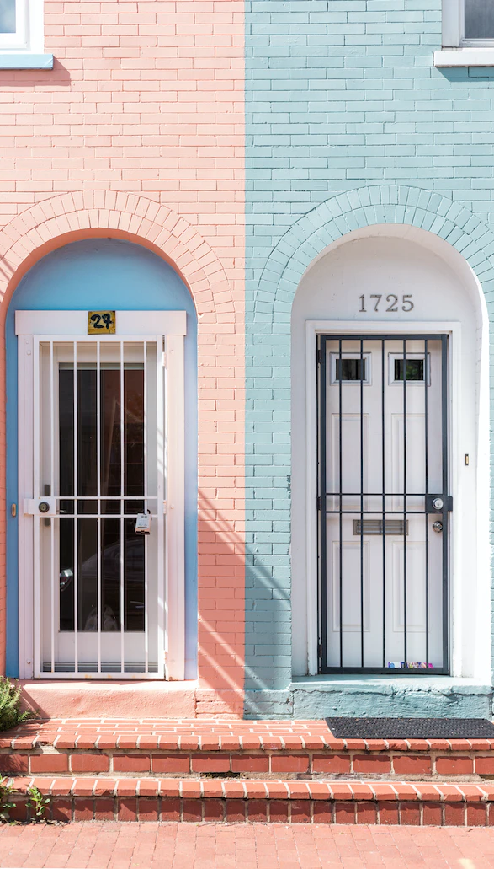
Participation Verification
Safe at Home can verify participation if given a potential participant’s:
name and Lot Number
or
name and date of birth

Slide 39
Safe at Home 651-201-1399 safe.athome@state.mn.us

