Slide 1
Thank you for joining our Webinar! We will begin shortly.
If you have any questions during the event, please utilize the Q&A panel to send questions to “all panelists.” We will leave time at the end of the presentation to answer your questions.

Slide 2
Data Practices Potpourri Webinar
June 6, 2025
2:00 – 2:30 PM

Slide 3
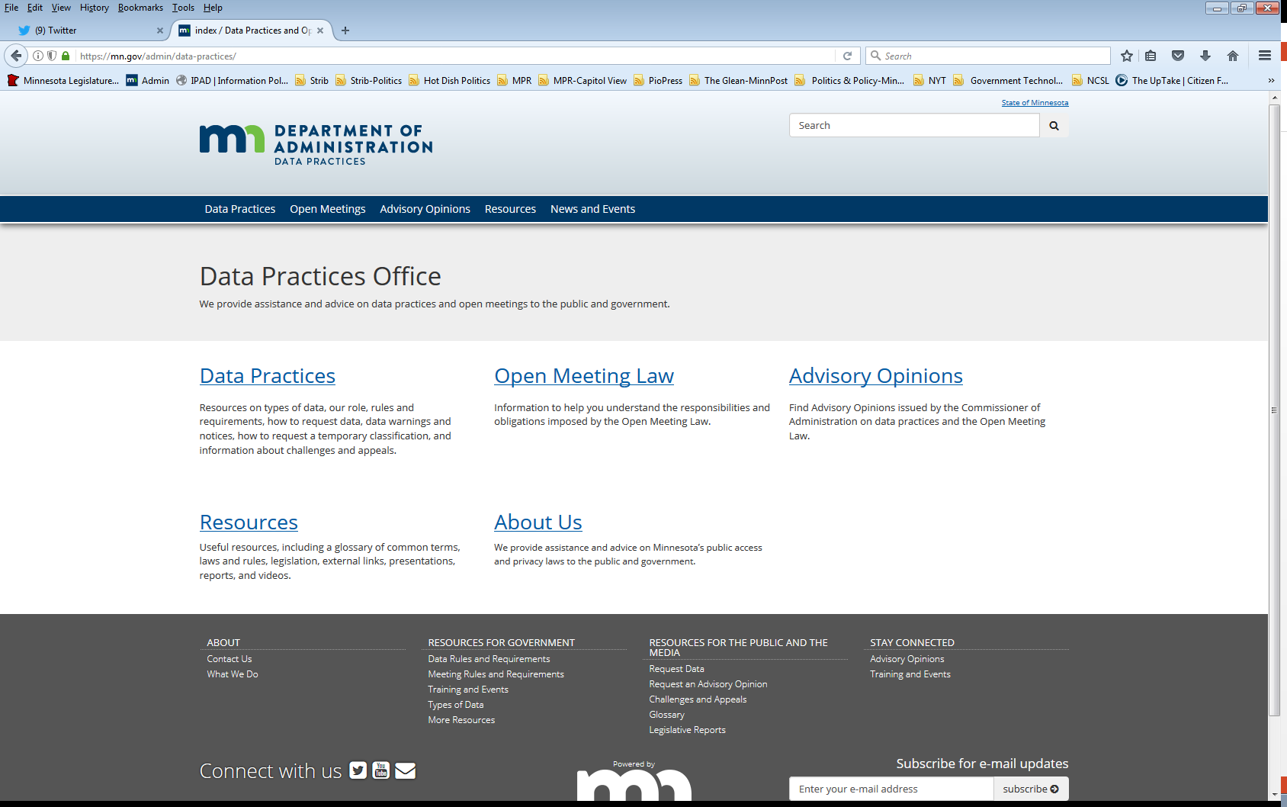
We are a statewide resource
Data Practices Office
Informal advice/technical assistance
Commissioner of Administration advisory opinions
Website and info pages: https://mn.gov/admin/data-practices/
Listserv and newsletters
Legislative assistance
Training

Slide 4
Today’s agenda
2:00 p.m.- Data Practices Potpourri: A discussion of questions that DPO has recently received
2:20 p.m. - Q&A
2:30 p.m. - End

Slide 5
#1 – Costs for Inspection Question
Question: Can a government entity charge any costs or fees when a data requester asks to inspect data?

Slide 6
#1 – Costs for Inspection Answer
Answer: No, a government entity may not charge costs or fees when a data requester asks to inspect data. Inspection is always free.
See Minn. Stat. § 13.03, subd. 3 (public data); Minn Stat. § 13.04, subd. 3 (data subjects); Minn. Rule 1205.0400, subp. 5 (data subjects); AO 10-024; Demers v. City of Minneapolis, 468 N.W.2d 71 (Minn. 1991)

Slide 7
#2 – Public Defenders Access Question
Question: Do public defenders get access to private data about their clients?

Slide 8
#2 – Public Defenders Access Answer
Answer: Public defenders do not automatically have access to private data about their clients. They may access private data about their clients with their clients’ informed consent.
*Note: under Minn. Stat. § 611.271, public defenders are entitled to free copies of certain data.

Slide 9
#3 – Data Request Response Time Question
Question: A parent of a 13-year-old student requested data about the student from their school; how long does the school have to respond?

Slide 10
#3 – Data Request Response Time Answer
Answer: 10 business days.
See Minn. Stat. § 13.04, subd. 3; Minn. Stat. § 13.02, subd. 8

Slide 11
#4 – Public Data in Gmail Question
Question: I volunteer on a city commission and communicate with fellow commission members via my personal Gmail account; does the public have the right to see those emails?

Slide 12
#4 – Public Data in Gmail Answer
Answer: Yes, probably. If the commission members are communicating in their capacity as commission members, the emails contain government data that are presumptively public under Ch. 13.
See Minn. Stat. § 13.02, subds. 7, 11; AO 12-019

Slide 13
#5 – ADA & DPA Question
Question: What if a data requester says that they are unable to use our standard data request form due to their disability; does the ADA apply to the DPA?

Slide 14
#5 – ADA & DPA Answer
Answer: While the DPA does not reference the ADA, state and local government entities are subject to Title II of the ADA and Minnesota has a public records accessibility law.
Thus, the government entity should make reasonable accommodations for the data requester.
See 42 U.S.C. §§ 12131-12150; Minn. Sat. § 363A.42

Slide 15
#6 – Online Portals Question
Question: Can a government entity require me to use their online portal to submit my data request?

Slide 16
#6 – Online Portals Answer
Answer: Government entities may have reasonable procedures for accepting data requests, including using an online portal.
Considerations:
Easily available policies
Anonymous requests
Honor requests sent directly to the RA
ADA requirements
See Minn. Stat. § 13.03, Minn. Stat. § 13.04, Minn. Stat. § 13.025; AO 03-025; AO 01-036

Slide 17
#7 – Receipt of Data Request Question
Question: Is a government entity required to send me an email acknowledging that they have received my data request?

Slide 18
#7 – Receipt of Data Request Answer
Answer: No. There is no requirement under the law for government entities to acknowledge receipt of data requests.

Slide 19
#8 – Real Property Complainant Question
Question: A person, “X”, called our police department to report an altercation with a neighbor. The neighbor threatened X with physical violence after X asked them to be quiet. Is X’s identity protected as a real property complainant under section 13.44?

Slide 20
#8 – Real Property Complainant Answer
Question: No. Section 13.44 only applies when the complainant is making a complaint about a use of real property that is a violation of state law or local ordinance.
See Minn. Stat. § 13.44, subd. 1

Slide 21
Send us your questions
Type your questions in the Q&A Panel
If we don’t get to your question, we will follow up afterwards
Slides are available: https://mn.gov/admin/data-practices/news/events/webinars/
A recording of this webinar will be available at: https://www.youtube.com/user/INFOIPAD
Please fill out the evaluation in the Polling Panel

Slide 22
Stay in touch!
Phone: 651-296-6733
Email: info.dpo@state.mn.us
Website: mn.gov/admin/data-practices
Twitter: @MNgovdata
YouTube: https://www.youtube.com/user/INFOIPAD

