Slide 1
Data Practices Potpourri Webinar
August 13, 2025
11:00 – 11:30 AM

Slide 2
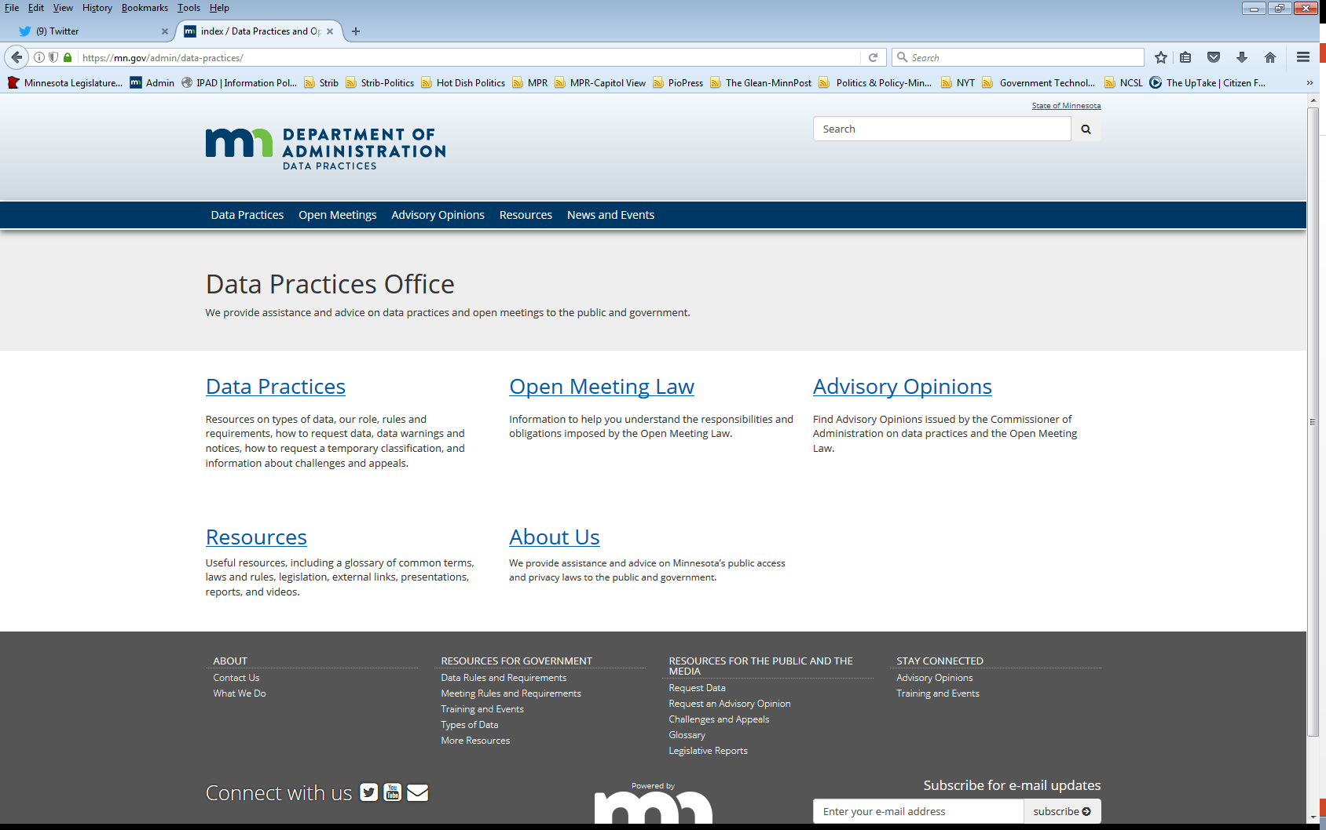
We are a statewide resource
Data Practices Office
  Informal advice/technical assistance
  Commissioner of Administration advisory opinions
  Website and info pages: https://mn.gov/admin/data-practices/
  Listserv and newsletters
  Legislative assistance
  Training

Slide 3
Today’s agenda
11:00 a.m.- Data Practices Potpourri: A discussion of questions that DPO has recently received
11:20 a.m. - Q&A
11:30 a.m. - End

Slide 4
Q. #1 – Approval of Policies
Question: Does our governing body (e.g., city council, school board, county commission) need to formally approve our data access policies required under section 13.025?

Slide 5
A. #1 – Approval of Policies
Answer: The Data Practices Act does not require a governing body to formally approve data access policies. Rather, section 13.025 states that the responsible authority must prepare the policies.
However, entities may have different procedures to formally approve and implement policies.
Remember: Policies must be updated by August 1 of each year!

Slide 6
Q. #2 – Taxpayer Identification Numbers
Question: What is the classification of a taxpayer identification number, such as a state taxpayer identification number or a Federal Employer Identification Number (FEIN)?

Slide 7
A. #2 – Taxpayer Identification Numbers
Answer: Generally, taxpayer identification numbers are public data when maintained by most government entities, except not public when:
  FEIN came directly from the IRS (26 U.S.C. § 6103(a))
  Income tax returns submitted by business when requesting financial assistance or benefit (section 13.359)
  Tax returns submitted to local entities for licensing purposes (section 13.204)
  Social security numbers (section 13.355)
Several other considerations exist. See our webpage:
https://mn.gov/admin/data-practices/data/types/taxpayer-identification-numbers/index.jsp

Slide 8
Q. #3 – Security Camera Data
Question: We received a request for security camera footage from the lobby of a government building. What is the classification of this data?

Slide 9
A. #3 – Security Camera Data
Answer: The data are likely presumptively public because the Data Practices Act does not contain language that specifically classifies “security camera data” as not public.
However, security camera video data may be saved and retained for other purposes. If so, then a different classification may apply.
Additionally, data may be “security information” under 13.37 if data captures secure locations. But designation must be applied on case-by-case basis.

Slide 10
Q. #4 – Access to BWC Data
Question: Who can obtain unredacted body camera data under section 13.825, subd. 4(c)?
Does the new language allow anyone who can be seen or heard in the data to get a copy unredacted body cam data?

Slide 11
A. #4 – Access to BWC Data
Answer: Only the individuals who can get a state accident report documenting the incident are permitted to obtain an unredacted copy of body camera data under section 13.825, subd. 4(c):
Notwithstanding section 13.82, subdivision 7, upon request, a person entitled to a report of a collision under section 169.09, subdivision 13, must be provided with copies of unredacted data from all portable recording systems used in the collision investigation, including data on other individuals who are the subject of the recording.

Slide 12
A. #4 – Access to BWC Data (cont.)
The following individuals may obtain unredacted body camera data documenting a collision investigation:
Any individual involved in the accident, the representative of the individual's estate, or the surviving spouse, or one or more surviving next of kin, or a trustee appointed under section 573.02
Any other person injured in person, property, or means of support, or who incurs other pecuniary loss by virtue of the accident
Legal counsel of a person described in item (i) or (ii)
Representative of the insurer of a person described in item (i) or (ii)
A city or county attorney or an attorney representing the state in an implied consent action who is charged with the prosecution of a traffic or criminal offense that is the result of a traffic crash investigation conducted by law enforcement

Slide 13
A. #4 – Access to BWC Data
Answer: If individual cannot obtain state accident report, then the individual cannot obtain unredacted copy of body camera data under 13.825, subd. 4(c).
For example:
  Copies of unredacted body camera data are not available when no state accident report is created
  Witnesses who are not involved in accident cannot obtain unredacted copies of body camera data.
Remember: Section 13.825, subd. 4(c) requires request to be in writing and include the state accident report

Slide 14
Q. #5 – ALPR Biennial Audits
Question: Our agency received a letter from the Data Practices Office about submitting a summary report about our biennial automated license plate reader audit.
What are we supposed to do?

Slide 15
A. #5 – ALPR Biennial Audits
Answer: Section 13.824, subd. 6 requires agencies operating automated license plate reader (ALPR) systems to complete a biennial audit.
A report summarizing the ALPR system audit must be provided to the Commissioner of Administration, specific members of the legislature, and the Legislative Commission on Data Practices.
When due, schedule the audit and share the applicable report summary as required.

Slide 16
Q. #6 – Special Meetings
Question: Can a public body add items to its agenda during a special meeting?

Slide 17
A. #6 – Special Meetings
Answer: No, a public body cannot add items or topics to its agenda during a special meeting that were not described in the purpose of the special meeting notice required under section 13D.04, subd. 2.
If a topic is not noticed, then the public body must wait until its next regular meeting, repost the special meeting notice at least three days in advance of the special meeting, or notice a new special meeting to discuss the topic. (See AO 23-003.)

Slide 18
Just one more thing…
The Data Practices Office is updating Minnesota Rules Chapter 1205, which implement the Data Practices Act.
Check out the DPO website for more information about the rulemaking process and let us know your feedback!

Slide 19
Send us your questions
Type your questions in the Q&A Panel
If we don’t get to your question, we will follow up afterwards
Slides are available: https://mn.gov/admin/data-practices/news/events/webinars/
A recording of this webinar will be available at: https://www.youtube.com/user/INFOIPAD
Please fill out the evaluation in the Polling Panel

Slide 20
Stay in touch!
Phone: 651-296-6733
Email: info.dpo@state.mn.us
Website: mn.gov/admin/data-practices
Twitter: @MNgovdata
YouTube: https://www.youtube.com/user/INFOIPAD

