Slide 1
Data Challenges and Appeals
Data Practices Office
May 19, 2026

Slide 2
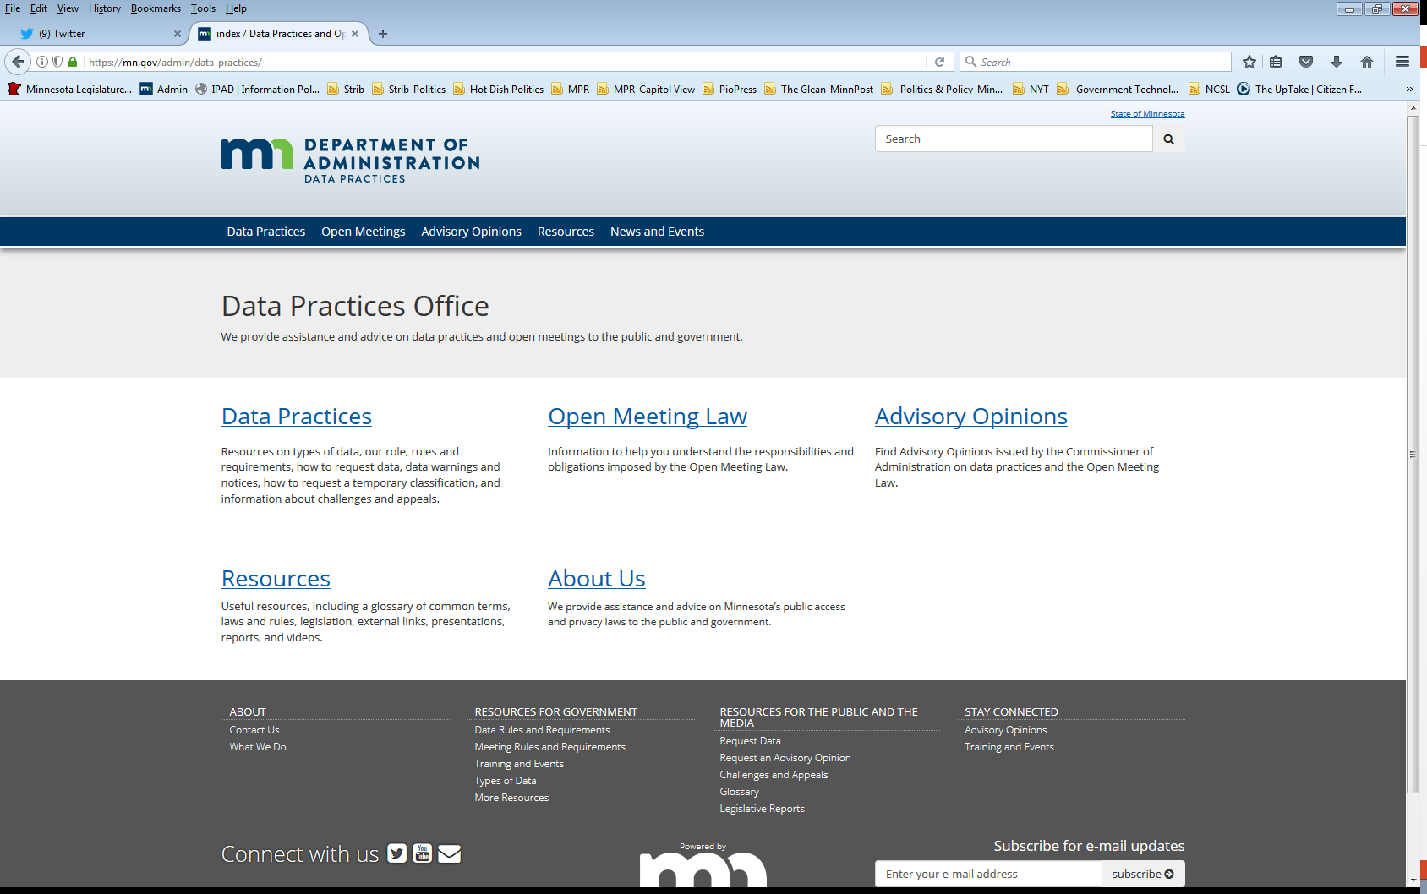
We are a statewide resource
Data Practices Office
  Informal advice/technical assistance
  Commissioner of Administration advisory opinions
  Website and info pages:
  https://mn.gov/admin/data-practices/
  Listserv and newsletters
  Legislative assistance
  Training

Slide 3
Today’s agenda
11:00 a.m. -11:45 a.m.
11:00 a.m. – Overview of the Data Challenge and Appeal Process
11:35 a.m. - Q&A

Slide 4
Accurate and complete data on individuals
(Minn. Stat., sec. 13.05, subd. 5)
Data that government maintains about individuals must be accurate and complete
“The responsible authority shall: (1) establish procedures to assure that all data on individuals is accurate, complete, and current for the purposes for which it was collected” (Minn. Stat., sec. 13.05, subd. 5)
Data on individuals are data about a living human being (Minn. Stat., sec. 13.02, subd. 8 – “Individual” means a natural person.)

Slide 5
Data Challenges
(Minn. Stat., sec. 13.04, subd. 4(a)-(c))

Slide 6
Challenging the accuracy/completeness of data
Minn. Stat., sec. 13.04, subd. 4(a)
“An individual subject of the data may contest the accuracy and completeness of public or private data about themselves”
Minn. Stat. §13.04, subd. 4(a)
Applies to:
“Individual”
  A natural person, or parent/guardian (§13.02, Subd. 8)
“Subject of the data”
“Public or private data”

Slide 7
The data must be capable of being proven false
Statements of facts
Opinions or judgments that rest on statements of fact
  In Schwanke v. Minnesota Dept. of Admin., 851 NW 2d 591 (Minn. 2014), the Minnesota Supreme Court reasoned that some opinions and judgments rest on statements of fact that are objectively verifiable and thus capable of being proved false
    "refusal to participate in a team-building exercise at a staff retreat shows that he is not a team player“
  However, “mere dissatisfaction with a subjective judgment or opinion cannot support a challenge under the Data Practices Act”

Slide 8

Statement of Disagreement
Minn. Stat. § 13.04, subd. 4(b)
“[A]n individual shall notify in writing the responsible authority describing the nature of the disagreement”
Minn. Stat. §13.04, subd. 4(b)
Statement of disagreement must be in writing
  describe in detail the data that is being challenged
  state why the data are inaccurate and/or incomplete
  state how the data should be changed
Must be sent to responsible authority* (refer to § 13.02, subd. 16)
*DCT MSOP challenges must be submitted to the DPCO of DCT
(Minn. Stat., §13.04, subd. 4a.)

Slide 9
Government Entity Responds
Minn. Stat. § 13.04, subd. 4(c)
Within 30 days, responsible authority must either:
1) Complete, correct, or destroy the data and attempt to notify past recipients of the data of the change;
or
2) Notify the data subject that the authority has determined the data to be correct & inform the individual of the right to appeal to determination to the Commissioner of Administration.
*Data in dispute may be disclosed only if copy of data subject’s Statement of Disagreement is attached thereto.

Slide 10
Data that have been successfully challenged
Minn. Stat. § 13.04, subd. 4(g)
“Data on individuals that have been successfully challenged by an individual must be completed, corrected, or destroyed by a government entity without regard to the requirements of section 138.17”
Minn. Stat. §13.04, subd. 4(g)
If the parties agree that the data are inaccurate and/or the Commissioner orders it, data can be altered or destroyed without regard to records retention requirements

Slide 11
Data Challenge Appeals
(Minn. Stat., sec. 13.04, subd. 4(d)-(i))

Slide 12
Appealing an entity’s determination
Minn. Stat. § 13.04, subd. 4; Minn. Rule § 1205.1600
An individual may appeal the Responsible Authority’s adverse determination of accuracy or completeness to the Commissioner of Administration.
Appeals must be submitted in writing (via mail or email)
Time to Appeal:
  If Responsible Authority notifies data subject of right to appeal in writing: 60 days
  If no written notice: 180 days
*Remember, under section 13.04, subd. 4(c)(2), the entity is required to inform the individual of the right to appeal the determination to the commissioner

Slide 13
Contents of the Appeal
Appeal letter must include:
  Name & mailing address of appealing party;
  Name of responsible authority and government entity;
  A description of the dispute and of the data in question;
  A description of the desired result of the appeal.
Appeal must include copies of:
  The disputed data in its original context
  The individual’s data challenge letter that they submitted to the RA
  The RA’s determination
See DPO’s webpage on data challenges appeals: https://mn.gov/admin/data-practices/data/appeals/howto/

Slide 14
DPO Review & Entity Notification
Initial steps when DPO receives an appeal:
  Review for completeness
    If incomplete, we will send the data subject a letter explaining what documents or information we need to process the appeal
    If complete, we will begin processing the appeal.
  Notify entity we are in receipt of appeal

Slide 15
Discretionary Dismissal
Minn. Stat., sec. 13.04, subd. 4(e)
The commissioner may dismiss an appeal without first attempting to resolve the dispute or before issuing an order and notice of a contested case hearing if:
(1) the appeal to the commissioner is not timely;
(2) the appeal concerns data previously presented as evidence in a court proceeding in which the data subject was a party; or
(3) the individual making the appeal is not the subject of the data challenged as inaccurate or incomplete.
Either party can provide DPO with information relevant to dismissal at any time before the case is referred to CAH
Discretion limited to these grounds (See Schwanke v. Minnesota Dept. of Admin., 851 NW 2d 591 (Minn. 2014))
If these grounds do not exist, and IR is not successful or appeal is not withdrawn, DPO is obligated to set the appeal for a hearing at CAH

Slide 16
Informal Resolution
Minn. Stat. § 13.04, subd. 4
DPO will contact the parties with an offer to participate in the informal resolution (IR) process.
Section 13.04, subd. 4 requires the Commissioner to try to resolve an appeal informally before sending to CAH
Informal Resolution is optional for the parties – either party can refuse
Parties can opt to resolve dispute informally at any time prior to the hearing, pursuant to §14.59

Slide 17
When is IR likely to be successful?
IR is more likely to be successful when:
the data are old and/or beyond the scope of retention period
the data are immaterial to the larger purpose for which it was collected (e.g. the use of a particular term which the data subject finds offensive, but was not the basis for any determination by the government entity)
amount of data is large, or of several different types, allowing the responsible authority to make an offer to change, redact, or destroy a portion of the challenged data
The entity is open to changing the data
The data subject is open to compromise

Slide 18
Participating in IR is voluntary
Participating in the IR process is voluntary – either party can decline to participate
  No is an okay answer!
A few reasons parties might decline to participate in IR:
  They don’t want to
  They are not open to compromise
  The entity believes the data are accurate and complete and wants or needs to maintain it*
*But remember, data that have been successfully challenged can be altered or destroyed without regard to records retention requirements (Minn. Stat., sec. 13.04, subd. 4(g))

Slide 19
Order and Notice of Hearing
Minn. Stat. § 13.04, subd. 4; Minn. Stat. § 14.58
If informal resolution is refused or unsuccessful, the Commissioner shall dismiss* the appeal or issue the order and notice of hearing
  set date/time for prehearing telephone conference w/ ALJ and hearing will be scheduled at that time
  state the issues that will be considered at the hearing
Copy of record sent to ALJ and both parties
Minn. Stat. § 14.57 – § 14.62
*The Commissioner’s discretion to dismiss an appeal before sending to CAH is limited to those grounds set out in Minn. Stat., sec. 13.04, subd. 4(e)
NOTICE OF HEARING

Slide 20
Contested Case Hearing and ALJ Recommendation - Minn. Stat. §§ 14.60-14.61
Data subject has the burden of proving that the data are inaccurate or incomplete.
All evidence submitted at the hearing becomes part of the case record.
A closed hearing may be conducted to consider data that are classified as not public.
Following the hearing, Administrative Law Judge (“ALJ”) issues a report and recommendation
*The entity is responsible for CAH costs (Minn. R. 1205.1600, subp. 5)

Slide 21
Final Decision by the Commissioner
Minn. Stat. §§ 14.61- 14.62
After the ALJ issues their Recommendations – the parties have an opportunity to file exceptions
  DPO sends a letter notifying the parties of the opportunity to file exceptions
  Must typically be filed within 30 days of the date of the letter
The Commissioner issues the Final Order, including findings of fact and legal conclusions
  Must issue Order within 90 days of record closure - either (1) the date the last exception to the Administrative Law Judge’s report is received or (2) the deadline for filing the exceptions, whichever is later
  May adopt or reject ALJ’s recommendation(s)

Slide 22
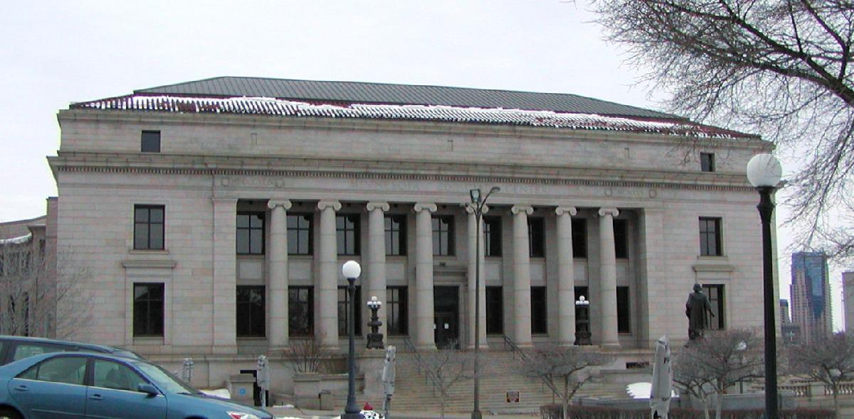
Judicial Review
Minn. Stat. §§ 14.63-14.69
Any person aggrieved by the Commissioner’s final decision is entitled to file a petition for certiorari with the Court of Appeals.
Petition must be filed and served upon all parties within 30 days of receiving Commissioner’s Opinion and Order.

Slide 23
Data Challenge and Appeal Process
Data Subject Submits Data Challenge to Entity
Government Entity Responds
Data Subject Submits Appeal to the Commissioner of Administration
Optional Informal Resolution
Order and Notice of Hearing
Contested Case Hearing and ALJ Recommendations
Final Decision by Commissioner
Application for Judicial Review

Slide 24
Additional Resources
The DPO website has webpages that provide additional information about data challenges and appeals:
https://mn.gov/admin/data-practices/data/appeals/
The Minnesota Court of Administrative Hearings has a Contested Case Guide available on their website: https://mn.gov/oah/self-help/administrative-law-overview/contested-case-hearing-guide.jsp

Slide 25
Send us your questions
Type your questions in the Q&A Panel
If we don’t get to your question, we will follow up afterwards
Slides are available: https://mn.gov/admin/data-practices/news/trainings/webinars/
A recording of this webinar will be available at: https://www.youtube.com/user/INFOIPAD
Please fill out the evaluation in the Q&A Panel

Slide 26
Stay in touch!
Phone: 651-296-6733
Email: info.dpo@state.mn.us
Website: mn.gov/admin/data-practices
YouTube: https://www.youtube.com/user/INFOIPAD

