Slide 1
Data Practices Potpourri: Body Camera Data Webinar
May 20, 2025
1 p.m. – 1:45 p.m.

Slide 2
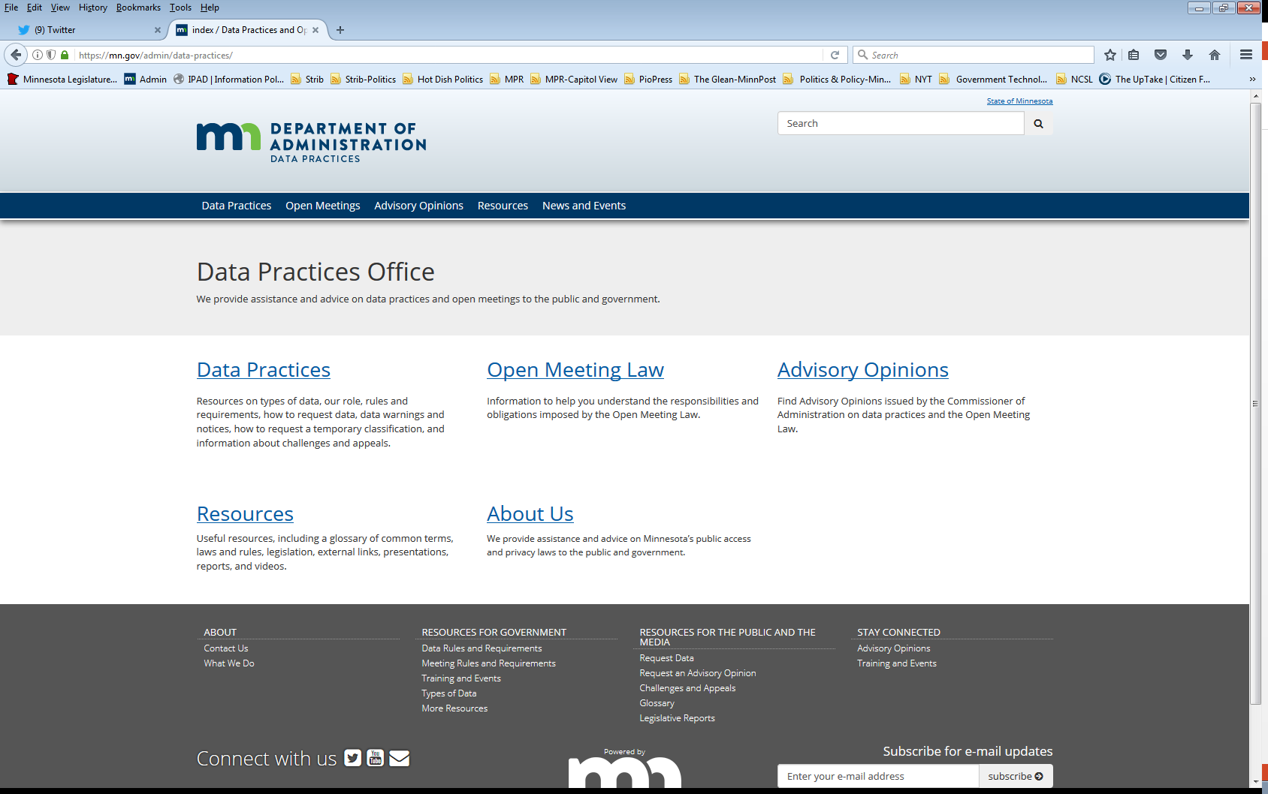
We are a statewide resource
Data Practices Office
Informal advice/technical assistance
Commissioner of Administration advisory opinions
Website and info pages: https://mn.gov/admin/data-practices/
Listserv and newsletters
Legislative assistance
Training

Slide 3
Today’s agenda
1 p.m. – 1:15 p.m. – Body camera data basics
1:15 p.m. – 1:30 p.m. – Body camera data potpourri
1:30 p.m. – 1:45 p.m. – Q&A

Slide 4
Body Camera Data Basics

Slide 5
Police body camera data Minnesota Statutes, section 13.825
BWC data that are active investigative data are confidential/protected nonpublic
Most other BWC data = private/nonpublic
BWC data are public if there is:
Discharge of firearm in the course of duty
Incident results in substantial bodily harm
Data subject makes data public, with applicable redactions
Public employee disciplinary data
Individual dies because of officer’s use of force; public within 14 days after incident

Slide 6
Access to body camera data Minnesota Statutes, section 13.825, subd. 4
Data subjects include:
Anyone who can be seen or heard
Peace officer who collects the data
Peace officers who can be seen or heard
Access by data subjects:
Data subject can “access” (inspect) unredacted data
Copies must be redacted, unless consent from other data subjects
On duty officers who are not undercover may not be redacted
Access to data with no identifiable individuals:
Nonpublic data – need to determine subject of data, if any

Slide 7
Access to body camera data – deadly use of force Minnesota Statutes, section 13.825, subd. 2(b-d)
For BWC data that document a deadly use-of-force incident, a law enforcement agency must:
Allow deceased’s next of kin, their lawyer, and parent of deceased’s shared children to inspect data within five days of request
Agency may deny access if there is a compelling reason why inspection would interfere with active investigation
Must provide prompt, written denial as well as inform family that relief may be sought from district court per section 13.82, subd. 7
Must disclose data (with applicable redactions) to the public within 14 days after incident
Agency may withhold access if it asserts disclosure would interfere with active investigation

Slide 8
Body camera data retention Minnesota Statutes, section 13.825, subd. 3
Retention
Must retain for at least 90 days unless
Discharge of a firearm or use of force resulting in substantial bodily harm (must retain for 1 year)
Formal complaint against officer (must retain for 1 year)
Documents deadly use-of-force incident (must retain indefinitely)
After 90 days, follow retention schedule
Must allow for requests for longer retention

Slide 9
General body camera data requirements Minnesota Statutes, section 13.825
Inventory (subd. 5)
Authorized access (subd. 7)
Data sharing (subd. 8)
Biennial Audits (subd. 9)
Notice to BCA (subd. 10)
Vendor requirements (subd. 11)
Increased penalties (subd. 12)
Public comment (626.8473)
Info page and FAQ: https://mn.gov/admin/data-practices/data/types/body-camera/

Slide 10
Body Camera Data Potpourri

Slide 11
Q. #1 – Body camera data collected by others
Question: Are BWC data that are captured by non-peace officer staff, such as community service officers or building security staff, governed under section 13.825?

Slide 12
A. #1 – Body camera data collected by others
Answer: No, data collected by non-peace officer staff who wear body cameras are not governed under section 13.825.
Section 13.825, subd. 1(b)’s definitions indicate the data must be created by a “peace officer.”
BWC data created by non-peace officers are presumptively public or governed under section 13.82.

Slide 13
Q. #2 – Redacting data subjects
Question: How much of a person needs to be redacted from BWC data in order to comply with the law?

Slide 14
A. #2 – Redacting data subjects
Answer: Section 13.825, subd. 1(b)(3) defines “redact” as:
“[T]o blur video or distort audio so that the identity of the subject in a recoding is obscured sufficiently to render the subject unidentifiable.”
In short, redaction must ensure data subjects cannot be identified.

Slide 15
Q. #3 – Redaction costs
Question: Our agency has a policy that we charge a flat rate of $50 per video to cover our costs to redact BWC data due to the amount of time required for staff to make redactions.
Is this charge appropriate under the Data Practices Act?

Slide 16
A. #3 – Redaction costs
Answer: The Data Practices Act prohibits government entities from charging data requesters any costs related to redacting data.
Rather, most BWC data requests come from data subjects, which means your agency may charge the actual costs to make and certify copies.
If your agency does charge a flat fee, it must comply with the copy costs limitations in the Data Practices Act.

Slide 17
Q. #4 – Unredacted data inspection
Question: Can a data subject give informed consent to allow a third-party to inspect unredacted copy of body camera data?

Slide 18
A. #4 – Unredacted data inspection
Answer: No, a data subject cannot give informed consent to allow that third-party access to unredacted data.
Section 13.825, subd. 4 provides a data subject with a special right to access private body camera data on other individuals. However, a data subject cannot provide informed consent that would allow a third-party to view private data on other data subjects.

Slide 19
Q. #5 – Sharing body camera data with LEAs
Question: A different law enforcement agency asked us to share body camera data with their agency. Are we permitted to share those data with the other agency?

Slide 20
A. #5 – Sharing body camera data with LEAs
Answer: Possibly, and the applicable analysis depends on whether the body camera data are part of an active investigation.
Part of an active investigation:
Body camera data are governed under section 13.82, subd. 7 and are confidential.
Section 13.82, subd. 24 allows data sharing when “pertinent and necessary” to requesting agency to initiate, further, or complete an investigation.

Slide 21
A. #5 – Sharing body camera data (cont.)
Part of an inactive investigation or no investigation:
Body camera data are governed under section 13.825, and data are private/nonpublic.
Section 13.825, subd. 8 allows agencies to share BWC data upon meeting standards for requesting access as provided in subdivision 7.
Section 13.825, subd. 7 permits access to BWC data according to agency’s written procedures and when access is for a “legitimate, specified law enforcement purpose.
Lastly, section 13.82, subd. 15 allows disclosure for “public benefit” purposes.

Slide 22
Q. #6 – BWC data and crash reports
Question: We’ve received a request from an insurance company for a crash report that’s required under section 169.09. The request also asks for unredacted BWC data documenting the accident. Can we disclose the BWC data?

Slide 23
A. #6 – BWC data and crash reports
Answer: Currently, no. Neither section 169.09, subd. 13 nor section 13.825 authorizes the disclosure of not public body camera data in addition to the state accident report.
Requesters may obtain a copy of redacted body camera data as a data subject or with informed consent.
BUT …

Slide 24
A. #6 – BWC data and crash reports (cont.)
The legislature recently passed legislation that amends section 13.825 to allow individuals identified in section 169.09, subd. 13 to obtain copies of unredacted body camera data for processing insurance claims or as evidence in court, with exceptions.
This language will be effective on July 1, 2025, assuming the Governor signs the bill into law.
See HF2432 (Art. 9, Sec.5) for the specific language.

Slide 25
Send us your questions
Type your questions in the Q&A Panel
If we don’t get to your question, we will follow up afterwards
Slides are available: https://mn.gov/admin/data-practices/news/events/webinars/
A recording of this webinar will be available at: https://www.youtube.com/user/INFOIPAD
Please fill out the evaluation in the Polling Panel

Slide 26
Stay in touch!
Phone: 651-296-6733
Email: info.dpo@state.mn.us
Website: mn.gov/admin/data-practices
YouTube: https://www.youtube.com/user/INFOIPAD

